Slide 1
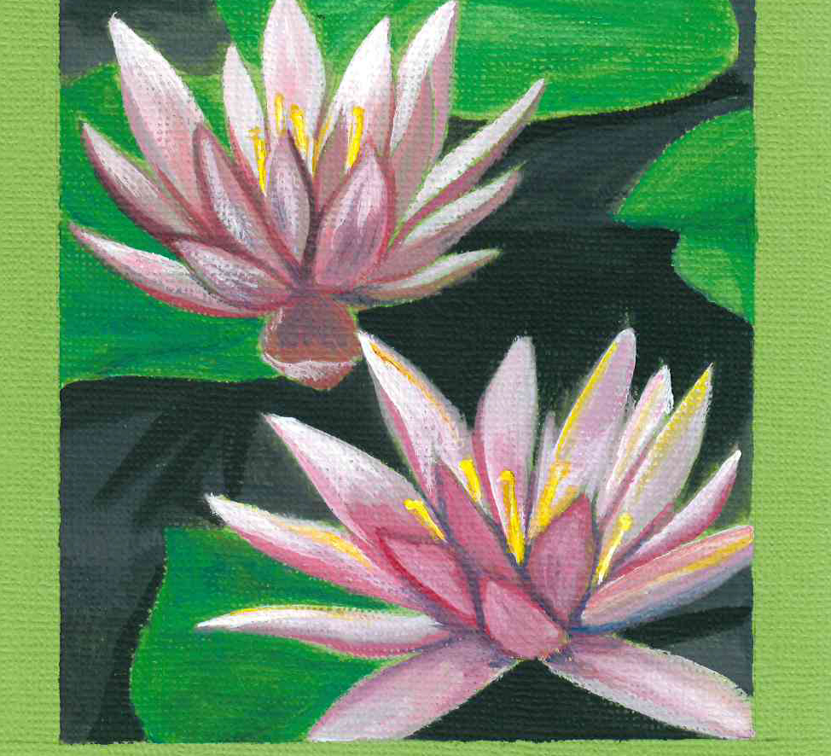
Introduction to NATURE JOURNALING Connecting to nature through art and observation
Class 1:
Getting Started
Notes:
Buckle up folks we’re about to get ARTSY

Slide 2
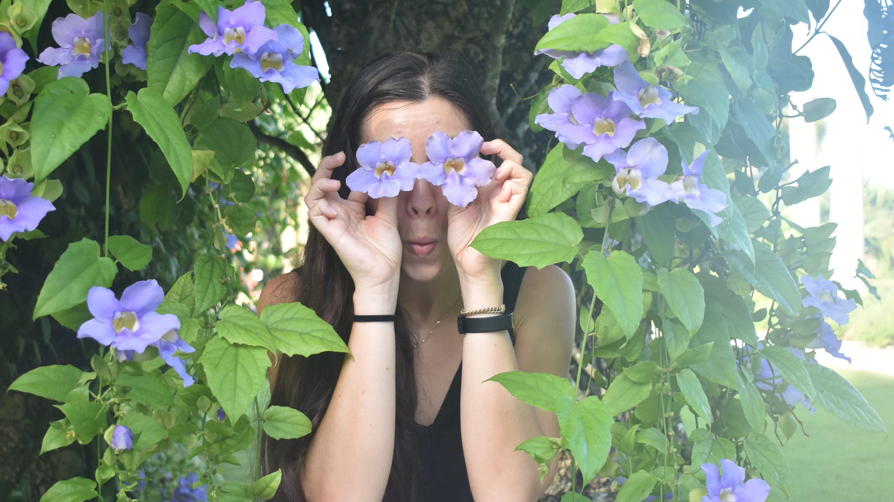
About the Instructor
My name is Donnamarie, I’m the Creative Programs Lead at Naples Botanical Garden and your Teaching Artist for this Nature Journaling course.
Notes:
Bachelor of Arts in Anthropology from UF
Have been enjoying art in the outdoors my whole life; nature is my greatest source of inspiration and comfort
Have been working at the Garden now for ~2 years, love this job because I get to share what I’m passionate about: the natural world around us and our connection to it.
I’m excited to be here with you and am looking forward to getting to know all of you.
All images used in these PowerPoints are my hand-drawn (or tablet-drawn) illustrations, unless otherwise stated.

Slide 3
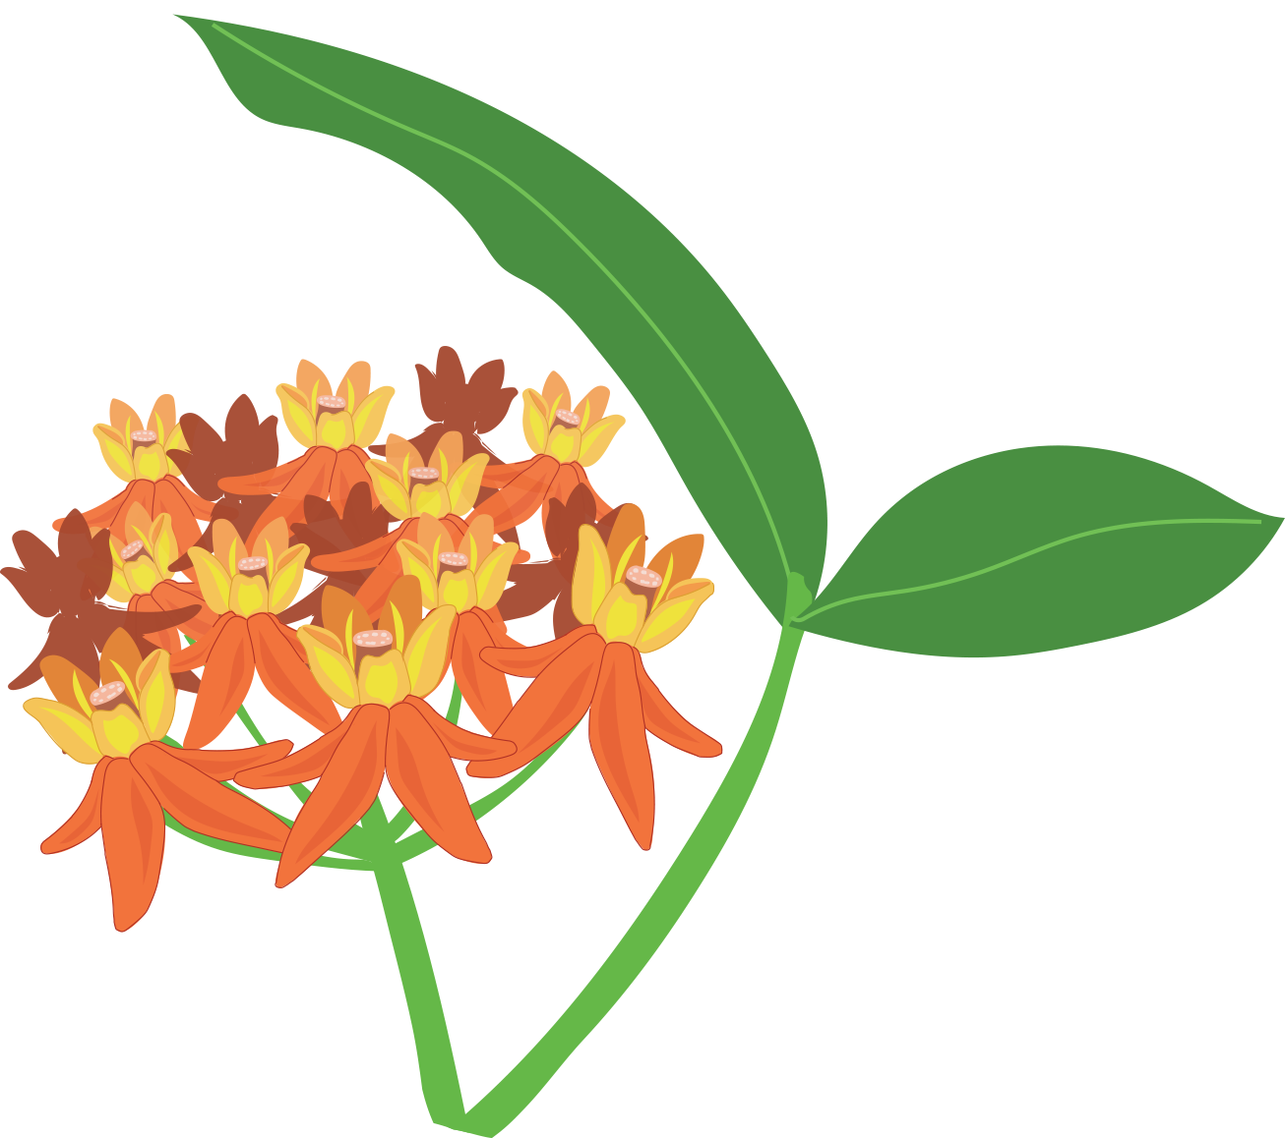
Class 1 Agenda
Getting Started: Class Structure
Why Nature Journaling is Important
Material Overview and Practice
Intro to Watercolor Pencils
Field Sketching vs. Studio Drawing
Homework Assignment

Slide 4
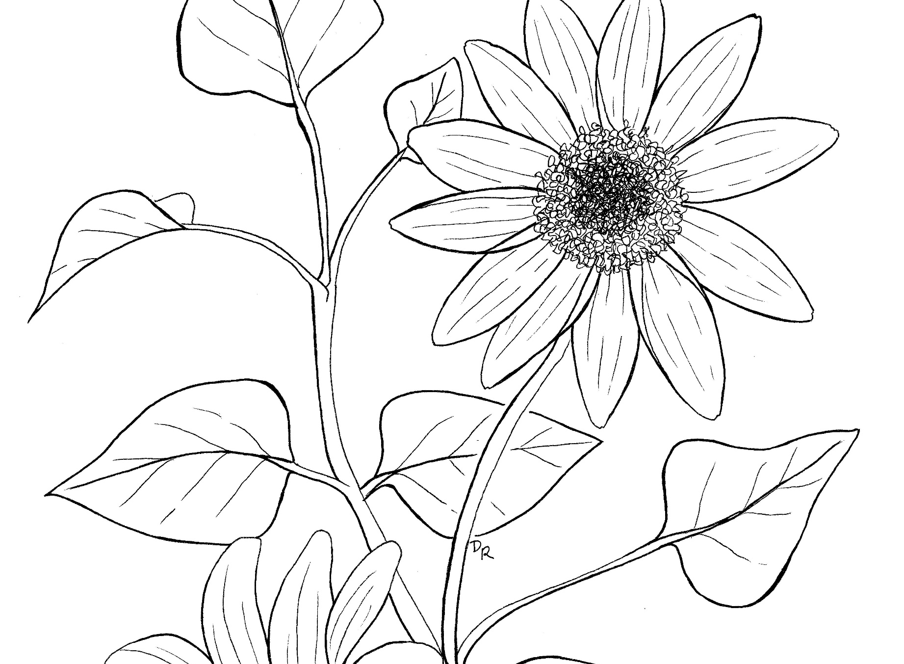
“A nature journal is a lens that focuses our attention and crystalizes our observations, thoughts, and experiences.” John Muir Laws
Notes:
What is a nature journal?
The long answer: an illustrated journal where you document your observations, questions, and connections to nature.
The short answer: whatever you want it to be!
Your nature journal reflects how you interact with your surroundings. In the next 8 weeks, we will explore how to observe and document what we experience in our environment through art.

Slide 5
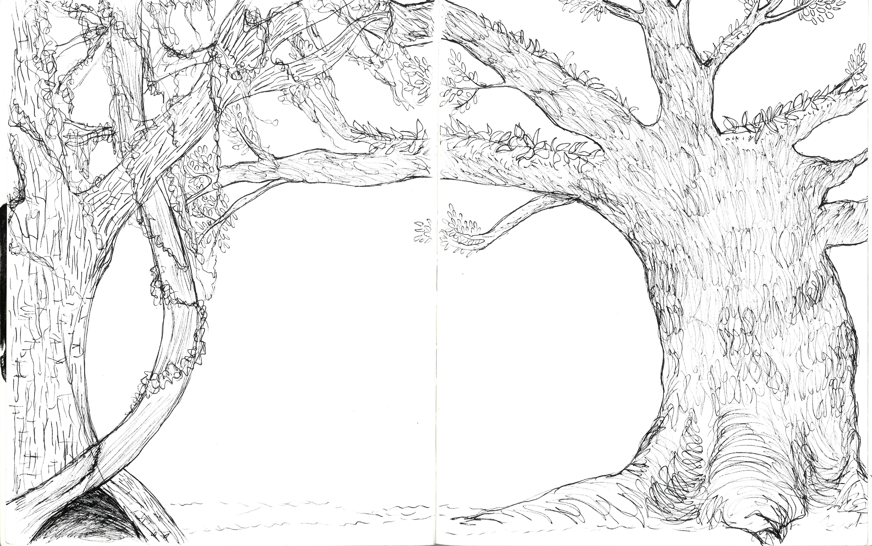
Class Structure
9:30-10:00 am Social Time and Ice Breaker
10:00-10:20 am Warm up drawing exercise
10:20-10:50 am Class lecture and Homework assignment
10:50-10:55 am Break
10:55-11:20 am Demos
11:20-11:30 am Discussion and Questions
Notes:
Each class is about an hour and thirty minutes total, though we strongly encourage you to log on early at 9:30 for optional social time and fun ice breaker activities. You can also use Google Classroom to post pictures of your journal pages, chat with each other, and ask questions.
Social Ice breaker (20 minutes)
Warm up drawing exercise (5 minutes)
Class lecture and Homework assignment (30 minutes)
Break Time! (5 minutes)
Demos (30 minutes)
Discussion/Questions (5 minutes)
Times may vary.
Bring all your nature journal materials with you to each class and have them handy. We’ll start each class by doing a short warm-up together using our materials.
Recordings will be accessible on YouTube. You’ll get a link in the post class email.
Every Wednesday you have the option of attending in-person mid week meetups at the Garden. If you have any questions for me or would like to talk face to face, you can meet me at the meetup! These in-person sessions are considered my ‘office hours’, and I will be present at each for the first 30 minutes.
Be sure to check your agendas! There are important dates in there that you need to know for the culminating event.

Slide 6
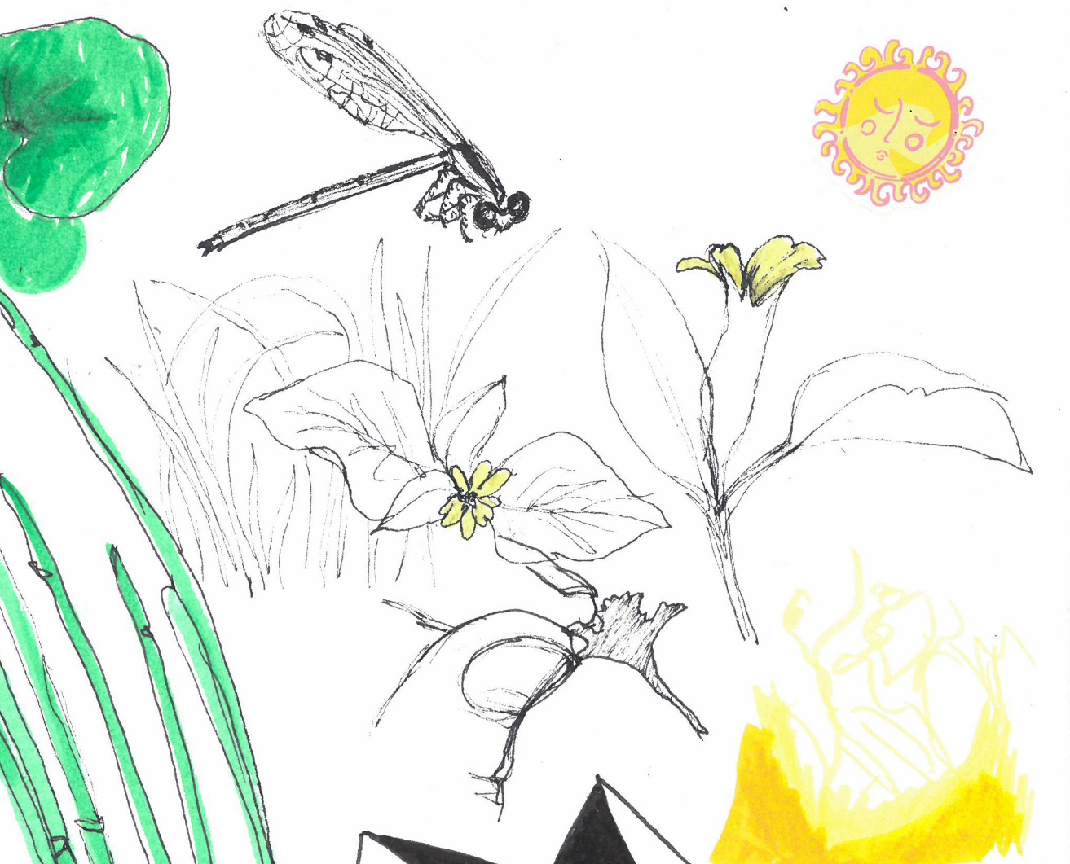
E. E. E. E!
EXPLORE your surroundings.
EXPRESS yourself through art and writing.
EDUCATE yourself and others.
EXPERIMENT with your creativity!
Notes:
Why is Nature Journaling all that and a bag of cats? (Alternatively, What makes Nature Journaling so special?)
It allows you to: EEEE!
Explore your surroundings and develop a deeper appreciation for the natural world.
Express yourself through art and writing. Keeping a detailed journal of your thoughts and notes can also act as an archive of your memories.
Educate yourself and others on the plants and animals you see in nature. Through nature journaling, you will learn about your environment and your connections to it.
Experiment with your creativity! Nature journaling will give you the opportunity to improve your skills as an artist, as well as discover new techniques and materials to make art with.

Slide 7
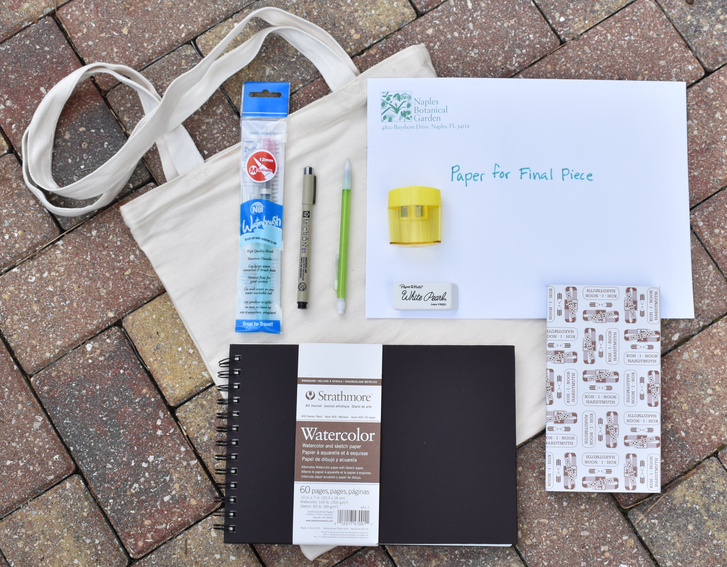
Materials
Your kit includes all the basics you’ll need to get started on your Nature Journal Journey.
Notes:
The Nature Journal kit you received includes the basic materials you’ll need for getting started on your journal pages. These materials are portable and easy to use, which are very important features when it comes to nature journaling.
Some of the best nature journaling happens outside – in nature! Having a ‘journal kit’ ready to go will make it easier for you to transport your materials, which in turn increases your motivation to journal.
When out ‘in the field’, only carry what you absolutely know you will use. It’s much better to only bring a pen and your journal, and sketch for three pages than to bring a whole set of paints and only color half a page. You can always save the paints for when you get back home.
And don’t forget these essentials! Water, hat, sunscreen, and bug spray. Always consider the weather and STAY HYDRATED.

Slide 8
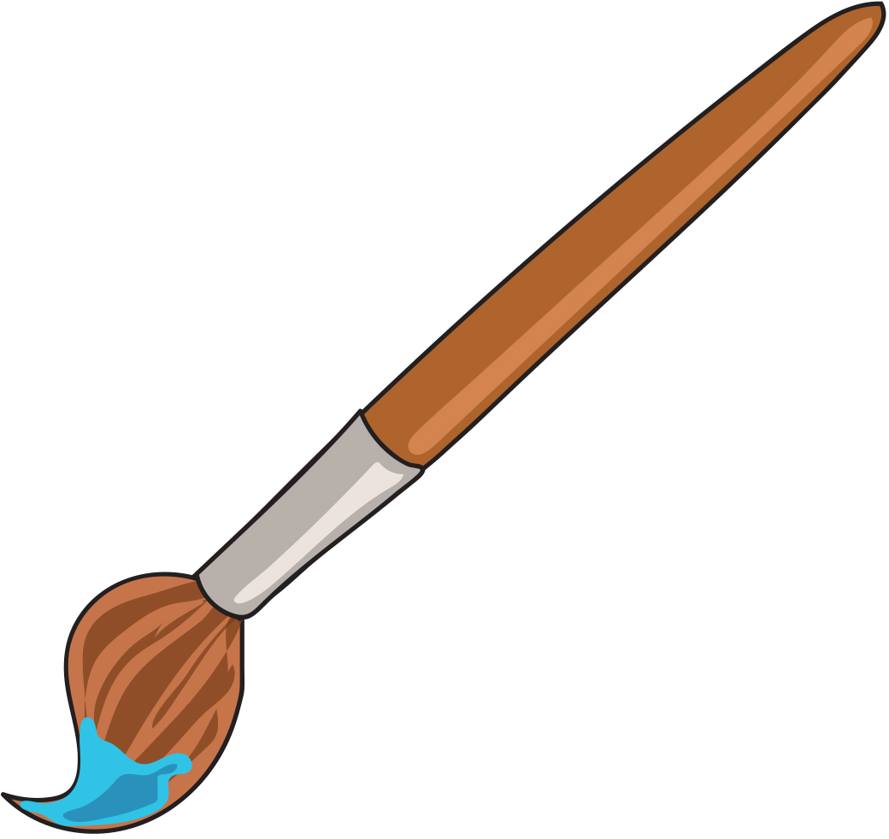
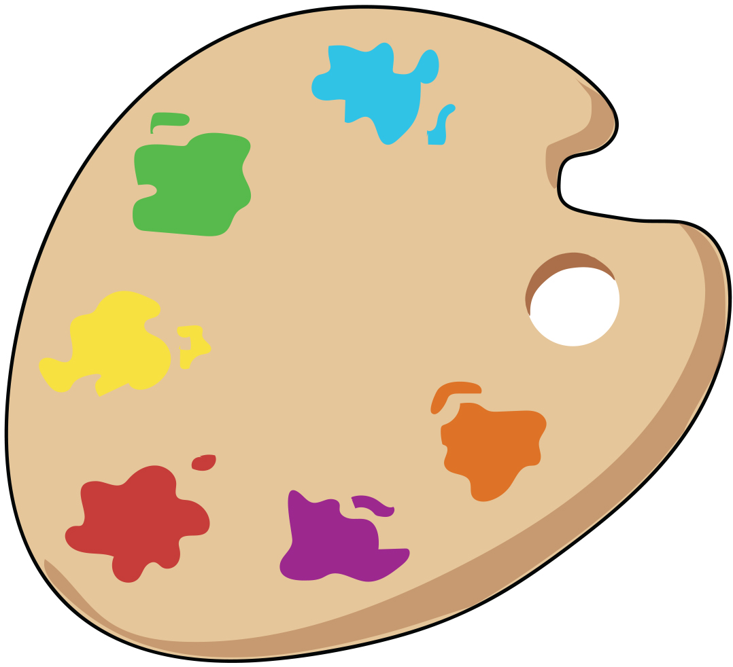
Inside your bag you’ll find:
Sketchbook
Pencil and eraser
Pen
Watercolor pencils
Waterbrush
Pencil sharpener
Notes:
Everyone has a different approach to how they use their materials. Don’t worry, there is no wrong way! If you find a method that works for you keep practicing and experimenting.
Feel free to personalize your material kit too! If you have a favorite pen or pencil, add that to your nature journal bag. You can also use other types of paints or media in your journal: try out some acrylic or gouache if you like, do a little collage on a page here and there, and add found objects. The key is to EXPERIMENT with whatever interests you. These are your tools; you should have fun using them!
Ask yourself: Does this pencil/pen/brush/paint spark joy???
Throughout this course we’ll be going over useful tips on how to use the materials included in your kit, as well as multiple techniques to help you communicate what you see on paper.
First, let’s go over the basics to familiarize ourselves with our tools.

Slide 9
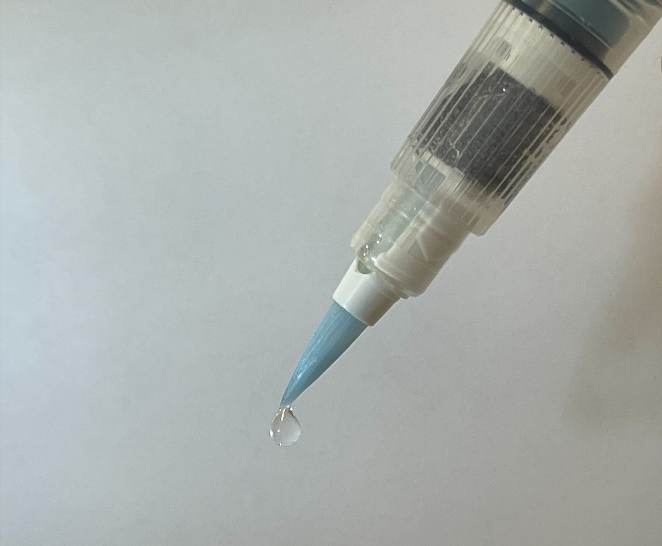
Filling the Waterbrush
Notes:
Your waterbrush will allow you to paint on the go!
To fill:
Unscrew the top of the brush by twisting it gently to the left.
Squeeze the barrel of the brush, dip it in a cup of water (make sure the black nib on the inside of the brush contacts the water), and release the barrel to let water in. You can also hold the barrel up to running water from a faucet.
Screw the brush head back on by twisting it to the right.
Voila, ready to use!
To use:
- Hold the brush so that the brush head faces down.
Gently squeeze the barrel of the brush so a small amount of water coats the brush head.
And you’re ready to paint!
Remember: the amount of water on your brush will affect the amount of color you put down on paper. Start slow with a little bit of water at a time.

Slide 10
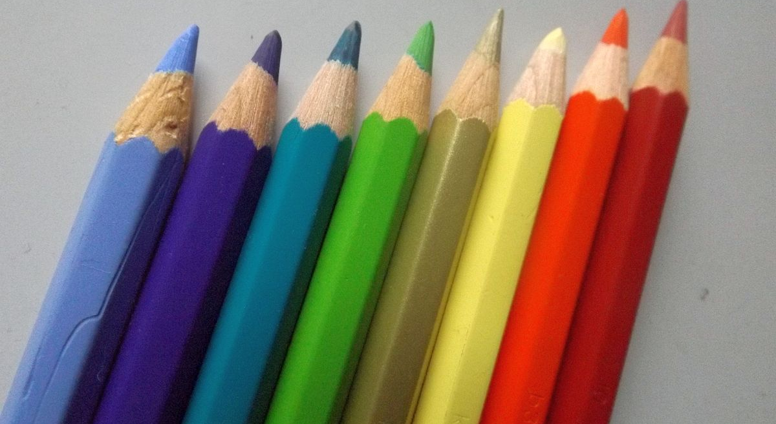
Using your watercolor pencils
Notes:
There are a few methods you can use to paint with your watercolor pencils:
Wet your waterbrush and tap it against the tip of the pencil to pick up pigment
Color and draw on your paper with the watercolor pencils, then use your waterbrush to spread the pigment around
Wet the pencil itself and draw on your paper
Wet the paper and draw on it with your watercolor pencils
[pause]
Experiment and find a method that you’re comfortable with. You may find that you end up using multiple methods in combination!
[play]
To make a color swatch with your colored pencils, apply a small square of each color in your set on a blank page in your journal. Be sure to leave some space between your squares and get a good amount of pigment on the paper. With a wet waterbrush, gently spread the pigment as far as it will go. This gives you an idea of what these colors look like at every value stage. Let your page dry and use it as a reference when drawing. You can even cut the page out of your journal and paste it into the lid of the pencil case. If you like, you can label each swatch with the name of the color on the pencil.
[pause]
Now let’s try making a color palette.
[play]
Take your watercolor pencils (make sure the pencils and your paper are dry) and lay down a LOT of pigment on a blank sheet of paper. Really get as much pigment as you can onto the paper. Now you can use the color as a ‘paint well’. With a damp waterbrush, gently tap the color on your paper to coat the brush in pigment. And that’s it!
Creative Commons: Photo of a set of eight watercolour pencils, by Shiftchange.

Slide 11
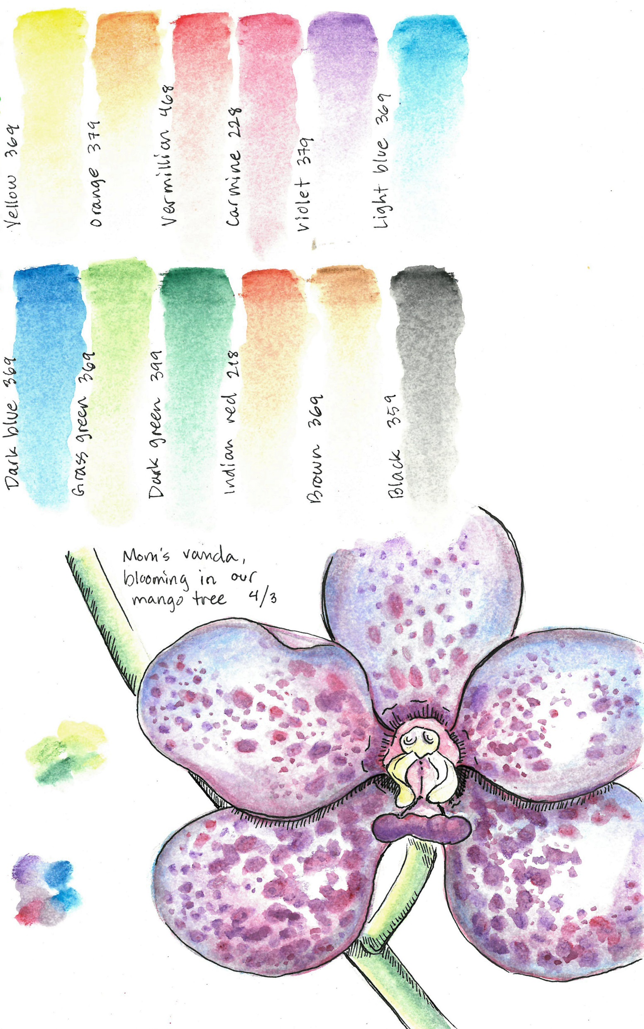
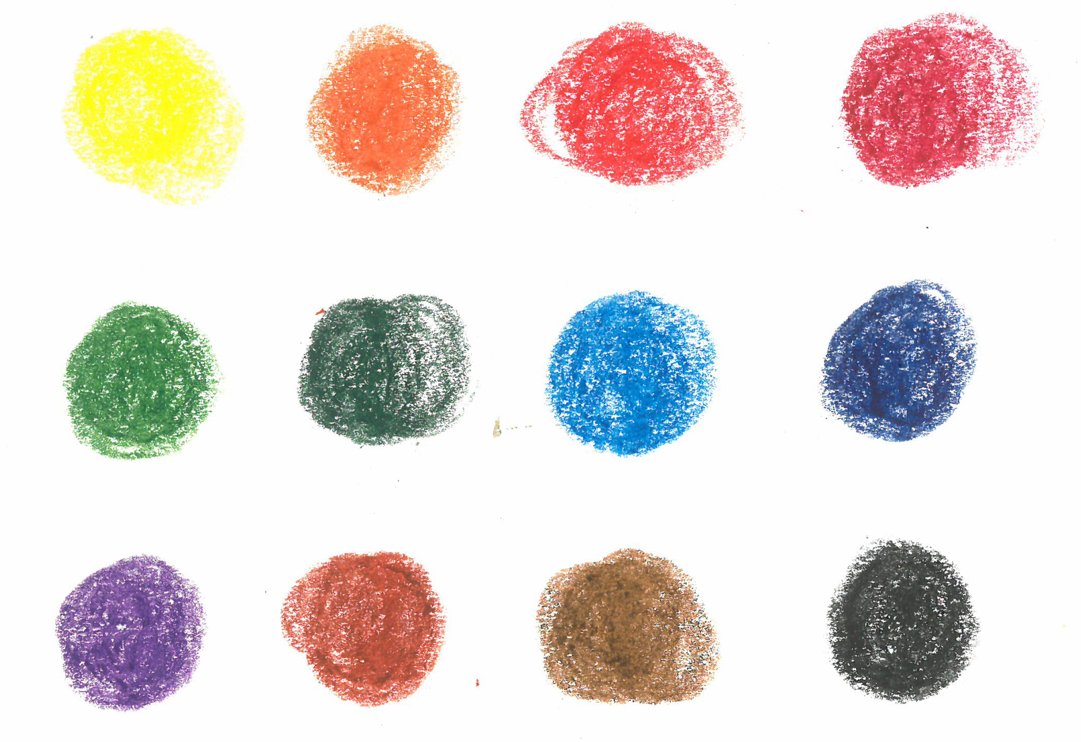
Swatch vs. Palette
Color swatch = a sample of color designed to show the actual dried result of applying certain paints
Color palette = the range of colors used by an artist
Color swatch
Color palette
Notes:
The best way to familiarize yourself with your materials is to use them!
One of the first things you can do after opening a new paint or pencil set is to make a color swatch. A color swatch is a sample of color that allows you to see the dried results of applying your paint on paper. Color swatches are a great way to practice spreading color on paper and giver you a reference to work from when choosing colors for your journal pages.
Another fun way to familiarize yourself with your watercolor pencils is to make a workable color palette right in your journal. A color palette is the range of colors used by an artist to create art. You can put a lot of pigment down on the paper and use your water brush to pick the pigment up and paint with it! Similar to how you might pick up oil paint from a traditional wood palette.

Slide 12
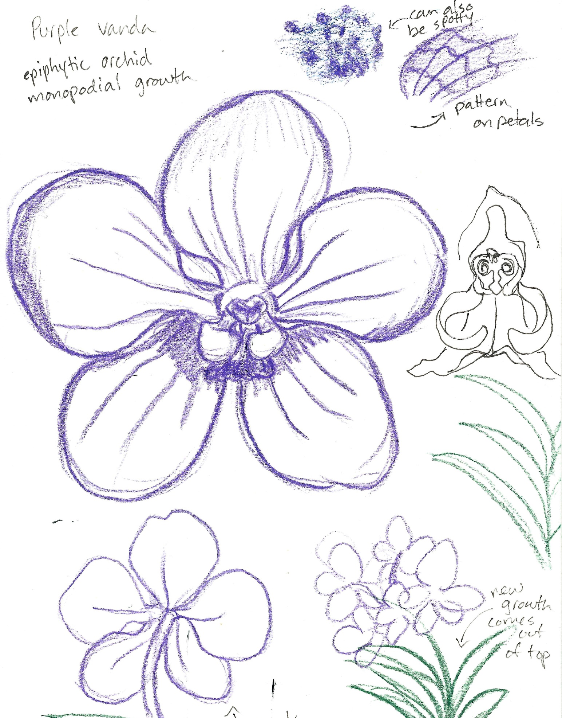


Field Sketch
vs.
Studio Drawing
Notes:
In this class, our goal is to observe and document the natural world while improving our artistic skills and learning new techniques along the way. There are two main ways we can accomplish this goal: field sketching and studio drawing.
Field sketching = quick observational sketches that happen in the field. When field sketching you may find yourself limited for time or materials. The objective here is to get as much information down on your journal page as possible. Don’t erase, just draw! Think of field sketching as the quick notes you might scribble down in a lecture class.
Studio drawing = an in-depth, time-consuming study of a subject. When drawing in a ‘studio’ (office, library, kitchen table) you get the chance to slow down and really get to know your subject. This is your opportunity to add the details that you may have learned from your field sketch ‘notes’. You can also use reference images from books or the internet to help you piece together a clear picture of your subject.
You can also add found objects to your journals. You can take leaf rubbings and paste them onto a journal page, or you might add a feather you found outside or a pressed flower from your garden.
Whether you’re out in the field or concentrating in your studio, remember to write down any information about your subject you might notice or learn. Take note of the weather, of how many plants or animals you see in the area and write about how or what you feel in the moment. You never know what kind of observation could be important to science, or better yet – important to YOU.

Slide 13
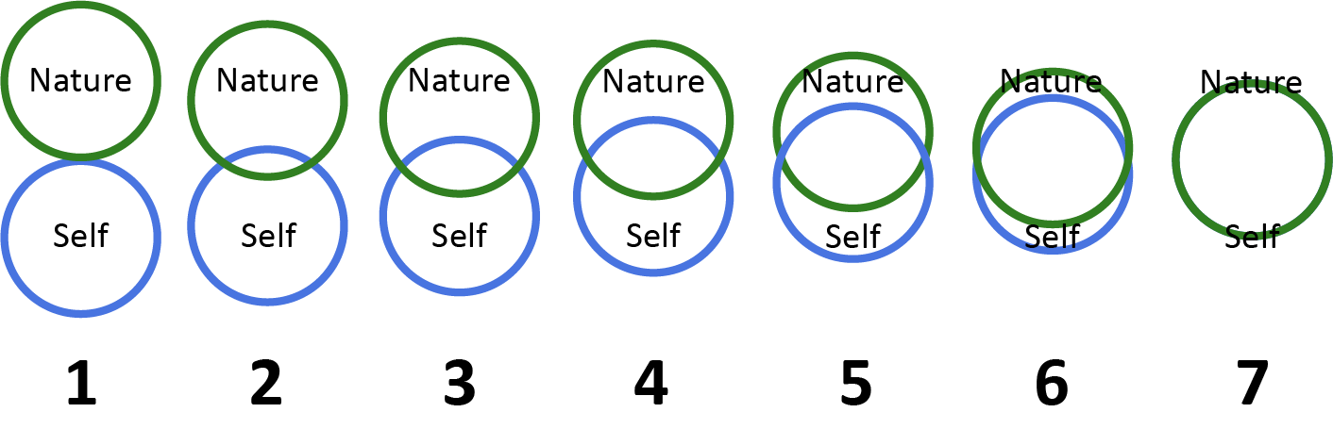
Homework
Test your materials and make a color swatch
Think about your relationship with the natural world. How interconnected do you feel with nature?
In your journal, describe how connected you feel to nature on a scale of 1 (completely disconnected) to 7 (completely connected).
Send your response to drichmond@naplesgarden.org
Notes:
And that’s it for our first class!
For Homework:
Decorate or personalize your sketchbook. You can use stickers, fabrics, paper cutouts, tape, etc to decorate the front cover/back cover of your journal. Or you can leave it as is if you like! One thing you should do is write your name on the inside of the front cover. That way if you misplace your journal, someone can contact you and get it back to you. It’s a good idea to include your name, phone number or email address, and/or mailing address. If you aren’t comfortable providing your personal mailing address, you can put down the Garden’s mailing address:
Test your materials and make a color swatch. Get familiar with your watercolor pencils and experiment with the different techniques of getting pigment on paper.
Think about your relationship with the natural world. How interconnected do you feel with nature on a scale of 1 to 7? Find a blank page in your journal and divide it in two by drawing a horizontal line across the page. Write your response to today’s homework in the top half. Keep the bottom half blank! We will revisit this question at the end of class.
You can type out your response or send a photo of your journal page to my email.
Optional: you can prep for the next class’s warm-up activity by drawing five boxes of different sizes on a blank page in your nature journal

Slide 14
Class 1 Recap
Getting Started: Class Structure
Why Nature Journaling is Important
Material Overview and Practice
Intro to Watercolor Pencils
Field Sketching vs. Studio Drawing
Homework Assignment
Notes:
Questions/Comments/Concerns
Don’t forget to bring your materials to the next class!
See you next Saturday ☺

