Slide 1
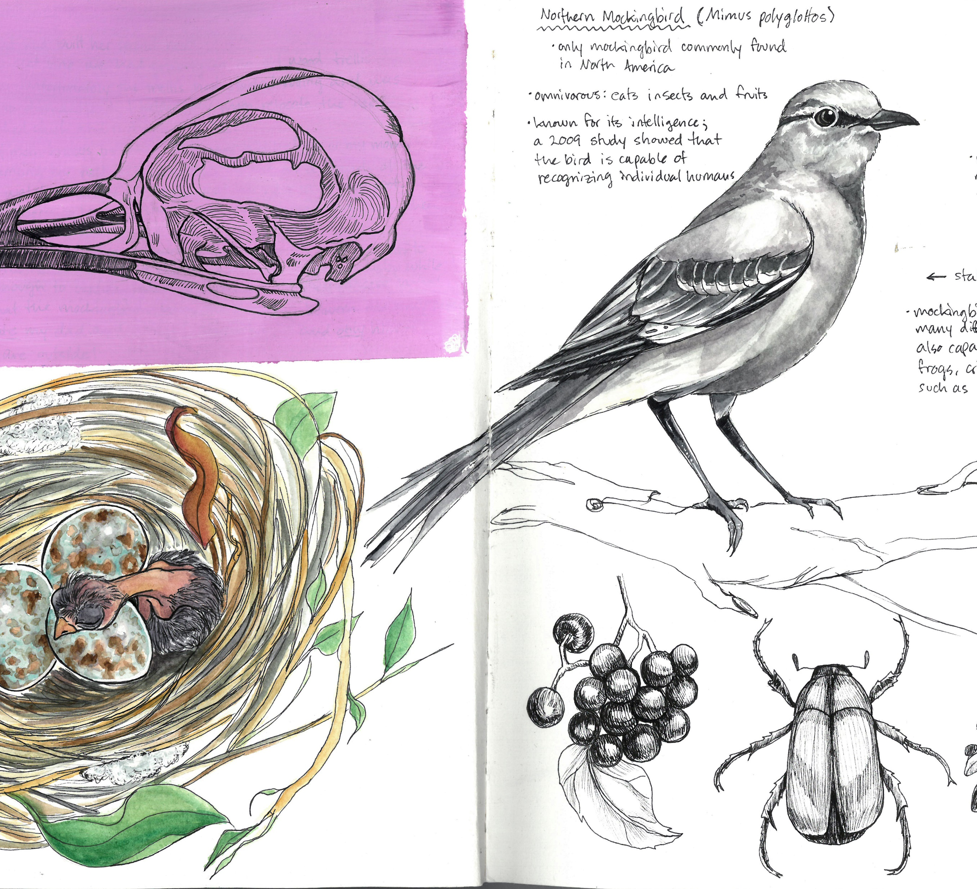
Introduction to NATURE JOURNALING Connecting to nature through art and observation
Class 2:
Drawing from
Observation
Notes:
Buckle up folks we’re about to get ARTSY

Slide 2
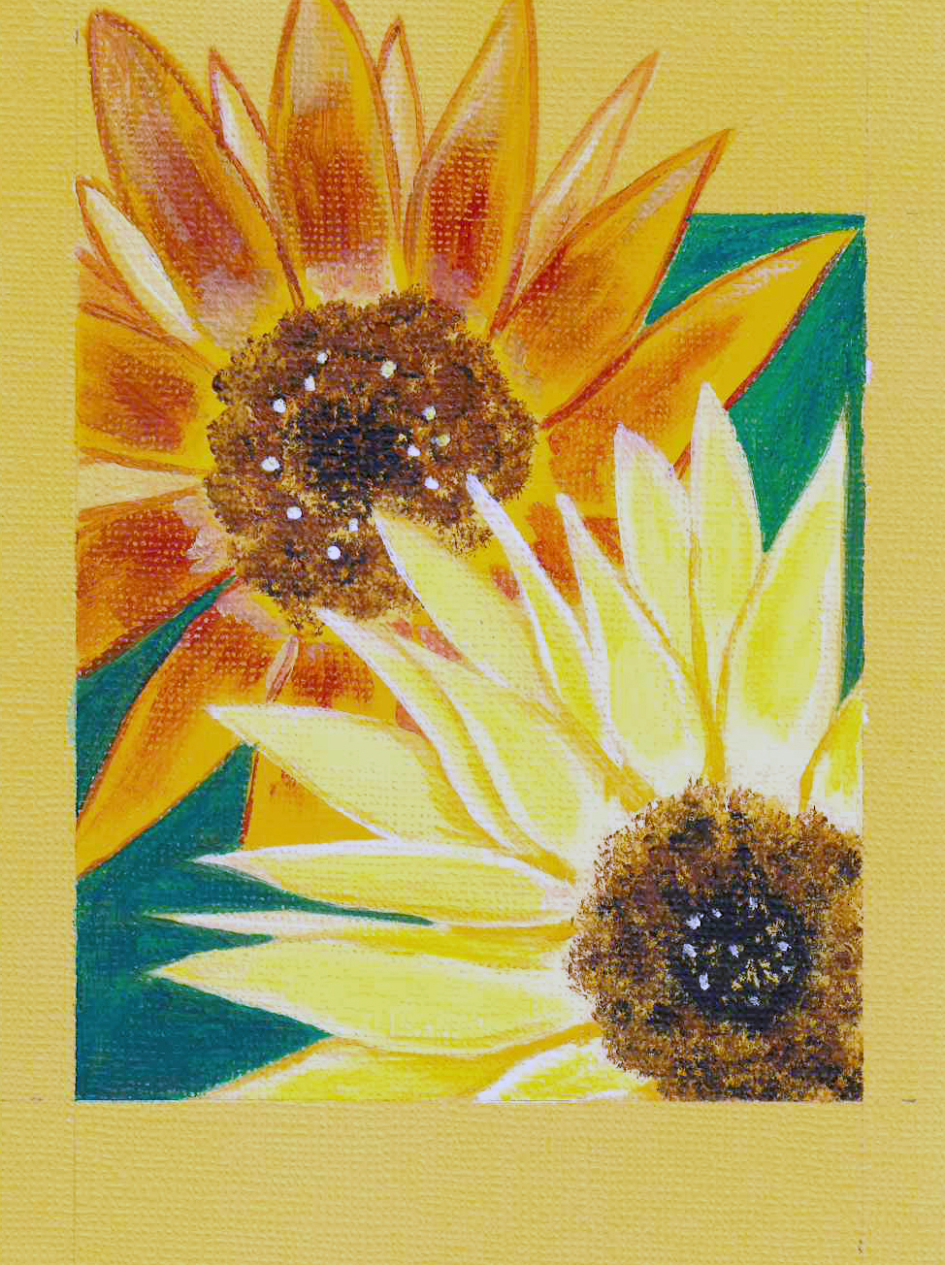
Class 2 Agenda
Warm-up Activity
Observing the World Around You
Using Lines and Shapes
Different Shapes = Different Plants
Homework Assignment

Slide 3
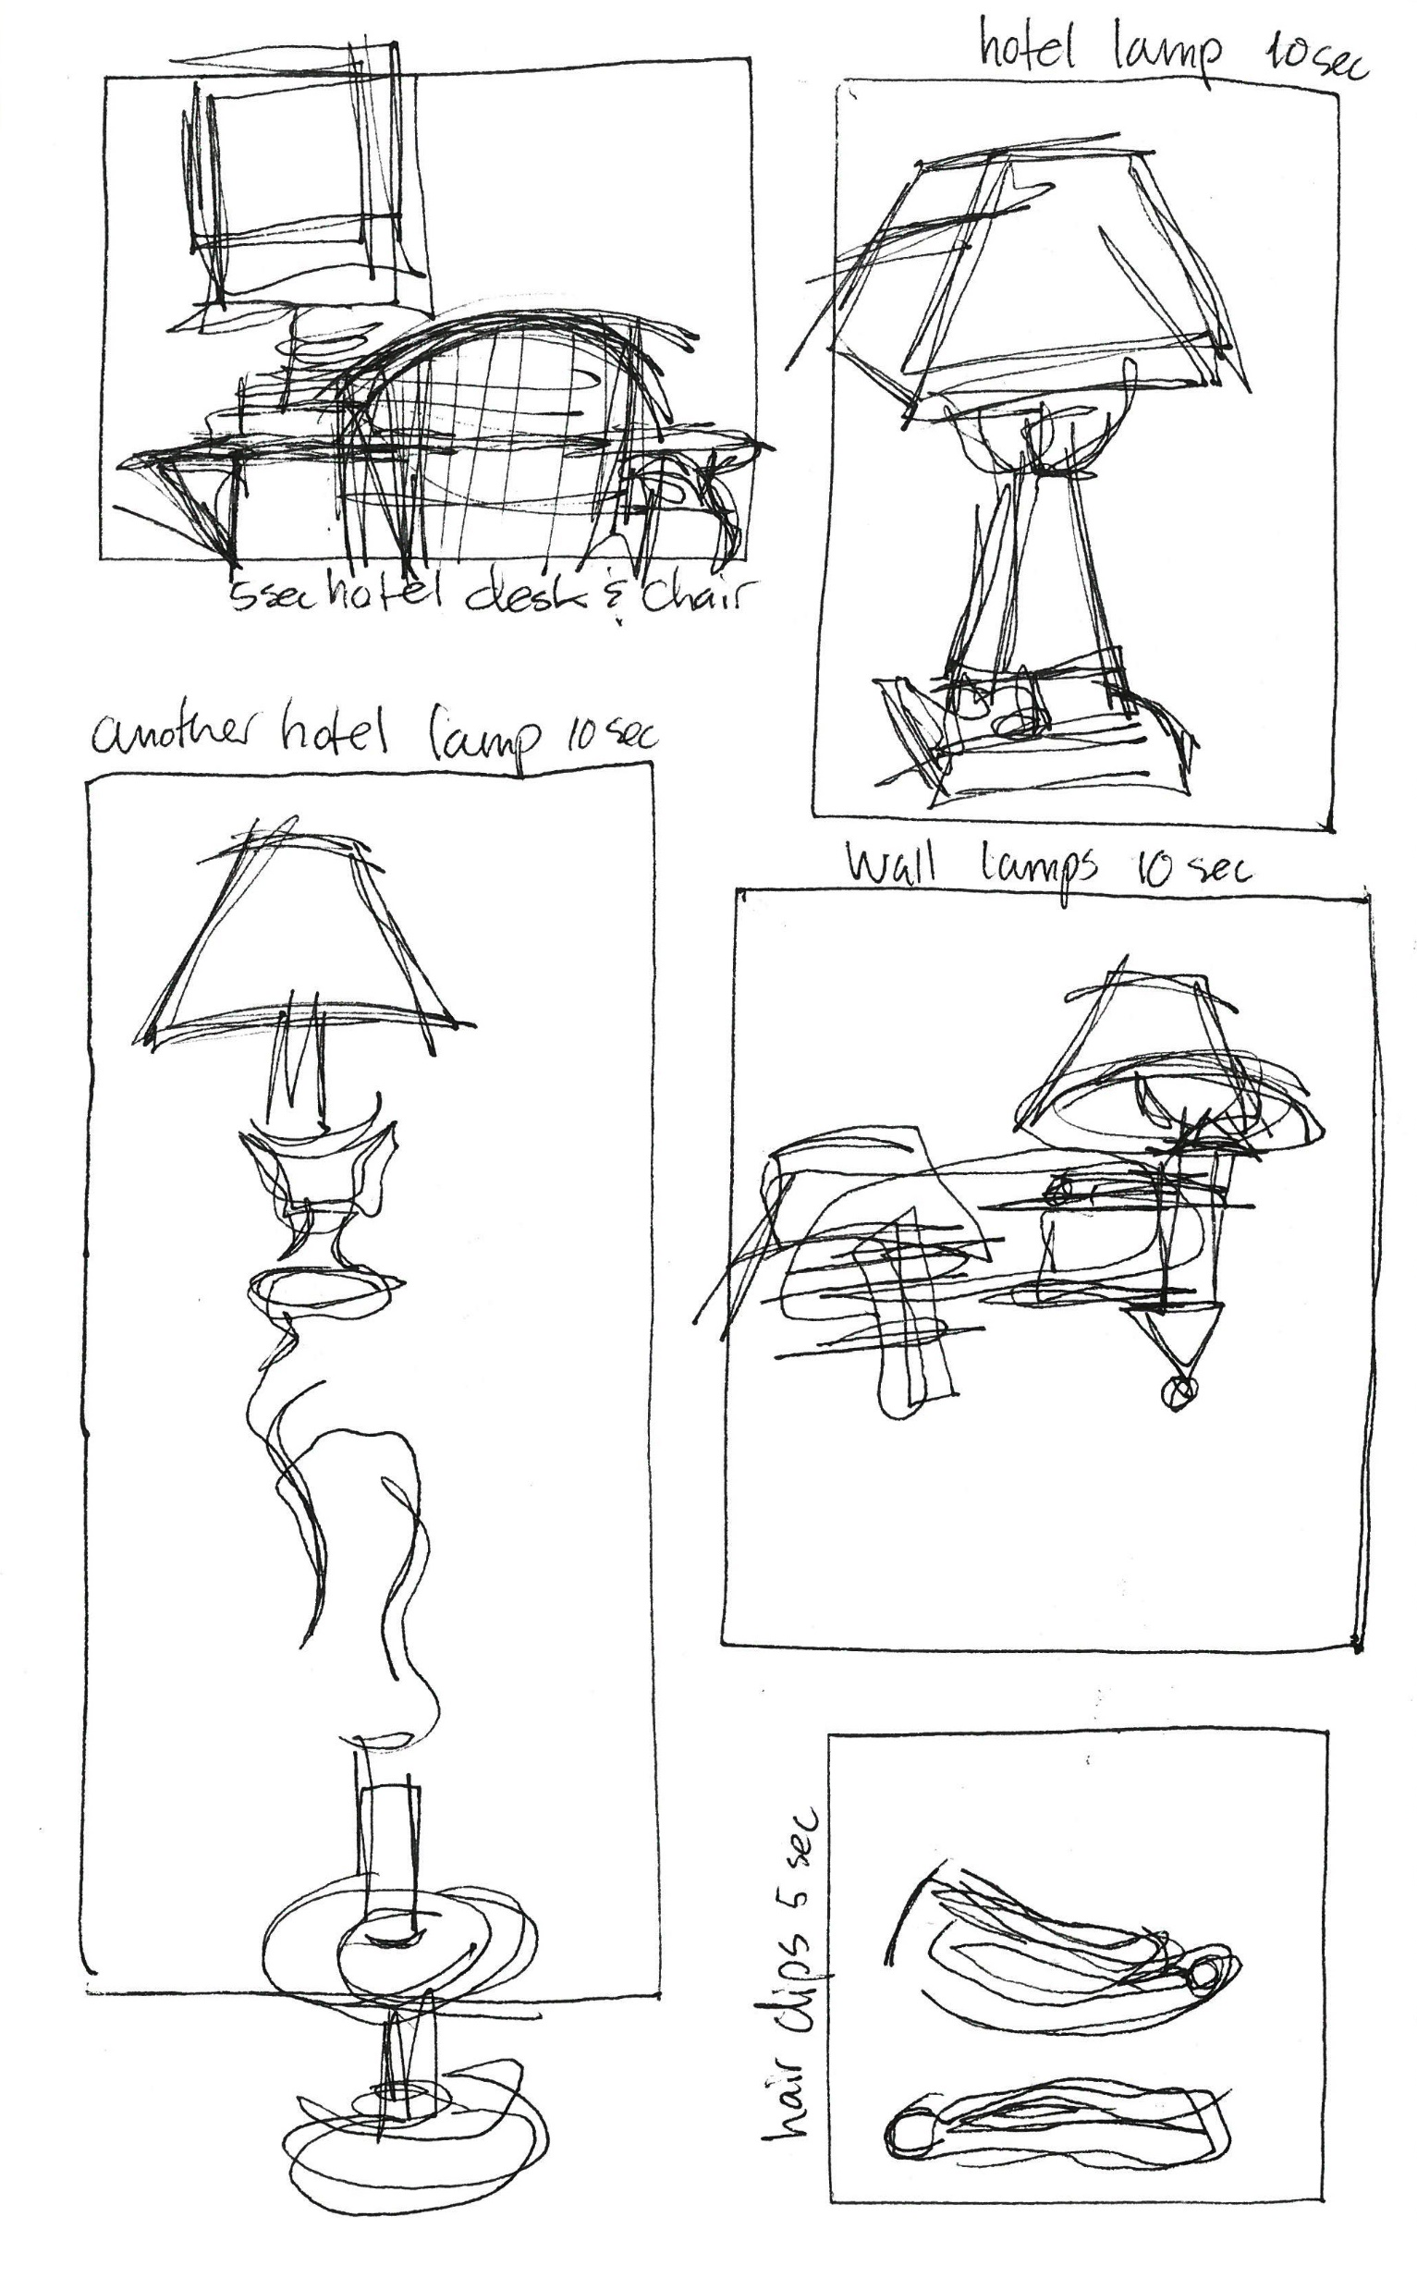
Warm-Up:
Blind Contour Drawings
Choose one object in front of you or near you as your subject.
Use your pen! Without looking at your paper and without lifting your pen, draw your subject in each of the five boxes.
Each box is timed! Box 1: one minute, Box 2: 50 seconds, Box 3: 40 seconds, Box 5: 30 seconds.
Notes:
Today we’ll be warming up with a drawing exercise called blind contour drawing. This exercise is a great way to build hand-eye coordination and train your eye for detailed observation in the field.
We’ll be using our Micron pens for this exercise. Let’s start off by quickly drawing five boxes on a blank page in our journals. They don’t have to be perfect, and they don’t have to be the same size.
Look around you and choose three objects to focus on as your subject. Doesn’t matter what the objects are, as long as you have a reference to fill each of the five boxes.
Draw your subject in one of the boxes without looking at the paper and without lifting your pen from the page.
We will only have 1 minute for each box. Abigail will set a timer; when you hear the timer, stop drawing. You can look at your paper to re-orient yourself and get ready to move to the next box.
These drawings are supposed to look a little goofy. That’s what makes blind contour drawings so charming! Remember, for this exercise the more abstract the final result is, the better.
Does someone want to share what they drew?
How did it feel to release control?
This exercise is meant to open your creativity to mistakes by freeing your hand from your eye.
Why do we warm up when drawing?
Ever notice how your first sketch of the day is a little wonky? In any type of art, just as with physical activity, it is important to warm up for best results and improvement.
Doing simple training exercises before you dive into sketching will warm up the parts of your body needed for drawing (shoulder, arm, wrist, fingers) and will greatly improve your steadiness and linework. It also gives your brain a moment to ‘switch gears’ into creative mode.
It’s a great practice to start on your own too! Your warmups don’t have to be complicated; they can be as simple as a few squiggly lines and shapes.

Slide 4
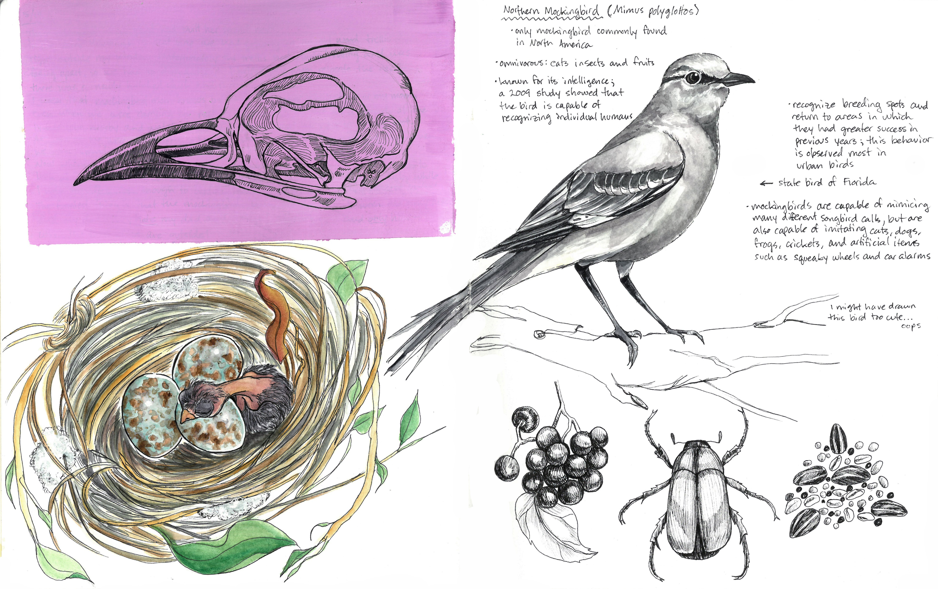
Observe with Curiosity
Use each of your senses to mindfully experience the world around you.
Notes:
Observation is all about how you use your senses and pausing to take a second look. Use all your senses whenever possible and be cautious about your surroundings.

Slide 5
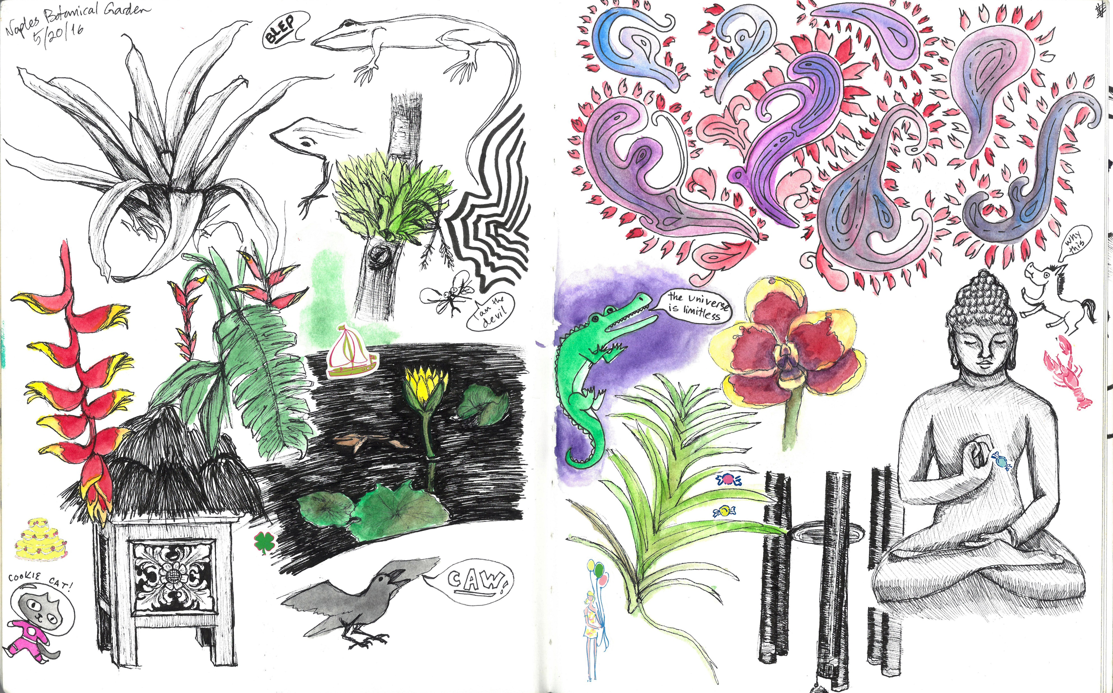
What do you see?
LOOK for:
Small details
Hiding animals
Interesting shapes
Textures
Bright colors
Notes:
Look: First, what are you LOOKING AT and what do you SEE? Are you looking at a large landscape, or are you focused on one tiny leaf? What do you see when you look at your subject? Do you see the different plants in the landscape? Maybe there are some animals hiding in the foliage? When you look at the leaf, do you see any variations in color? Do you see the veins on the leaf, or the way its texture looks in the light? Take note of as many details as you can. Write or draw any observations that stand out to you or provoke an emotional response and observe your surroundings with curiosity.

Slide 6
What do you hear?
LISTEN for:
Birds singing
Moving water
Insects chirping
Wind or rain
Complete silence
Notes:
Listen: Close your eyes. Take a moment to be still and listen to your surroundings. What do you hear? Perhaps you’re standing next to running water or maybe it’s a particularly windy day. Do you hear the croaking of frogs, the chirping of crickets or the trill of birds? What you hear in nature can tell you a lot about your surroundings. The sounds of frogs or insects can indicate a change in the weather. If small animals suddenly go quiet, it could indicate a predator is in the area, such as a hawk or cat. You might even hear a dispute between territorial animals. Natural sounds give us information that helps us to understand our environment and to assure us that we’re safe.

Slide 7
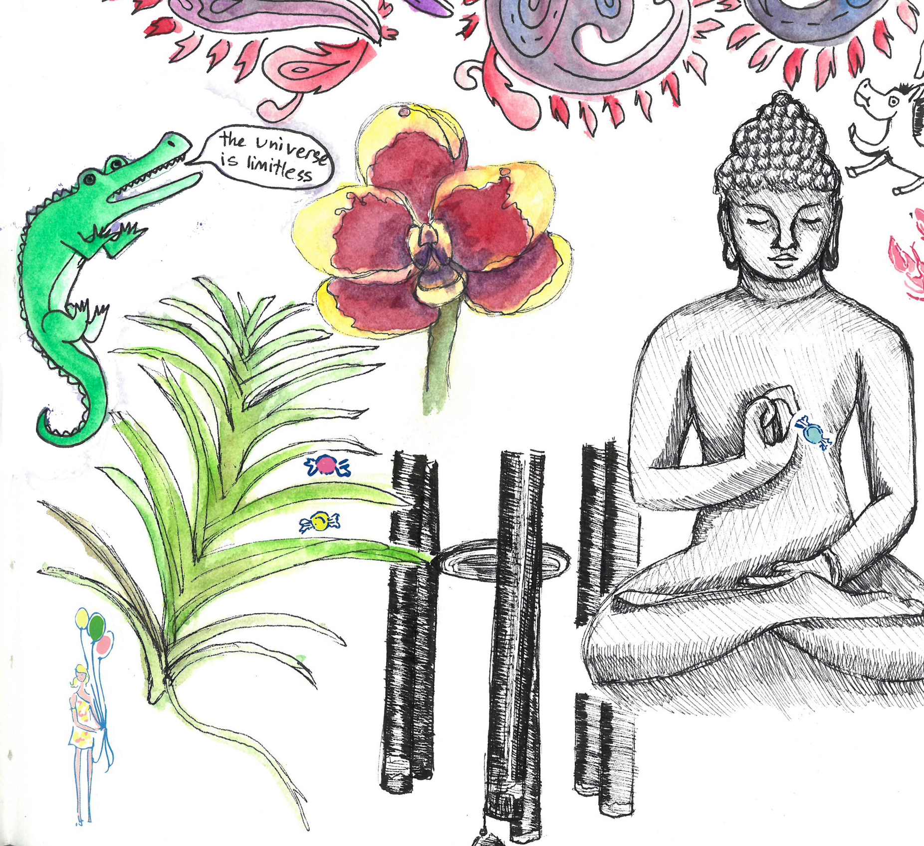
How do you feel?
THINK about:
Your emotions
What you remember
What the weather is like
Textures in nature
How nature can influence your mood
Notes:
Nature inspires many emotions from happy to sad to indescribable. Writing about how nature affects your emotions can be a soothing experience.
Touch: Tactile observations are also an important part of nature journaling. Your sense of touch can be more than what you physically feel with your hands. Write about how the weather feels. Is it wet, hot, dry or cold? Look for interesting textures in nature. Draw what you see and describe how it would feel. Did you find a soft leaf or flower? Or are you sitting under a tree with rough bark? When you review these observations, you will remember how it felt to be in nature at that time.

Slide 8
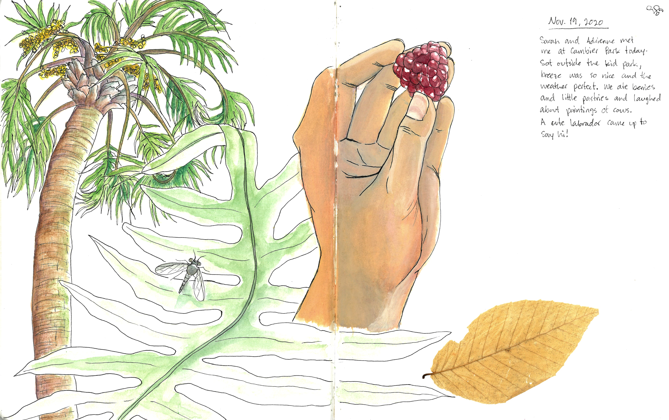
What do you smell or taste?
PAY ATTENTION to:
Blooming flowers
What the air smells like
Fruiting plants
Colors that remind you of flavors
Notes:
Smell: Smell isn’t our strongest sense, but its association with our emotions is powerful. Natural scents from blooming plants can help you feel calmer and alert while boosting your mood. Certain smells can even signify a change in season or weather. You might notice that the air smells different when the weather starts to get cooler during the fall. In Florida, the air smells more ‘crisp’ during fall and winter because of the decrease in humidity.
Taste: Taste is linked to our sense of smell. Your taste sense likely won’t be so stimulated in nature, unless you’re drinking water from a safe stream or eating produce from an orchard or farm. You might come across a fruit or vegetable that reminds you of a favorite food or see a color in nature that makes you think of a certain flavor. Taste isn’t limited to food. If you’re in a coastal town you might notice that the breeze tastes a little salty some days. If it’s humid or rainy, can you taste the rain in the air?
By using each of your senses to mindfully absorb your environment, you can enjoy the benefits to your body and mind of being out in nature. When you think you’re done observing, take another look! There’s always another detail to discover.
Now let's take a look at how you can start drawing your observations using lines and shapes.

Slide 9
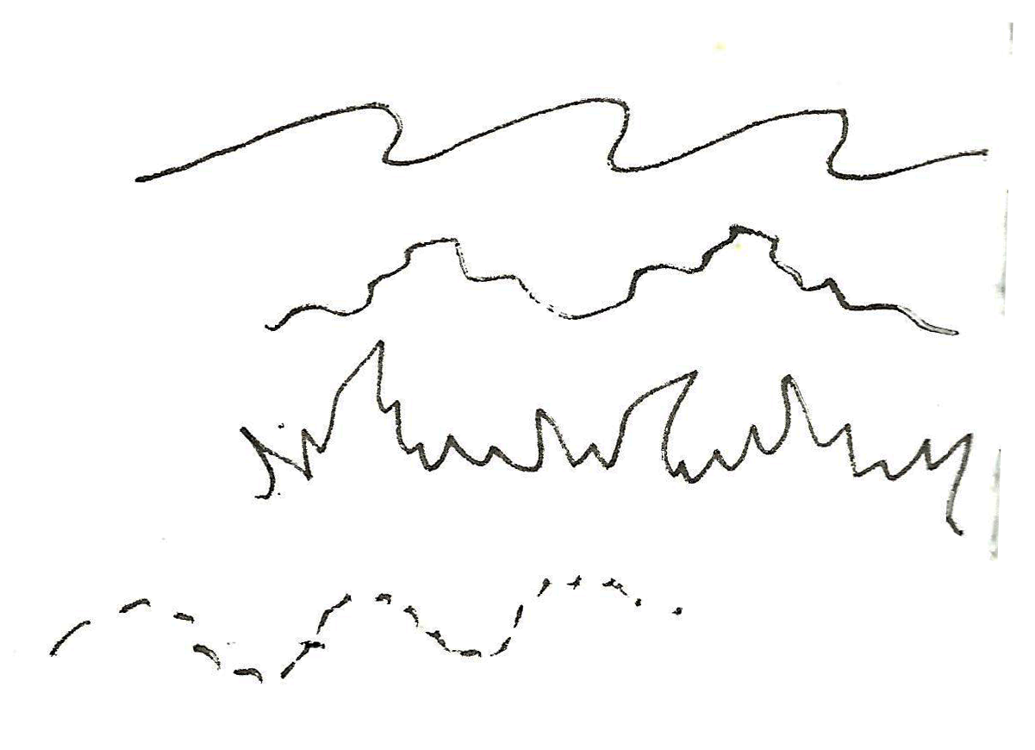
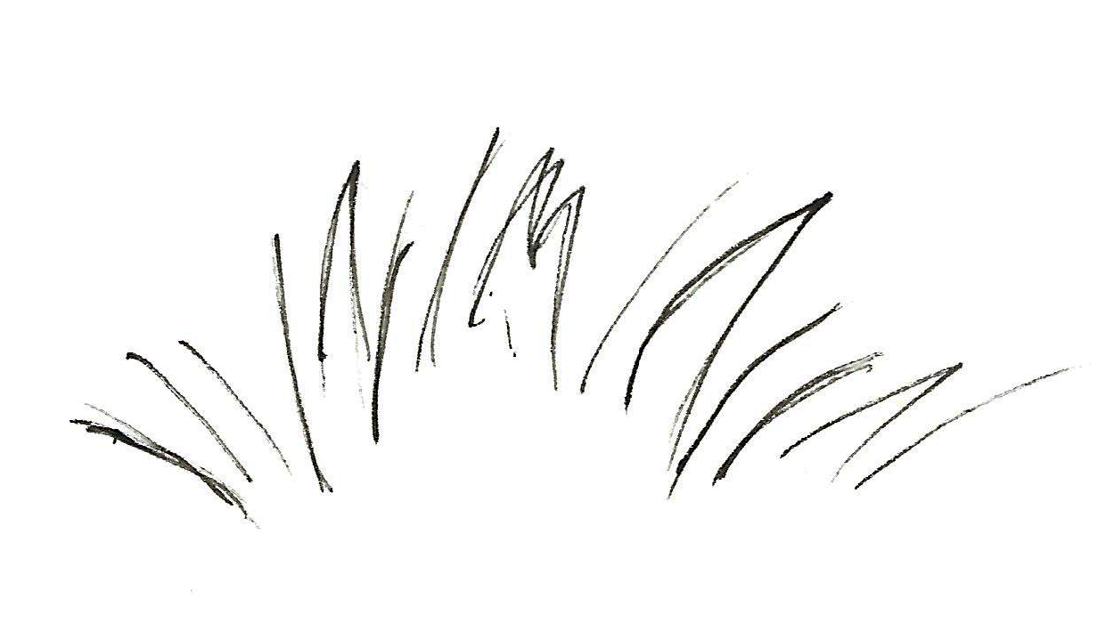
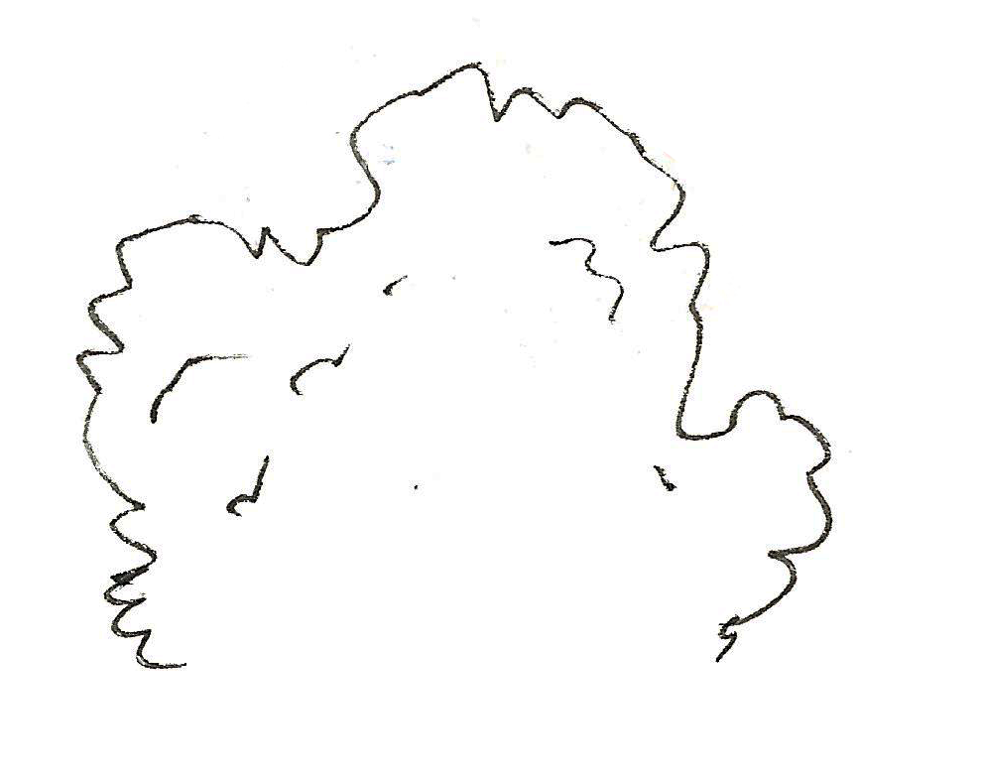
Using Lines
and Shapes
Lines become shapes, and shapes become things.
Simplify what you see – break it down into shapes that you recognize.
Lines can be expressive.
Notes:
“Lines become shapes, and shapes become things” - Elizabeth Smith
Simplify what you see into shapes that you recognize. Start lightly sketching the basic shapes, then add details. A flower petal can start out as a circle or an oval, a tree as a cylinder, and a bush as a wiggly line.
Start with large shapes that you are familiar with and can identify right away, then move on to smaller shapes to add detail and depth to your sketch

Slide 10
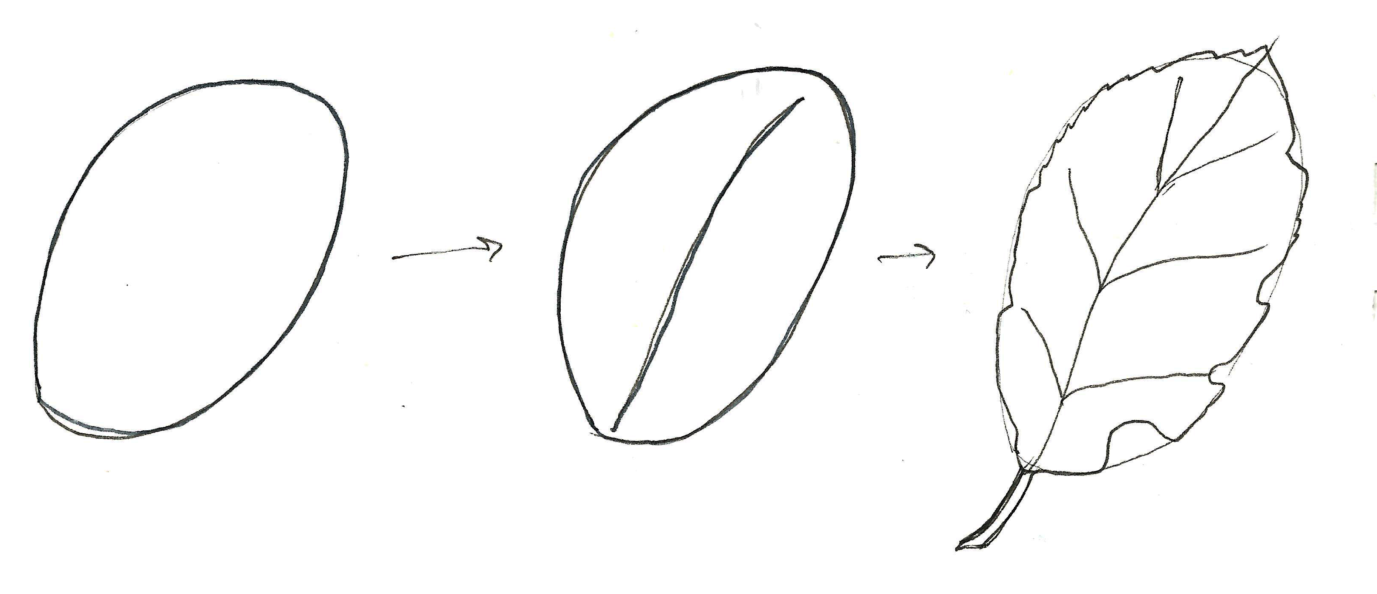
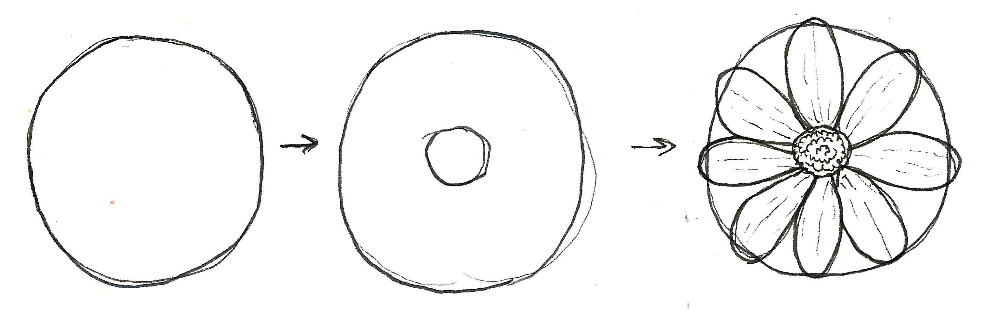
Using Lines
and Shapes
Lines become shapes, and shapes become things.
Simplify what you see – break it down into shapes that you recognize.
Lines can be expressive.
Notes:
“Lines become shapes, and shapes become things” - Elizabeth Smith
Simplify what you see into shapes that you recognize. Start lightly sketching the basic shapes, then add details. A flower petal can start out as a circle or an oval, a tree as a cylinder, and a bush as a wiggly line.
Start with large shapes that you are familiar with and can identify right away, then move on to smaller shapes to add detail and depth to your sketch

Slide 11
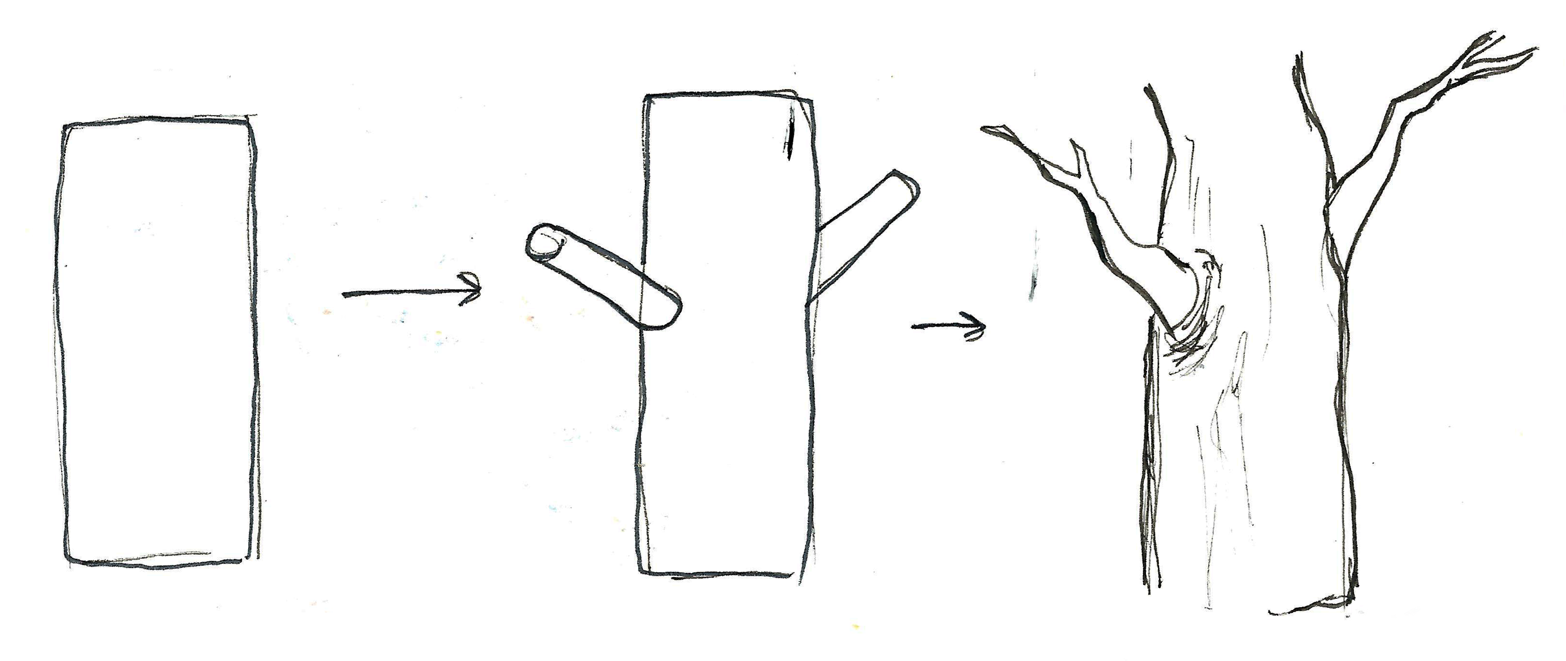
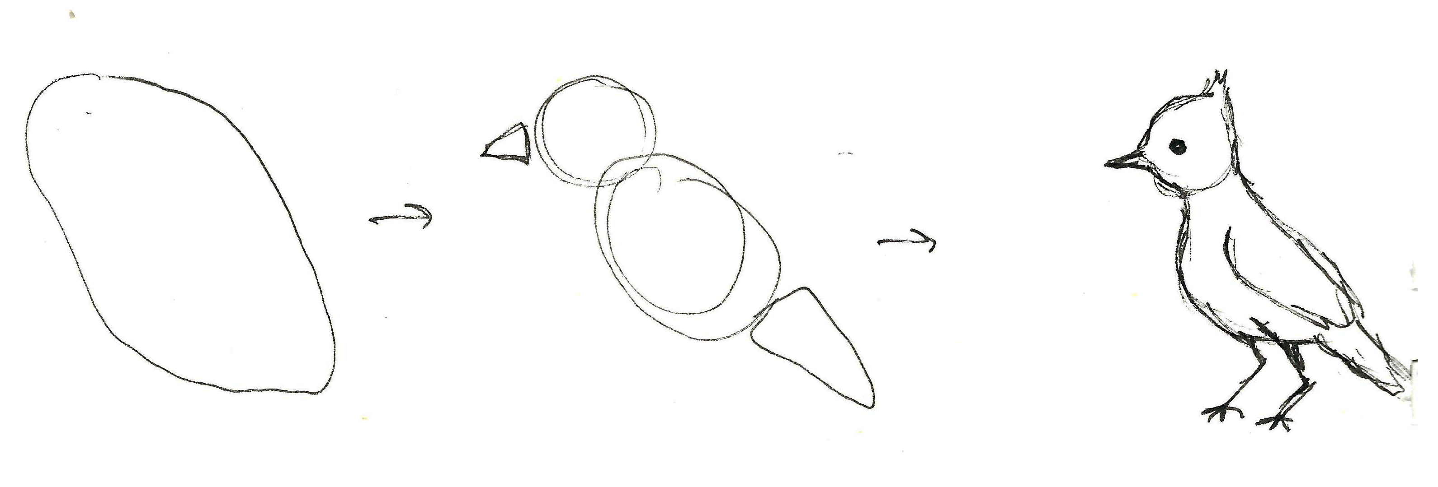
Using Lines
and Shapes
Lines become shapes, and shapes become things.
Simplify what you see – break it down into shapes that you recognize.
Lines can be expressive.
Notes:
“Lines become shapes, and shapes become things” - Elizabeth Smith
Simplify what you see into shapes that you recognize. Start lightly sketching the basic shapes, then add details. A flower petal can start out as a circle or an oval, a tree as a cylinder, and a bush as a wiggly line.
Start with large shapes that you are familiar with and can identify right away, then move on to smaller shapes to add detail and depth to your sketch

Slide 12
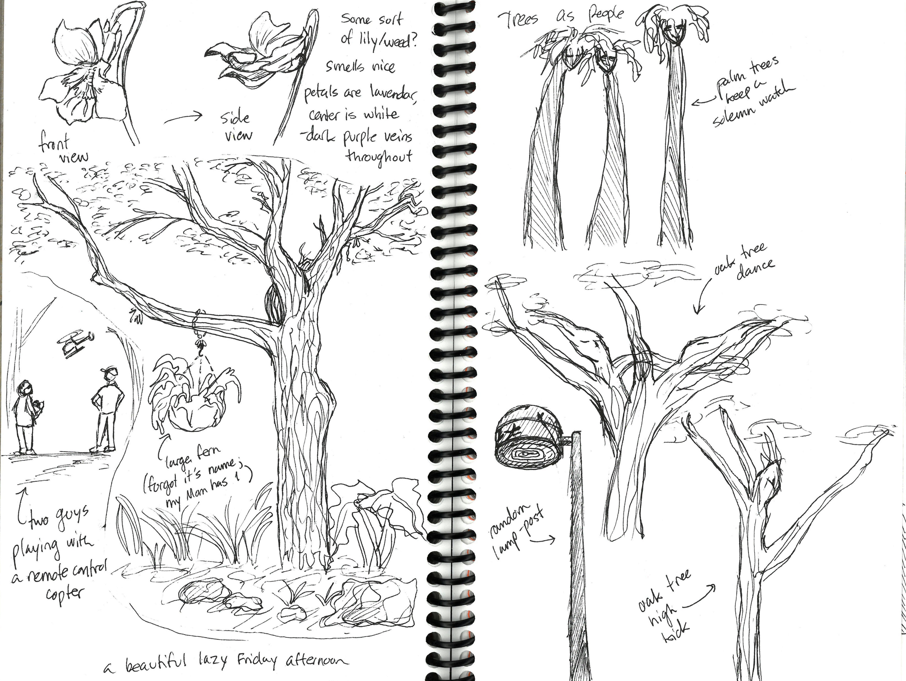
Using Lines
and Shapes
Lines become shapes, and shapes become things.
Simplify what you see – break it down into shapes that you recognize.
Lines can be expressive.
Notes:
Lines create the outlines/contours of a shape, create texture and value, and can be expressive. Thick lines imply that something is heavy, dark lines show that the object is in the foreground, thin lines can communicate that something is delicate, and light lines might signify that the object is far away or in the background.
As the artist, you can always crop and simplify what you see
You don’t need to include every leaf on a bush in your journal if you don’t feel like it.
You’re allowed to leave things unfinished.
Quick, sketchy shapes in the field can provide an excellent reference for when you want to sit down in the studio to add detail.

Slide 13
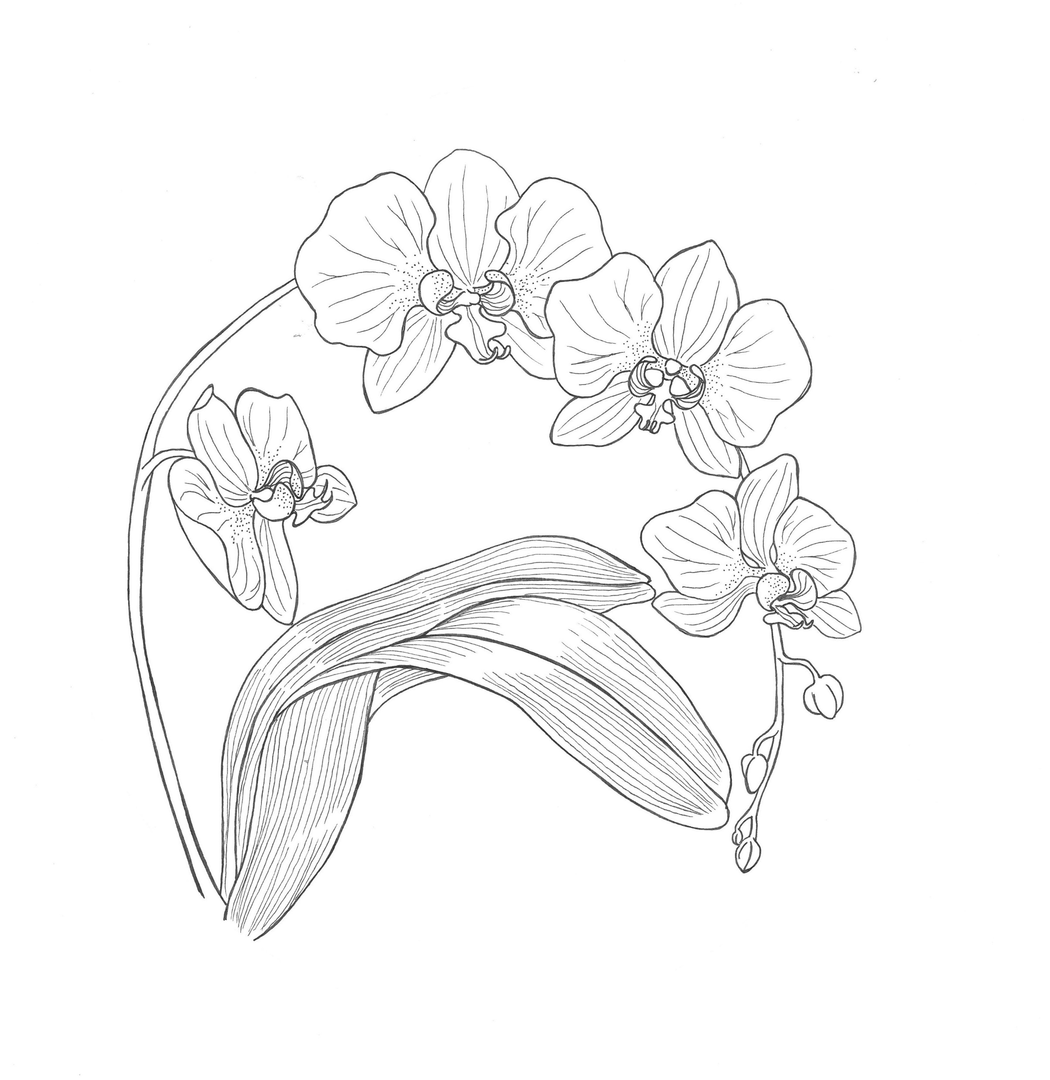
Notes:
Everybody unmute yourselves; I want you to call out your answers.
Let’s look at how to draw this phalaenopsis orchid.
What simple shapes can you identify here? Start with the big shapes – what is the very first one you notice?
Once we’ve figured out our big shapes, let’s take a second look and add smaller shapes for detail.
[Draw shapes on presentation as called out]
Is there a difference in the thickness (weight) of the lines in this picture?
How does that difference affect the illustration as a whole?

Slide 14
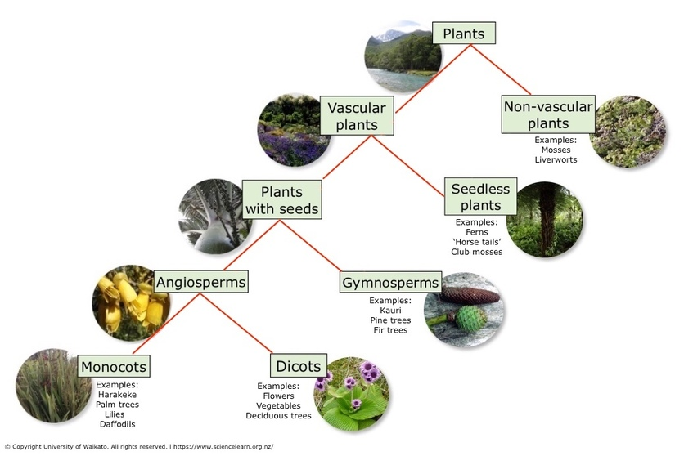
Notes:
Now let’s talk about how you can learn about a plant’s classification based on what you observe.
This diagram shows the classification of plants and the major characteristics used to categorize them.
Based on the shape of these plants and their visible characteristics, we can learn to identify what category of plant they belong to.
Phalaenopsis: We can tell this orchid is a vascular plant because it has upright leaves, stems, and flowers. This indicates that it has a vascular system, which is made up of cells and tissues that transport water through the plant. Non-vascular plants such as mosses and liverworts are simple, low-growing, and nonflowering. Pretty much all flowering plants produce seeds, so we can infer that because this orchid has flowers it too produces seeds. And because we know that this orchid is a flowering plant, we know that it is also an angiosperm (all flowering plants are angiosperms).
Plant vocab:
Plants = all living organisms that belong to the kingdom Plantae.
Non-vascular plants = plants that have simple root systems and lack a vascular system (mosses and liverworts).
Vascular plants = plants that have a more complex root system and have a vascular system (the system of cells and tissues that transport water throughout a plant).
Seedless plants = plants that don’t produce seeds, but reproduce through the dispersal of spores (ferns, ‘horse tails’, and club mosses).
Plants with seeds = are divided into two groups; Gymnosperms – plants that do not produce flowers and have seeds unprotected by an ovary (fruit); and Angiosperms – plants that produce flowers and fruits.
Diagram Image Credit: Plant image © Stephen Finn, 123RF Ltd; vascular plants image © Adkana, 123RF Ltd; kōwhai © Neville Gardner; kauri cones © Tony Foster, Bushmans Friend; harakeke © Jon Sullivan, Creative Commons 4.0.

Slide 15
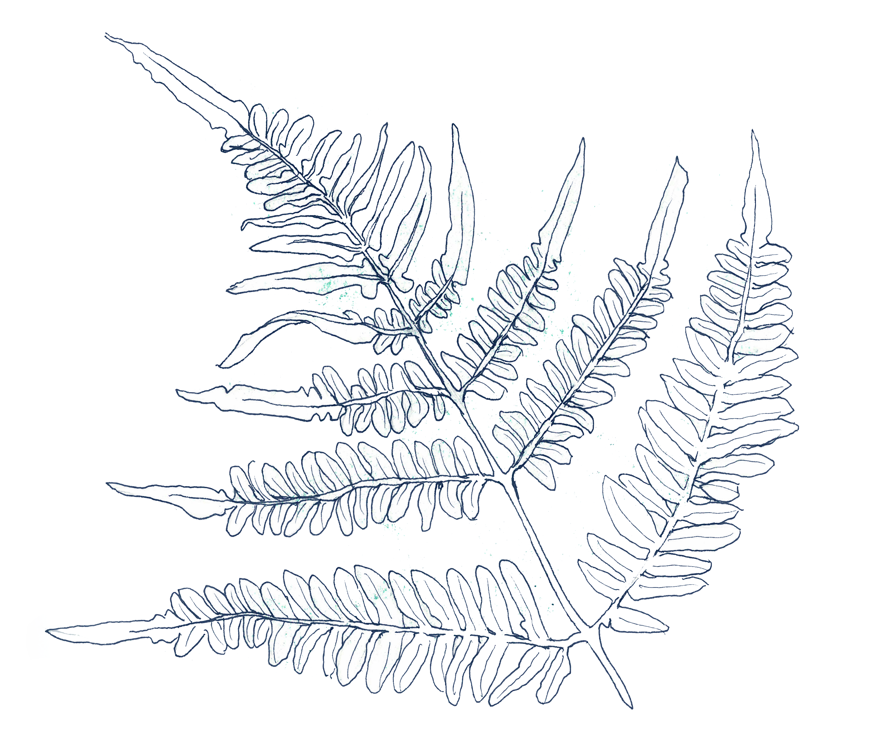
Notes:
Now let’s talk about how you can learn about a plant’s classification based on what you observe.
This diagram shows the classification of plants and the major characteristics used to categorize them.
Based on the shape of these plants and their visible characteristics, we can learn to identify what category of plant they belong to.
Bracken fern: Raise your hand if you think this fern is a non-vascular plant. Who thinks it’s a vascular plant? It’s vascular! If you’ve ever encountered a fern before, you may have noticed small brown dots on the underside of the leaves. Those brown dots are collections of tiny spores. Plants such as ferns, horse tails, and club mosses are seedless plants that reproduce through the use of spores instead of seeds.
You can use your observation skills to differentiate between plant species and identify ones that you may be familiar with. You’ll also find yourself discovering plants that are entirely new to you, and who knows, maybe even new to science!
Plant vocab:
Plants = all living organisms that belong to the kingdom Plantae.
Non-vascular plants = plants that have simple root systems and lack a vascular system (mosses and liverworts).
Vascular plants = plants that have a more complex root system and have a vascular system (the system of cells and tissues that transport water throughout a plant).
Seedless plants = plants that don’t produce seeds, but reproduce through the dispersal of spores (ferns, ‘horse tails’, and club mosses).
Plants with seeds = are divided into two groups; Gymnosperms – plants that do not produce flowers and have seeds unprotected by an ovary (fruit); and Angiosperms – plants that produce flowers and fruits.
Diagram Image Credit: Plant image © Stephen Finn, 123RF Ltd; vascular plants image © Adkana, 123RF Ltd; kōwhai © Neville Gardner; kauri cones © Tony Foster, Bushmans Friend; harakeke © Jon Sullivan, Creative Commons 4.0.

Slide 16
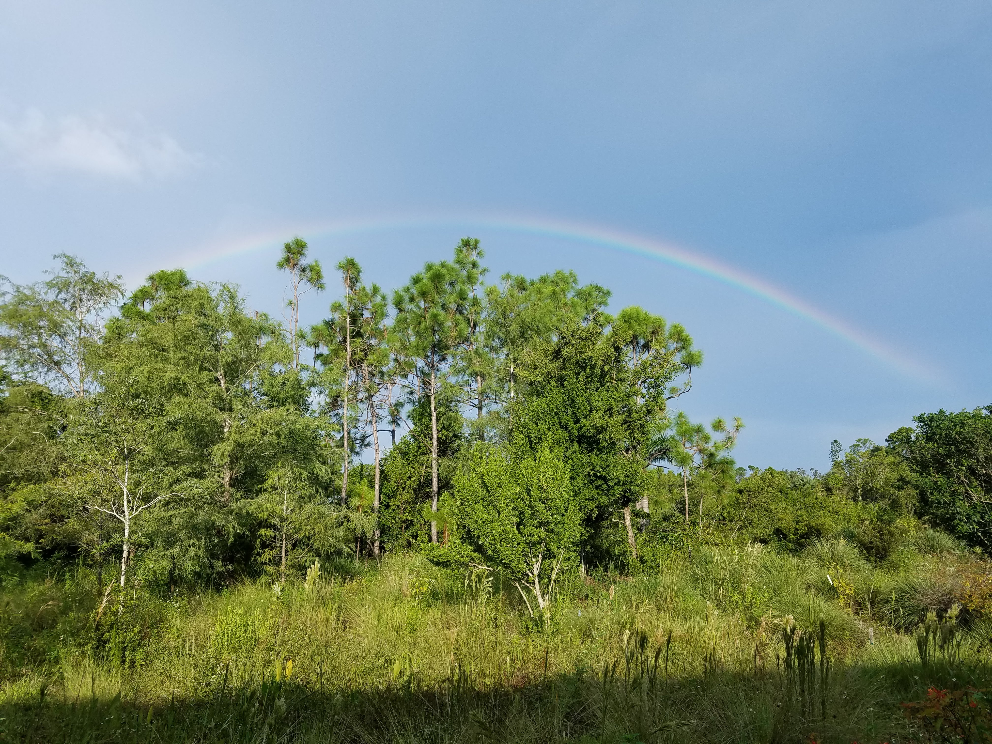
Notes:
By learning how to identify plants based on their shape, you’ll be able to appreciate the many different species of plant that grow around you. What at first glance may have been a wall of homogenous green can turn into an amazing display of diversity with just a closer look.
Better understanding leads to greater appreciation.
Image credit: Adrienne Lewis

Slide 17

Homework
Create your first ‘official’ nature journal page using this prompt:
If you were an inch tall, where in nature would you go and what would you see?
Post a picture of your journal page to Google Classroom and write a few sentences about your experience.
Notes:
For Homework:
Create your first ‘official’ journal page using the following prompt:
If you were an inch tall, where in nature would you go and what would you see?
Write about what you’d observe and how you’d feel to be tiny
Draw a scene from the perspective of a person only one inch tall

Slide 18
Class 2 Recap
Freeing your hand from your eye
Observing the World Around You
Using Lines and Shapes
Different Shapes = Different Plants
Homework Assignment
Notes:
Questions/Comments/Concerns
Don’t forget to bring your materials to the next class!
See you next Saturday ☺

