Slide 1
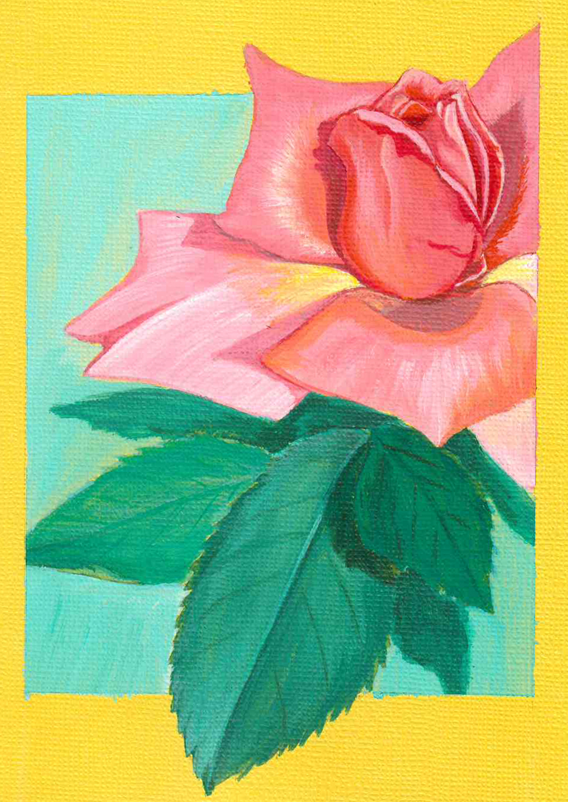
Introduction to
NATURE
JOURNALING
Connecting to nature through art and observation
Class 3:
Color Theory and Mixing
Notes:
Buckle up folks we’re about to get ARTSY

Slide 2
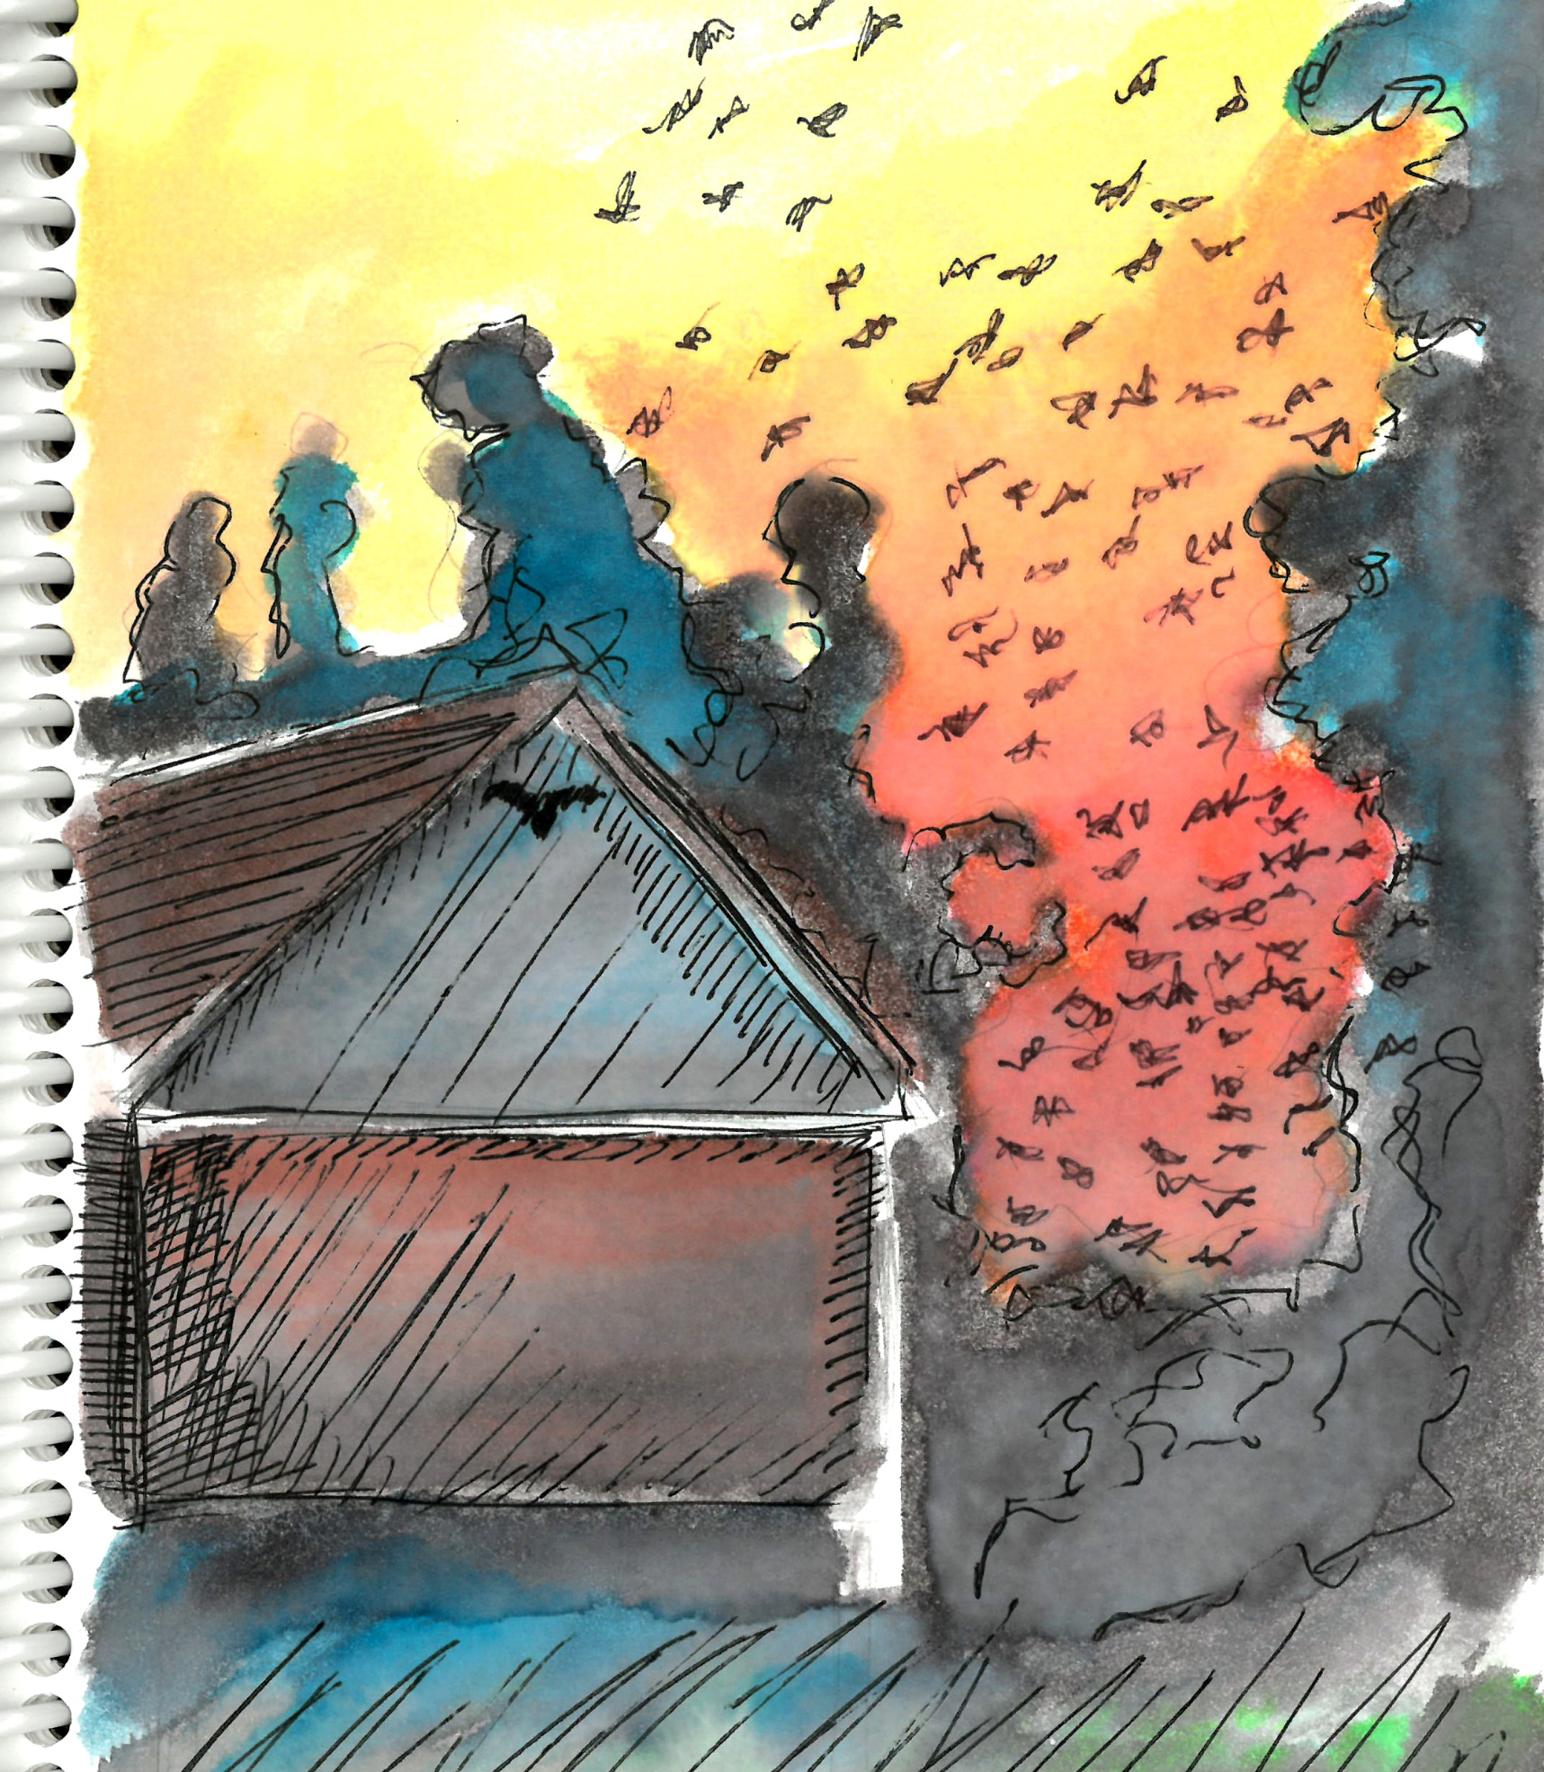
Class 3 Agenda
Warm-up Activity
Introduction to Color Theory
Color Mixing
Color in Nature
Homework Assignment

Slide 3
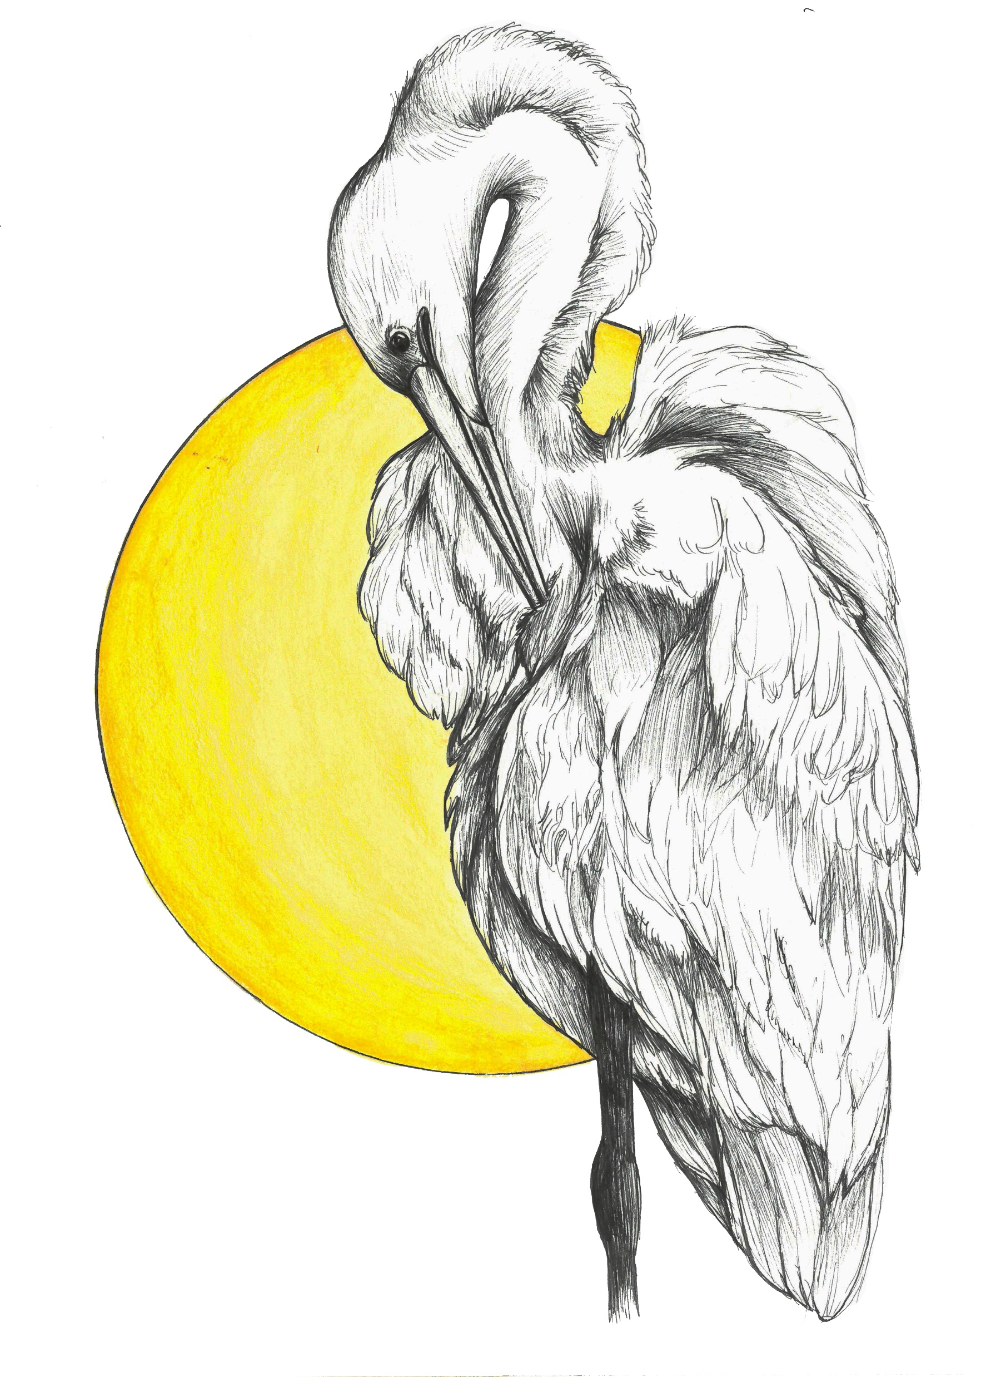
Warm-Up:
Color and Your Mood
Choose a color from your pencil set that reflects the mood you’re in today.
Draw or write the first thing that comes to mind when you think of the word nature.
Did your color have an affect on what you drew or wrote?
Notes:
Choose a color from your watercolor pencils that reflects the mood you’re in today, or choose one at random
Make a small drawing or write a few sentences of the first thing that comes to mind when you think of the word “nature”, using the color you chose
Choose two volunteers: Did your color have an affect on what you drew or wrote? Would a different color have had a different effect? Share your warm-up page and thoughts with other classmates (on Google Classroom if we don’t have time). If you want to discuss this warm-up further, come to the mid week meet up or log in early next class for social time.

Slide 4
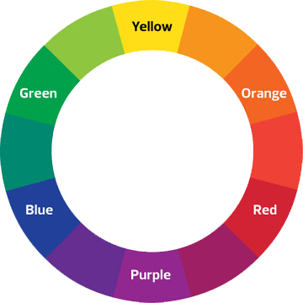
1
3
3
Introduction to
Color Theory
2
2
3
3
The color wheel is broken down into three main levels:
Primary Colors
Secondary Colors
Tertiary Colors
1
1
3
3
2
Notes:
Using a color wheel will help you understand color relationships. Understanding color relationships will help you choose which colors to mix, how to desaturate colors when needed, how to create color harmony in your work, and how to add a little spice/flair/drama.
Color wheel is broken down into three main levels: primary, secondary, tertiary
Primary: red, yellow, blue
Secondary: red+yellow = orange; yellow+blue = green, blue+red = purple
Tertiary: the in-between colors such as yellow-green, red-orange, or purple-blue
Next, we’re going to look at four of the most prevalent color relationships: complementary, analogous, monochromatic, and temperature.

Slide 5
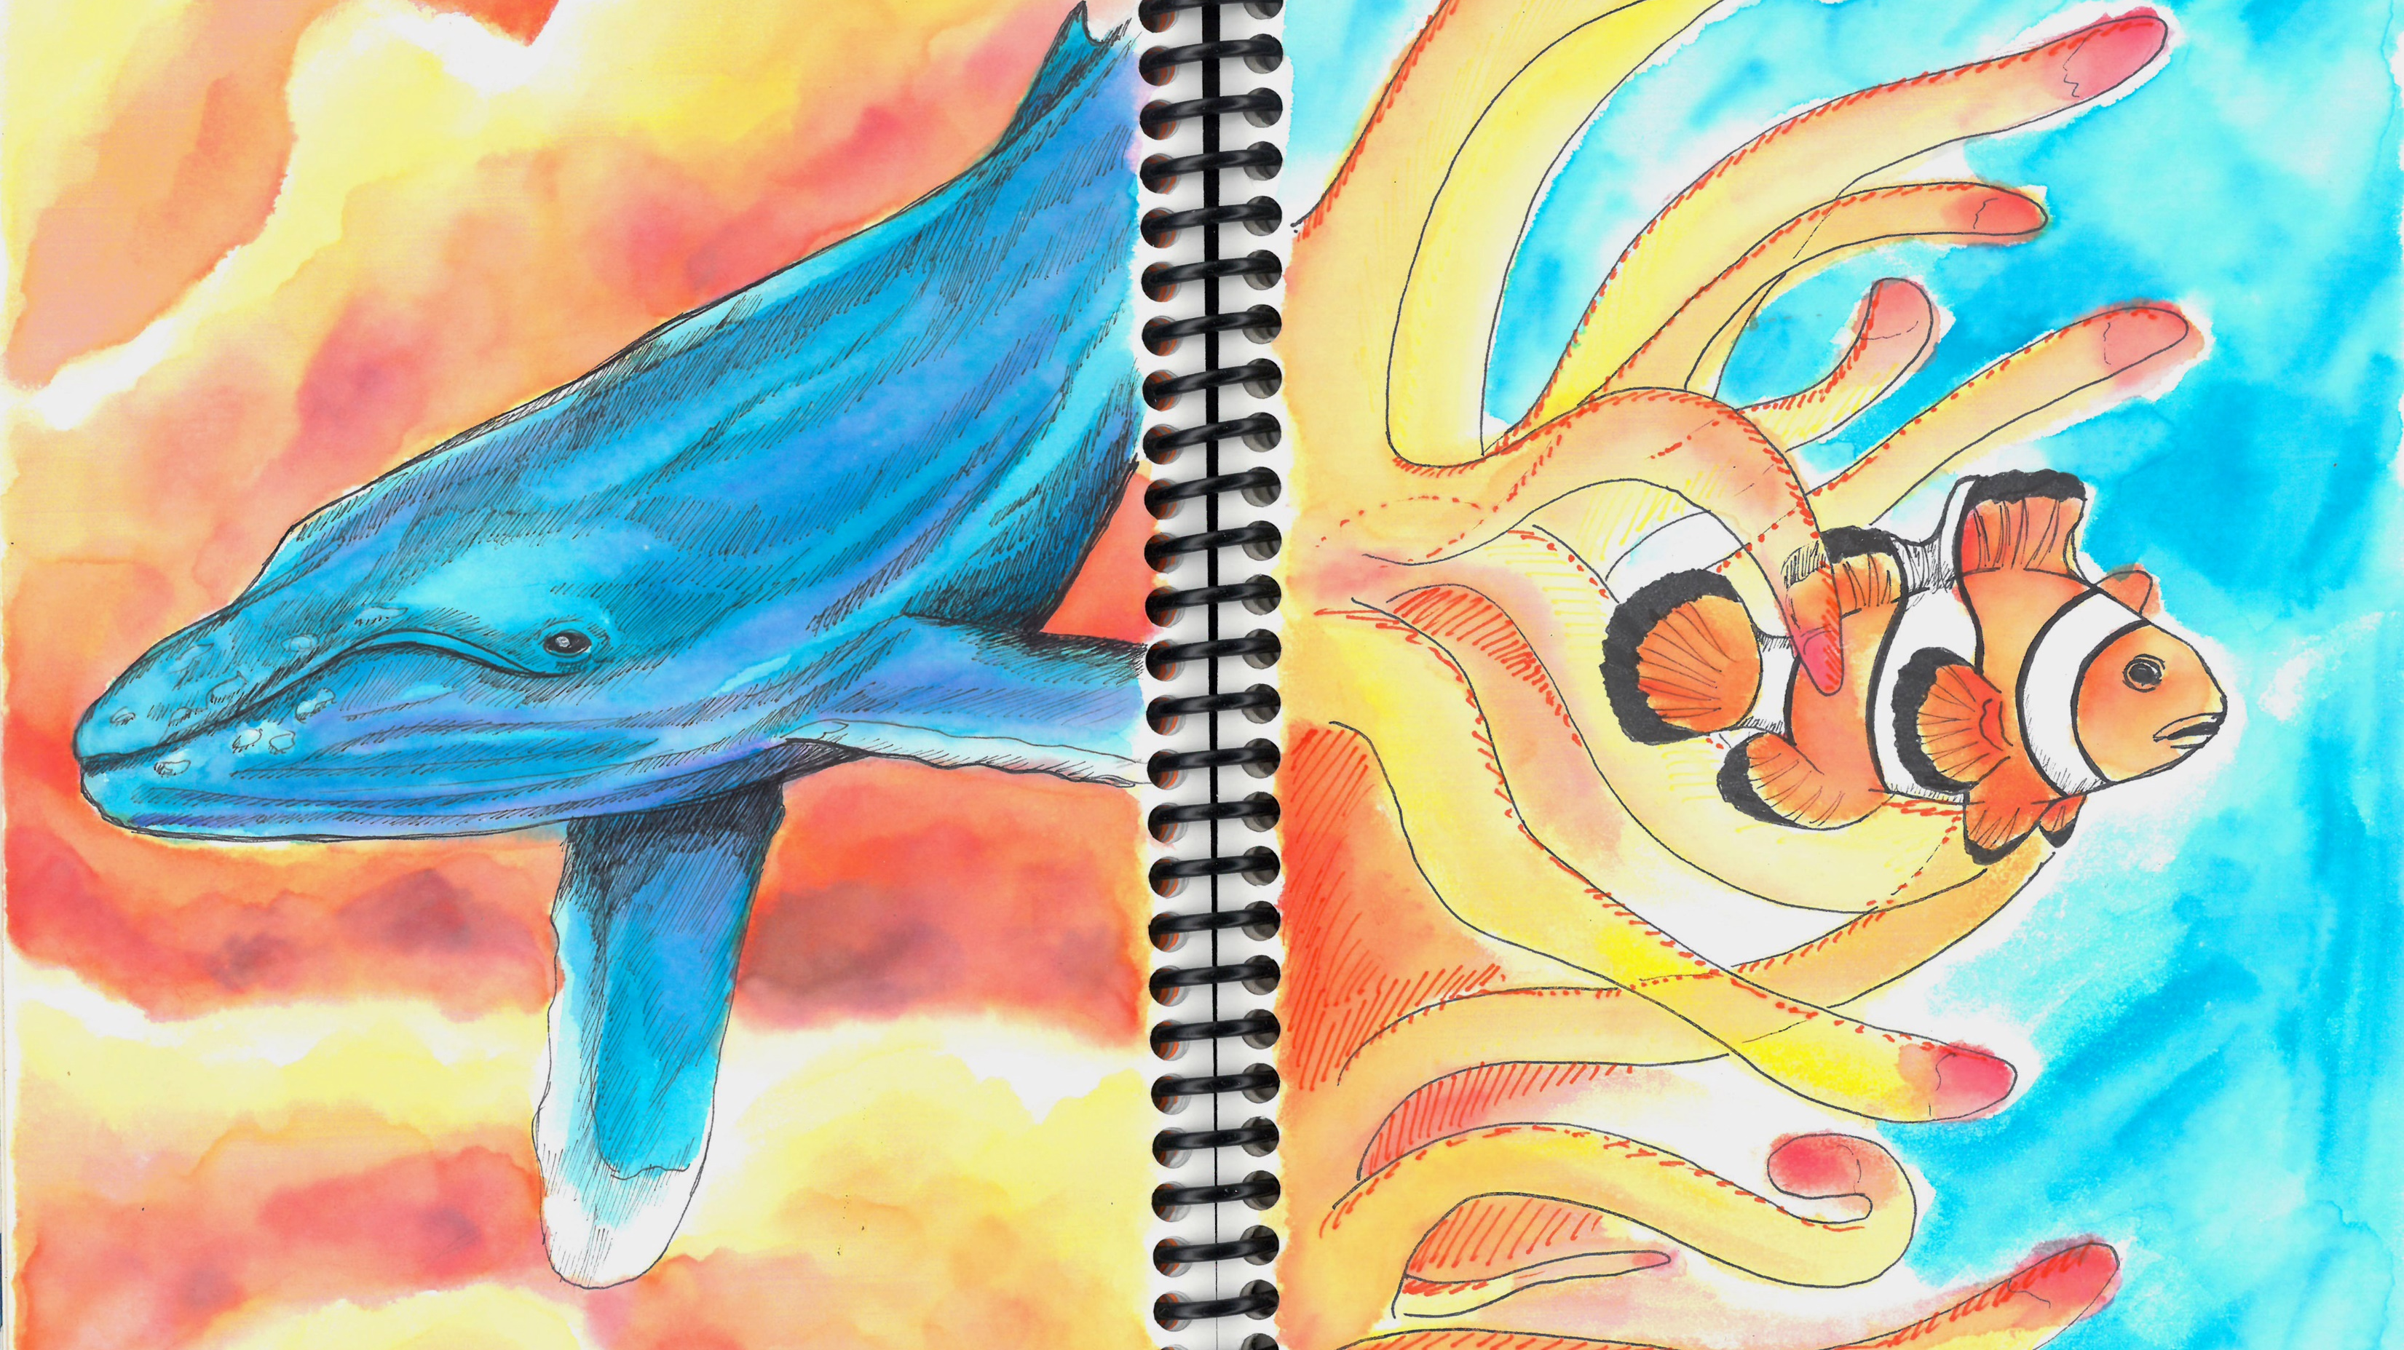
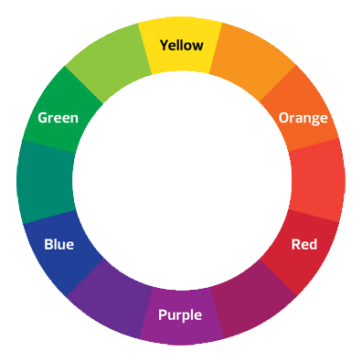
Complementary colors = colors that are opposite of each other on the color wheel
Analogous colors = three colors next to each other on the color wheel
Notes:
Complementary colors are two colors opposite of each other on the color wheel. They create visual drama.
Yellow and purple, blue and orange, red and green
You’ll find complimentary colors everywhere in advertising! Your favorite sports team likely uses complimentary colors in their color scheme.
Analogous colors are three colors next to each other on the color wheel. They create color harmony and are often what you’d see in nature.
Always let one color dominate, and use its analogous colors to create depth
Where do you see the use of complimentary and analogous colors in these journal pages? What effect does it have on how you view these images?

Slide 6
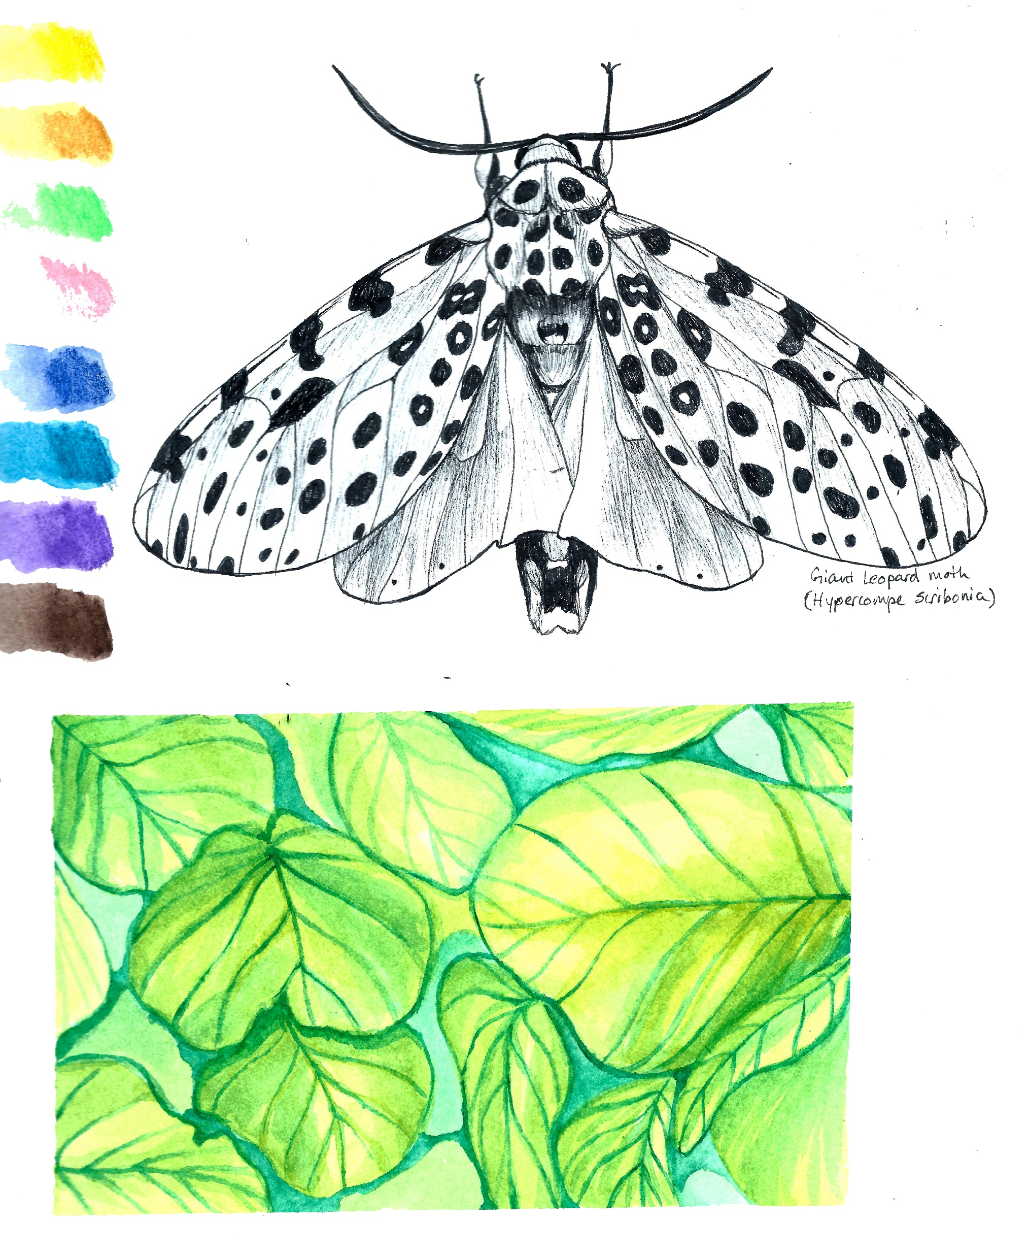
Monochromatic = containing or using only one color
Notes:
Monochrome means one color, so in relation to art, a monochrome artwork is one that includes only one color.
You can use the full range of value from one color to create depth in a monochromatic artwork.
Adding more pigment will give you a darker hue, while adding more water will give you a lighter hue.
Why use a monochromatic color scheme? The use of monochrome can reduce a painting to its simplest form so that the focus of the artwork is on the pure physical elements of form and texture. It is also a great way to practice using the different values of a color.

Slide 7
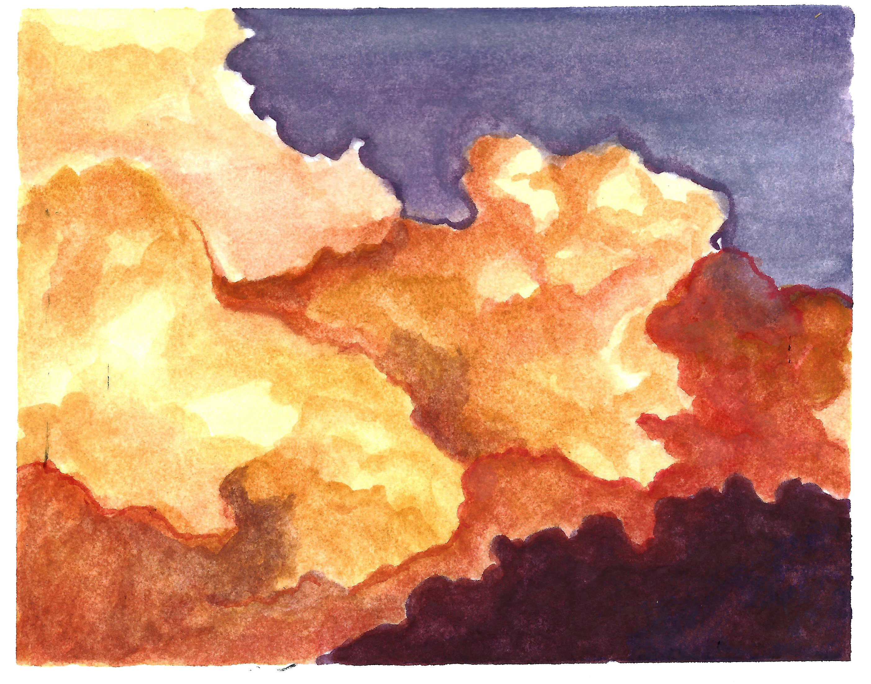
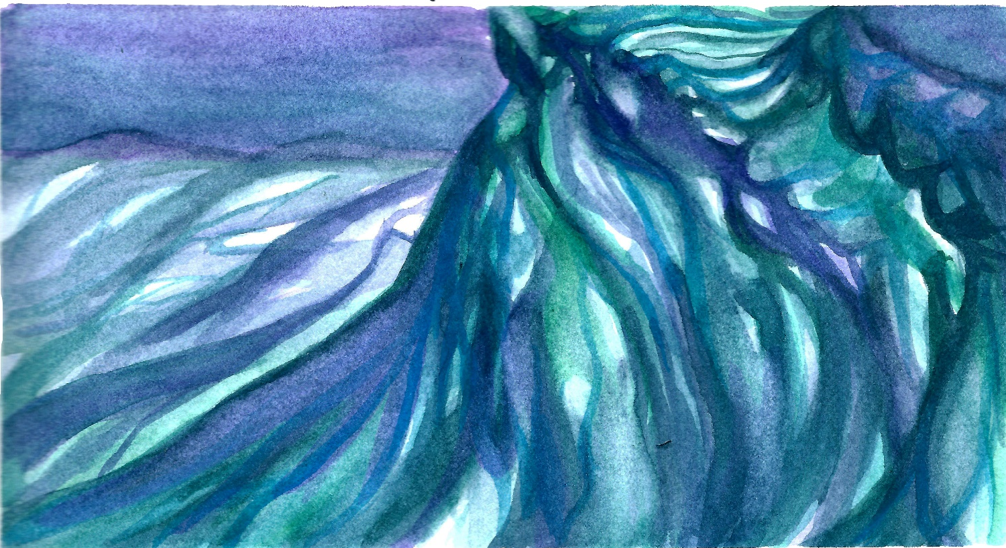
Color temperature= the categorization of colors as warm or cool
Warm color = using reds, yellows, and oranges.
Cool color = using blues, greens, and purples.
Notes:
Color temperature refers to the level of warmth contained within a color. Colors can be categorized as warm or cool. Warm and cool colors will contrast well with each other.
Warm color = using reds, yellows, and oranges to evoke warmth because these colors remind us of things like the sun, fire, or daytime.
Cool color = using blues, greens, and purples (violet) to evoke a cool feeling because they remind us of things like water, grass, or nighttime.

Slide 8
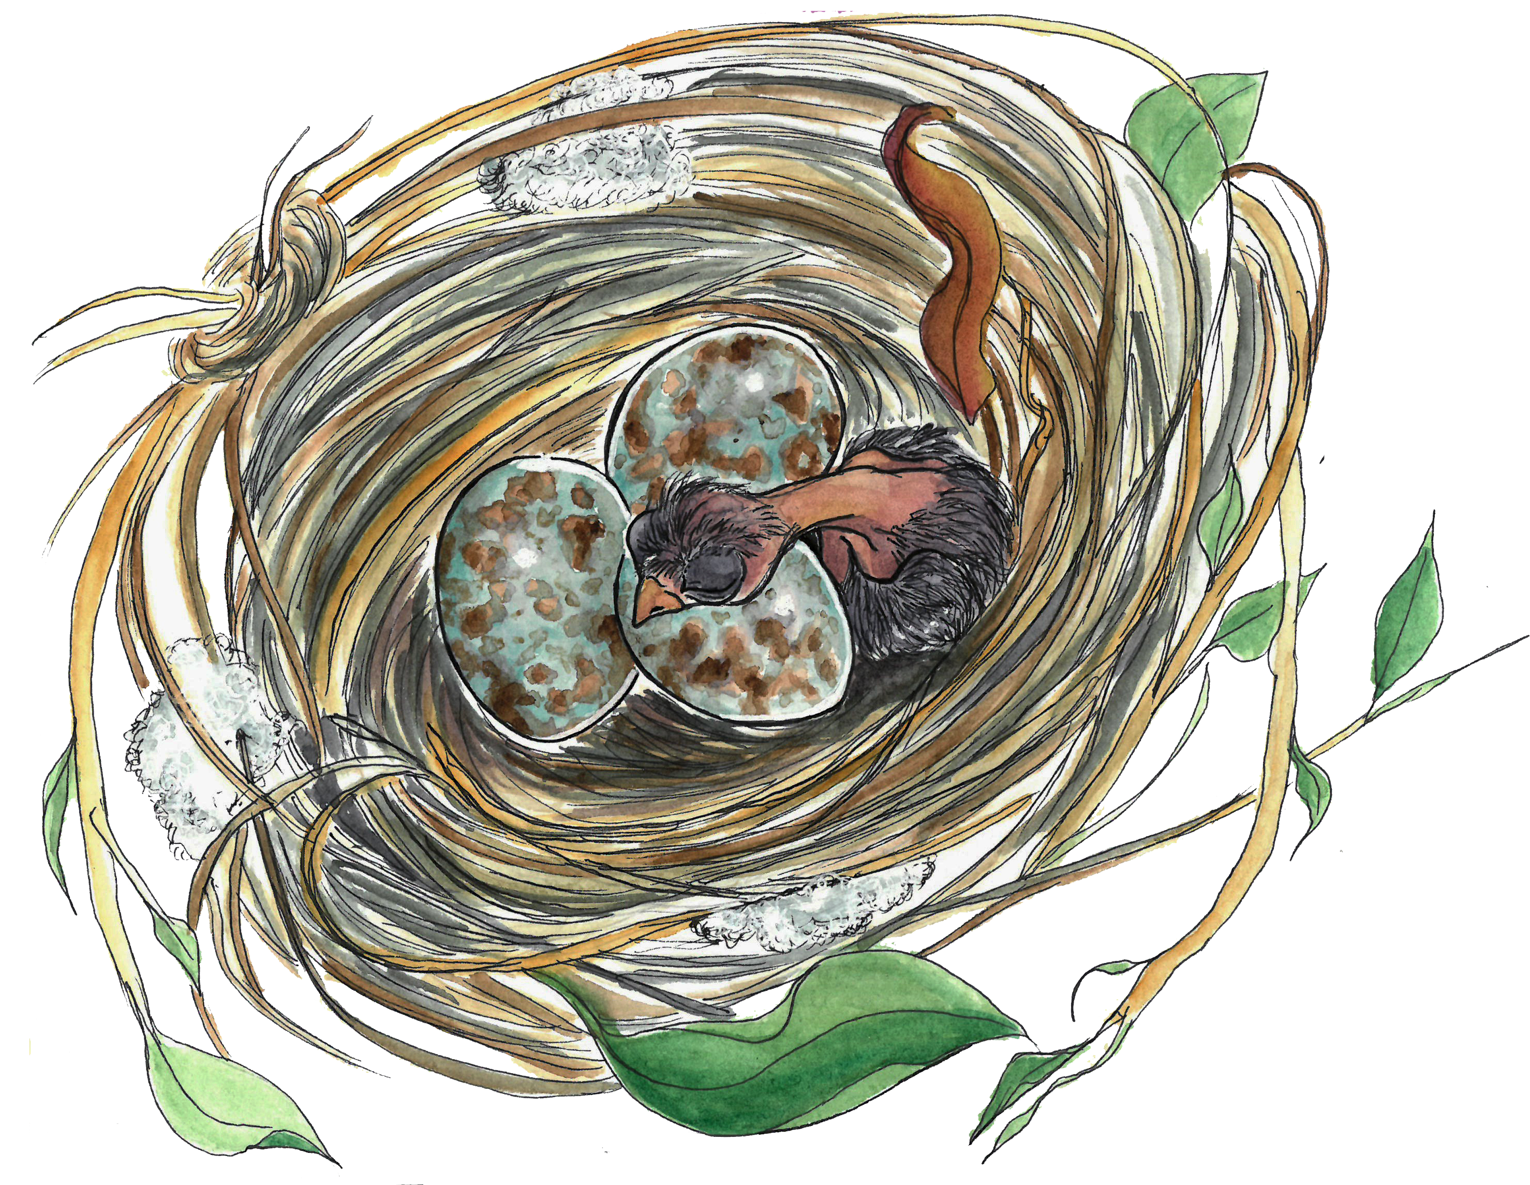
Color Mixing Demo
Notes:
Color mixing tips:
Start with a base color. With watercolor pencils, a good way to mix is to start dry, build up color, and then add a little water at a time. Remember that watercolor pencils dry quickly, so you need to blend fast once you start adding water.
Keep in mind the ‘temperature’ of the color – adding greens, blues, and purples will make a color ‘cooler’, while adding reds, yellows, and oranges will make a color ‘warmer’
Mixing complimentary colors is a great way to create de-saturated values. This is useful for colors that may seem too vibrant right out of the box.
Don’t add black! Try to darken your colors by adding browns, blues, or purples to your base. If you want to add black, remember that a little goes a long way!
If you want lighter colors, add more water.
When working with watercolor pencils, it’s always a good idea to start light and build up to dark. You can always come back to add more layers of color, but it’s harder to take color away once you’ve put it down.

Slide 9
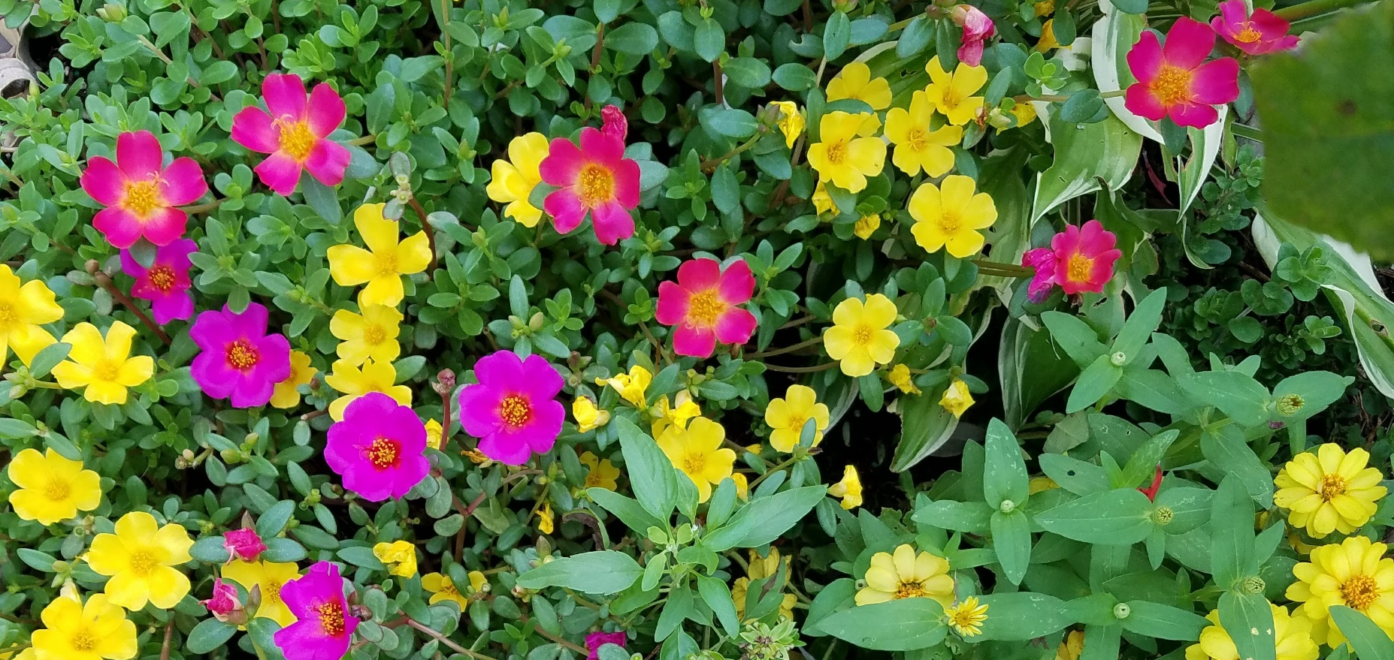
Color in Nature
Notes:
Color helps plants and animals survive in the wild in three major ways: by aiding in reproduction, hiding from predators, and acting as a warning for defense.
Pollination/Reproduction
Different colors attract different pollinators.
Bats: dull white, green, or purple; Bees: bright white, yellow, blue, or UV; Beetles: dull white or green; Birds: scarlet, orange, red, or white.
Many insect pollinated flowers also have markings on their petals called nectar guides that lead the insect straight to the flower’s nectar and pollen.
All three of these flowers are bee pollinated, but only two of them have visible nectar guides.
Camouflage
A plant’s or animal’s best defense against getting eating is to disappear.
Green anoles can change the shade of their skin to match their surrounding environment so they can blend into the background.
A monk orchid’s mottled pattern make them hard to spot against the forest floor, and even deters herbivorous insects from snacking on the leaves.
Just like anoles, tree frogs range in color from green to gray based on where they live. This makes them almost invisible to hungry predators, especially when they flatten themselves against a surface and lie very still.
Defense
Color in nature can also act as a warning to stay away.
Bright reds and oranges are usually indicators that something is poisonous.
Atala butterflies eat the poisonous coontie plant (Zamia integrifolia) when they are caterpillars. The poison they ingest stays in their tissues throughout metamorphosis and carries over into adulthood. Their bright orange color warns potential predators that these caterpillars and butterflies are a deadly last meal.
Plants use the same colorful tricks to keep animals away. Coffee berries are bright red to scare away mammals and to attract birds. While we may enjoy a nice cup of joe, caffeine is poisonous to other mammals and the bright red of coffee berries keeps them far away from the plant.

Slide 10
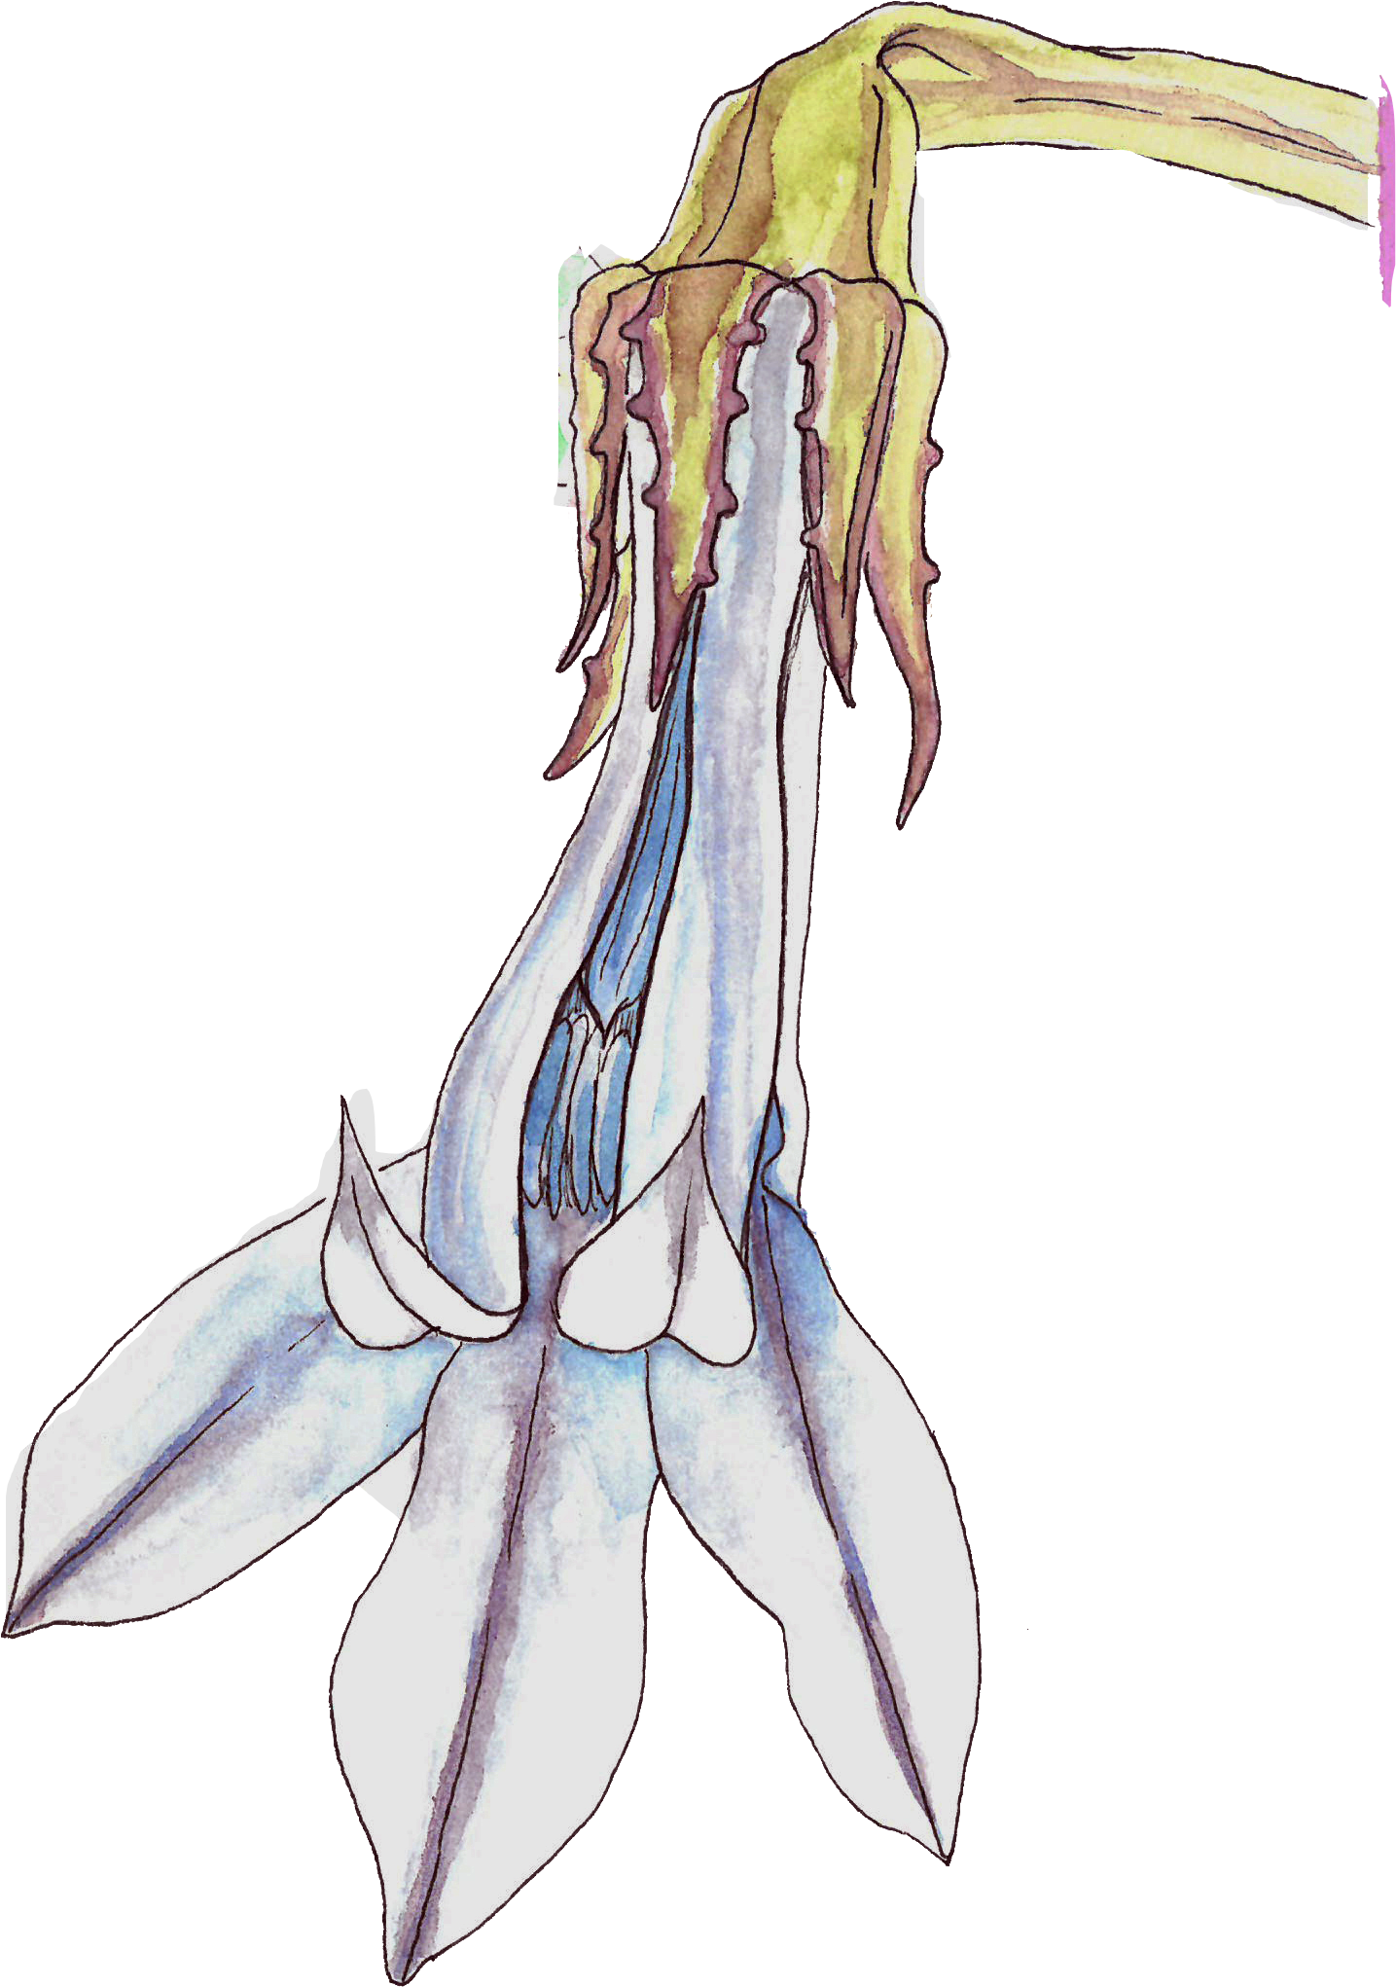
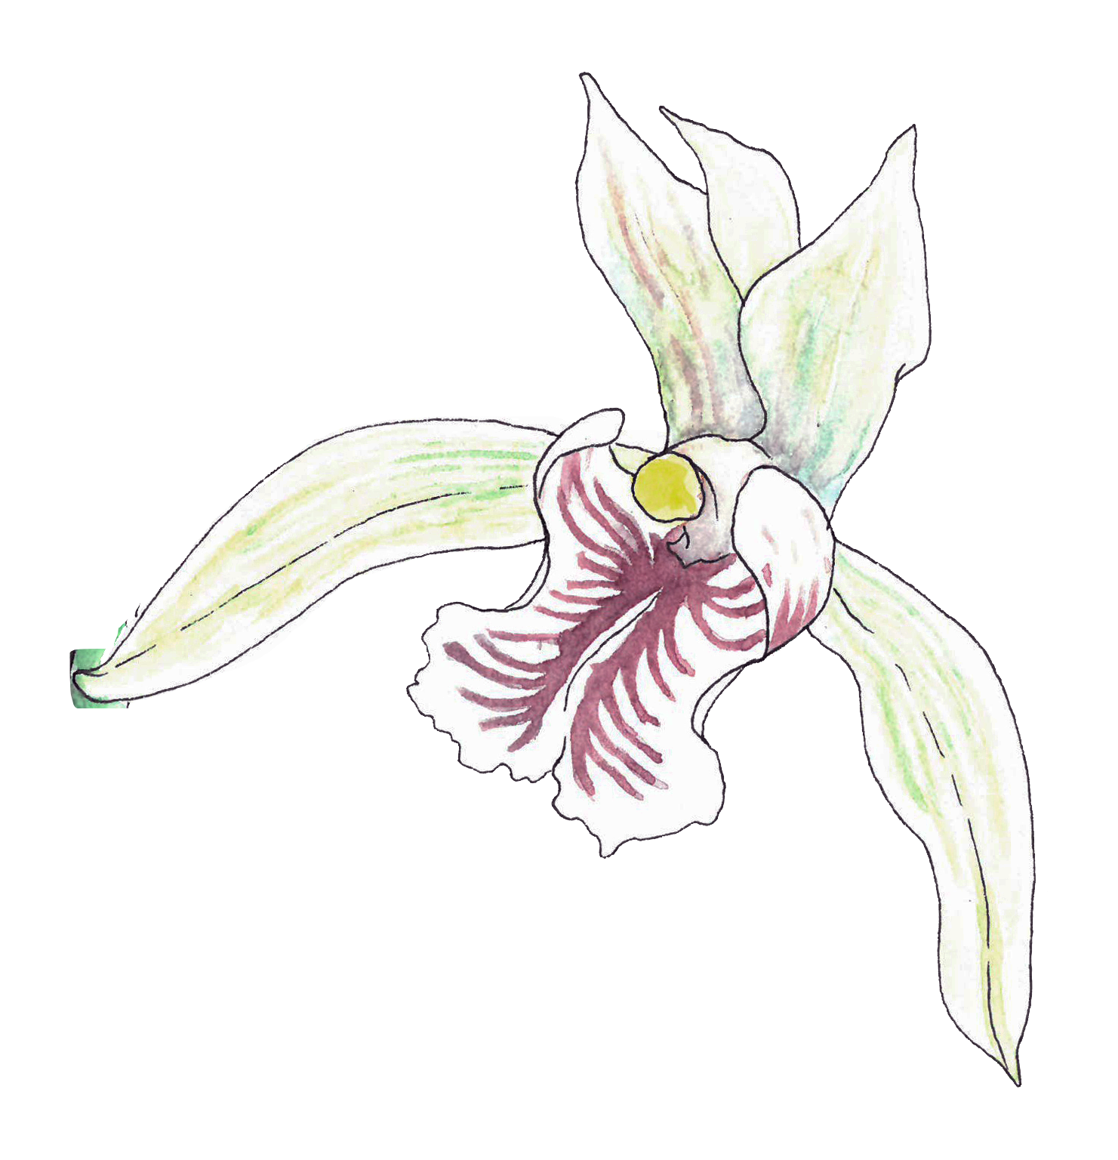
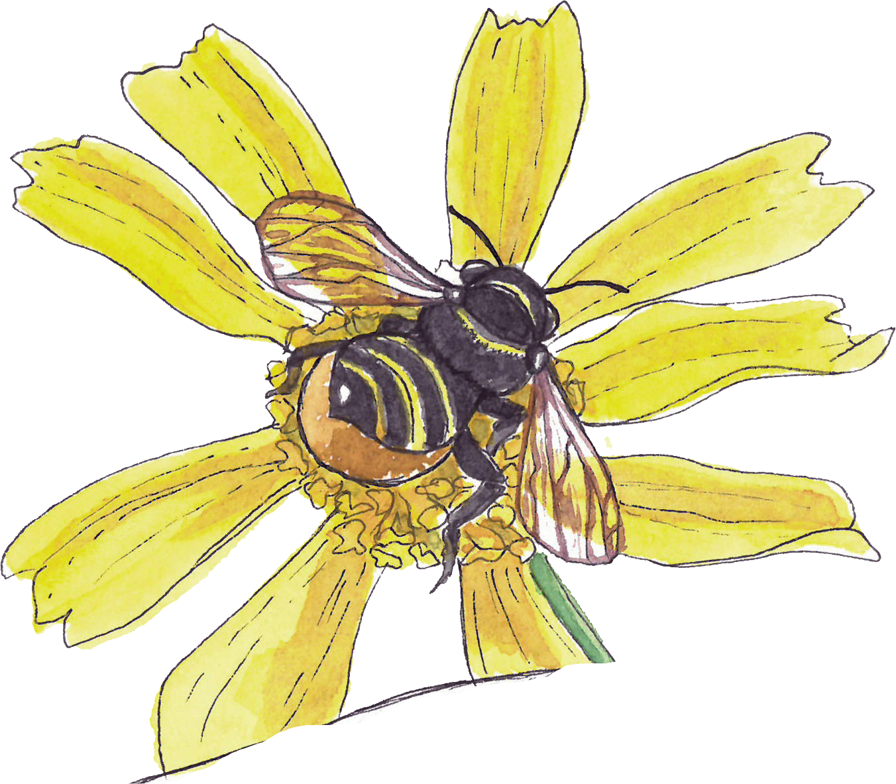
Pollination
Notes:
Color helps plants and animals survive in the wild in three major ways: by aiding in reproduction, hiding from predators, and acting as a warning for defense.
Pollination/Reproduction
Different colors attract different pollinators.
Bats: dull white, green, or purple; Bees: bright white, yellow, blue, or UV; Beetles: dull white or green; Birds: scarlet, orange, red, or white.
Many insect pollinated flowers also have markings on their petals called nectar guides that lead the insect straight to the flower’s nectar and pollen.
All three of these flowers are bee pollinated, but only two of them have visible nectar guides.

Slide 11
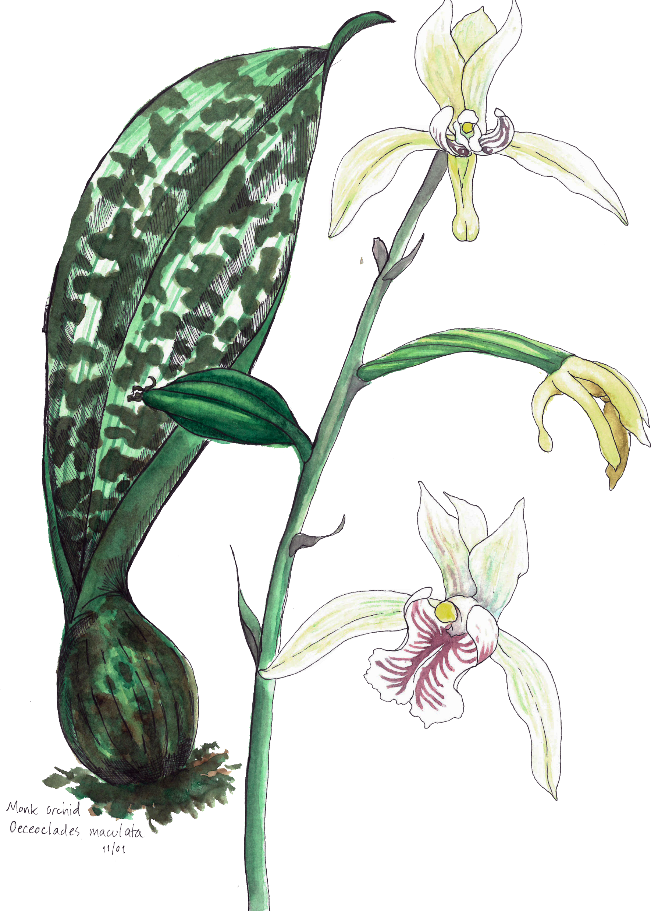
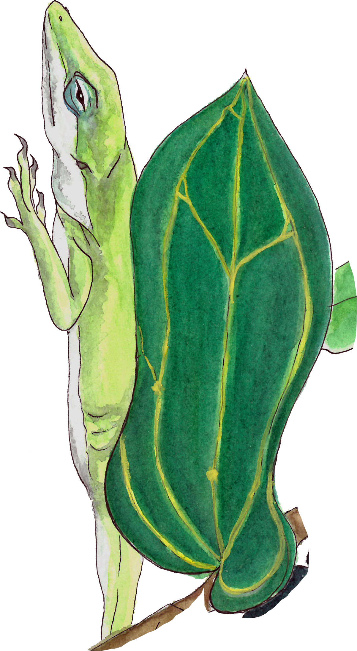
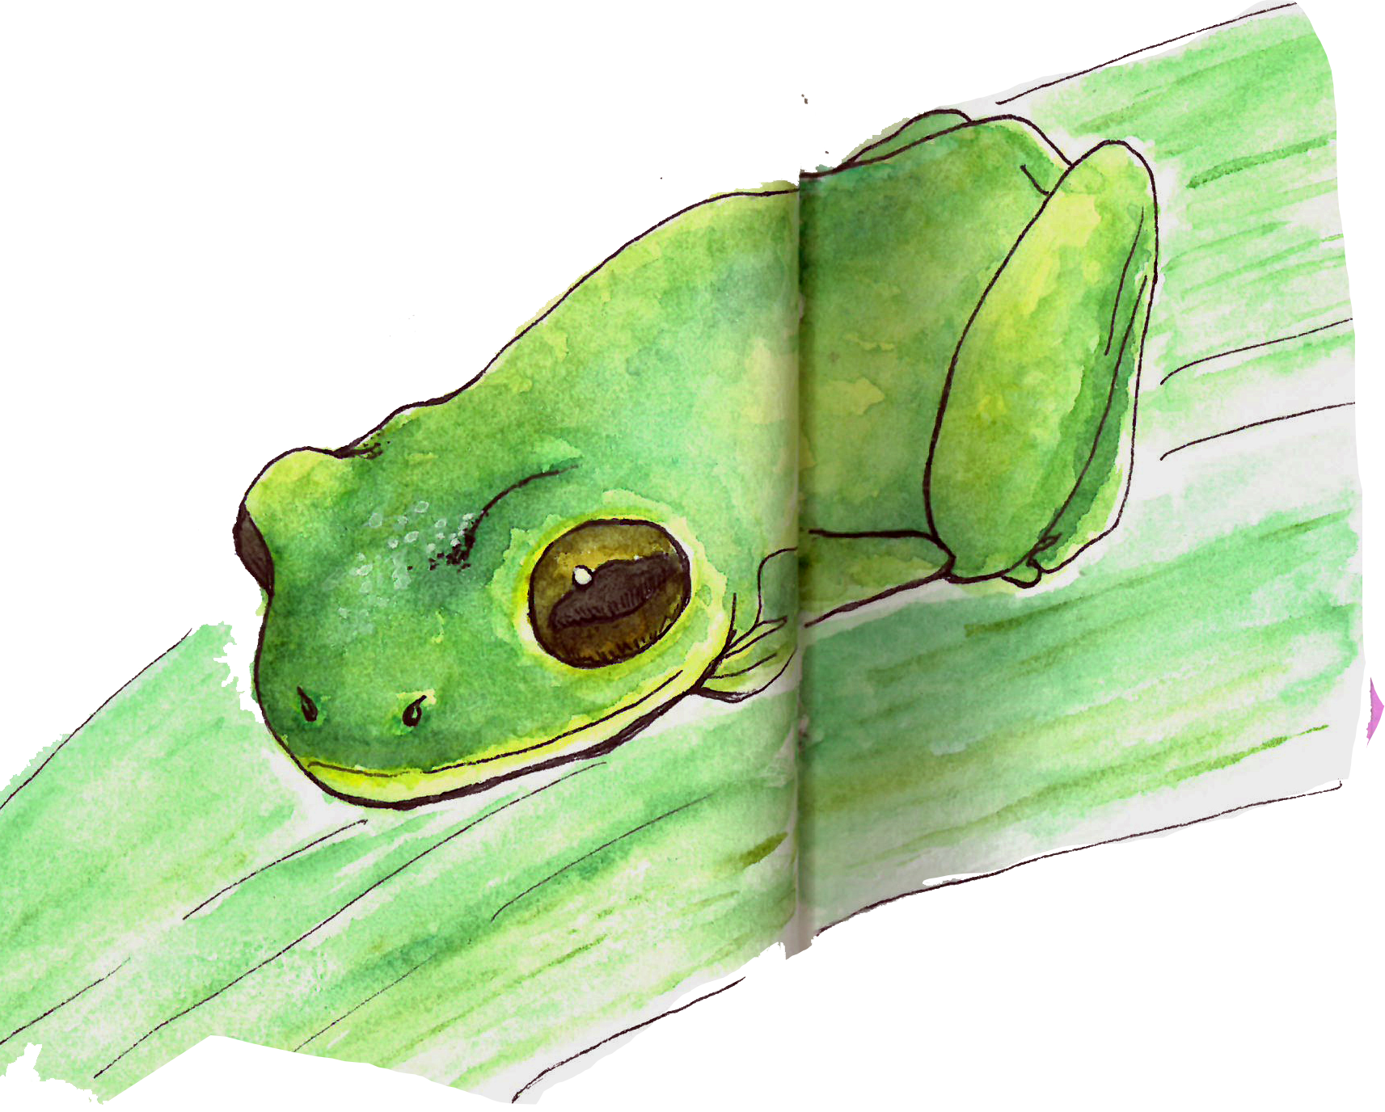
Camouflage
Notes:
Color helps plants and animals survive in the wild in three major ways: by aiding in reproduction, hiding from predators, and acting as a warning for defense.
Camouflage
A plant’s or animal’s best defense against getting eating is to disappear.
Green anoles can change the shade of their skin to match their surrounding environment so they can blend into the background.
A monk orchid’s mottled pattern make them hard to spot against the forest floor, and even deters herbivorous insects from snacking on the leaves.
Just like anoles, tree frogs range in color from green to gray based on where they live. This makes them almost invisible to hungry predators, especially when they flatten themselves against a surface and lie very still.

Slide 12
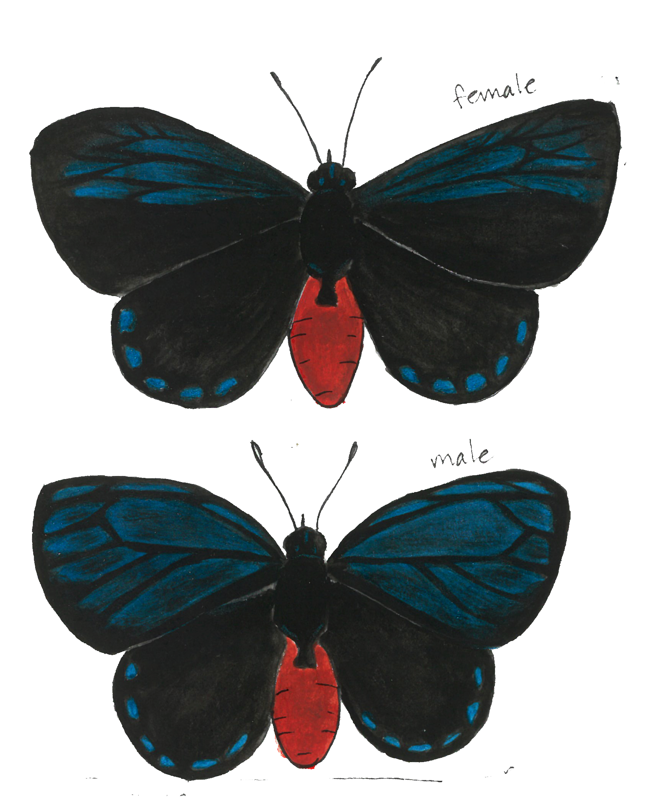
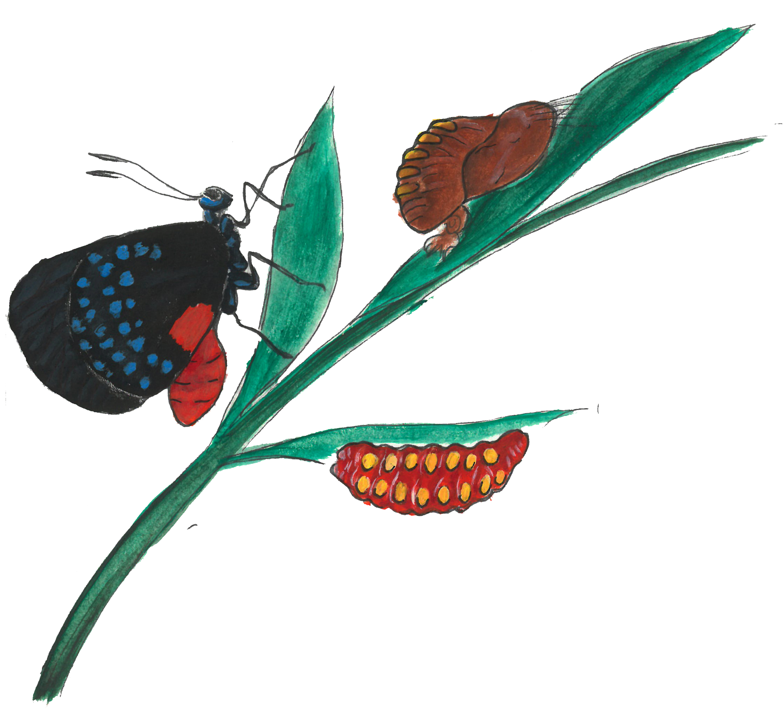
Defense
Notes:
Color helps plants and animals survive in the wild in three major ways: by aiding in reproduction, hiding from predators, and acting as a warning for defense.
Defense
Color in nature can also act as a warning to stay away.
Bright reds and oranges are usually indicators that something is poisonous.
Atala butterflies eat the poisonous coontie plant (Zamia integrifolia) when they are caterpillars. The poison they ingest stays in their tissues throughout metamorphosis and carries over into adulthood. Their bright orange color warns potential predators that these caterpillars and butterflies are a deadly last meal.
Plants use the same colorful tricks to keep animals away. Coffee berries are bright red to scare away mammals and to attract birds. While we may enjoy a nice cup of joe, caffeine is poisonous to other mammals and the bright red of coffee berries keeps them far away from the plant.

Slide 13
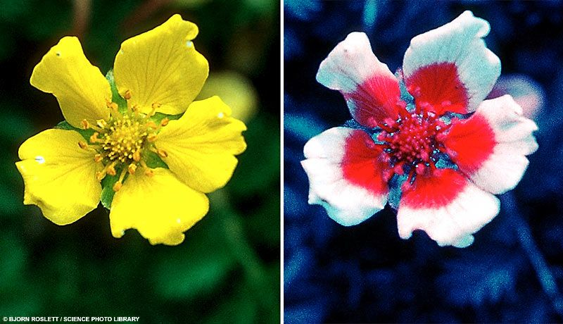
Notes:
Bee Vision!
In many bee-pollinated flowers there is a region of low ultraviolet reflectance near the center of each petal. Bees can see this contrasting ultraviolet pattern, which helps guide them to the center of the flower.
Photo credit:
Bjorn Roslett / Science Photo Library
PBS

Slide 14
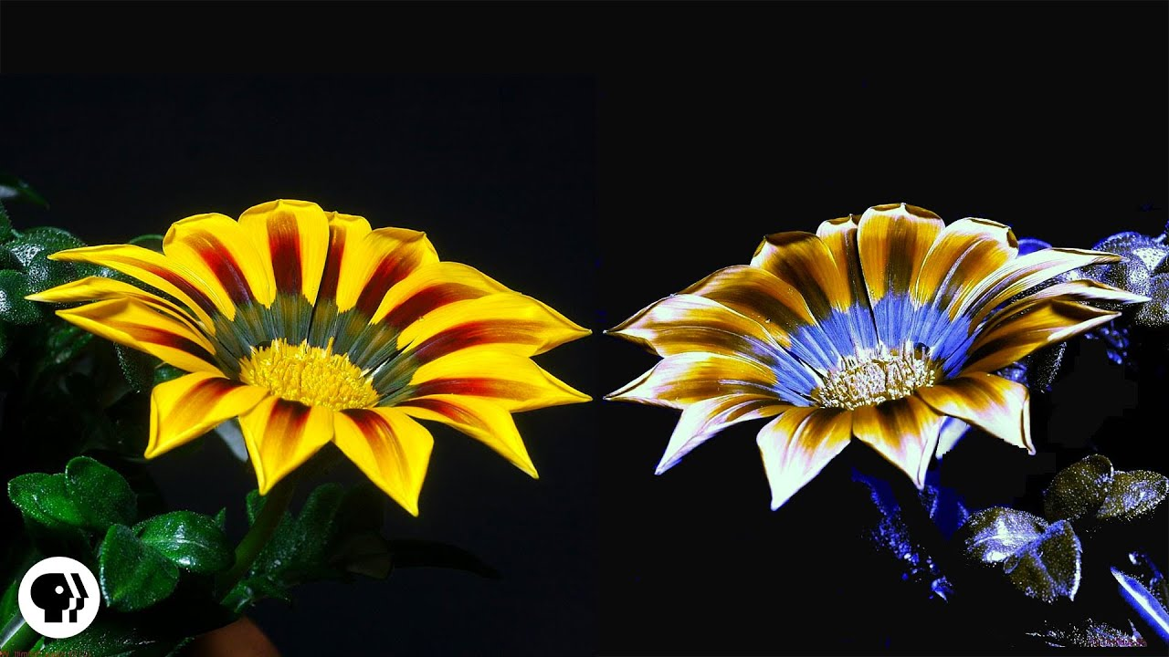
Notes:
Bee Vision!
In many bee-pollinated flowers there is a region of low ultraviolet reflectance near the center of each petal. Bees can see this contrasting ultraviolet pattern, which helps guide them to the center of the flower.
Photo credit:
Bjorn Roslett / Science Photo Library
PBS

Slide 15
Homework
Practice using what you learned today about color theory:
Make your own color wheel.
Choose two complimentary colors from your color wheel.
Draw a simple object using only the two colors you chose.
Write about your experience.
Notes:
For Homework:
Make your own color wheel using your watercolor pencils. Choose two complimentary colors from the wheel your pencil kit. Draw a simple object (such as a flower, leaf, or fruit) using only the two colors you chose.
Writing prompt: observe something in nature for 5 minutes and write three short bullet points or sentences about what you observed.
Try to answer these questions: How many colors can you identify? Do the colors blend or are there sharp contrasts? What do the colors remind you of?

Slide 16
Class 3 Recap
Connecting color to how you feel
Introduction to Color Theory
Color Mixing
Color in Nature
Homework Assignment

