Slide 1
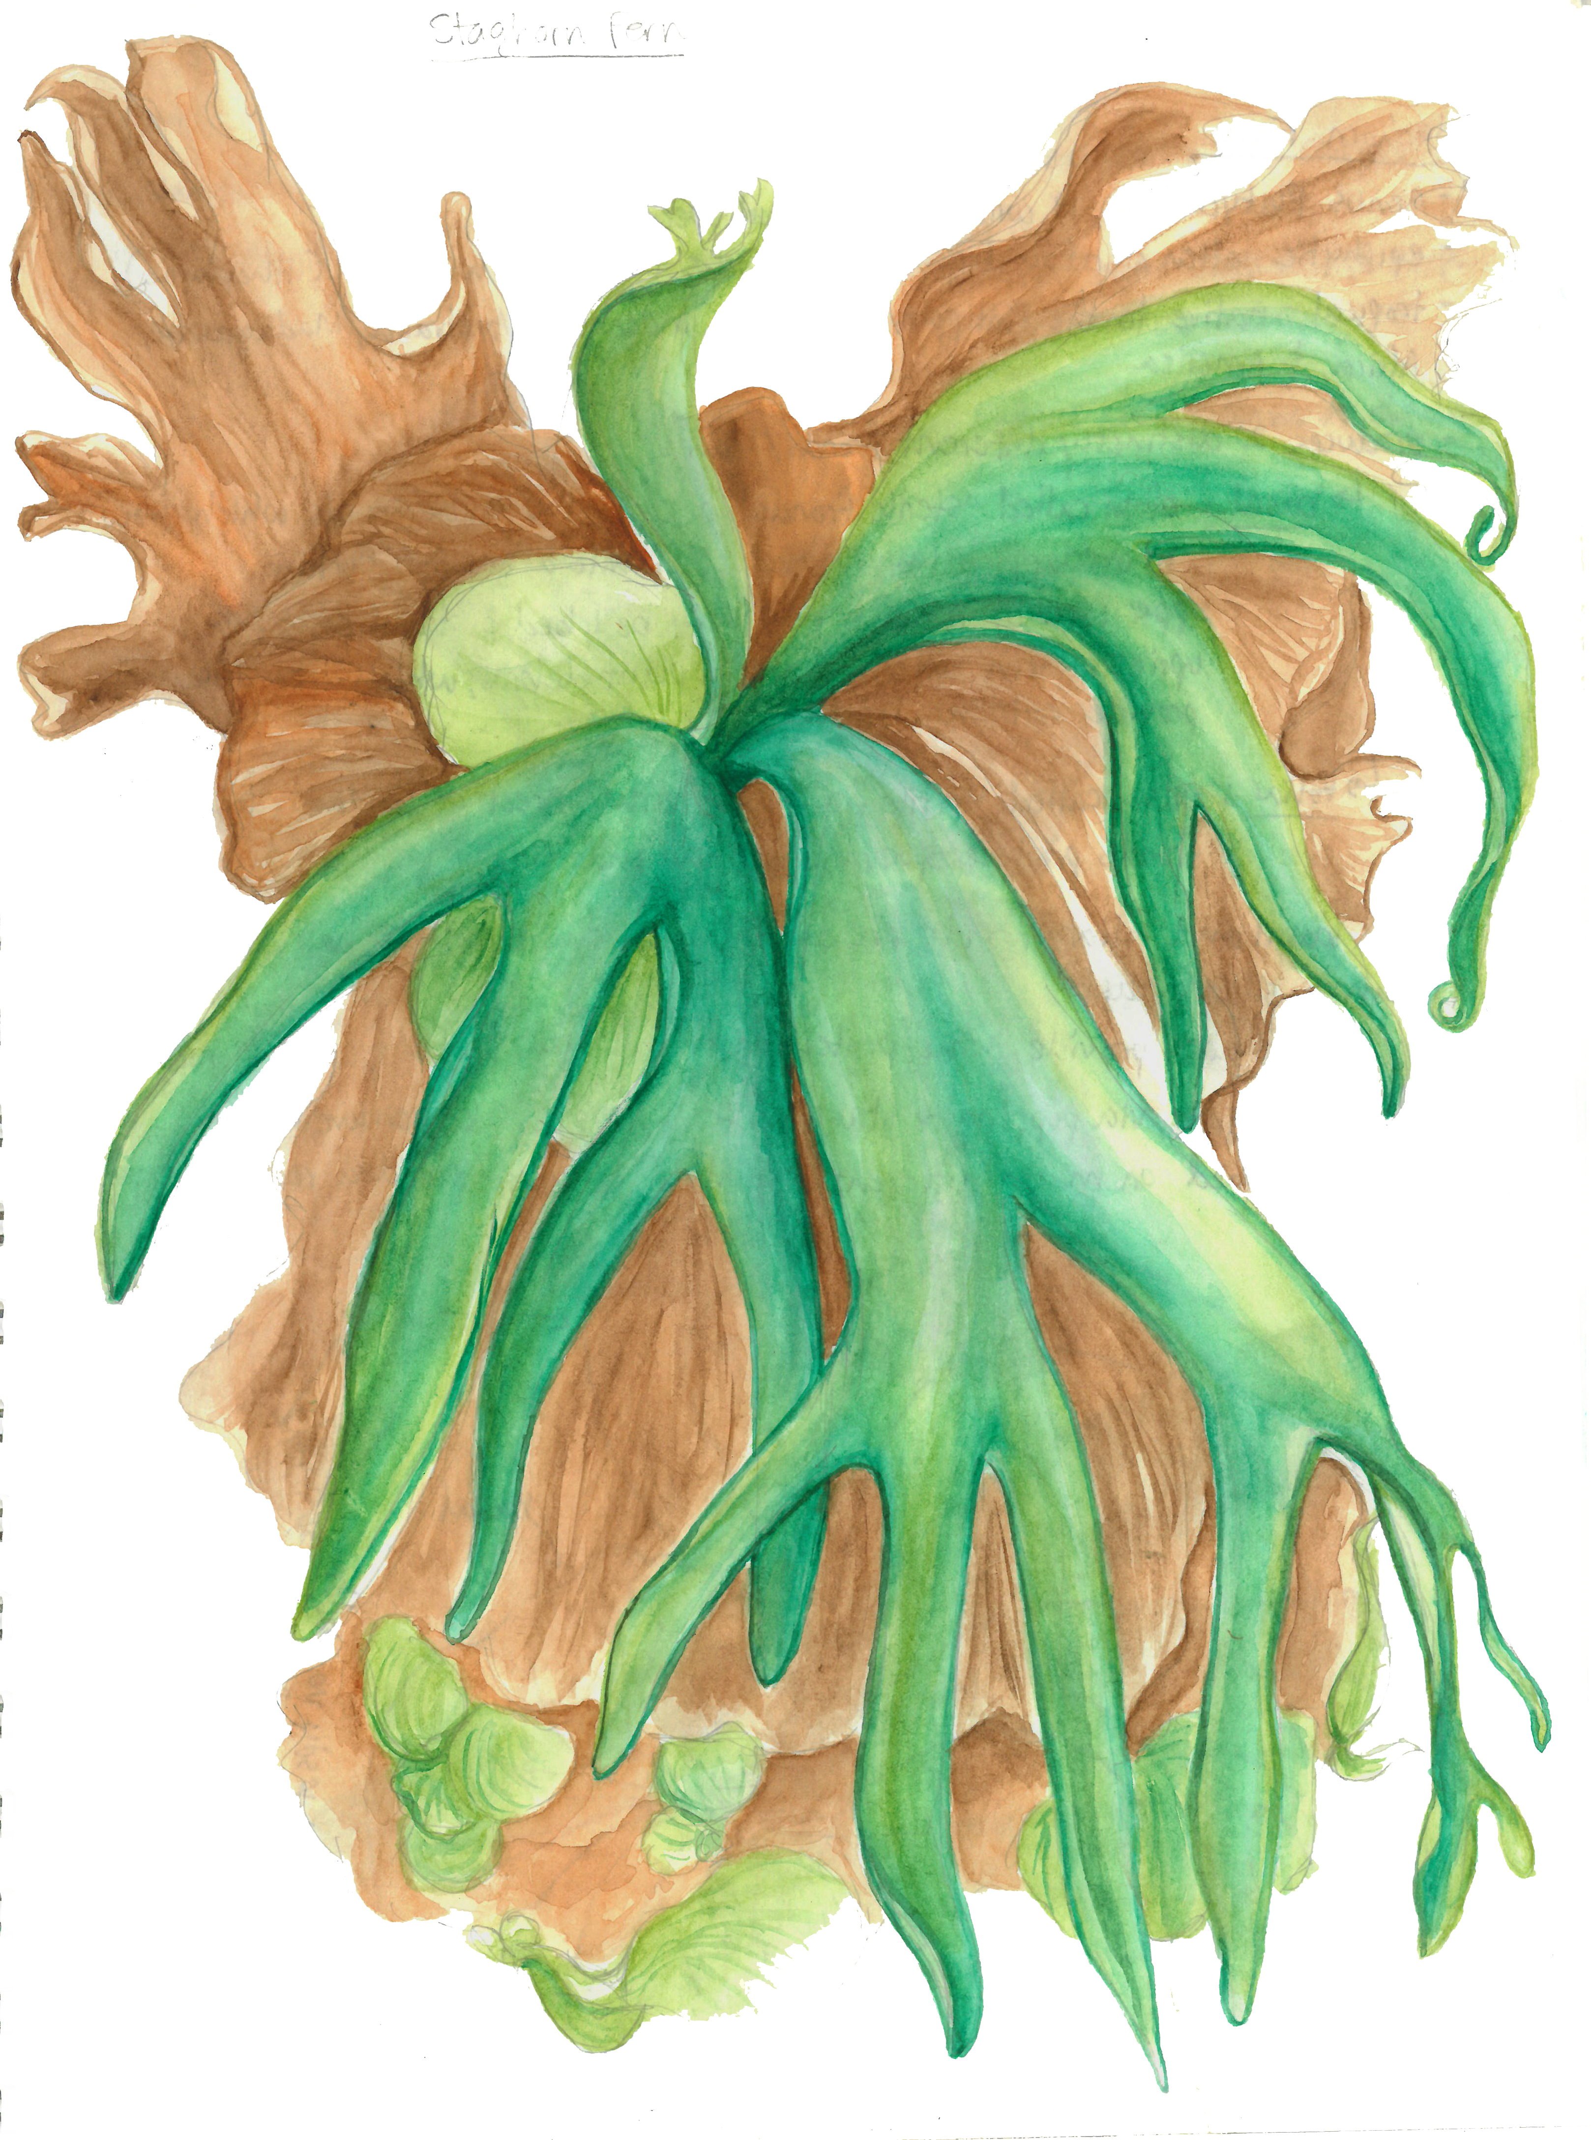
Introduction to
NATURE
JOURNALING
Connecting to nature through art and observation
Class 4:
Creating Form
And Depth
Notes:
Buckle up folks we’re about to get ARTSY

Slide 2
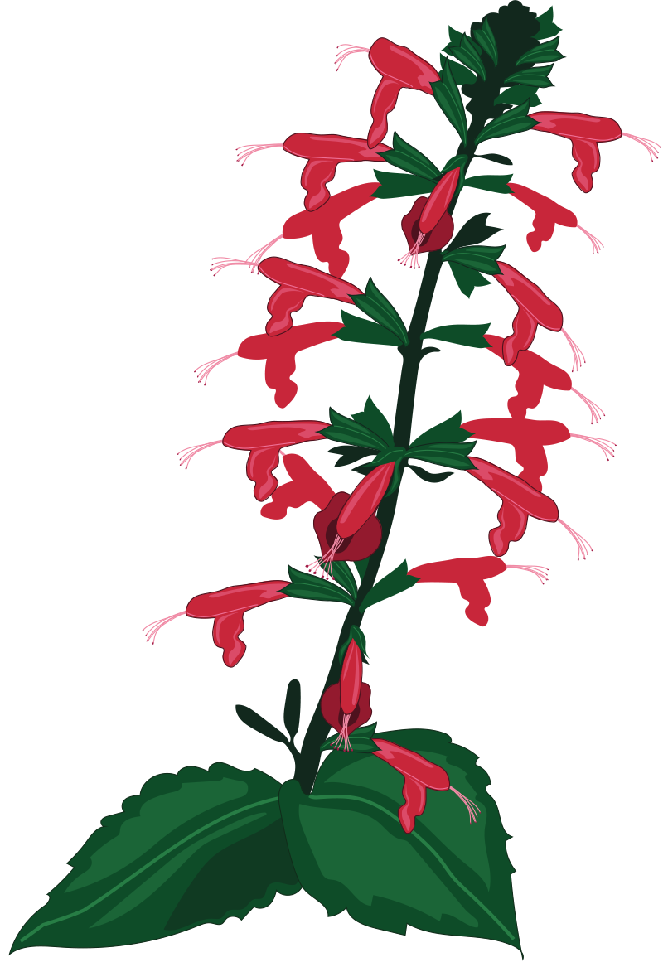
Class 4 Agenda
Getting started with your Final Piece
Value and Form
Finding Your Light Source
Adding Depth
Demo: Value of a Tomato
Homework Assignment

Slide 3
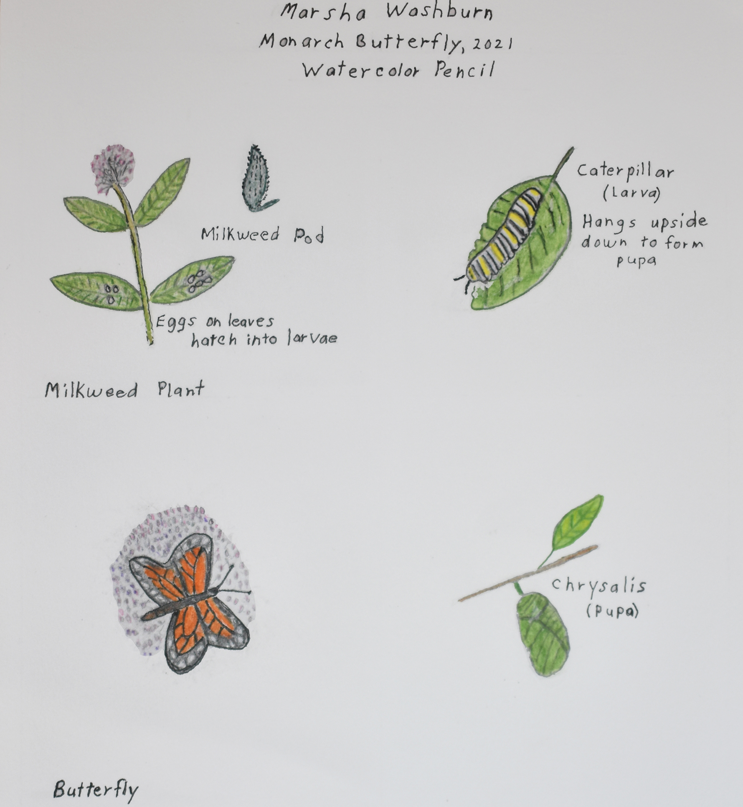
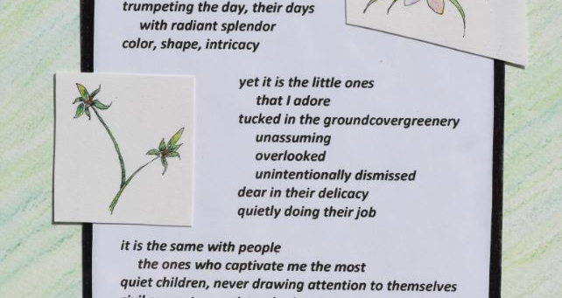
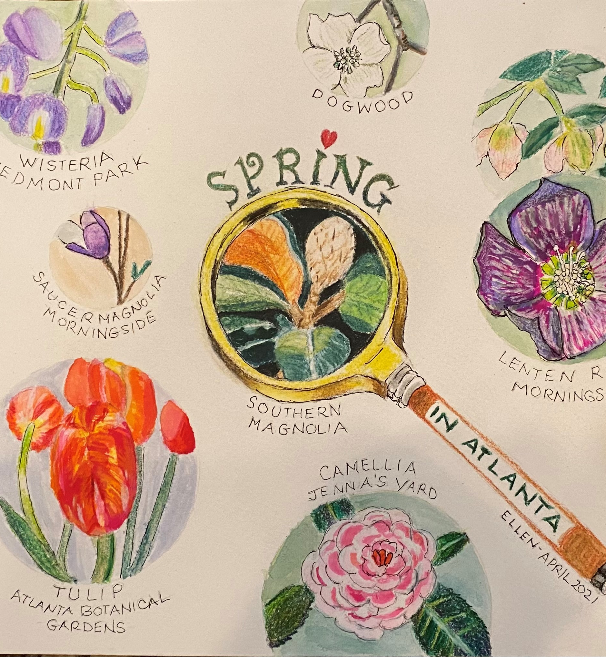
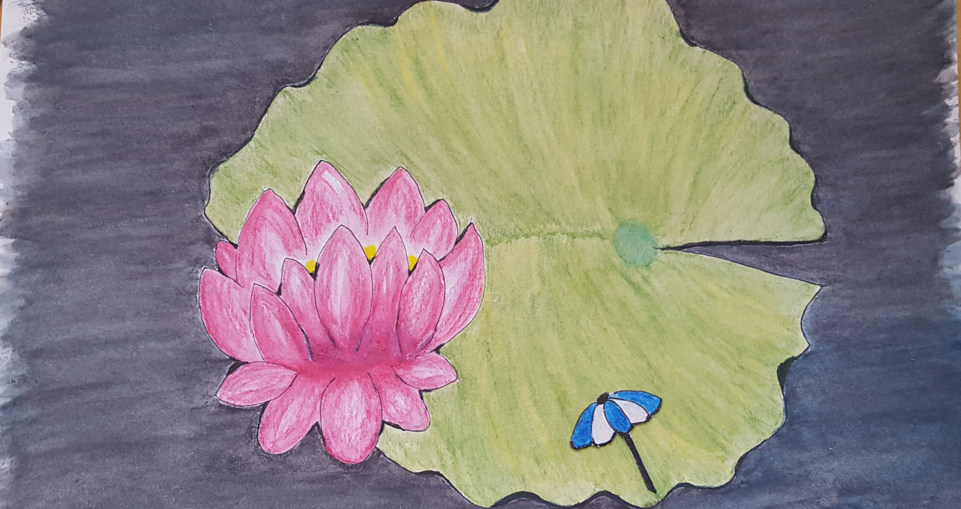
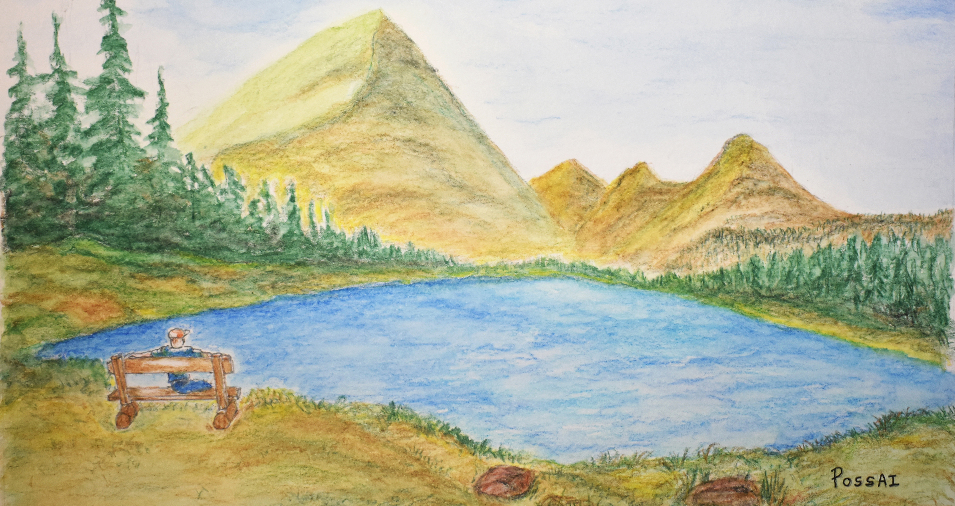
Final Piece Prompt
What in nature inspires you?
Notes:
Final piece prompt:
What in nature inspires you?
For your final piece you will:
- Create a work of art using the techniques and materials you learned over the course of this class
- Write an artist statement to accompany your work of art
Your final piece can be any style: landscape, plant study/scientific illustration, poem, collage, etc. Let your creativity soar!
What is an artist statement?
Simply put, an artist statement is a description of your work in your own words. It is an explanation of why you do what you do and how you made what you created. Your artist statement can be specific to your final piece, or it can represent your entire body of work. An artist statement explains your creative process, including your motivations, inspirations, mission, and methods.

Slide 4
Final Piece Criteria
Submit one (1) final piece.
The artist statement must be typed and emailed to Abigail at aswisher@naplesgarden.org.
Artist statements must be a maximum of 3-4 sentences long.
Don’t forget to sign your work!
Notes:
Submit one final piece.
You will find two sheets of 8x10” watercolor paper in you supply pack. There is an extra piece of final piece paper included for you to practice on.
To submit a final piece, you must use the 8x10” watercolor paper supplied to you.
You may only submit one final piece.
The artist statement must be typed.
Do not write your artist statement on your final piece.
You can email your artist statement to me or to Abigail if you have questions or would like feedback.
Artist statements must be a maximum of 3-4 sentences long.
Sign your final piece in the bottom right corner of your paper. Use your favorite signature or print your name.

Slide 5


Value and Form
Value – how light or dark something is on a scale of white to black.
Form – something that is three-dimensional, has volume, and has length, width, and height.
Notes:
Light and shadows visually define objects.
As artists, we can use values to translate the light and shadows we see into shading – which helps us create the illusion of form.
Values are the different shades of gray between black and white, or the range of shades you can get from a color from lightest to darkest.
When shading, it’s best to use a full range of values – from white, to mid-tones, to the darkest darks.
A full range of values is the basic ingredient for shading. When you can draw lots of different values, you can add depth to your illustrations.

Slide 6
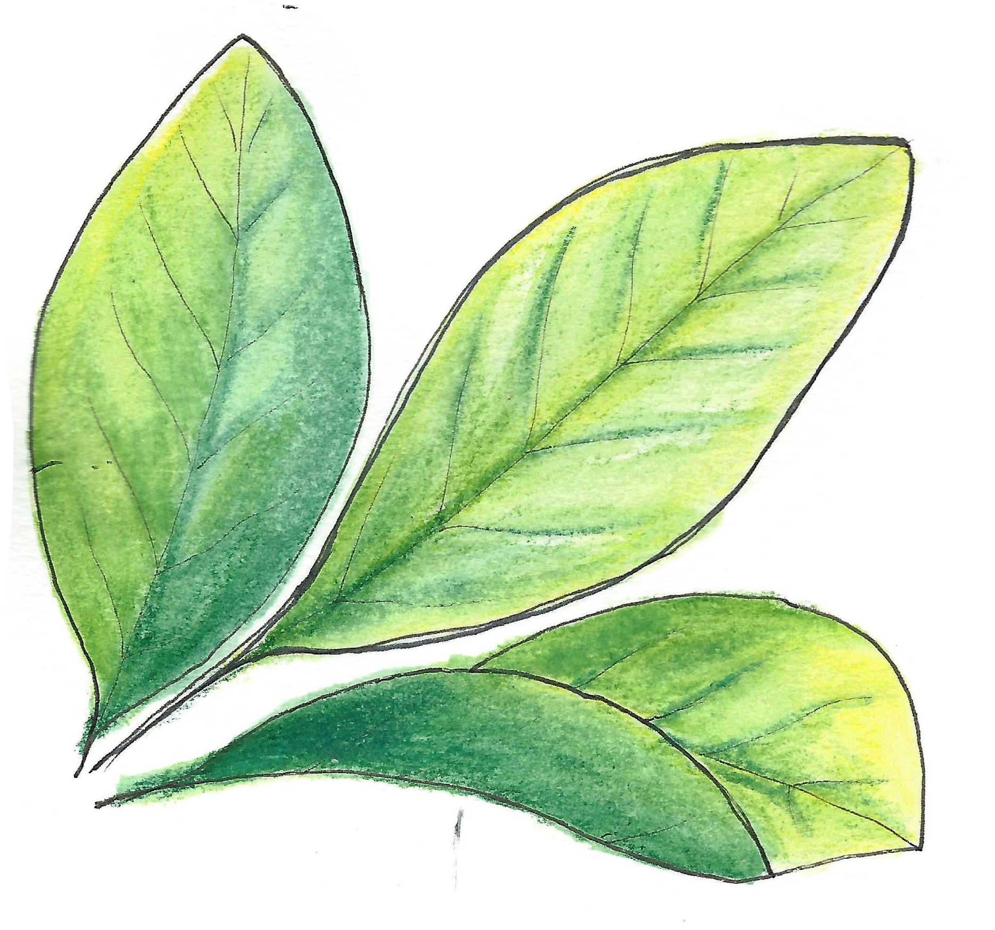
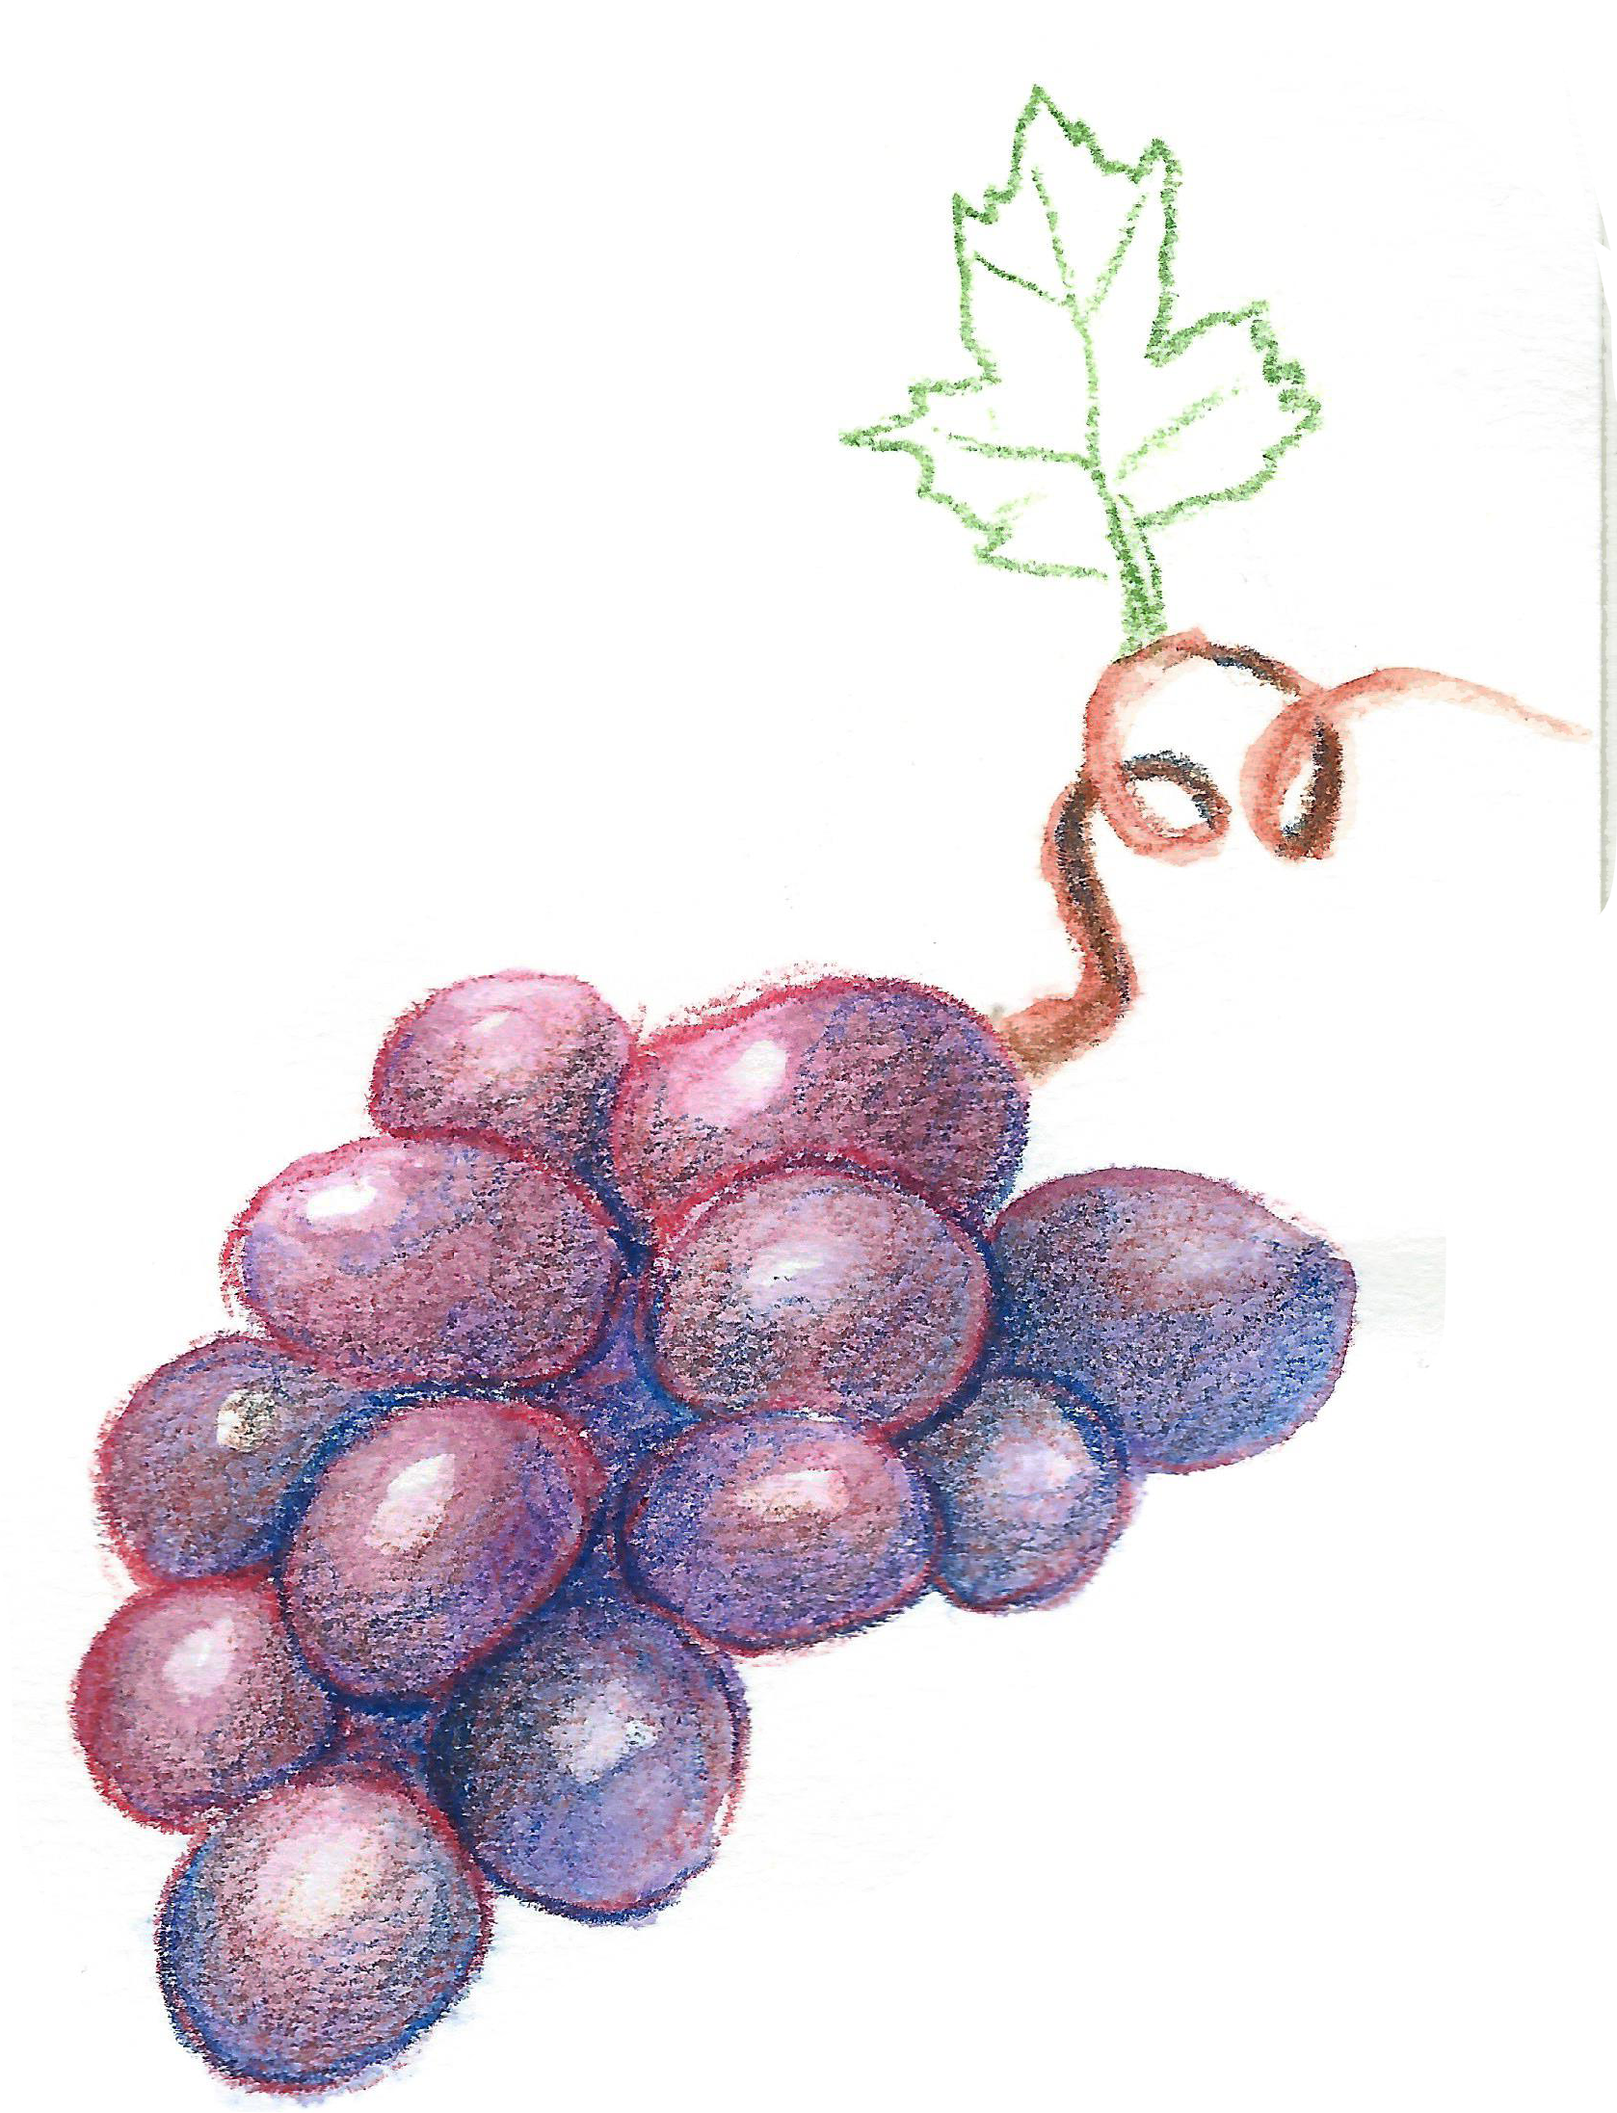
Value and Form
Value – how light or dark something is on a scale of white to black.
Form – something that is three-dimensional, has volume, and has length, width, and height.
Notes:
Form pertains to the way a shape or object occupies space. You can create the appearance of form on a flat surface (your sketchbook paper) by using light, shadow, the appearance of the object’s contours, negative space, and the object’s surroundings.
There are two types of form in art:
-Geometric form: precise, regular, angular shapes that are mathematically consistent. This can include spheres, cubes, pyramids, cones, and cylinders. Think architecture and other man-made products.
-Organic (or biomorphic) form: irregular shapes that often occur in the natural world. They can be asymmetrical, free-form, or curved.
You can use geometric forms to make sense of more complicated organic forms by breaking them down into simple, recognizable shapes.

Slide 7
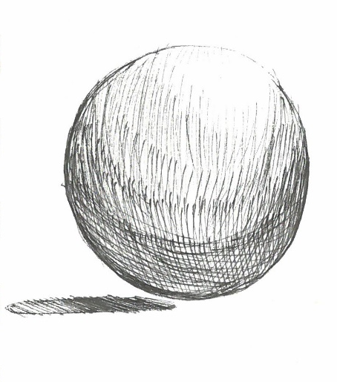
Finding Your Light Source
Light Source
Midtones
Light source – the direction from which a dominant light originates.
Shadows – the areas on an object that receive little or no light.
Cast shadow – the dark area on a nearby surface where light is blocked by a solid object.
Reflected light – when light is reflected onto an object, from the surface it sits on.
Shadows
Cast Shadow
Reflected Light
Notes:
Before you can illustrate light and shadows correctly, you need to identify these four things:
Your light source: the direction from which the dominant light originates. The placement of the light source affects every aspect of the drawing from beginning to end. Look for the lightest areas on the object. The very brightest of light values are called highlights and are often what you’d leave white on your paper.
Shadows: these are the areas that receive little to no light. You can think of shadows as opposite of the light source. They add depth and communicate the shape of an object. If you’re struggling to find your light source, look for your shadows first. Your light source will be opposite your shadows (shadows on the left = light source on the right).
Cast shadow: the dark area on a nearby surface where light is blocked by a solid object. Cast shadows appear on objects in the immediate background when one object overlaps another and underneath an object when it is resting on/nearby a surface. The section of the cast shadow closes to the object is usually the darkest values in a drawing.
Reflected light: usually a small amount of light that is reflected onto an object from the surface it sits on. This often happens with round, spherical objects such as berries or grapes.

Slide 8
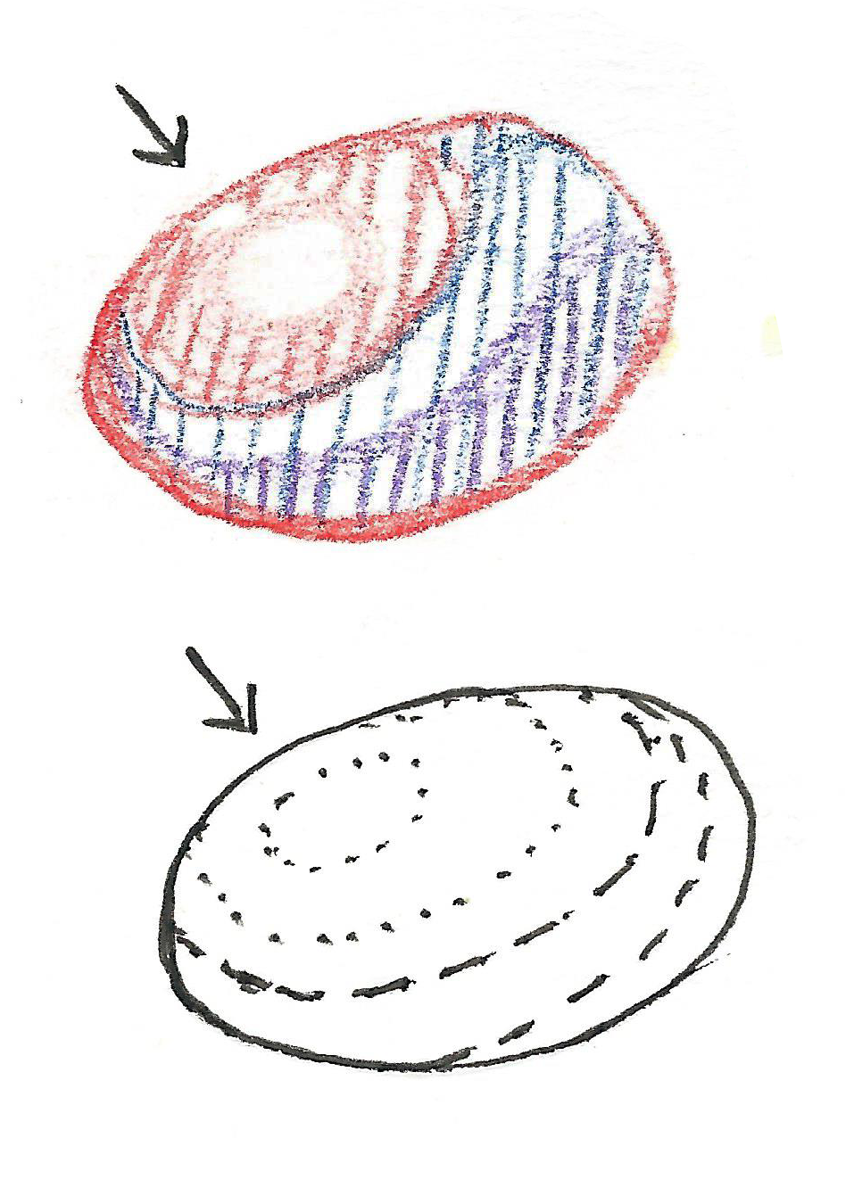
Finding Your Light Source
Light source – the direction from which a dominant light originates.
Shadows – the areas on an object that receive little or no light.
Cast shadow – the dark area on a nearby surface where light is blocked by a solid object.
Reflected light – when light is reflected onto an object, from the surface it sits on.
Notes:
The direction of your light source will impact how you draw your values from light to dark. That’s why it’s a good idea to start with drawing your lightest values and build up to your darkest values.
Each time your light source moves, identify these things:
The shadows on the object (dark values)
The brightest areas (the highlights)
The light values (light to mid-tones; areas closer to the light source or not in shadow)
The cast shadow (the darkest values)

Slide 9
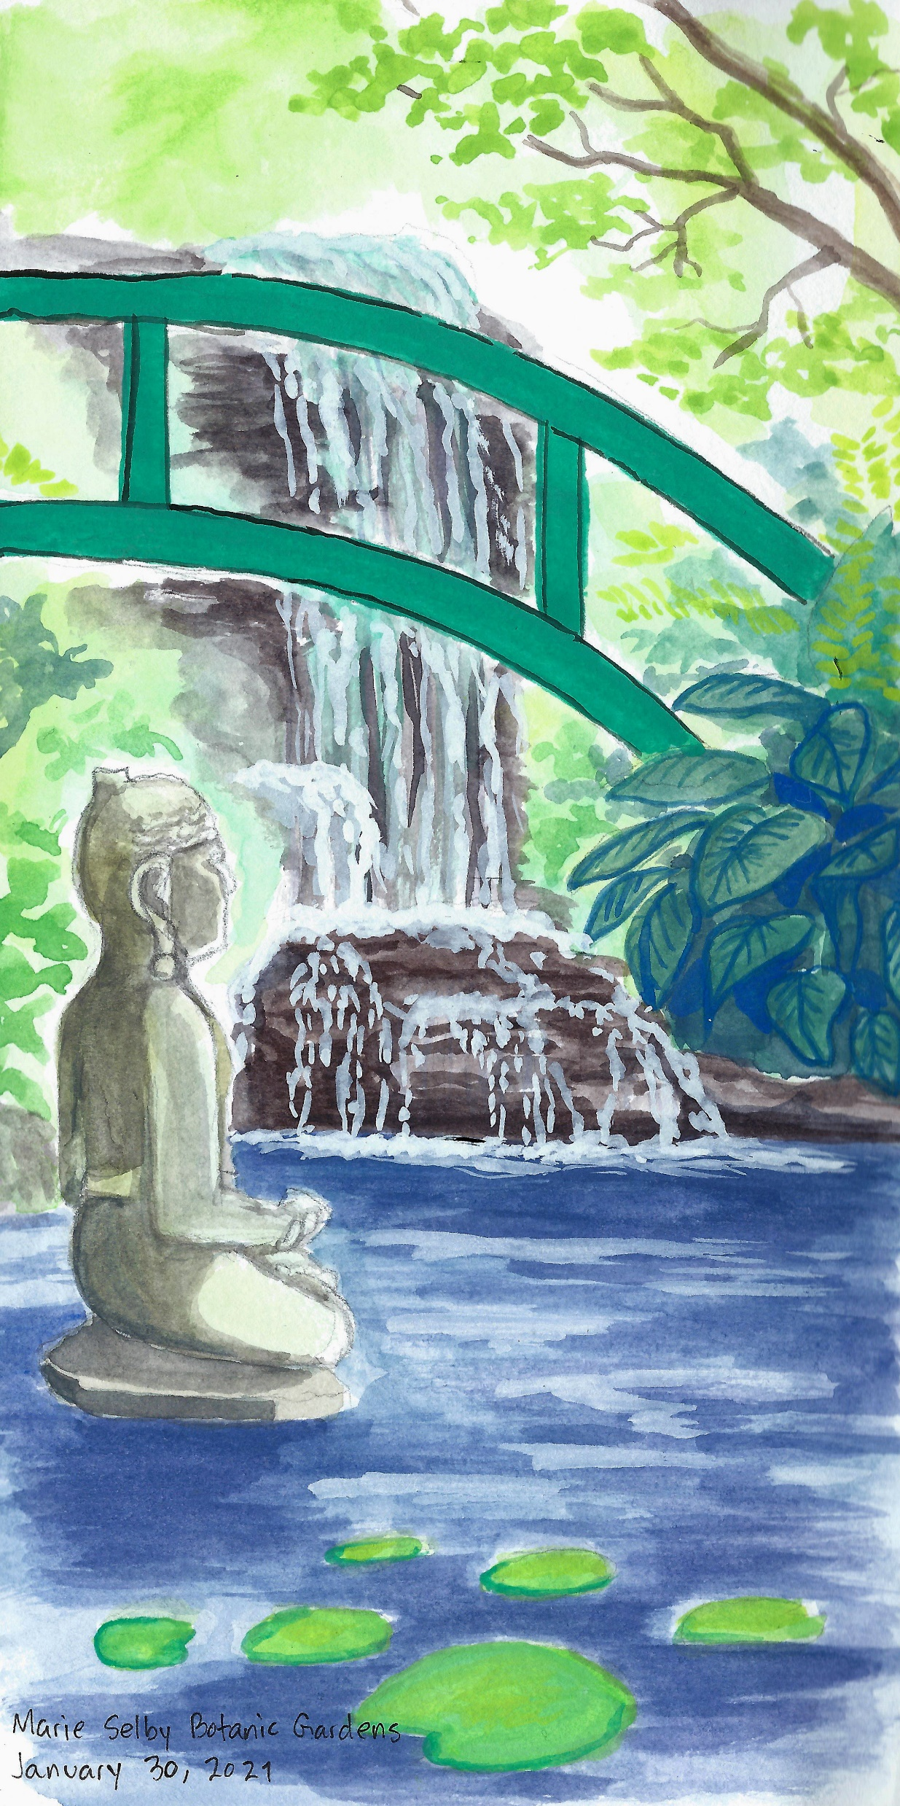
Adding Depth
Depth – the apparent distance from front to back, or near to far, in an artwork
Foreground – the area of an artwork that is nearest to the viewer
Background – the area of an artwork that is furthest from the viewer
Notes:
Foreground vs background
Foreground​
- objects nearer to viewer are larger than those farther away​
- can be more 'in focus' or 'fuzzier', depending on the effect you want to achieve and what element in the illustration you want as your focal point​
- foreground colors are often more vibrant​
​
Background ​
- objects further from the viewer are often smaller and less 'in focus'/'fuzzier'​
- background objects often appear lighter in color and are less vibrant​
​
Adding depth to your work can create interesting compositions and brings life to your journal illustrations. It can also give the viewer a sense of space and scale when looking at your artwork.

Slide 10
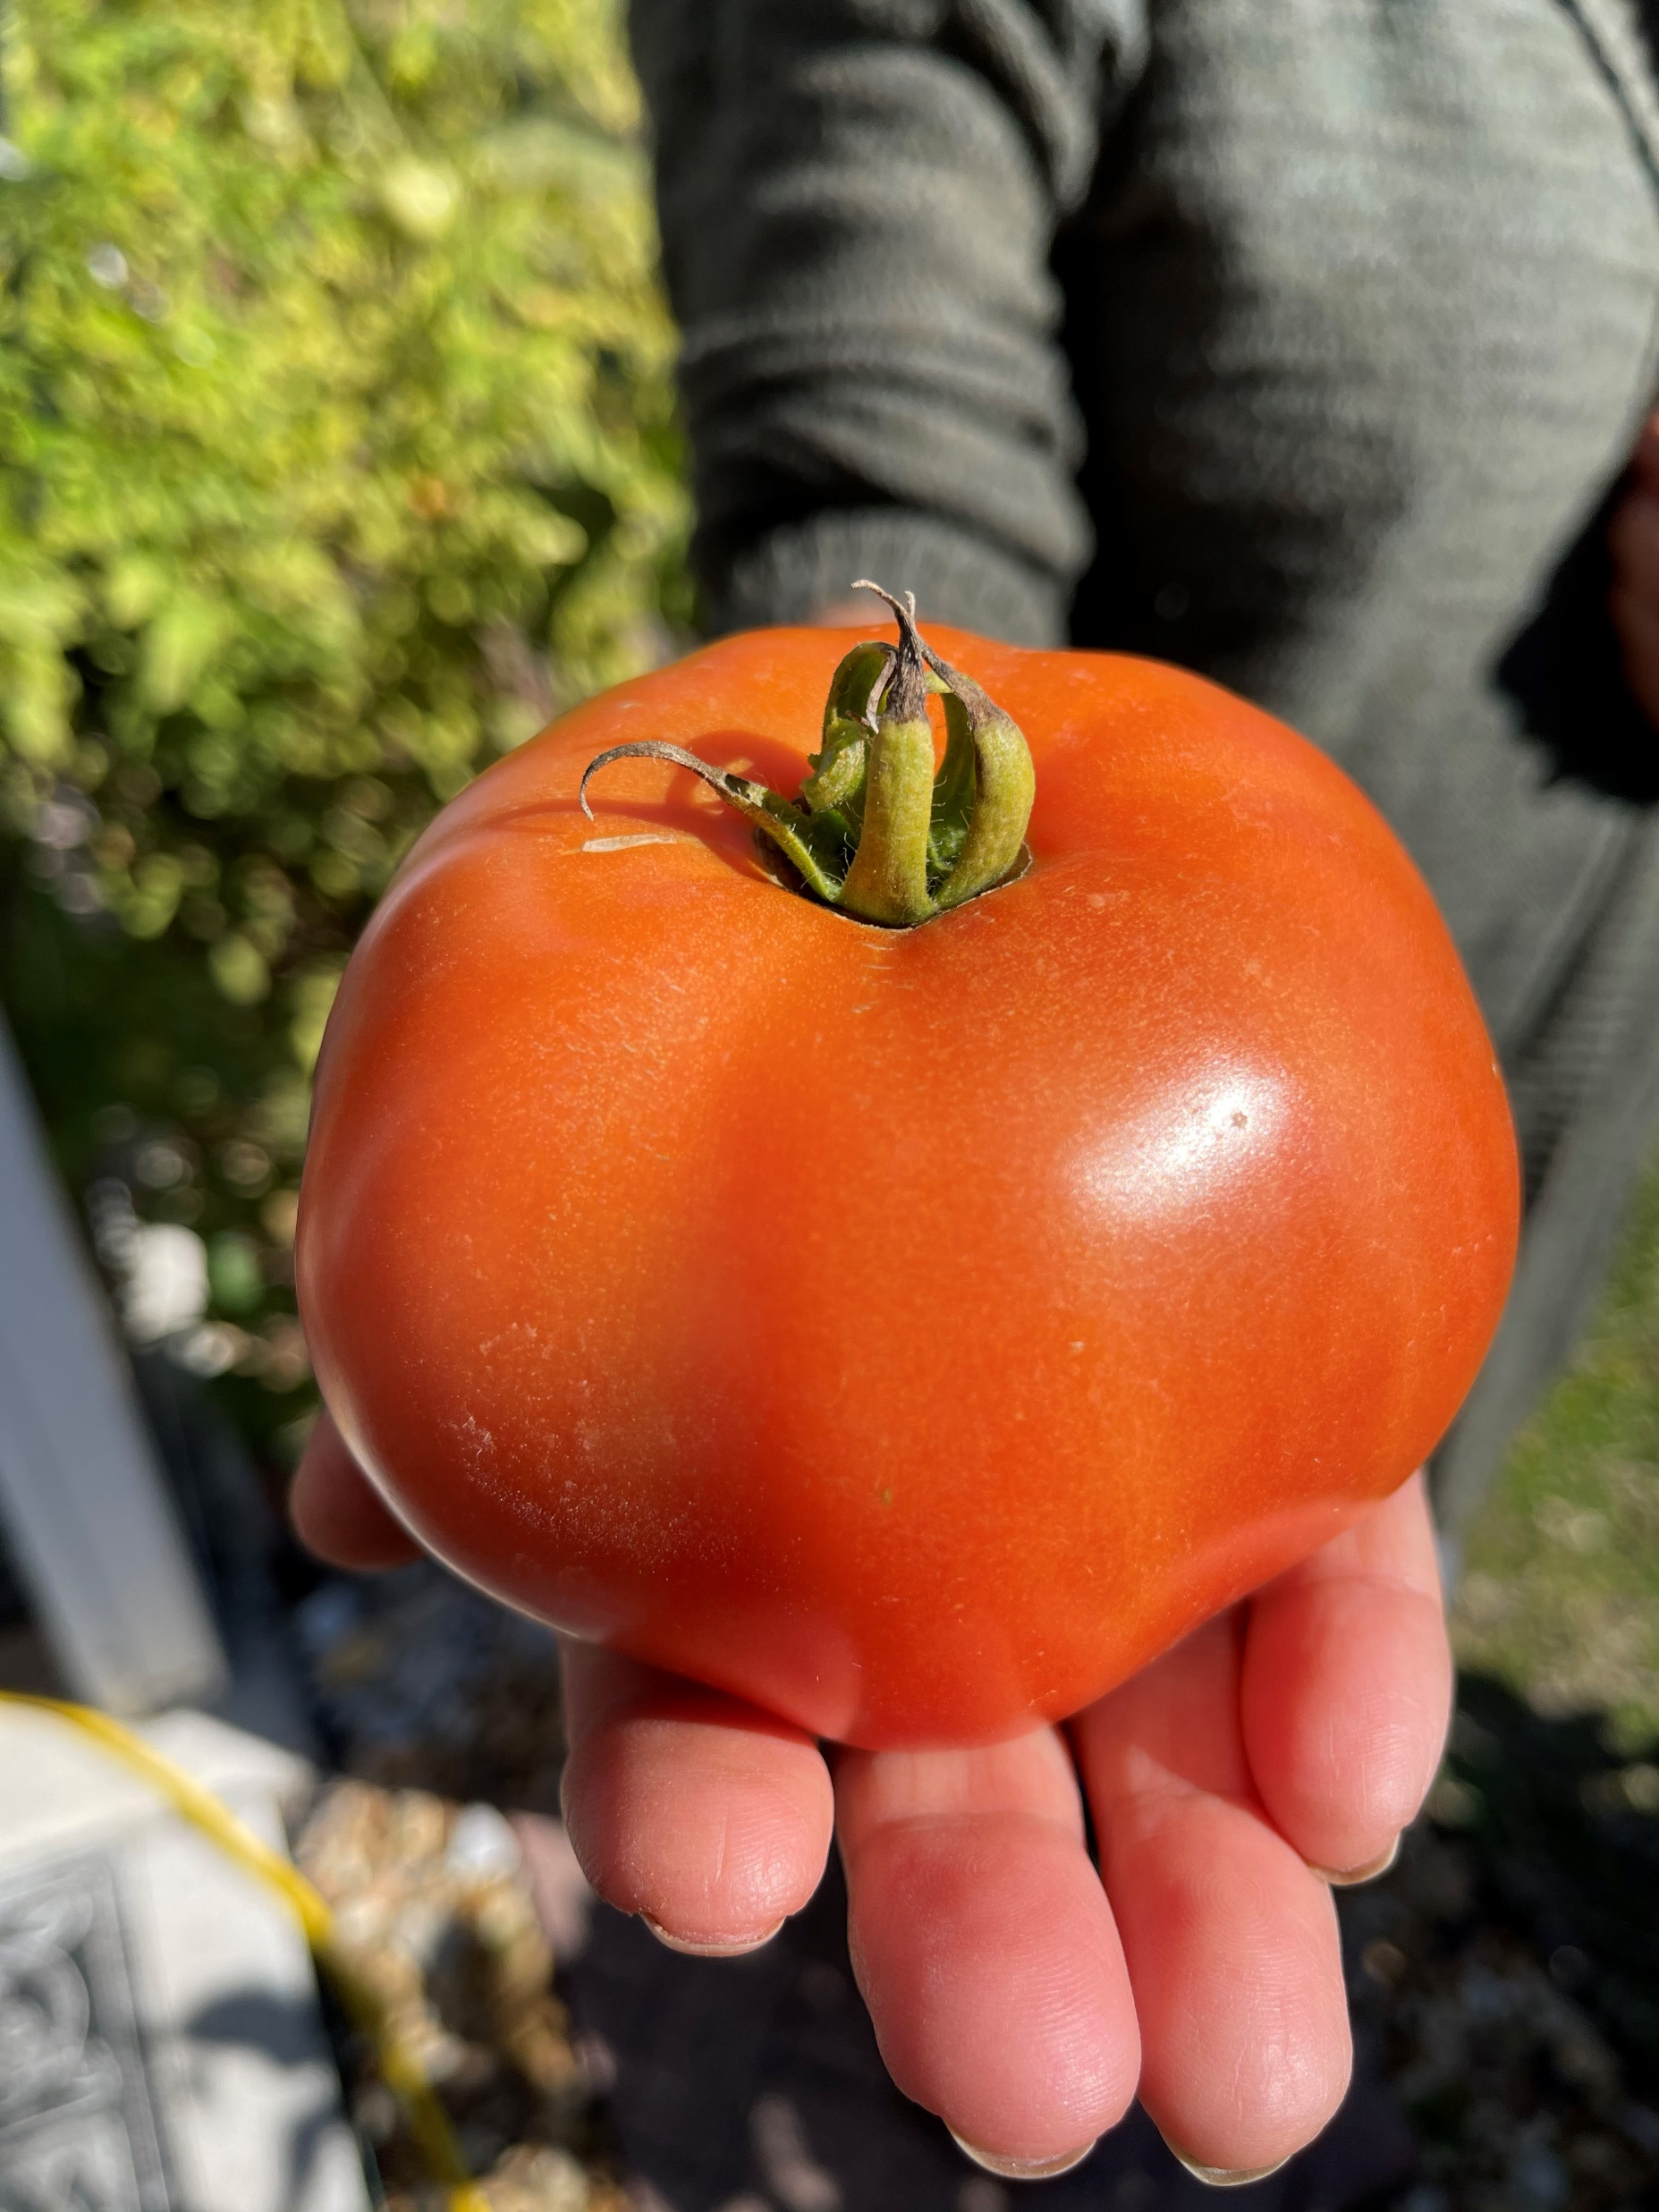

Demo:
Value of a Tomato

Slide 11
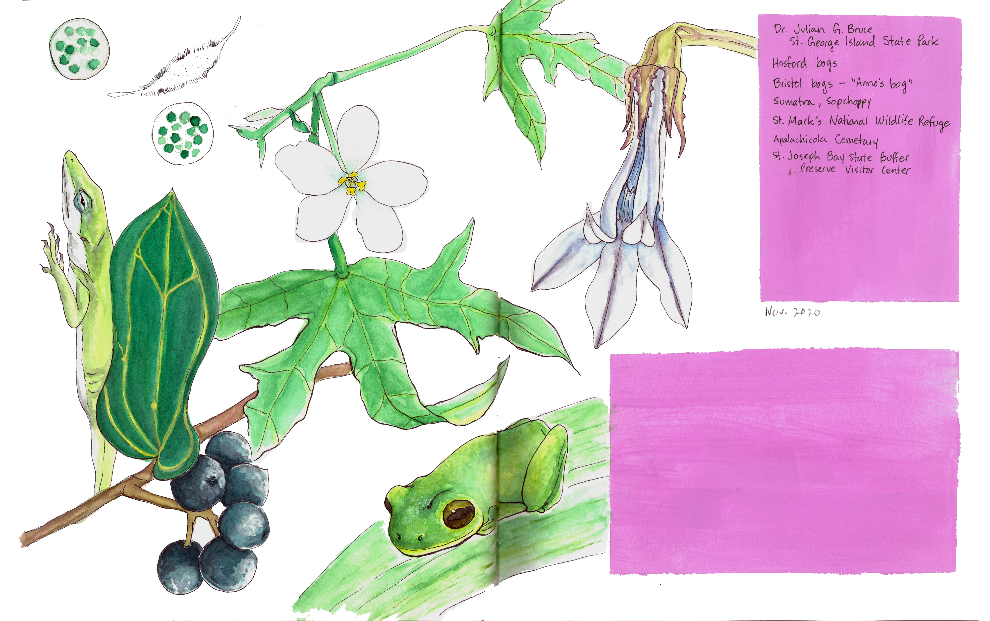
Homework
Getting started on your final piece:
What in nature inspires you?
Write down what you think of when you hear this question.
Start sketching out your ideas in your nature journal.
Notes:
For Homework:
This week’s homework is to get started on your final piece. To help get your ideas flowing, write out a list of what comes to mind when you think: What inspires you in nature?
-Write out a couple of sentences or a short paragraph to describe what you think of when you hear this prompt. This is good practice for the artist statement you will be writing to accompany your final pieces.
-Start sketching out your ideas in your nature journal. Practice laying out how you want your final piece to look. The more you practice and sketch, the more confident you'll be when you start your final piece.

Slide 12
Class 4 Recap
Getting started with your Final Piece
Value and Form
Finding Your Light Source
Depth
Homework Assignment

