Slide 1
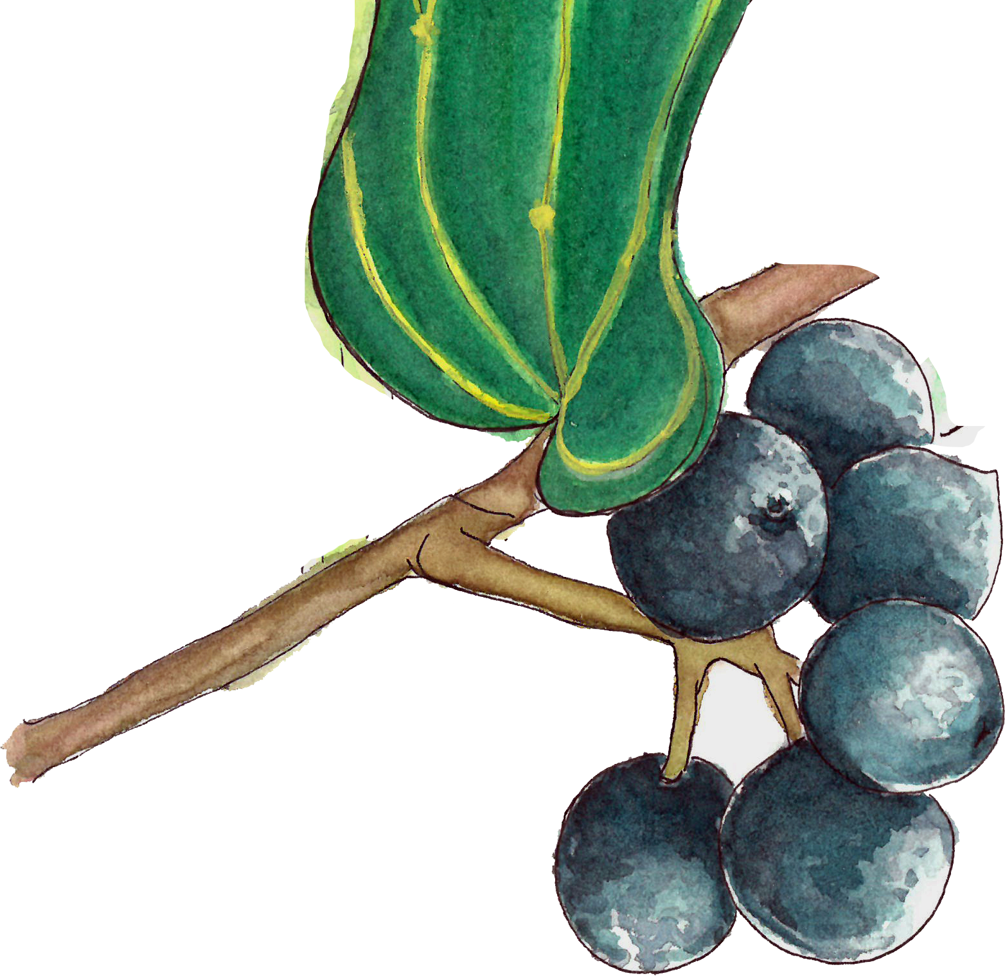
Introduction to
NATURE
JOURNALING
Connecting to nature through art and observation
Class 5:
Textures
Notes:
Buckle up folks we’re about to get ARTSY

Slide 2
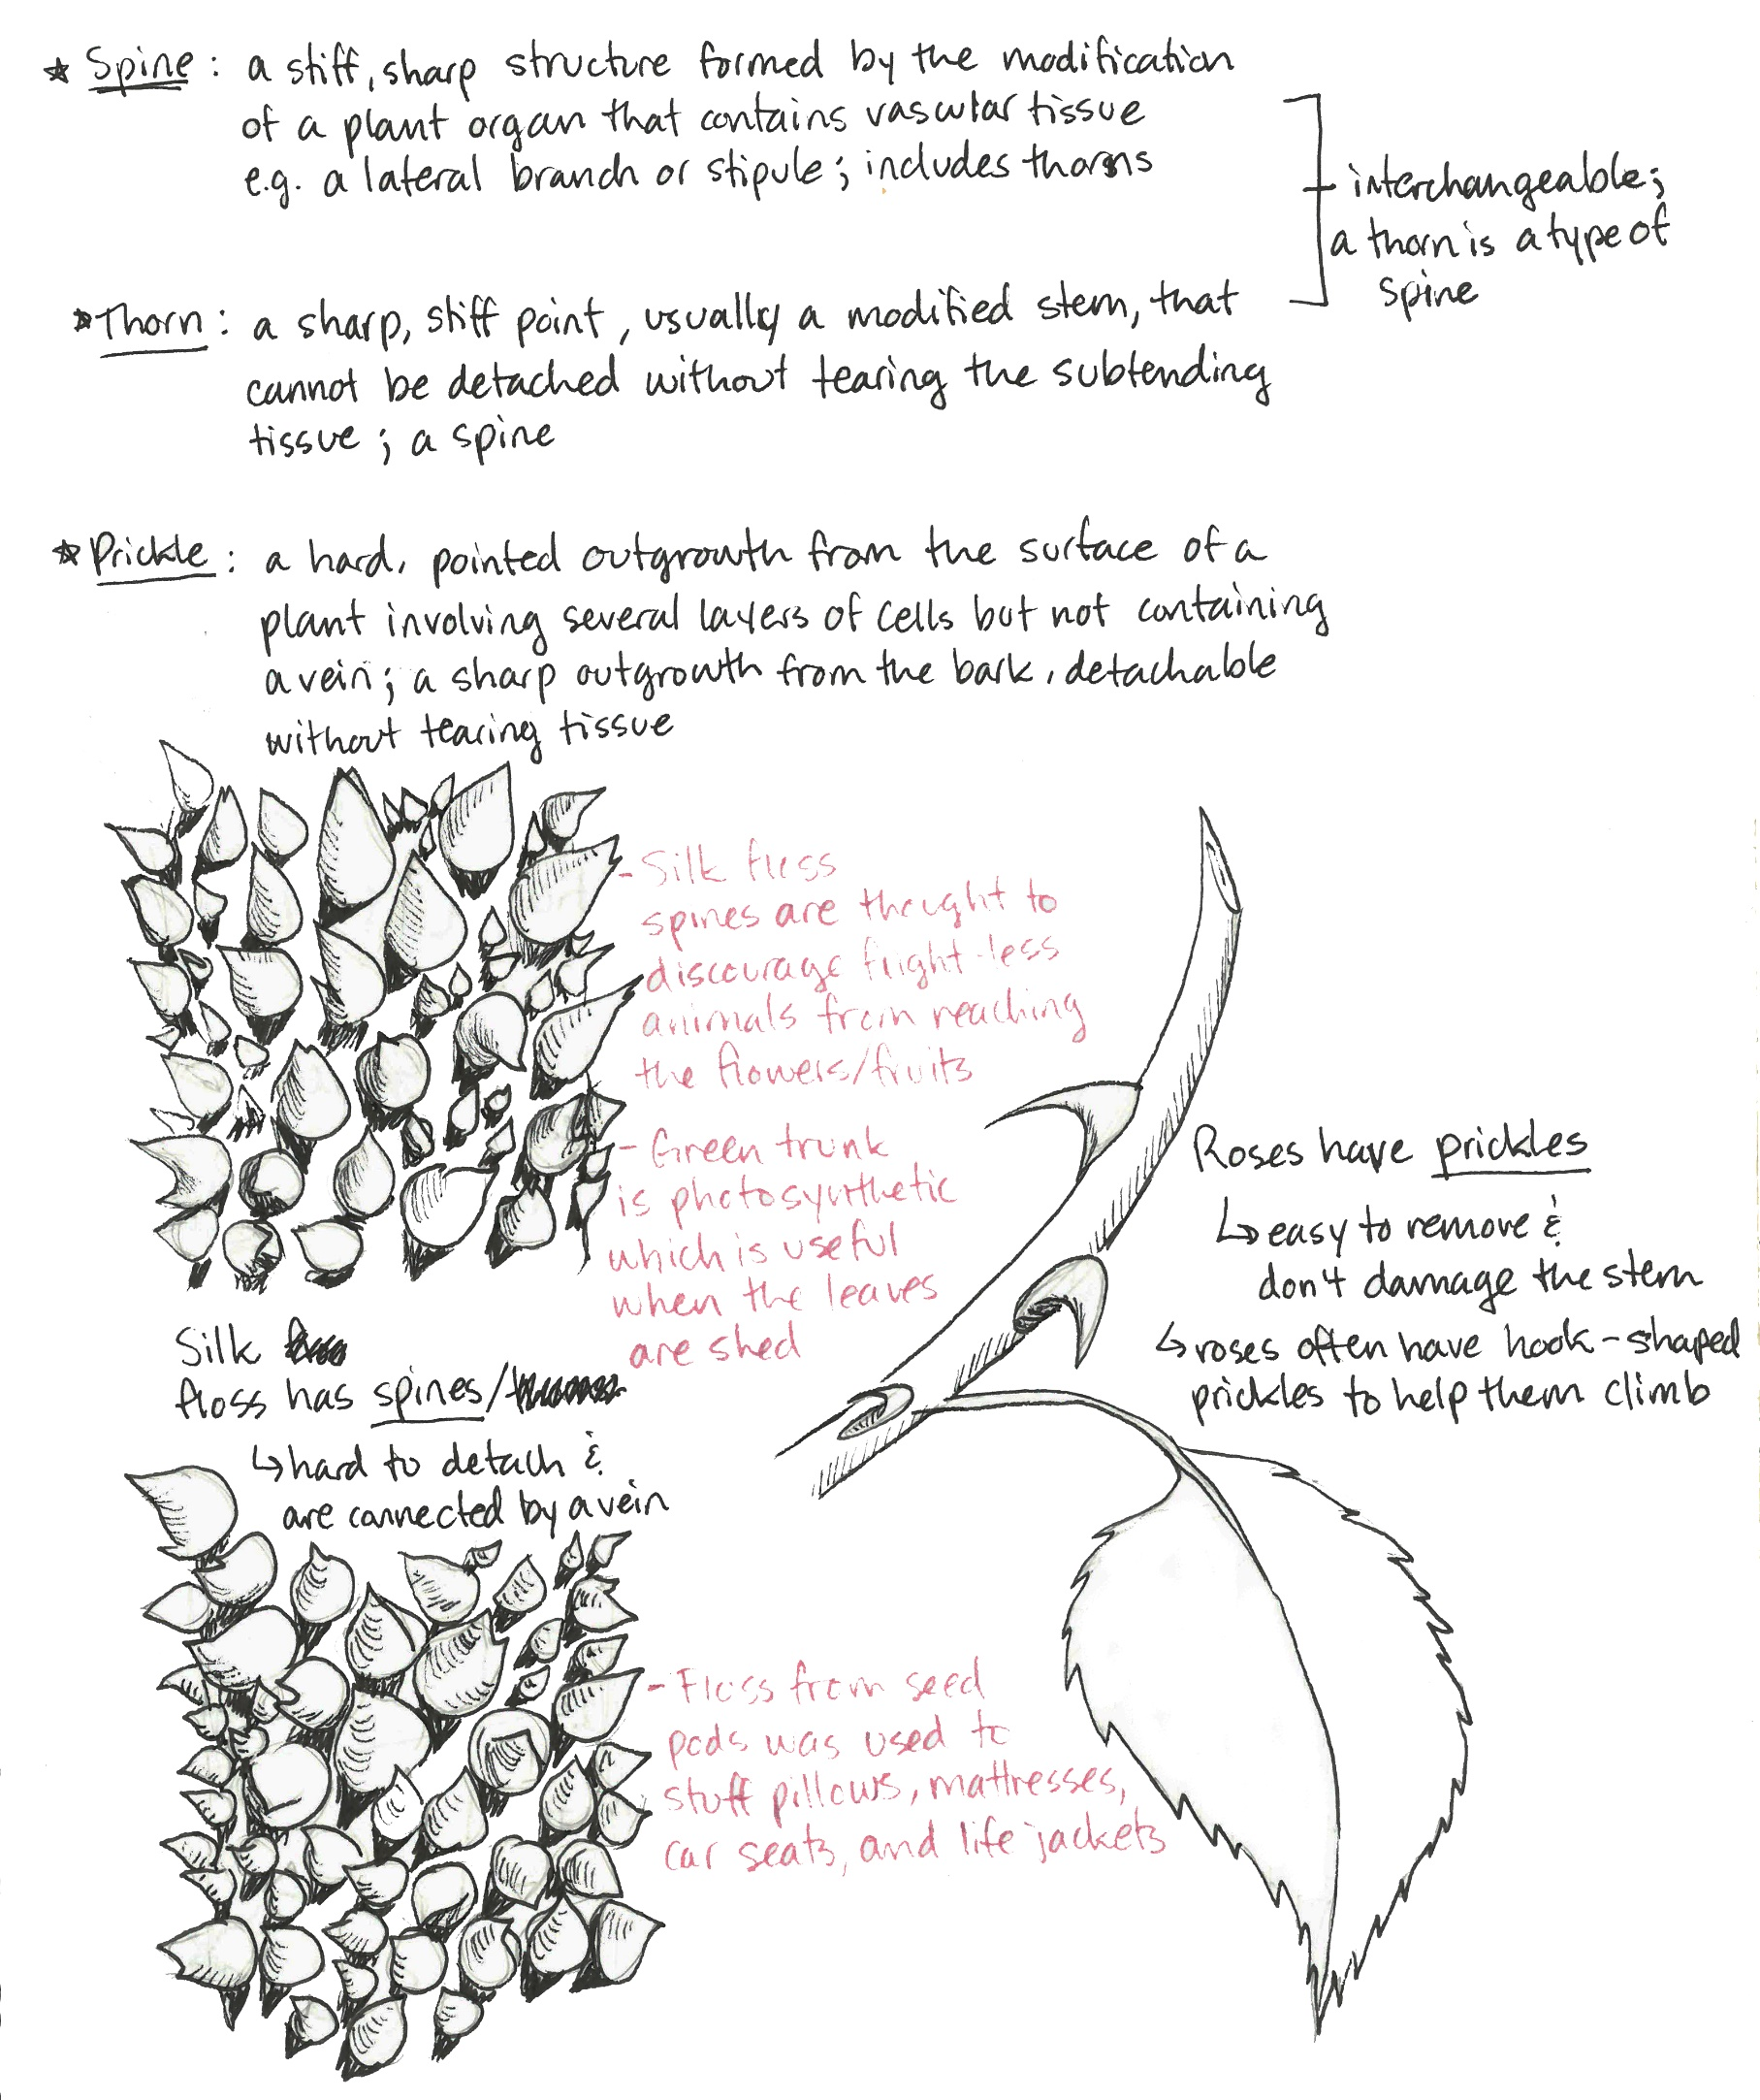
Class 5 Agenda
Warm-up Activity
What is Texture?
Lines and Shapes
Adding Context
Demo: Tips on Texture
Homework Assignment

Slide 3
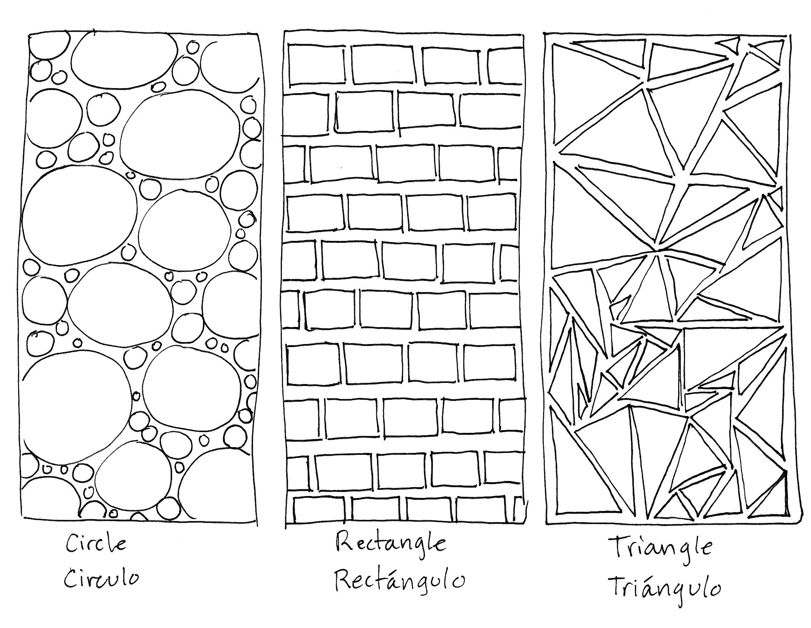
Warm-Up:
Repeating Patterns
Draw three rectangles on a page in your nature journal.
Inside each rectangle, draw a different shape in a repeating pattern. Box 1: Circles, Box 2: Rectangles, Box 3: Triangles.
Fill each box with as many shapes as possible. Use large and small shapes.
Notes:
Draw three rectangles on a page in your nature journal. Inside each rectangle, draw a different shape in a repeating pattern.
We’ll practice with circles, rectangles, and triangles.
You can start out with large and medium shapes, then fill in the gaps with small shapes.
You can create a uniform pattern or a random pattern, whichever comes to mind first.

Slide 4
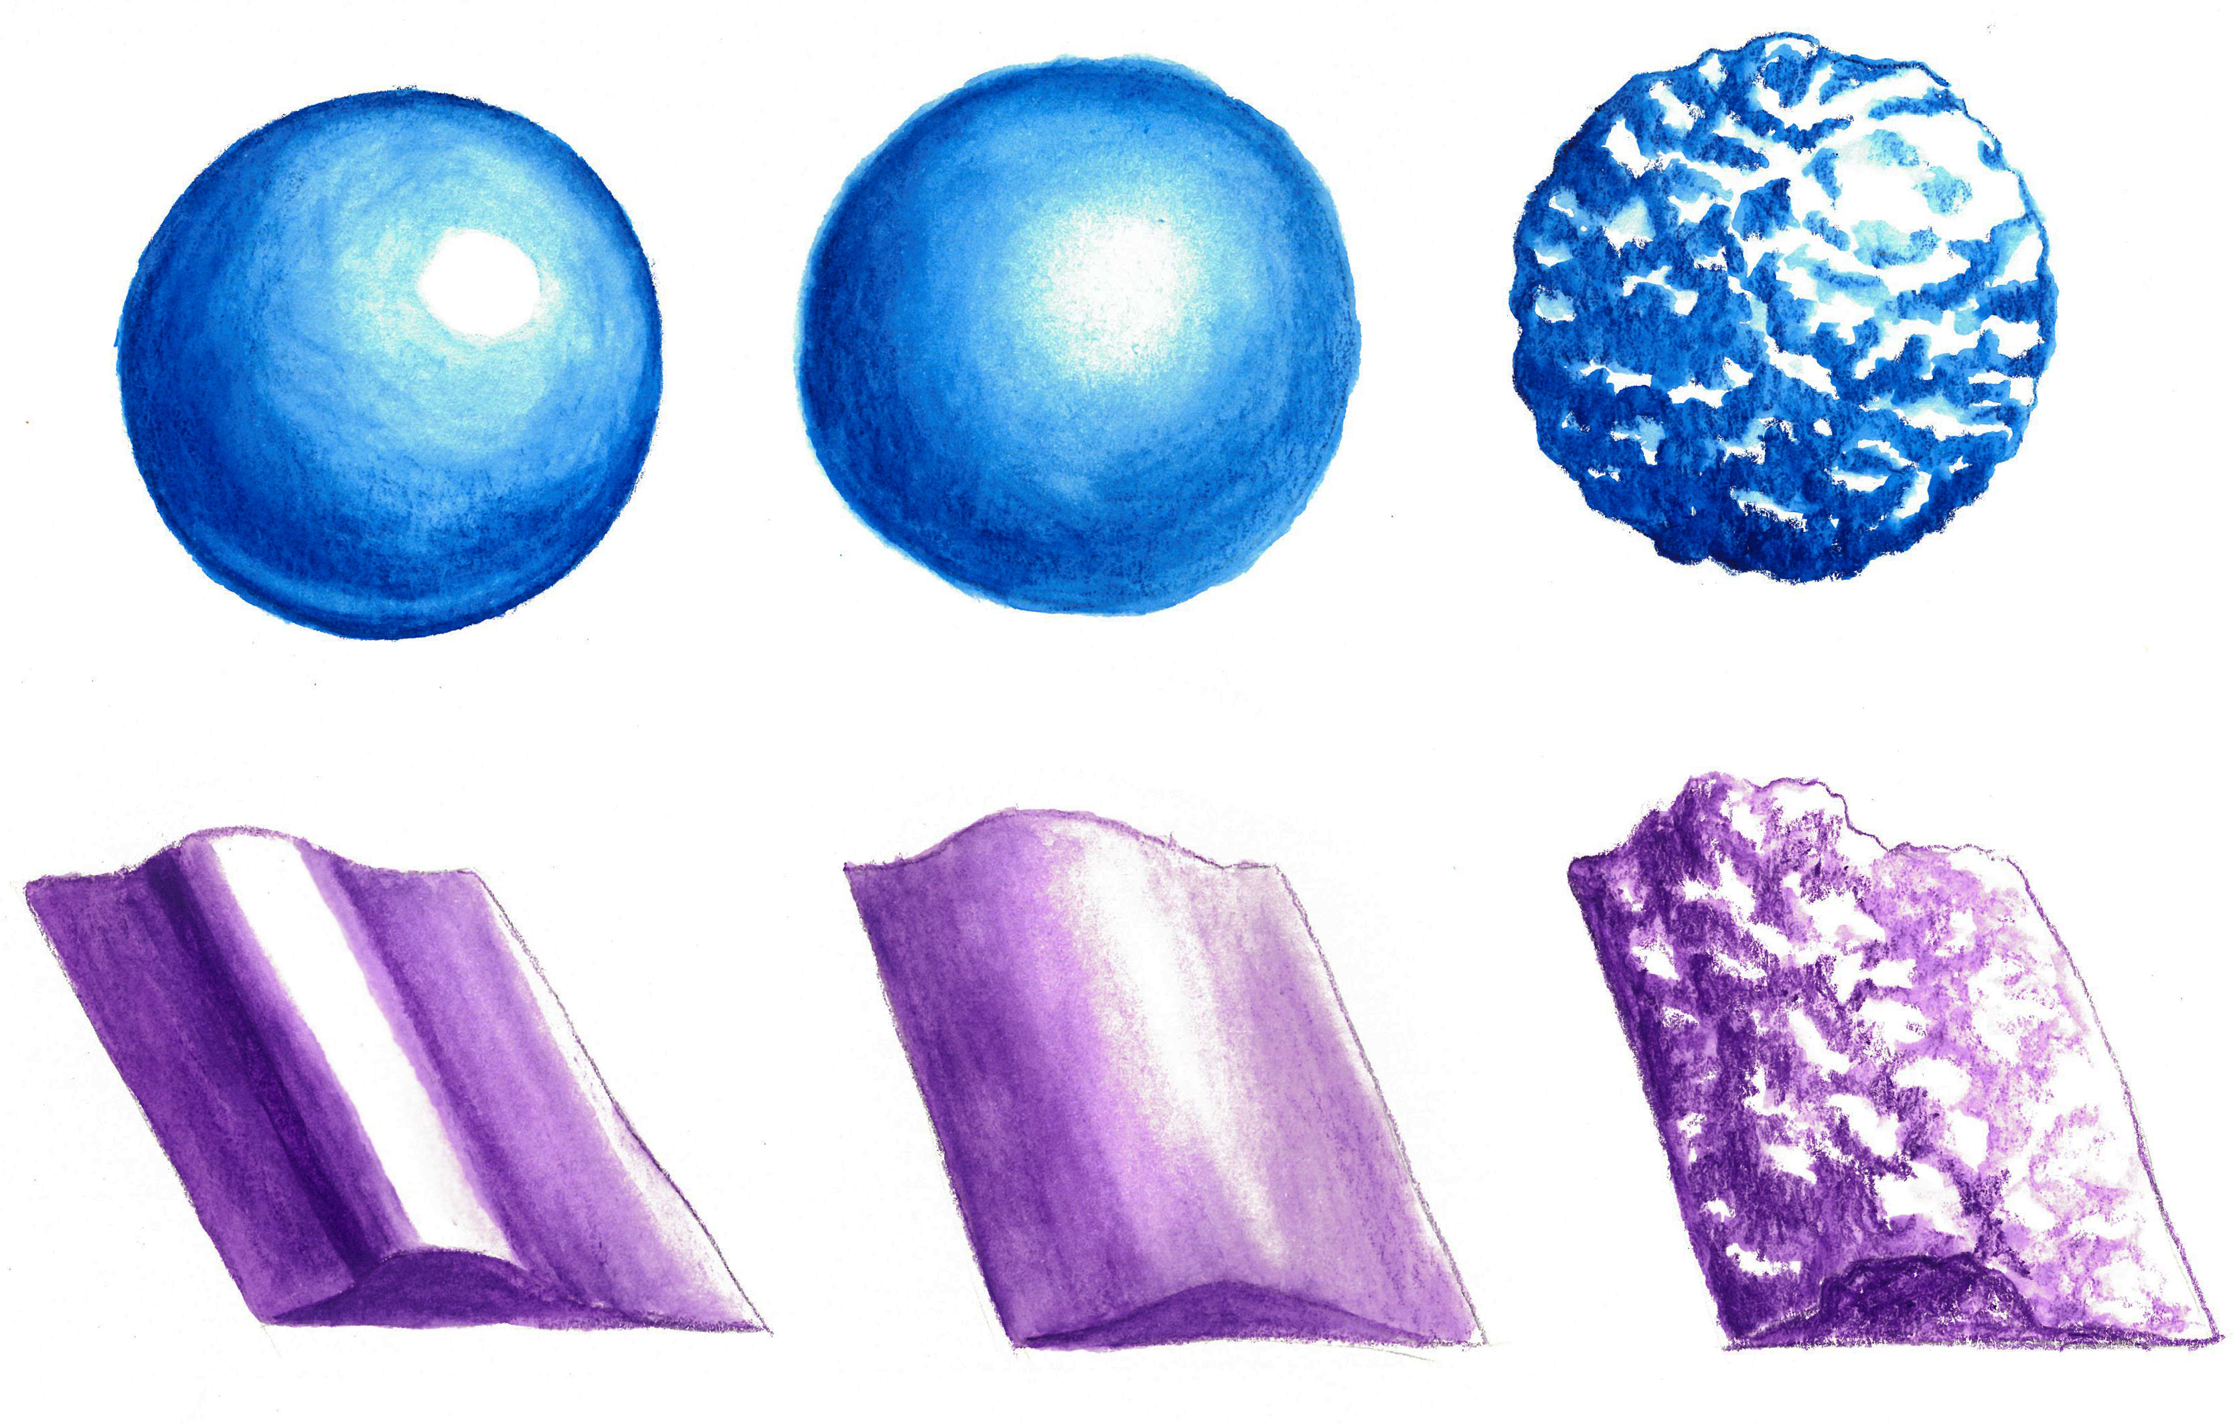
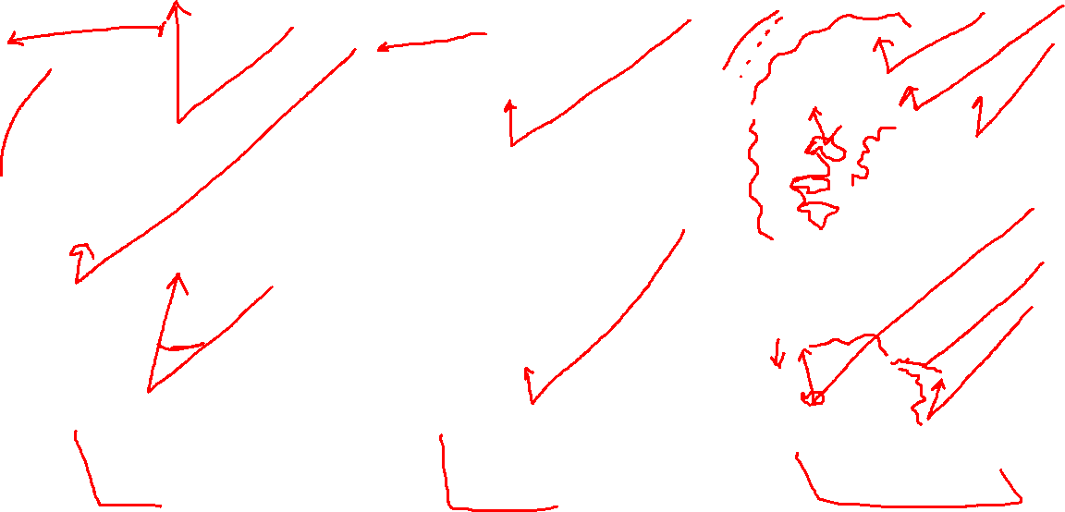
What is Texture?
Hard
Soft
Rough
Texture associates art with our sense of touch.
Actual texture is palpable or physically real (like tree bark) while visual, or implied, texture is the illusion of physical texture experienced with our eyes.
Notes:
So what is texture? We touch an object and can feel that it is smooth or rough, but how do we translate what we feel into what we see. The type of surface and the amount of texture determines the amount of light that is reflected off the surface.
Hard surfaces – A hard, smooth surface such as metal or glass is highly reflective. This means that the light hits more of the surface and bounces off. This creates sharp, crisp edges and stronger contrasts of light and dark values.
Soft surfaces – A soft surface such as cloth or leaves absorb the light, creating smooth transitions between highlights and shadows.
Rough surfaces – If the surface is rough, the light hits less of the surface or hits it in less or sporadic areas. The reflected light is less, making softer variances in values. But the deeper the dips or crevices, the rougher the texture is. Rough surfaces like tree bark, have many small ridges that catch the light on the high ridge with a dark shadow behind the ridge, creating stronger variances.

Slide 5
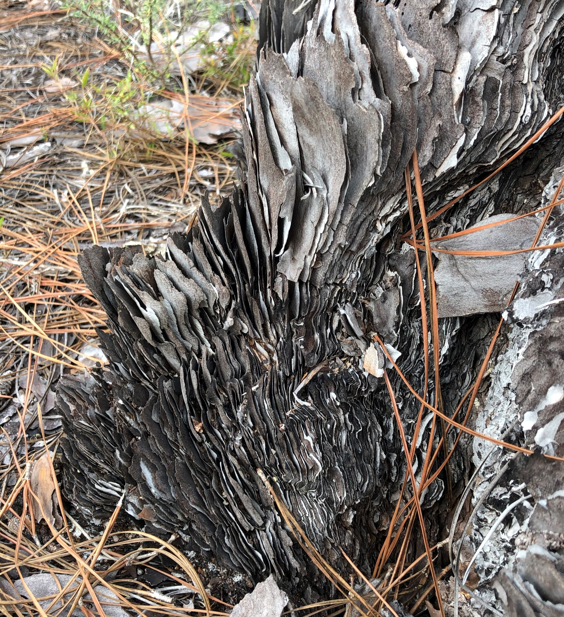
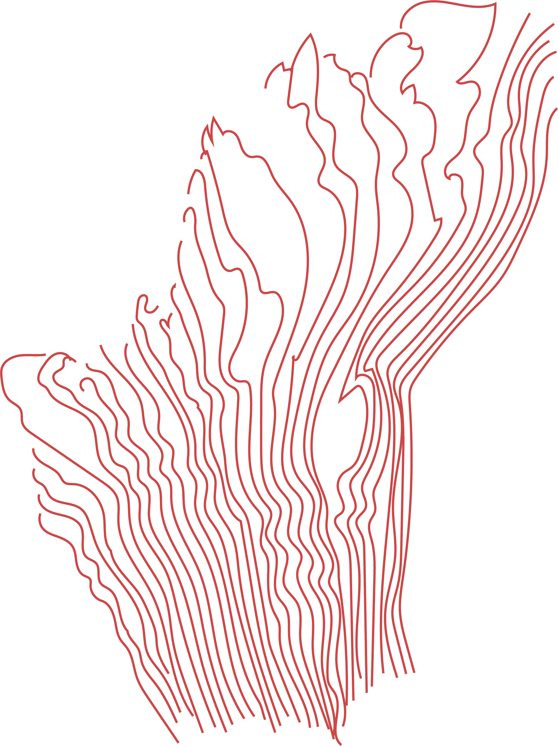
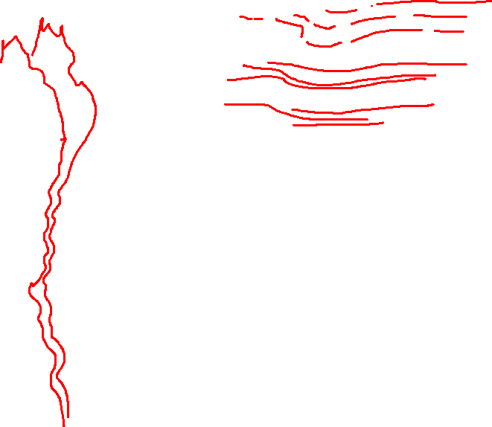
Lines and Shapes
Notes:
Textures can be broken down into repeated patterns of dots, lines, and shapes, colors, and value tones.
Converting a complicated texture into shapes of color may help you determine where your light source needs to go.
Exceptions to every rule: sometimes textures can throw off your light source and shadows.
Light source for textures are often more complicated because textures are a series of hills and valleys.
Smooth surface = one light source
Textured surface = a spattering of light

Slide 6
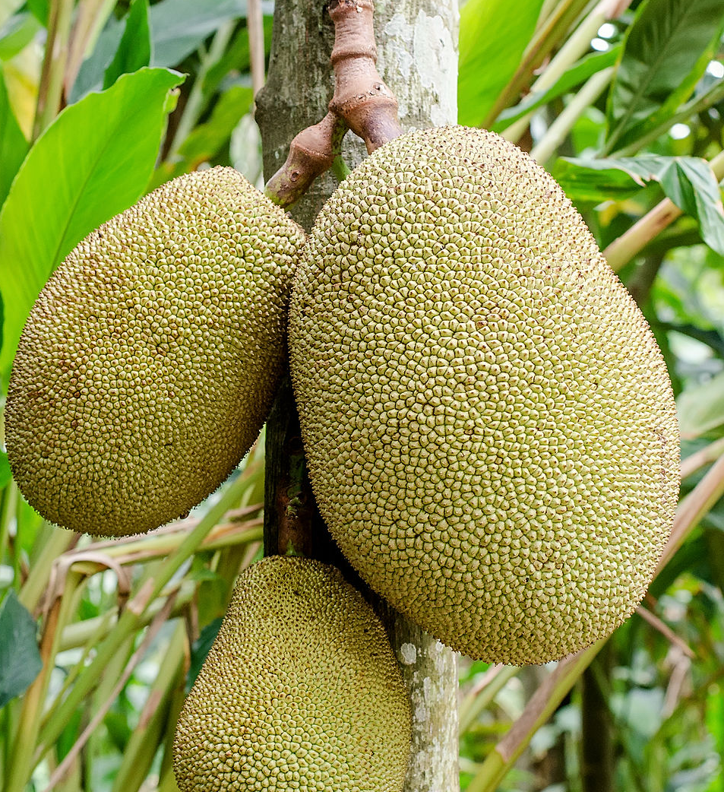
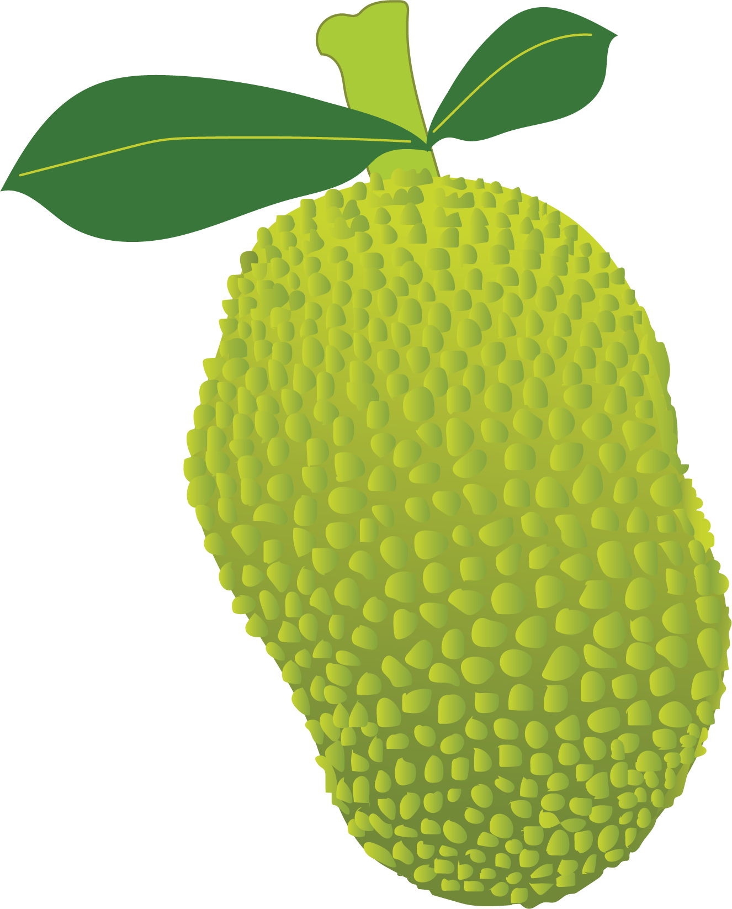
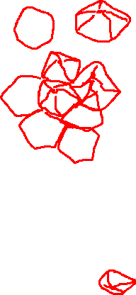
Lines and Shapes
Notes:
Textures can be broken down into repeated patterns of dots, lines, and shapes, colors, and value tones. Converting a complicated texture into shapes of color may help you determine where your light source needs to go.
Exceptions to every rule: sometimes textures can throw off your light source and shadows.
Light source for textures are often more complicated because textures are a series of hills and valleys.
Smooth surface = one light source
Textured surface = a spattering of light

Slide 7
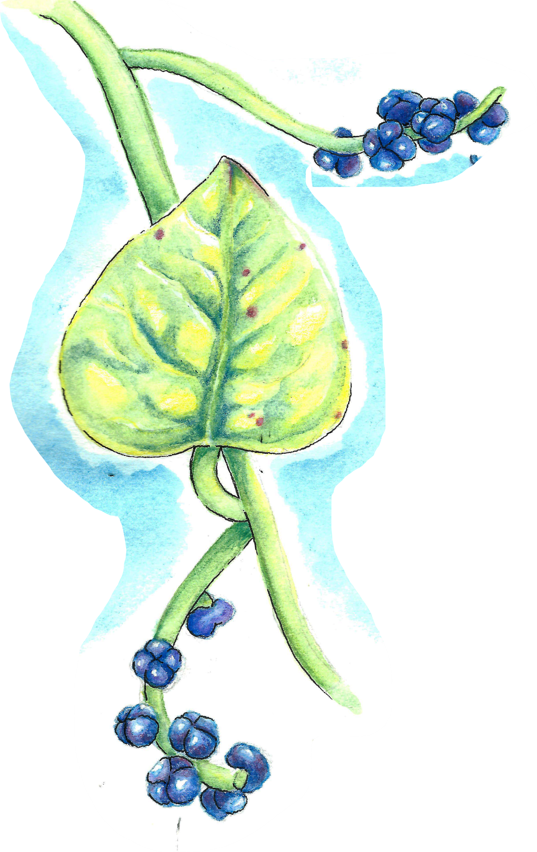
Texture adds Context
Shiny – Plants often grow a waxy coating as protection against their environment. Waxy coatings are barriers between the leaf and the environment, and they can help the plant retain moisture in hot or dry climates.
Dull – Plants that aren’t shiny don’t have as thick of a waxy coating, and don’t need as much protection. This could mean that there are other ways the plant has adapted to its environment.
Notes:
Textures are great for adding interesting elements to your artwork, but they also serve an important purpose in nature. They tell a story of how a plant survives in its natural habitat and add context to your nature observations.
A shiny leaf vs a dull leaf may be adapted to retain or release moisture based on the conditions in their environment.
Some shiny leaves or fruits are coated in a waxy surface to help protect them from their environments
You can accomplish ‘shine’ by using value and leaving a dramatic white space where your light source hits. Something that is matte won’t reflect as much light, so the colors can be blended a bit more where the light source is.
An abrupt transition in color and value, as well as sharp edges, will indicate a shinier surface.
A smooth transition in color, value, and edges will indicate a more dull or soft surface.

Slide 8
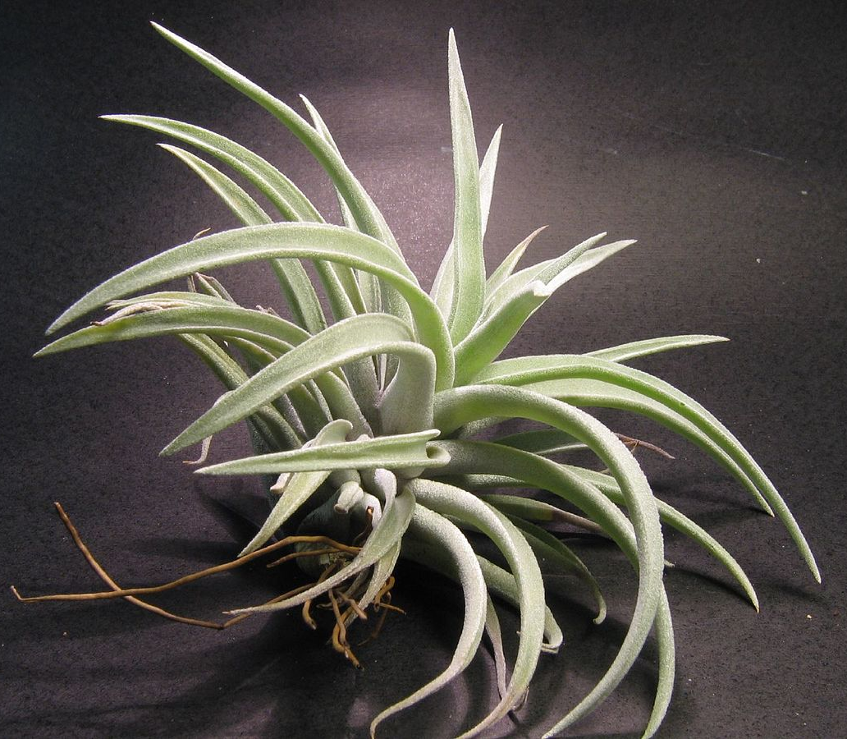
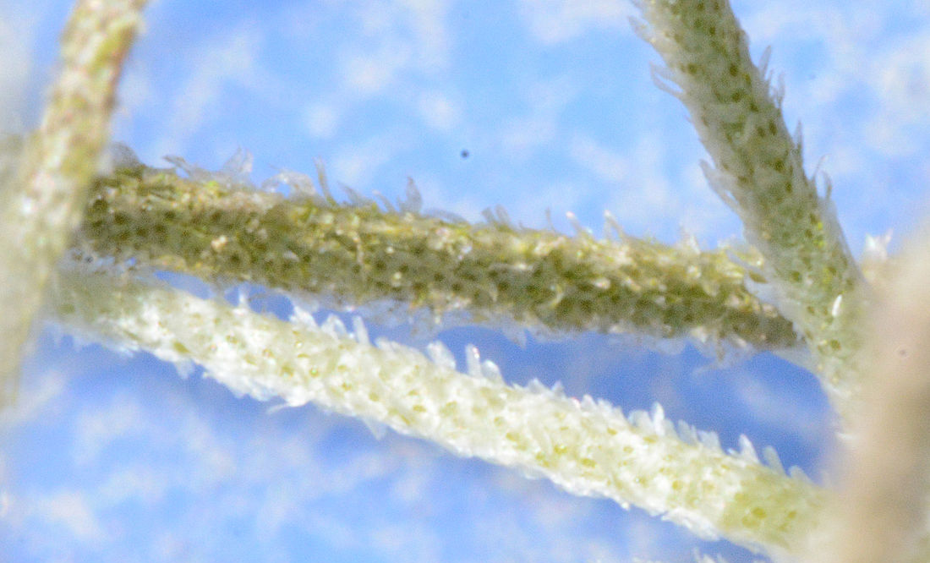
Texture adds Context
Fuzzy/Hairy – Some plants are covered in fuzz or tiny hairs called trichomes. As roothairs or leafhairs on epiphytes (such as air plants) trichomes absorb water and minerals. As leaf hairs, they reflect radiation, lower plant temperature, and reduce water loss. They also provide defense against insects.
Notes:
Plants that are dull or lacking in a protective waxy coating often have a fuzzy or soft texture to help them survive.
Take a close look at a tillandsia (air plant). Some tillandsia are covered in tiny hair-like structures called trichomes. These trichomes help the plant pull water out of the atmosphere through condensation.
Hairy texture can also fend off insects. Some bugs don’t like feeling the fuzzy texture on their abdomens and will avoid landing on a hairy plant. If the fuzz or hair is very dense on a plant, it could act as a buffer that prevents pests from reaching the plant’s leaves or stems.
Ever looked at the stem of a tomato plant? You might’ve noticed that it’s covered in tiny hairs. What do you think the hairs do for the tomato plant?
Fuzz can be accomplished through patterns of lines. To draw a fuzzy texture you can use short, quick strokes.
Image Credit:
Spanish Moss close up.JPG by Bubba73 (Jud McCranie) CC Creative Commons Attribution-Share Alike 4.0 International
Tillandsia harrisii (43971695).jpg by James Ho CC Creative Commons Attribution-Share Alike 2.0 Generic

Slide 9
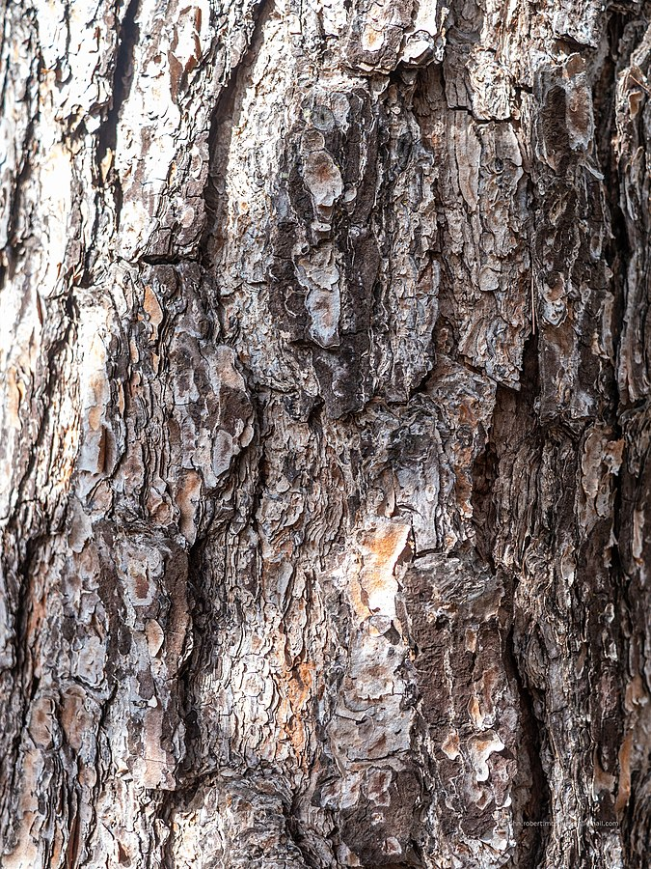
Texture adds Context
Rough – Rough texture helps prevent plants from overheating. A rough leaf or rough bark has more surface area for water to evaporate on, which cools the plant in hot climates.
Flaky – Slash pines (Pinus elliottii) have flaky bark that peels easily. Their bark structure is important for fire resistance. Outer bark layers overlap and protect grooves where the bark is thinner, and the platy bark flakes away to dissipate heat.
Notes:
Rough texture helps prevent plants from overheating. A rough leaf or rough bark has more surface area for water to evaporate on, which cools the plant in hot climates. Just like how sweating is our bodies’ natural cooling mechanism.
The bark on a tree is often a good indicator of how that tree survives in its environment.
Being flaky in nature might just save your life! Most trees naturally shed some bark in response to environmental factors such as weather or the change of the seasons. Some species, however, peel more easily than others.
Slash pines have flaky bark that peels very easily because they grow in a fire-prone environment. The flaky bark protects the tree by peeling off after it burns and preventing damage to the inner heartwood.
Bark can be drawn with repeating patterns of line.
Image Credit:
Pinus elliottii bark 7th Brigade Park Chermside P1030451.jpg by John Robert McPherson CC Creative Commons Attribution-Share Alike 4.0 Internationa
Starr-070403-6373-Petrea volubilis-flowering habit-Lanai City-Lanai (24259566953).jpg by Forest and Kim Starr CC Creative Commons Attribution 3.0 United States

Slide 10
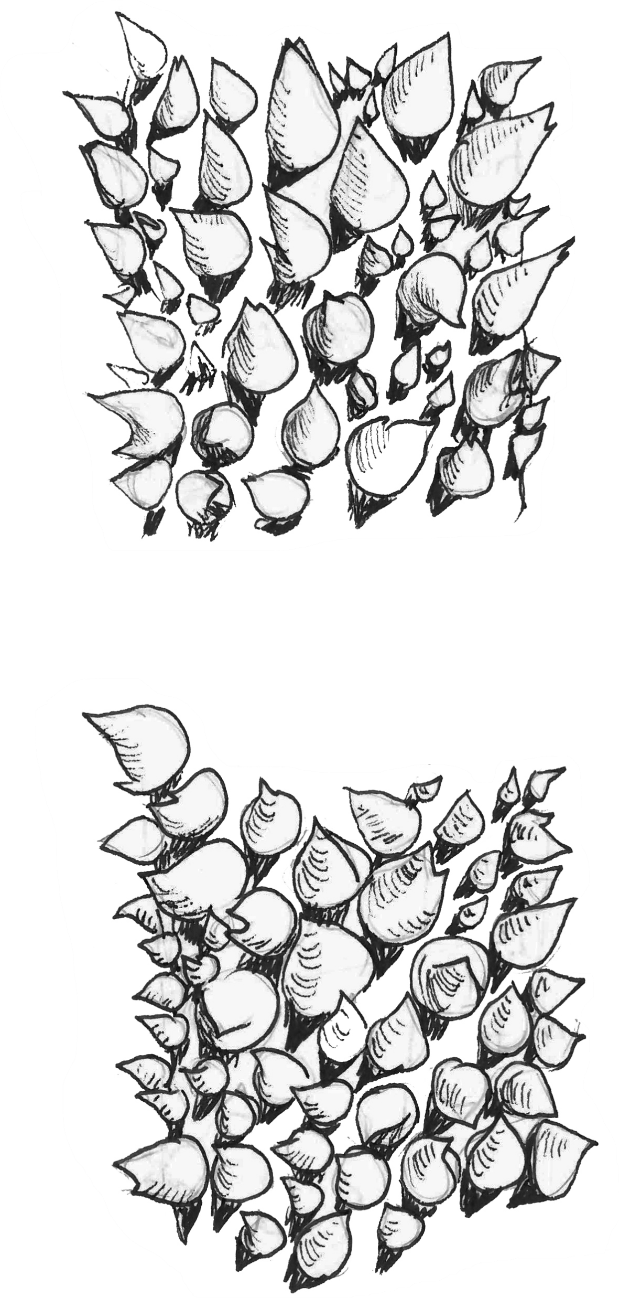
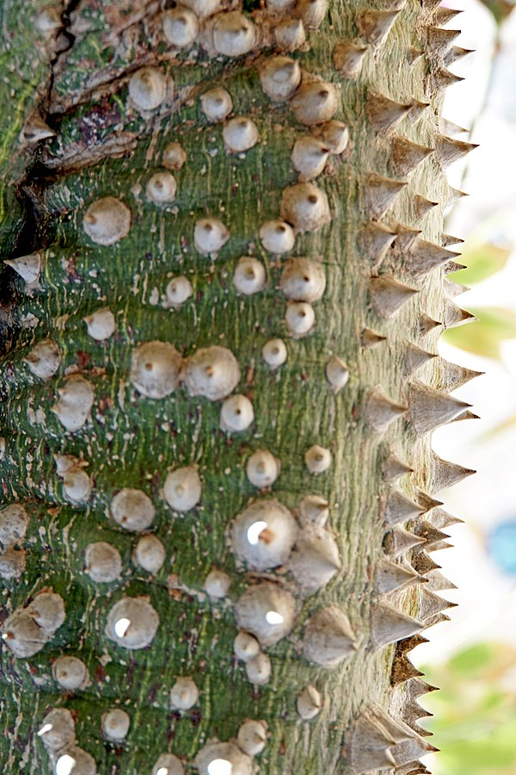
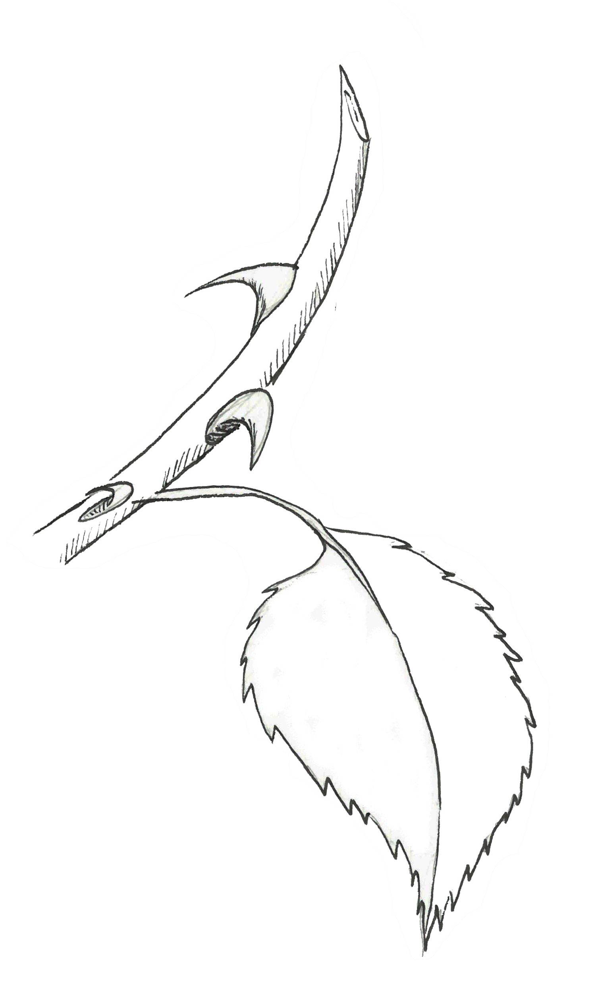
Texture adds Context
Sharp – Plants that have spines, thorns or prickles use them as defense against hungry animals or to protect themselves from damage.
Thorn – form from stem tissue.
Spine – form from leaf tissue.
Prickle – form from neither! These are simply sharp points that project from a plant’s ‘skin’, or dermal tissue.
Notes:
Sharp or jagged textures are great ways to defend against social interaction.
Ceiba trees (silk floss, kapok) have sharp prickles that grow on their trunks and their bark is sometimes green. Their bark is green because when the tree drops its leaves, the chlorophyll in the bark takes over photosynthesis to provide nutrients to the tree even when its leaves are gone. The prickles are there to protect the bark from climbing animals.
Cactus spines are its leaves!
Image Credit:
Israel-04716 - Silk Floss Tree (33508810882).jpg by Dennis Jarvis CC Creative Commons Attribution-Share Alike 2.0 Generic

Slide 11
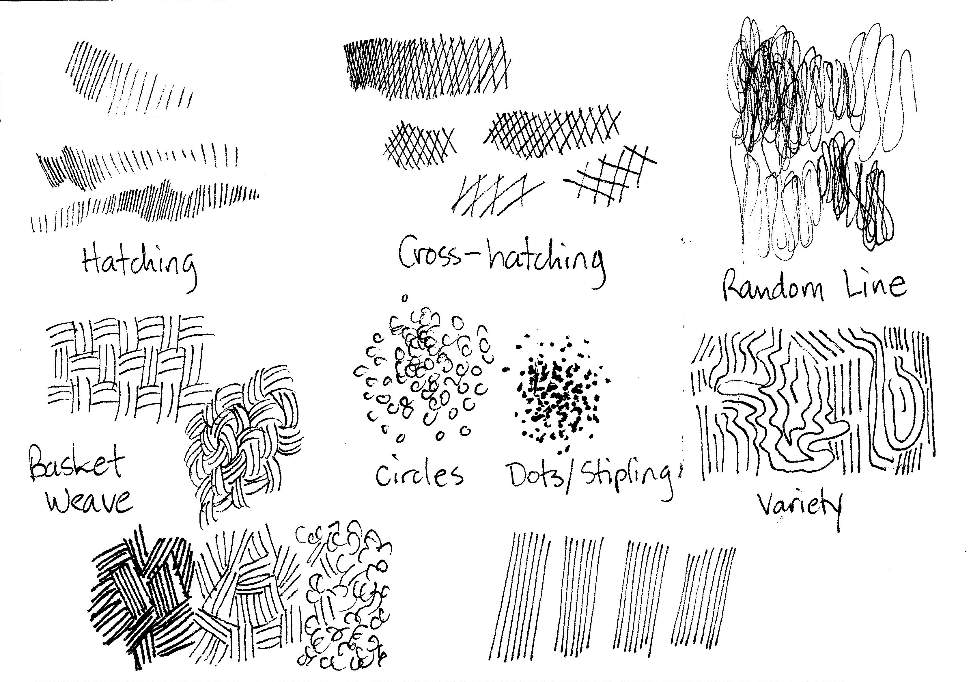
Demo: Tips on Texture
Notes:
Line textures:
Dots – sandy, pebbly rind, dimpled
Dashes – hairy stems or roots, fuzzy seeds, long grasses, or long pine needles
Jagged lines/teeth – thorns, prickles, short grasses, short pine needles
Wavy lines – wood grain, bark, waves, uneven ground
Value textures
Can add depth to texture
Spatter – soil, sand
Surface sheen – abrupt change in value, color, & edges = shiny, smooth change in value, color, & edges = matte
There are many different line techniques you can use to create texture:
Stipling (small dots)
Hatching (lines close together in the same direction)
Crosshatching (same as hatching, except now the lines cross each other)
Circles, squiggles, basket weave…
And any combination of the afore mentioned.
Draw some lines/circles/dots close together and some far apart. Can you see a difference in value?

Slide 12
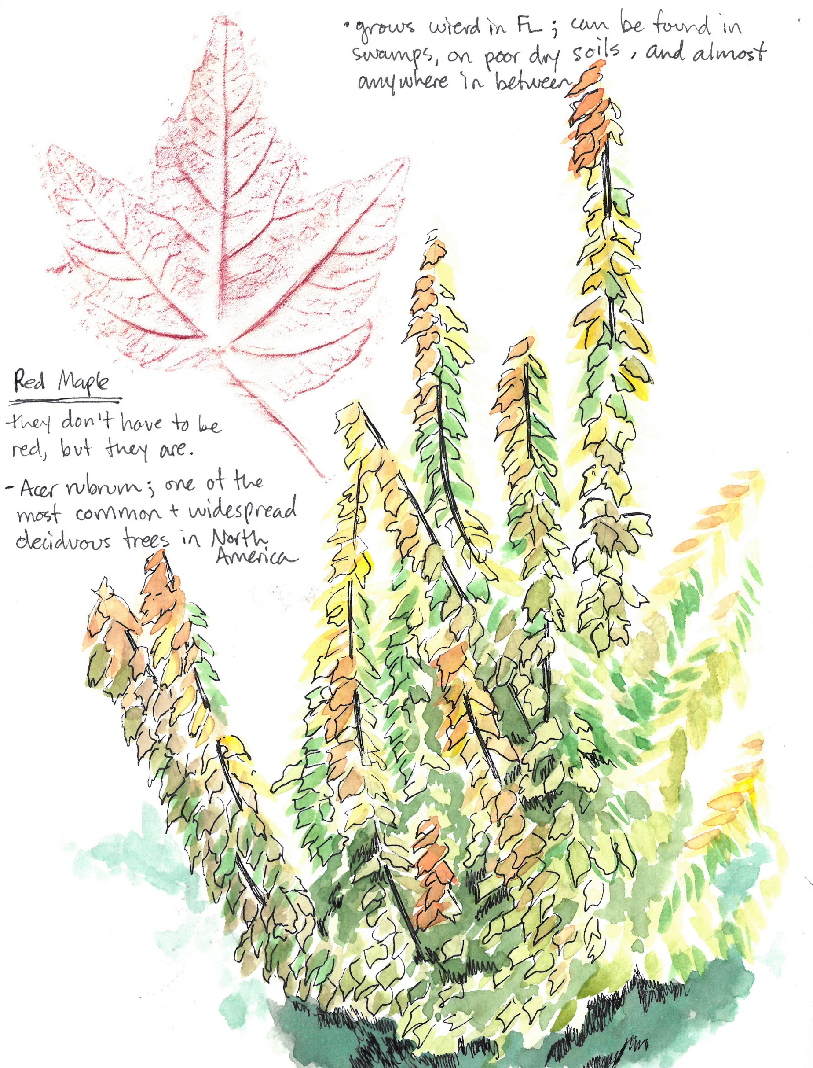
Homework
Observing as Citizen Scientists
Find a plant that has an interesting texture.
Draw and write your observations of that plant and its surrounding habitat.
Based on what you observe, guess how that plant’s texture might help it survive in the wild.
Notes:
For Homework:
Observing as Citizen Scientists
Find a plant that has an interesting texture. Be cautious, not all textures are friendly! Some plants can cause irritation or have large prickles or spines that can hurt you.
Draw the plant and write your observations of that plant and its surrounding habitat. Take note of the location and weather (humidity, rainfall, hot/cold). Is the plant in full sun or in shade? Write down every little observation you make.
Based on what you observe, guess how that plant’s texture might help it survive in the wild.
Post your plants on google classroom to get an id and to share your findings with each other. Once you have a positive identification for your plant, do some research on it and see if your guess about its texture was correct.

Slide 13
Class 5 Recap
Creating texture with lines
Patterns and Values
Adding Context
Demo: Tips on Texture
Homework Assignment
Notes:
Questions/Comments/Concerns

