Slide 1
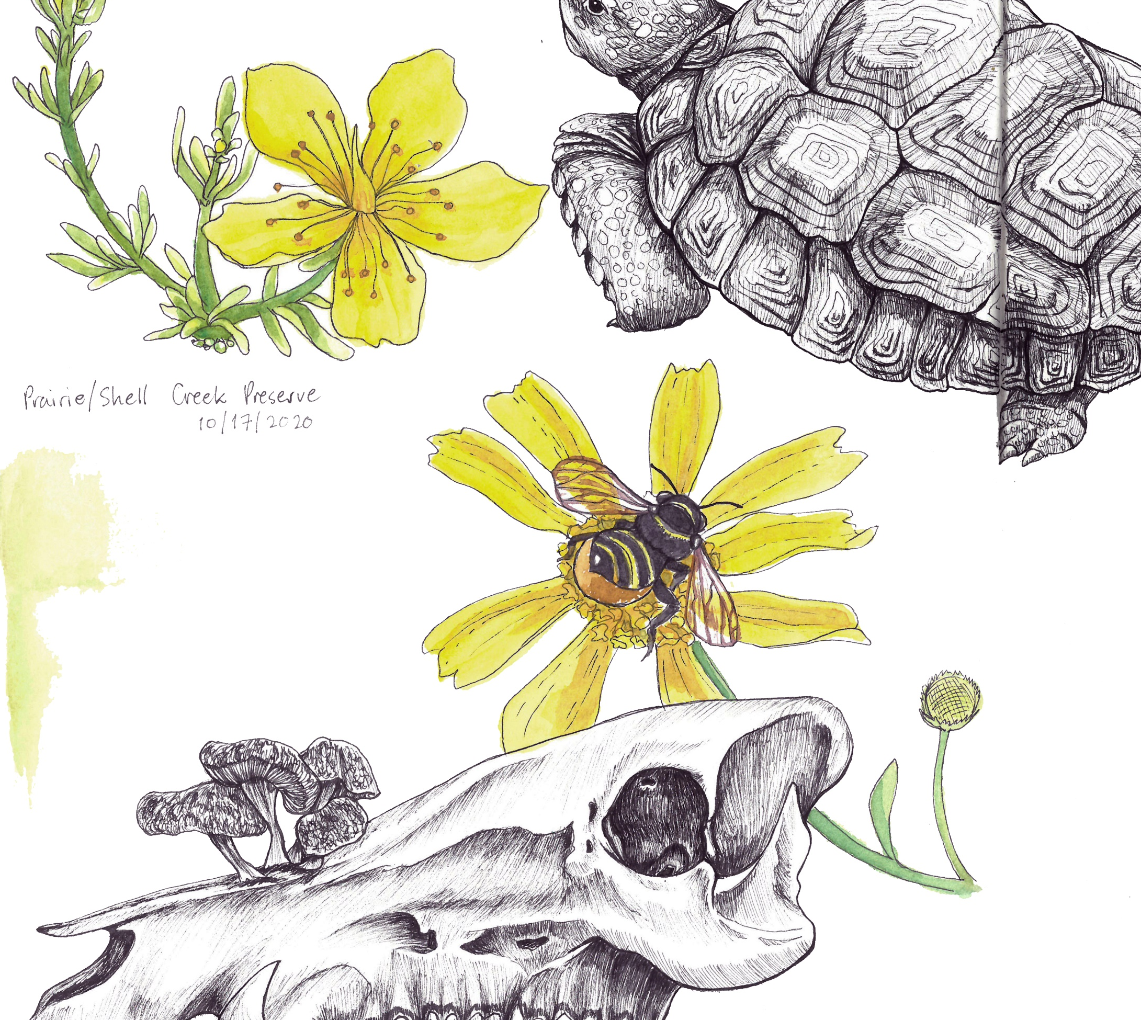
Introduction to
NATURE
JOURNALING
Connecting to nature through art and observation
Class 6:
Composition
Notes:
Buckle up folks we’re about to get ARTSY

Slide 2
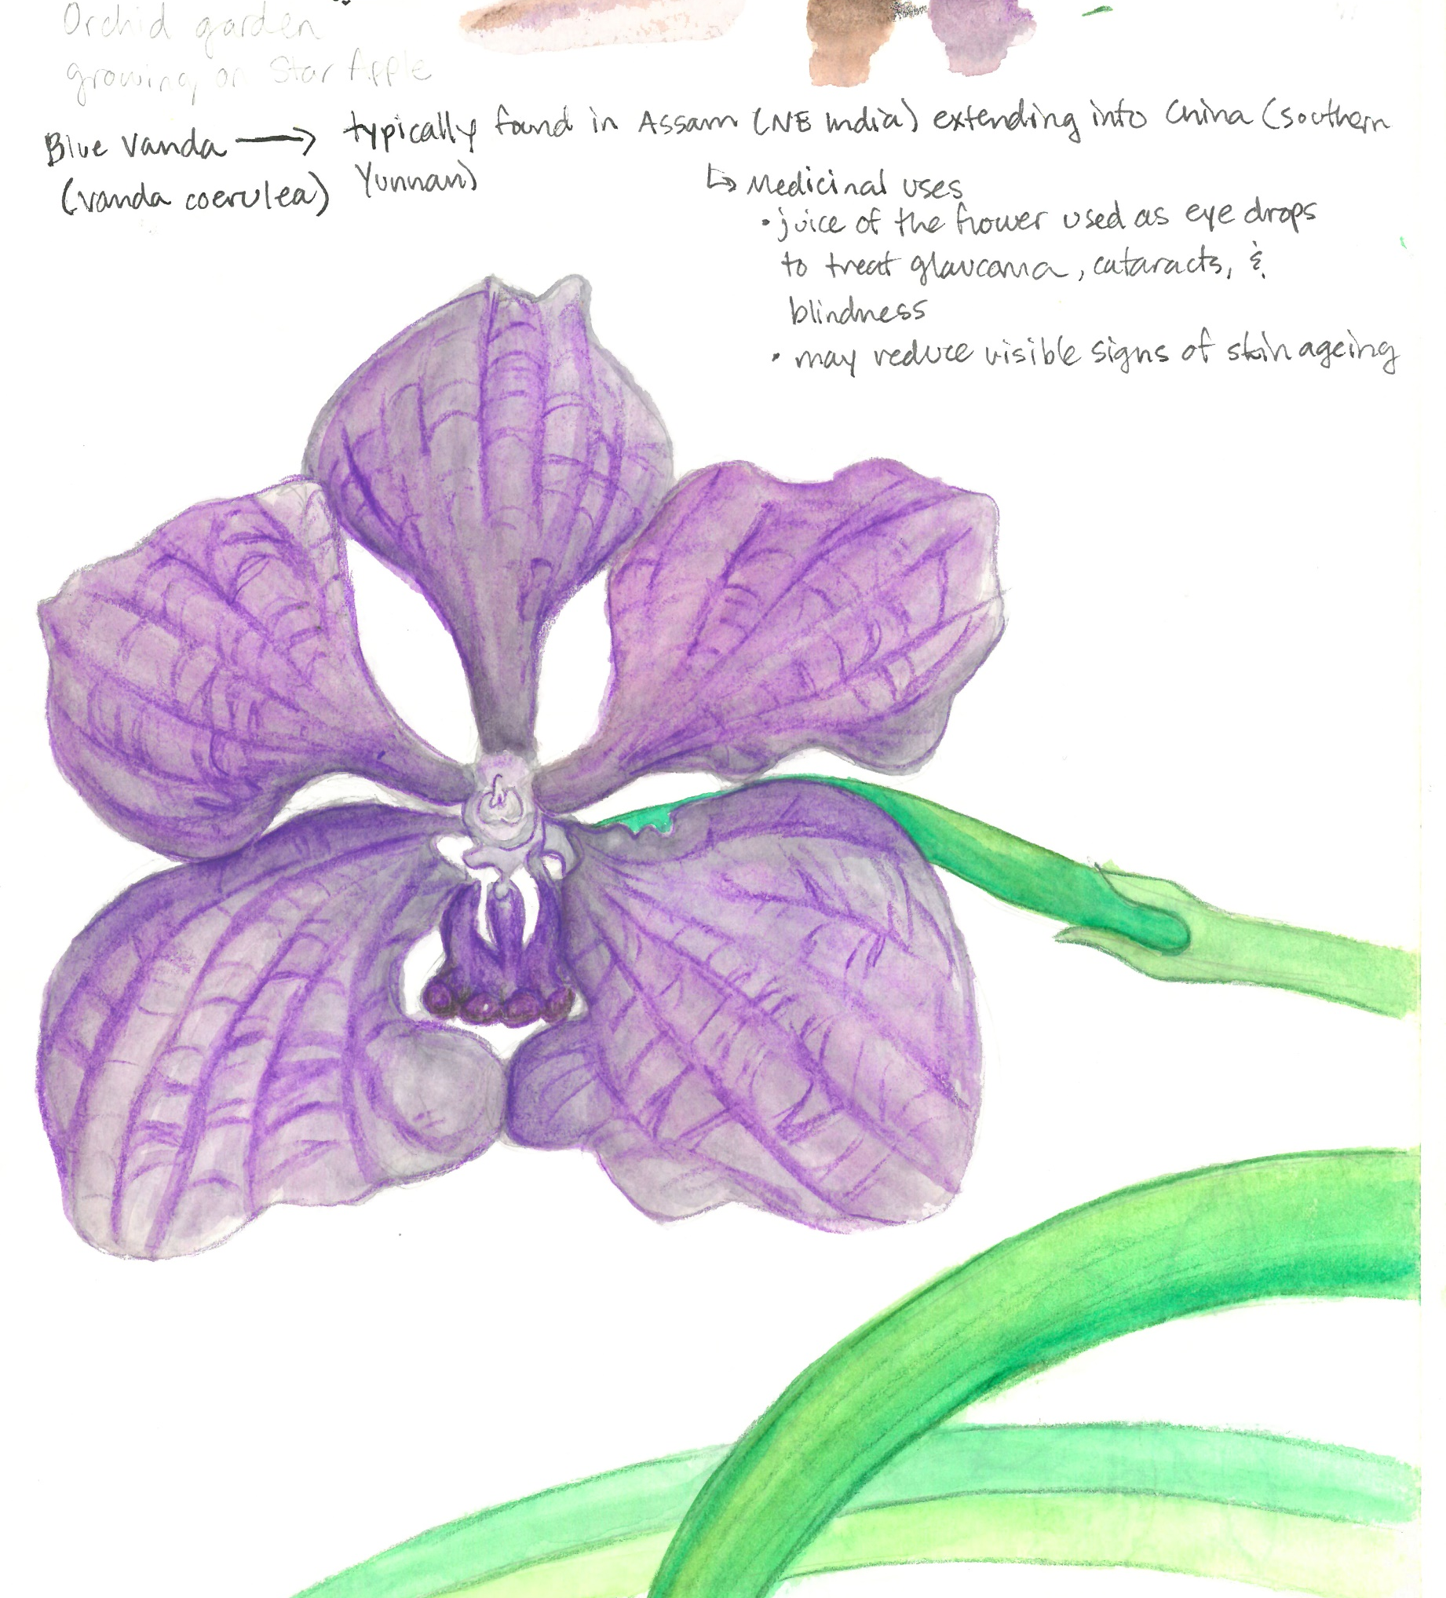

Class 6 Agenda
Warm-up Activity
What is Composition?
Arranging your Page
Homework

Slide 3
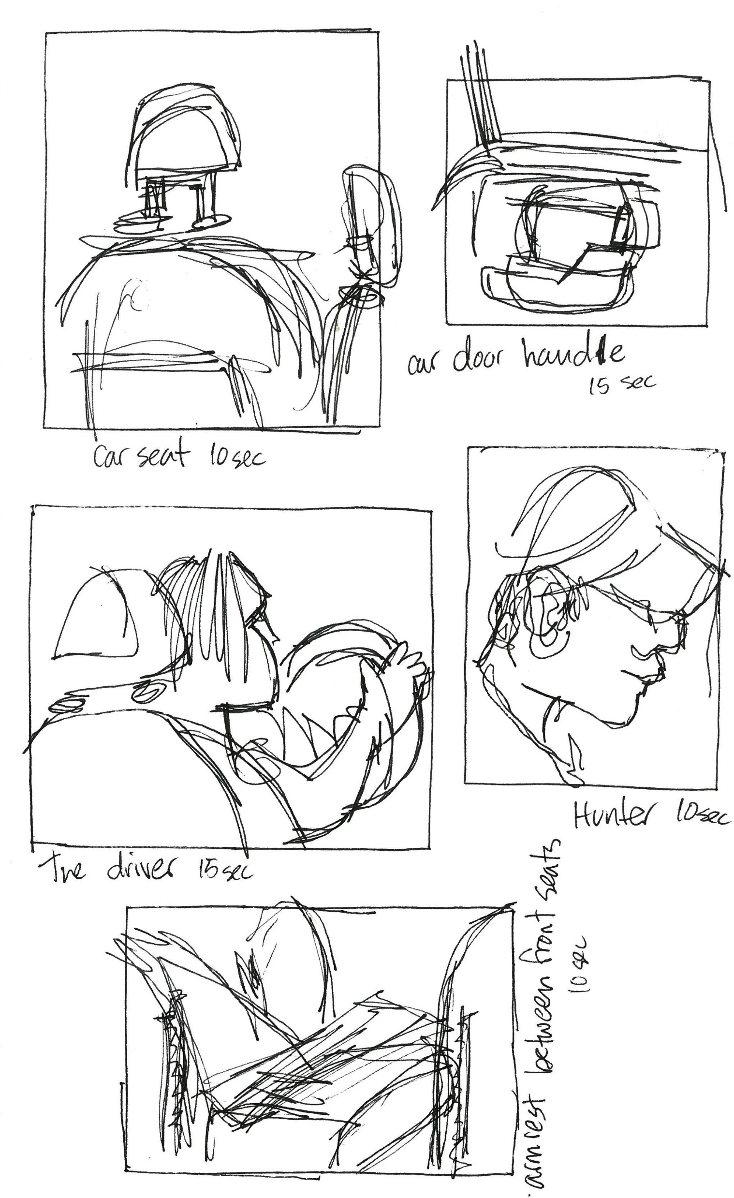
Warm-Up:
Blind Contour Drawings
Round 2
Choose one object in front of you or near you as your subject.
Use your pen! Without looking at your paper and without lifting your pen, draw your subject in each of the five boxes.
Each box is timed! Box 1: 1 minute, Box 2: 50 seconds, Box 3: 40 seconds, Box 4: 30 seconds. Box 5: 15 seconds.
Notes:
Today we’ll be revisiting the blind contour drawing exercise. Pay special attention to how you focus on larger, simpler shapes first. Freeing your hand from your eye will prevent you from focusing too much on details.
We’ll be using our Micron pens for this exercise. Let’s start off by quickly drawing five boxes on a blank page in our journals. They don’t have to be perfect, and they don’t have to be the same size.
Look around you and choose one object to focus on as your subject. Doesn’t matter what the object is, as long as you have a reference to fill each of the five boxes.
Draw your subject in one of the boxes without looking at the paper and without lifting your pen from the page.
We will only have 1 minute for each box. Abigail will set a timer; when you hear the timer, stop drawing. You can look at your paper to re-orient yourself and get ready to move to the next box.
These drawings are supposed to look a little goofy. That’s what makes blind contour drawings so charming! Remember, for this exercise the more abstract the final result is, the better.
Does someone want to share what they drew?
Did this exercise feel different this time vs the first time? Did your contour drawings look different?

Slide 4
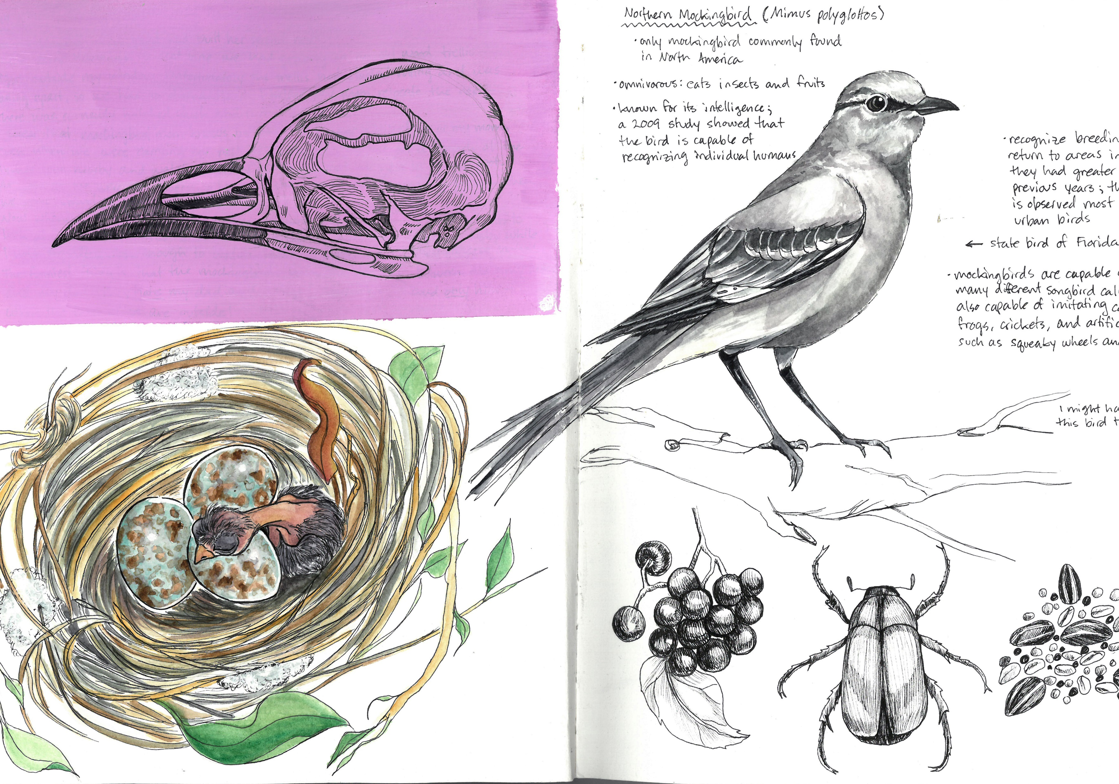
What is Composition?
Composition – the arrangement of visual elements in an artwork.
Components of composition:
Balance
Movement
Focus
Contrast
Pattern
Proportion
The components of composition come together to create unity.
Notes:
Composition is the arrangement of visual elements in an artwork. There are 6 main components of composition that, when used in combination, create a sense of unity in an illustration or final piece.
Let’s break down the components of composition and take a look at the effect they have on an artwork. You’ll find that as we go through the list, many of these components overlap. And as always, there are exceptions to every rule in art.

Slide 5
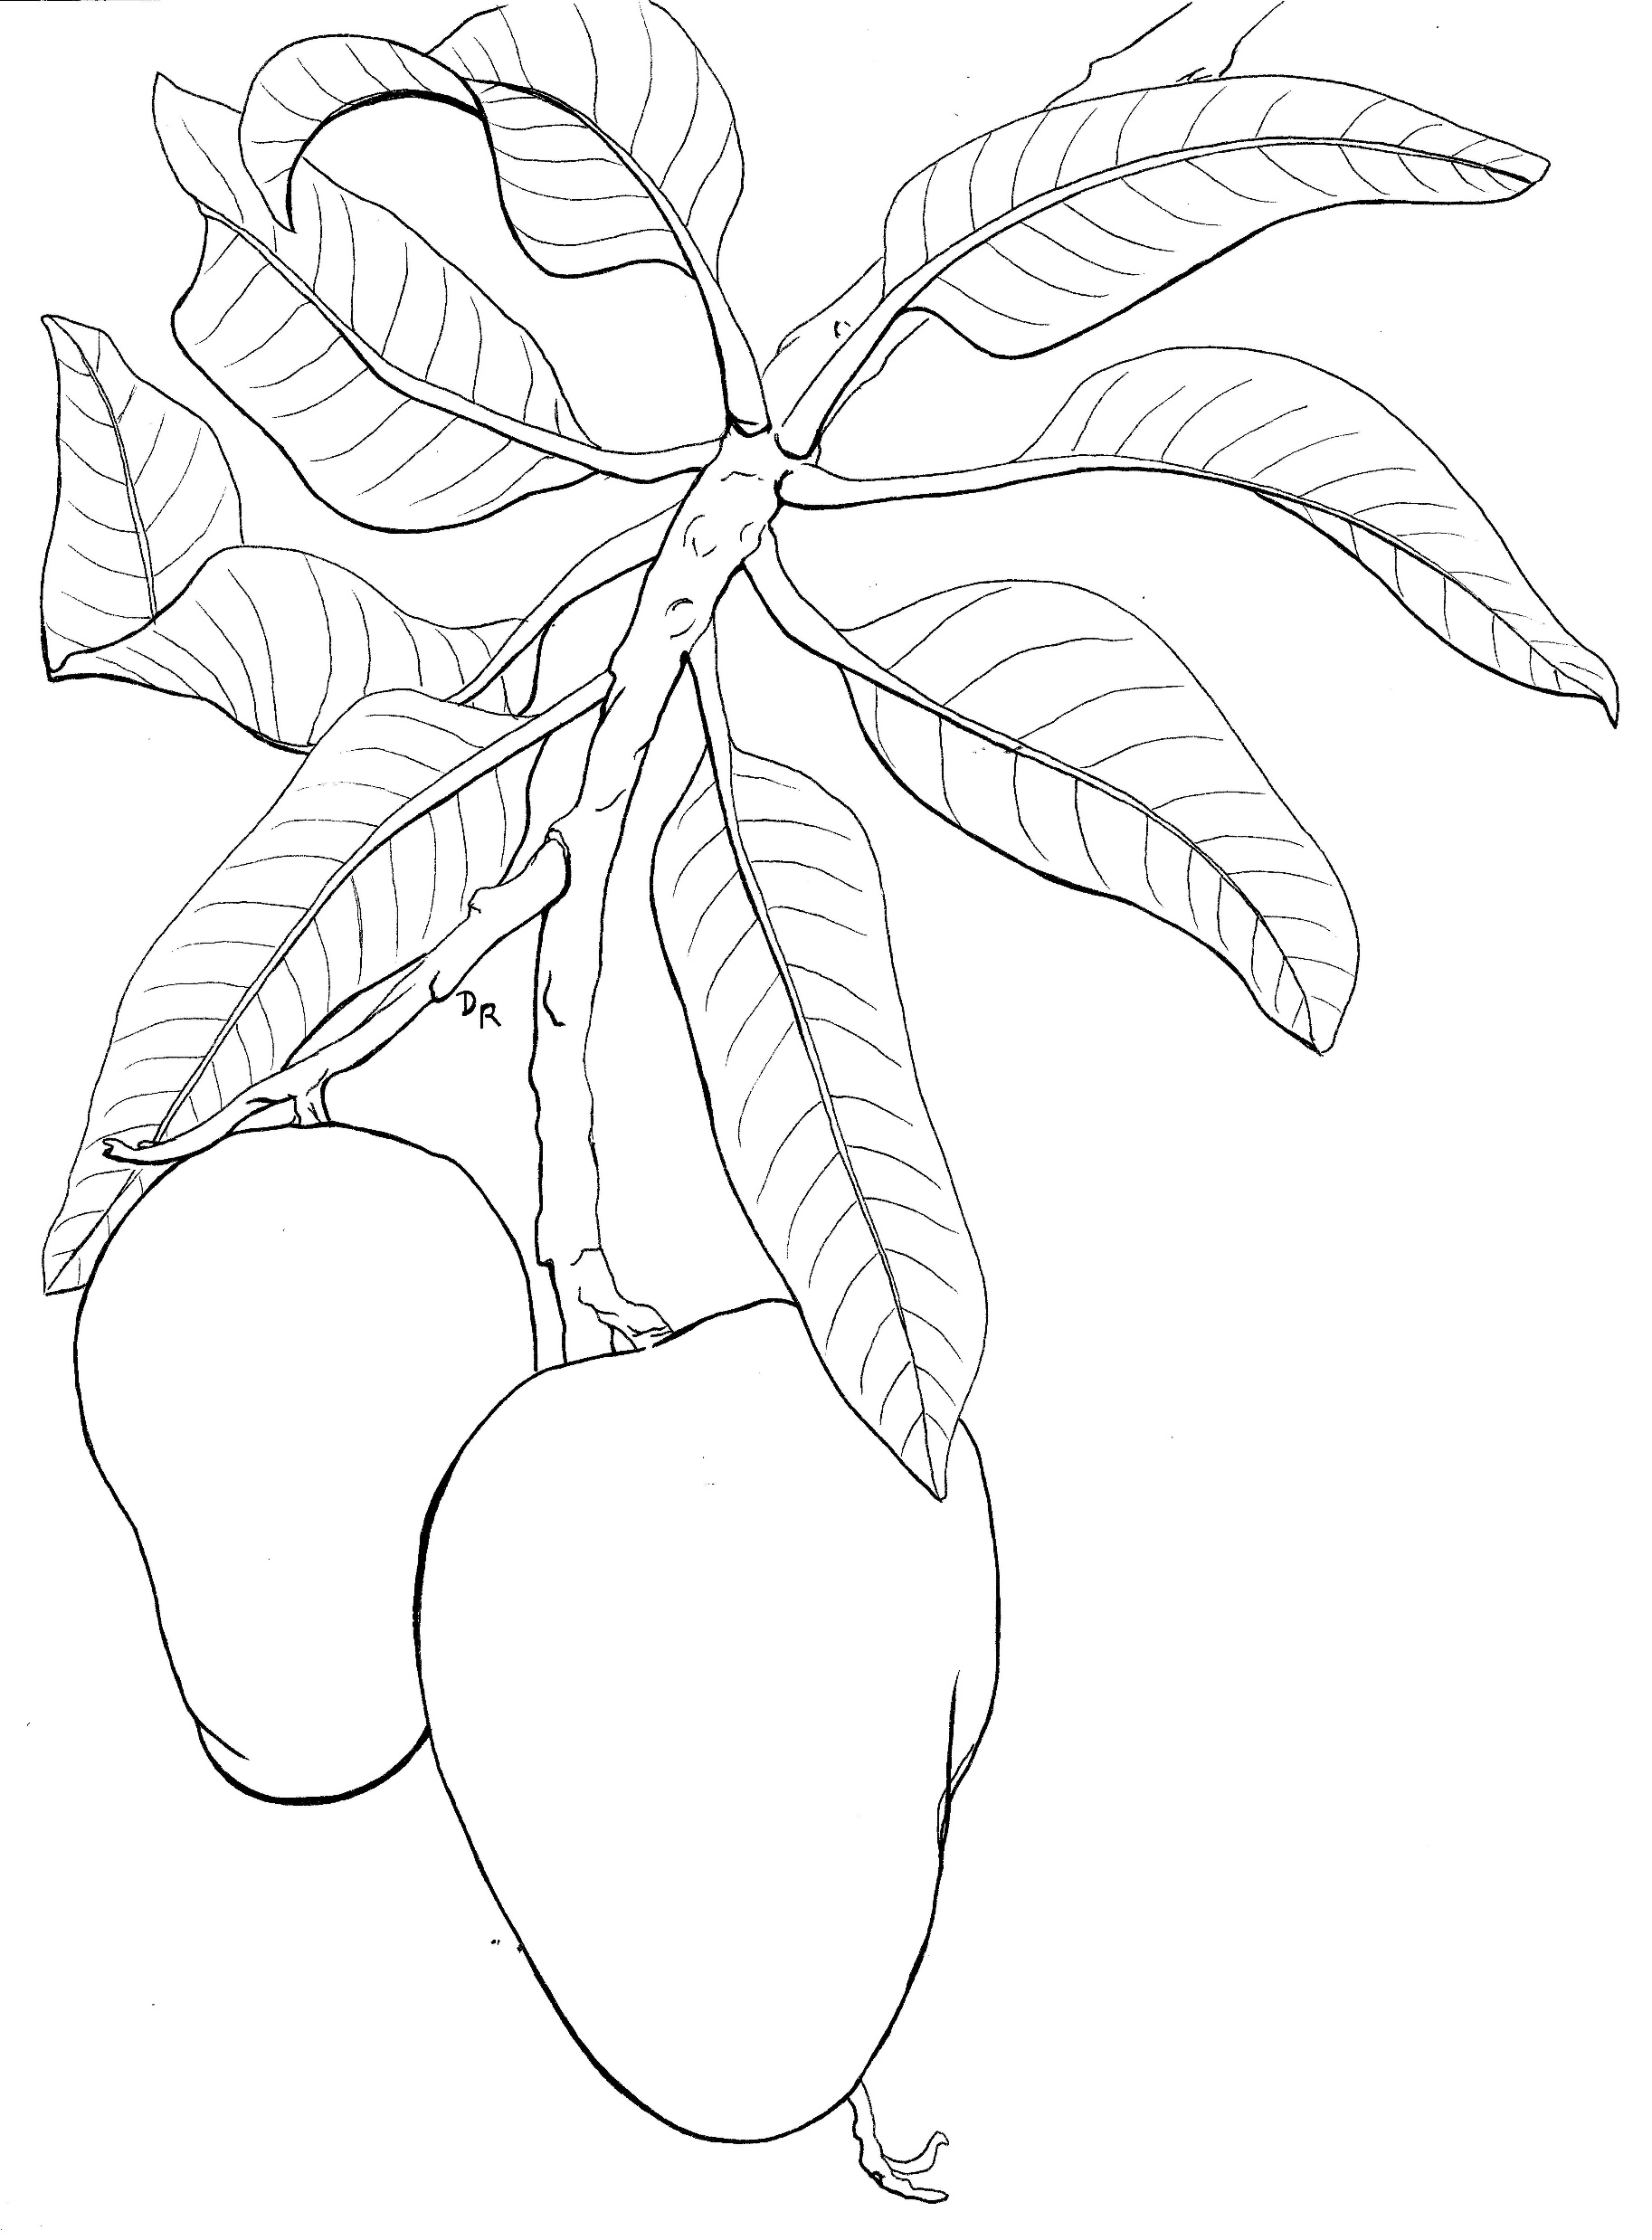
Balance – the distribution of visual weight in an artwork.
Movement – the path the viewer’s eye takes through a work of art.
Notes:
Balance is the distribution of the visual weight of line, color, texture, and form in an artwork. Balance is all about bringing visual stability to your art. The two most common types of balance are symmetrical and asymmetrical. Symmetrical balance is when you have an even distribution of visual weight on either side of an axis. Asymmetrical balance happens when one side of the axis has more visual weight than the other. Both types of balance can make an artwork more visually pleasing and interesting to look at.
Movement doesn’t always have to mean that something is in motion. In composition, movement is the path the viewer’s eye takes through a work of art. It’s how your eye moves from one focal area to another. Movement can be directed along lines, edges, shape, and color.

Slide 6
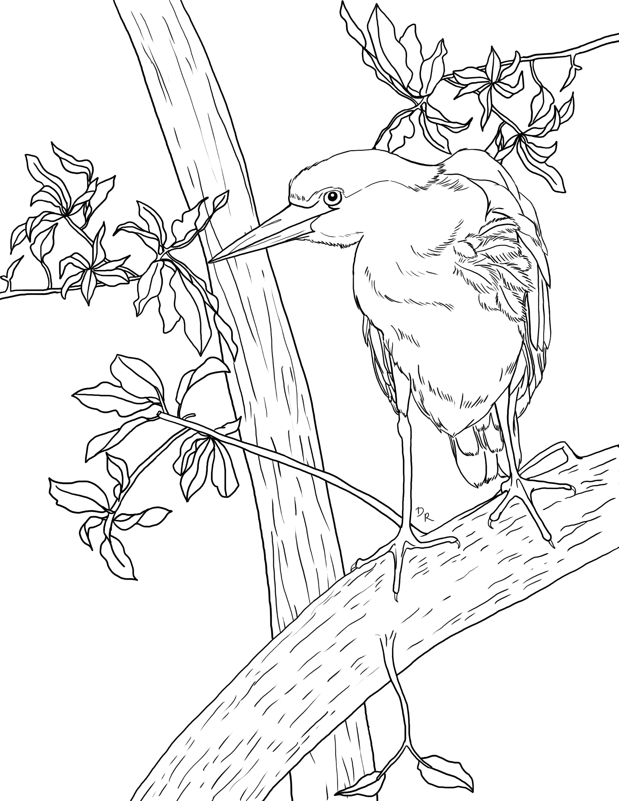
Focus – the area of emphasis in an artwork that demands the most attention.
Contrast – the effect achieved when opposite elements are arranged together.
Notes:
The focal point of a painting is an area of emphasis to which the viewer’s eye is immediately drawn. Having a strong focus/focal point can pull the viewer into an artwork and increase their engagement with it. Think of this as a bullseye on a target, and the arrows or darts are the viewer’s eyes. Where in your painting do you want to put your target? What is the first thing you want people to see when they look at your finished piece?
Contrast is achieved when opposite elements are arranged together. This creates an appealing and interesting effect in an artwork. There are many different types of contrast you can use to make your artwork really pop: contrasting colors, textures, line weight, object size, and even contrast between form and negative space.

Slide 7
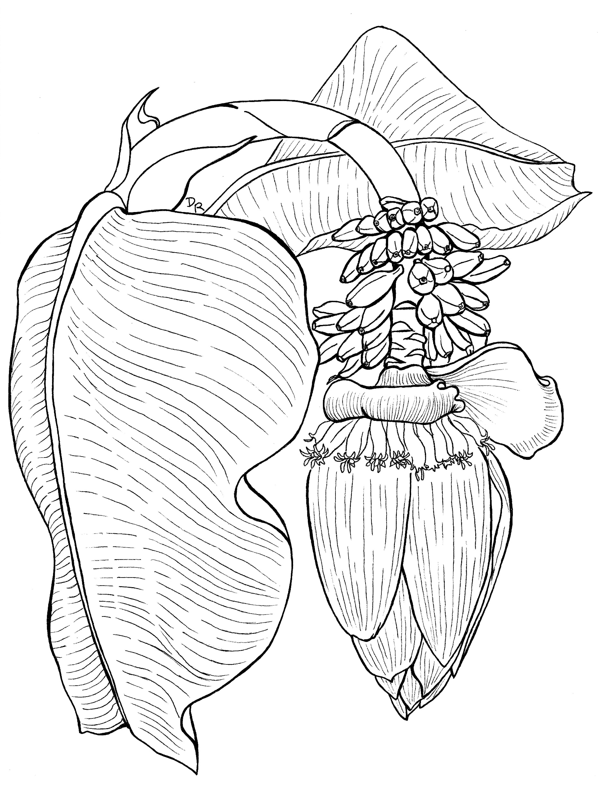
Pattern – a design in which lines, shapes, forms, or colors are repeated.
Proportion – the relationships between height, width, and depth.
Notes:
Pattern refers to the visual arrangement of elements in some form of repetition. Think of a line of trees, a floral dress, the way petals are arranged on a flower, or even the back-and-forth sway of ocean waves. Repetition can work with pattern to make an artwork seem active and can increase visual excitement by creating ‘surface interest’.
Proportion is all about the relationships between the height, width, and depth of the elements in an artwork. It can communicate how the sizes of different elements relate to each other. Think of how the size of a flower is different than the size of its leaves. In this example, we can see the mango leaves are about the same length as the fruit, which can tell us that the fruit is relatively young and may not be ripe yet. Proportion can also tell you how close or far away an object is. Larger objects appear more in the foreground, while smaller objects appear farther away from the viewer.

Slide 8
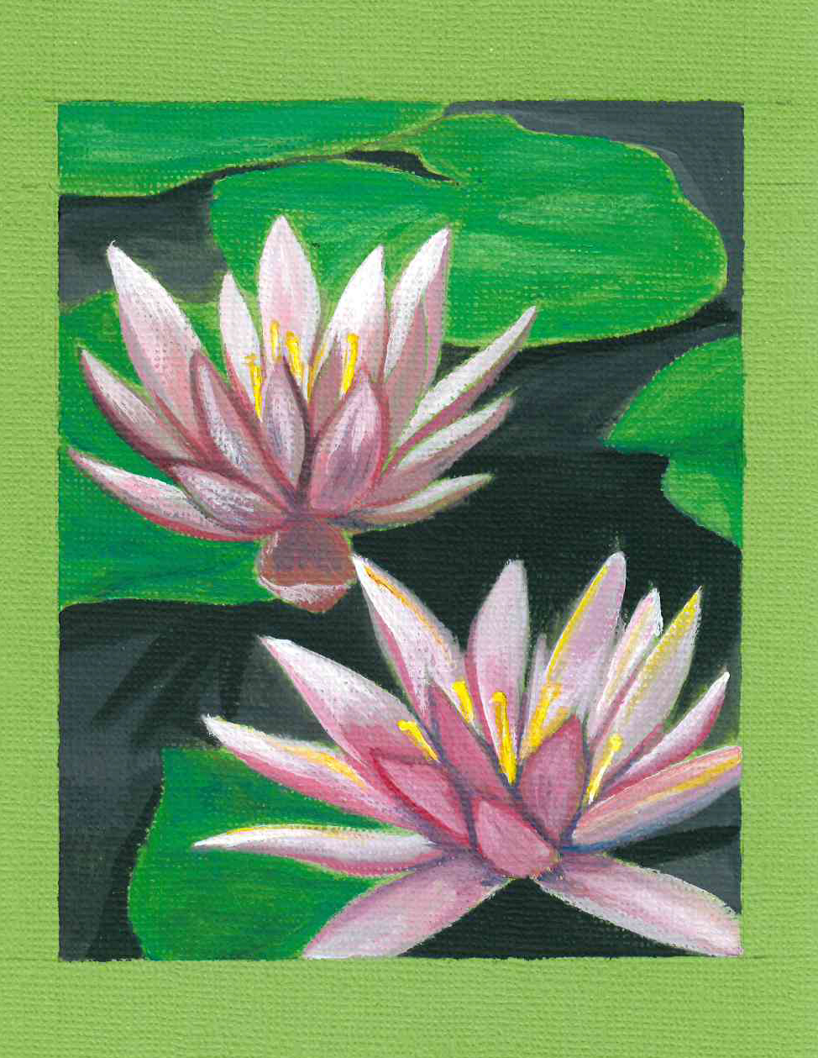
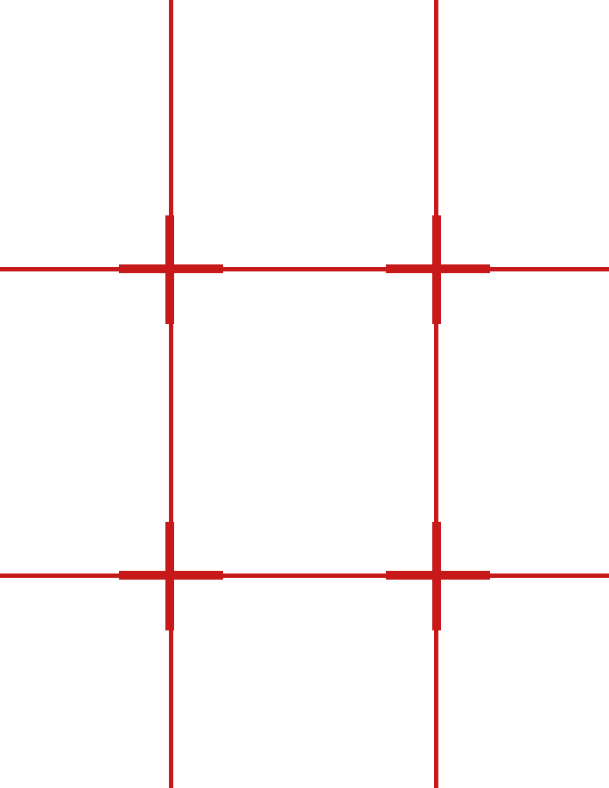
Arranging Your Page
The Rule of Thirds – an image is most appealing when the points of interest are placed along lines that divide the image into thirds.
Following the lines of a simple grid is a great way to practice using the rule of thirds.
Notes:
Remember, this is a guide for you to use as you see fit. You don’t need to place your design elements exactly along the grid lines if you don’t want to. The grid is a tool to train your eye to identify where on your page you can arrange your artwork to create a pleasing final effect.
There are always exceptions to the rules!
This tool is best used for arranging a final piece or a studio artwork. Don’t worry about using a grid for your field sketches or nature journal pages.

Slide 9
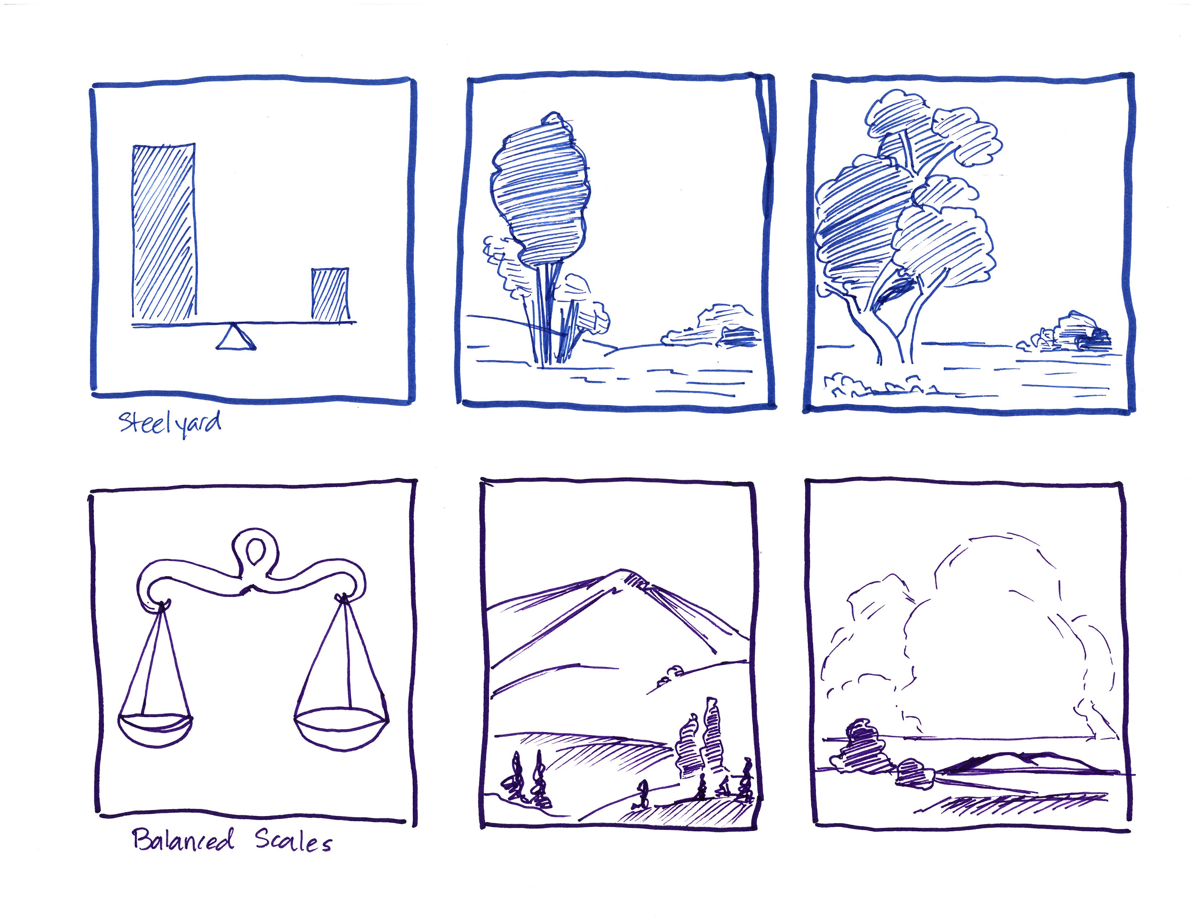
Steelyard
Balanced scales
Notes:
Practicing with your rule of thirds grid will open the opportunity to experiment with many different types of composition.
Here are a few examples of interesting ways you can use shapes to arrange the elements on your page.

Slide 10
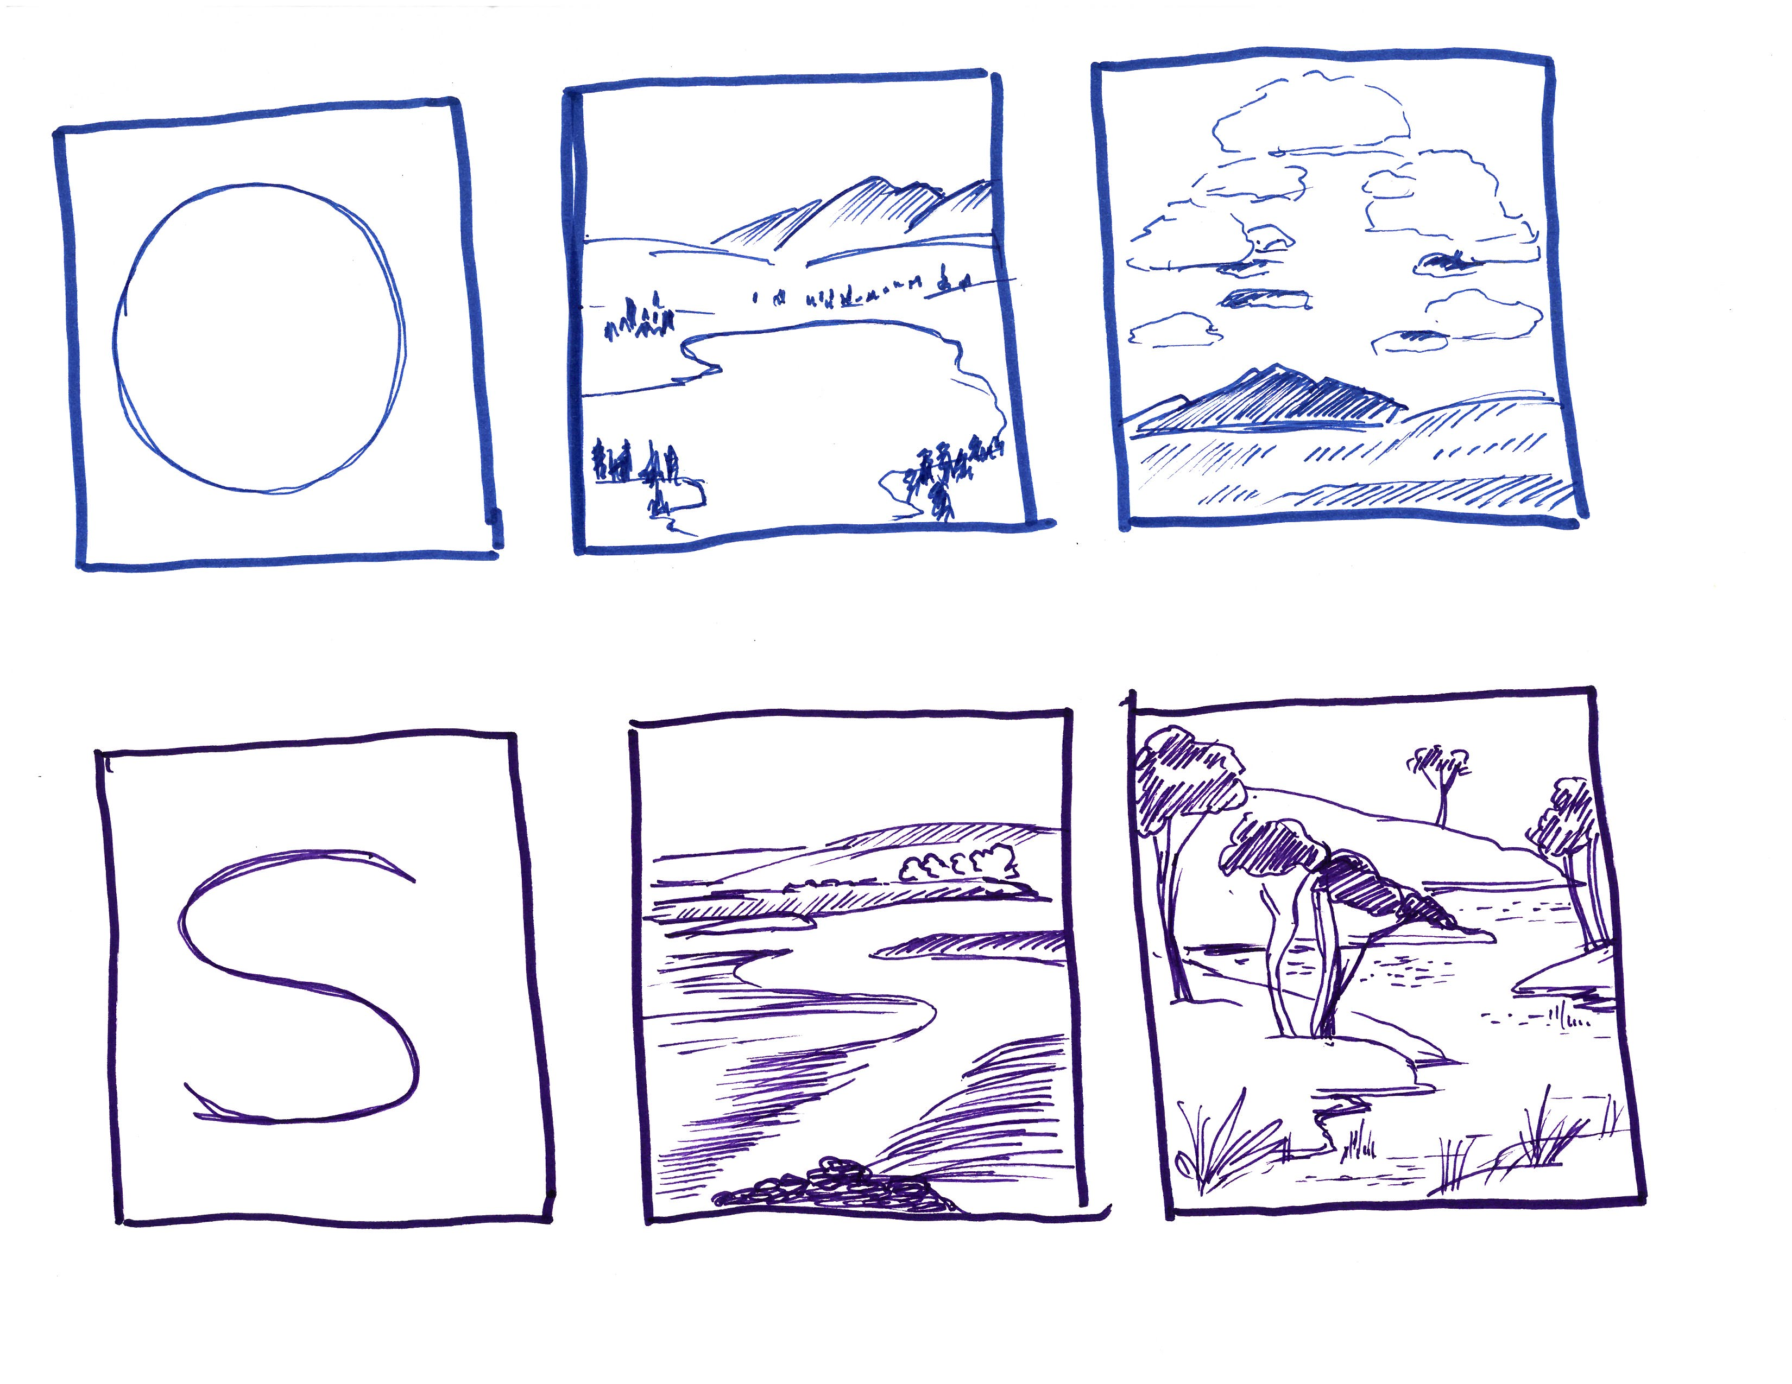
Circular
Compound curve
Notes:
Practicing with your rule of thirds grid will open the opportunity to experiment with many different types of composition.
Here are a few examples of interesting ways you can use shapes to arrange the elements on your page.

Slide 11
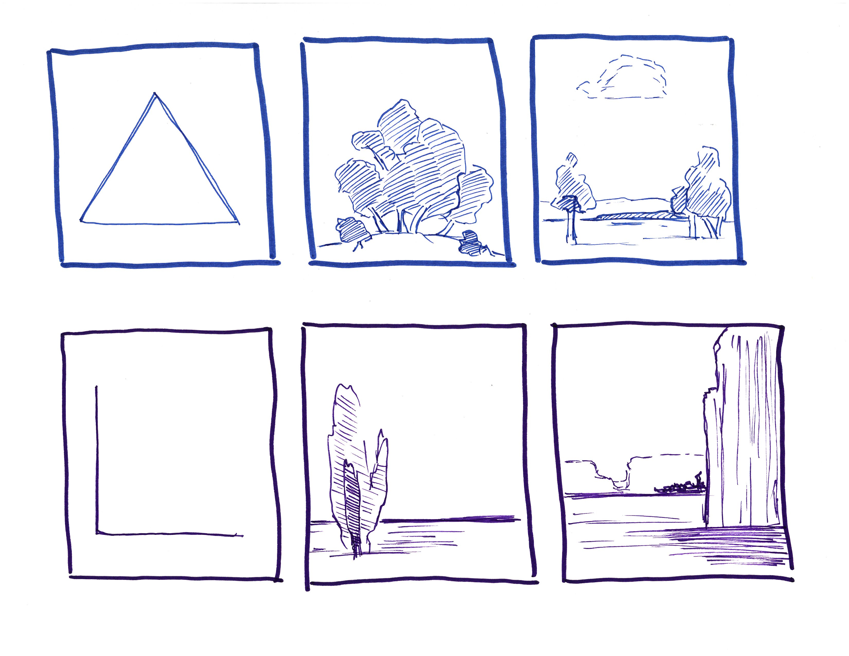
Triangle
L-shape
Notes:
Practicing with your rule of thirds grid will open the opportunity to experiment with many different types of composition.
Here are a few examples of interesting ways you can use shapes to arrange the elements on your page.

Slide 12
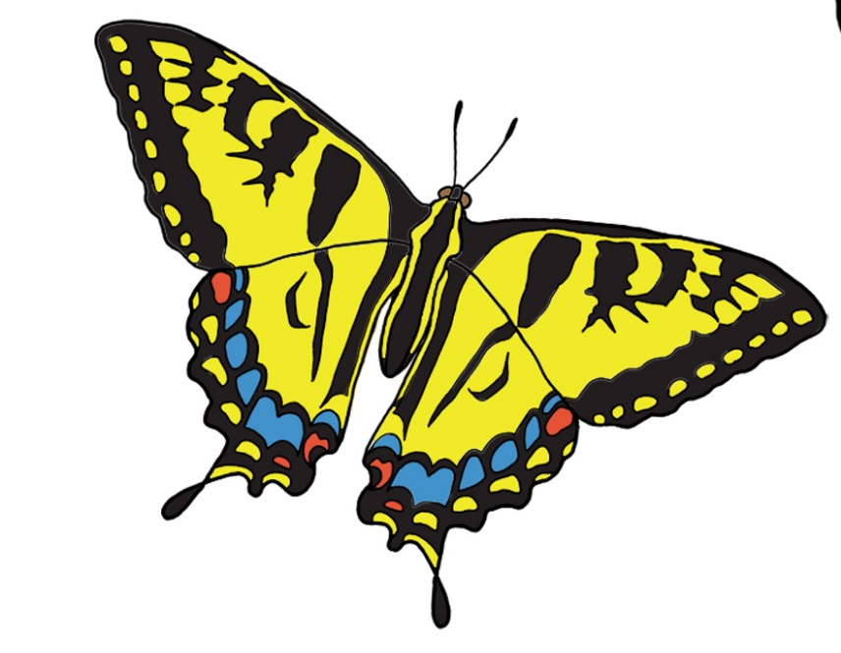

No Homework!
Work on finishing up your final pieces.
What inspires you in nature?
Notes:
For Homework:

Slide 13
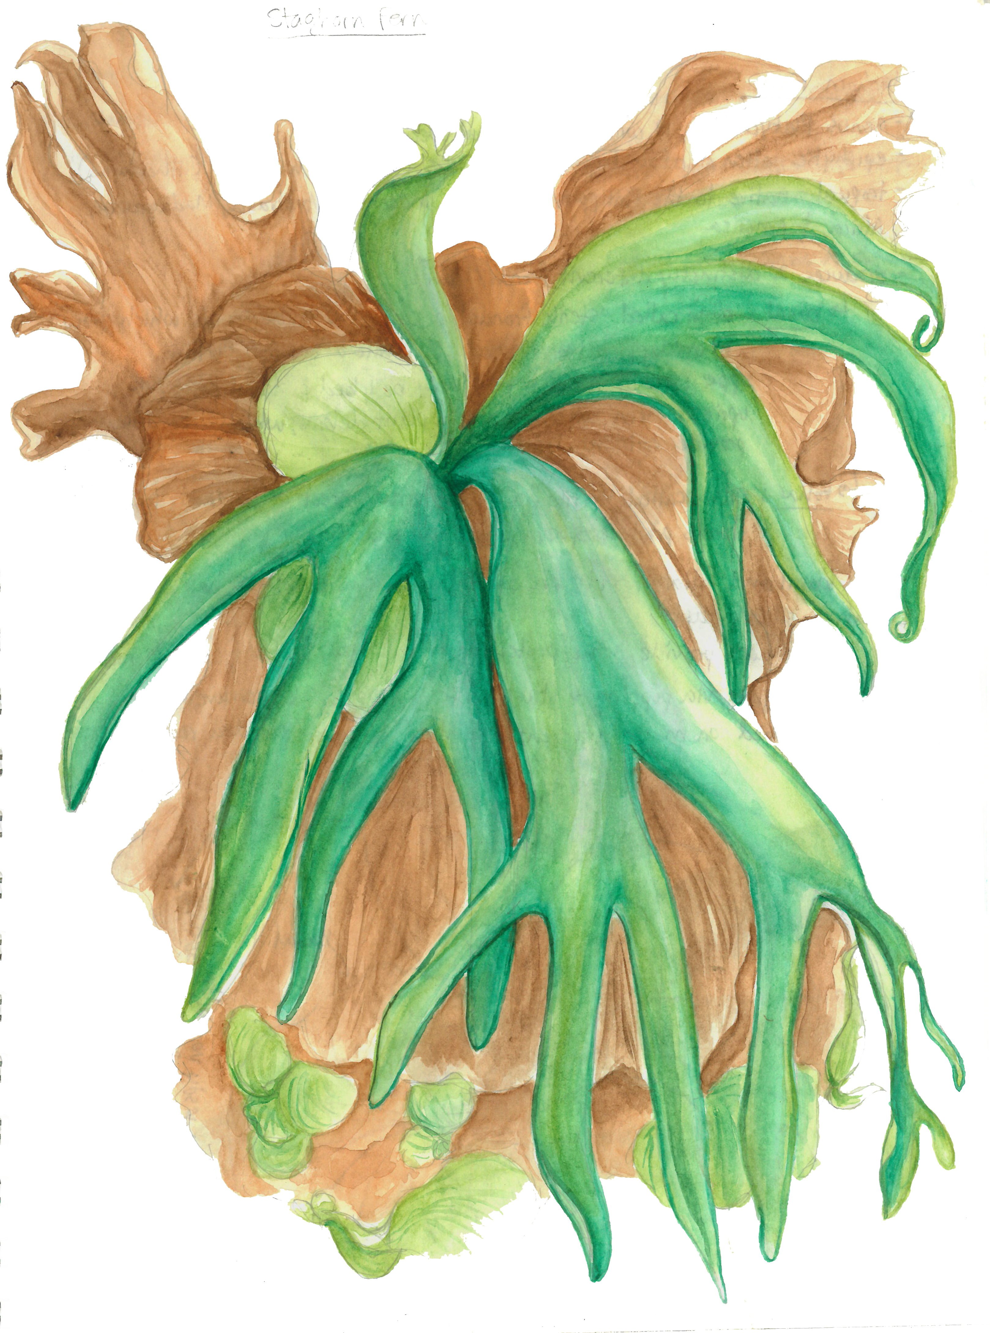
Final Piece Criteria
Submit one (1) final piece.
The artist statement must be typed and emailed to Anny at ajaraba@naplesgarden.org.
Artist statements must be a maximum of 3-4 sentences long.
Don’t forget to sign your work!
Notes:
Submit one final piece.
You will find two sheets of 8x10” watercolor paper in you supply pack. There is an extra piece of final piece paper included for you to practice on.
To submit a final piece, you must use the 8x10” watercolor paper supplied to you.
You may only submit one final piece.
The artist statement must be typed.
Do not write your artist statement on your final piece.
You can email your artist statement to me or to Abigail if you have questions or would like feedback.
Artist statements must be a maximum of 3-4 sentences long.
Sign your final piece in the bottom right corner of your paper. Use your favorite signature or print your name.

Slide 14
Class 6 Recap
Blind Contour Drawing
What is Composition?
Arranging your Page
Homework

