Slide 1
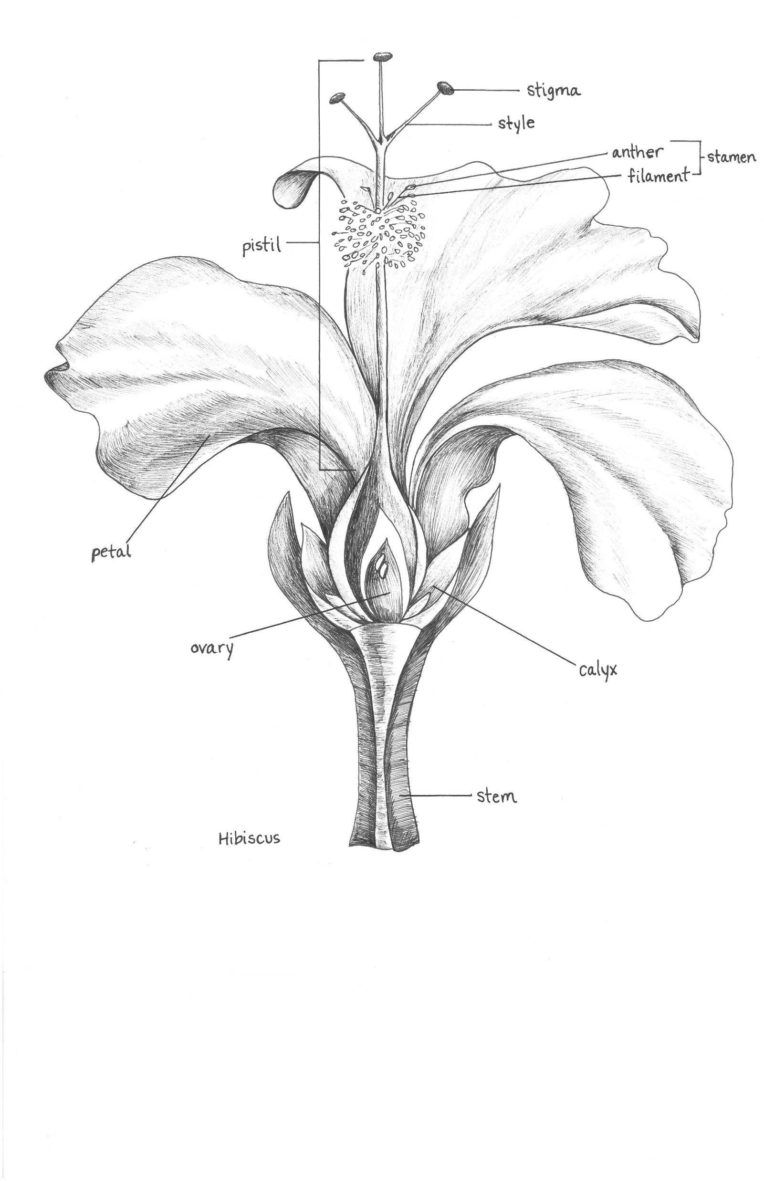
Introduction to NATURE JOURNALING Connecting to nature through art and observation
Class 7:
Making Sense of
Structure
Notes:
Buckle up folks we’re about to get ARTSY

Slide 2
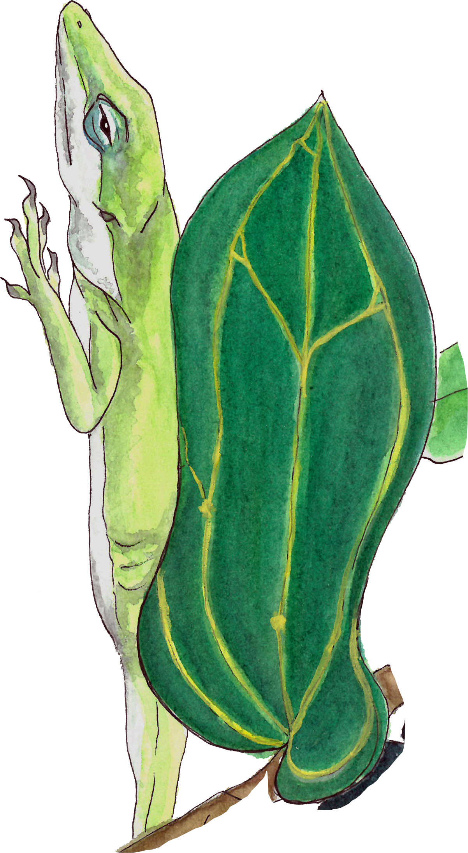
Class 7 Agenda
Warm-up Activity
Structure and Growth of Leaves
Common Flower Parts
Homework & Final Touches on your Final Pieces
Demo: Tips, Tricks, and Techniques

Slide 3
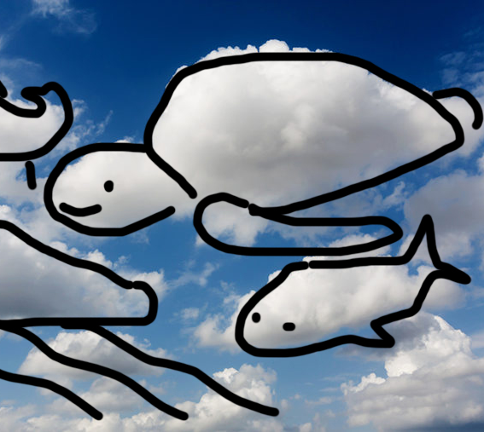
Warm-Up:
‘Cloud’ Gazing
Choose your favorite color from your watercolor pencil kit.
Paint loose blobs of color on a blank page in your journal. Let the paint dry for a moment, then draw details with your pen.
Look for shapes that pop out at you or that remind you of something. Get creative and don’t be afraid to be silly!
Notes:
Today we’ll be
Break a few pieces of the pigment into the lid of your pencil tin, or another small container. Add 2-3 drops of water and mix well. Don’t put too much otherwise the color will be too light and will take too long to dry.
Start on one side of the page, then fill the space as you go. Once you’re done filling the page/designated space, the shapes you began with should already be dry.

Slide 4
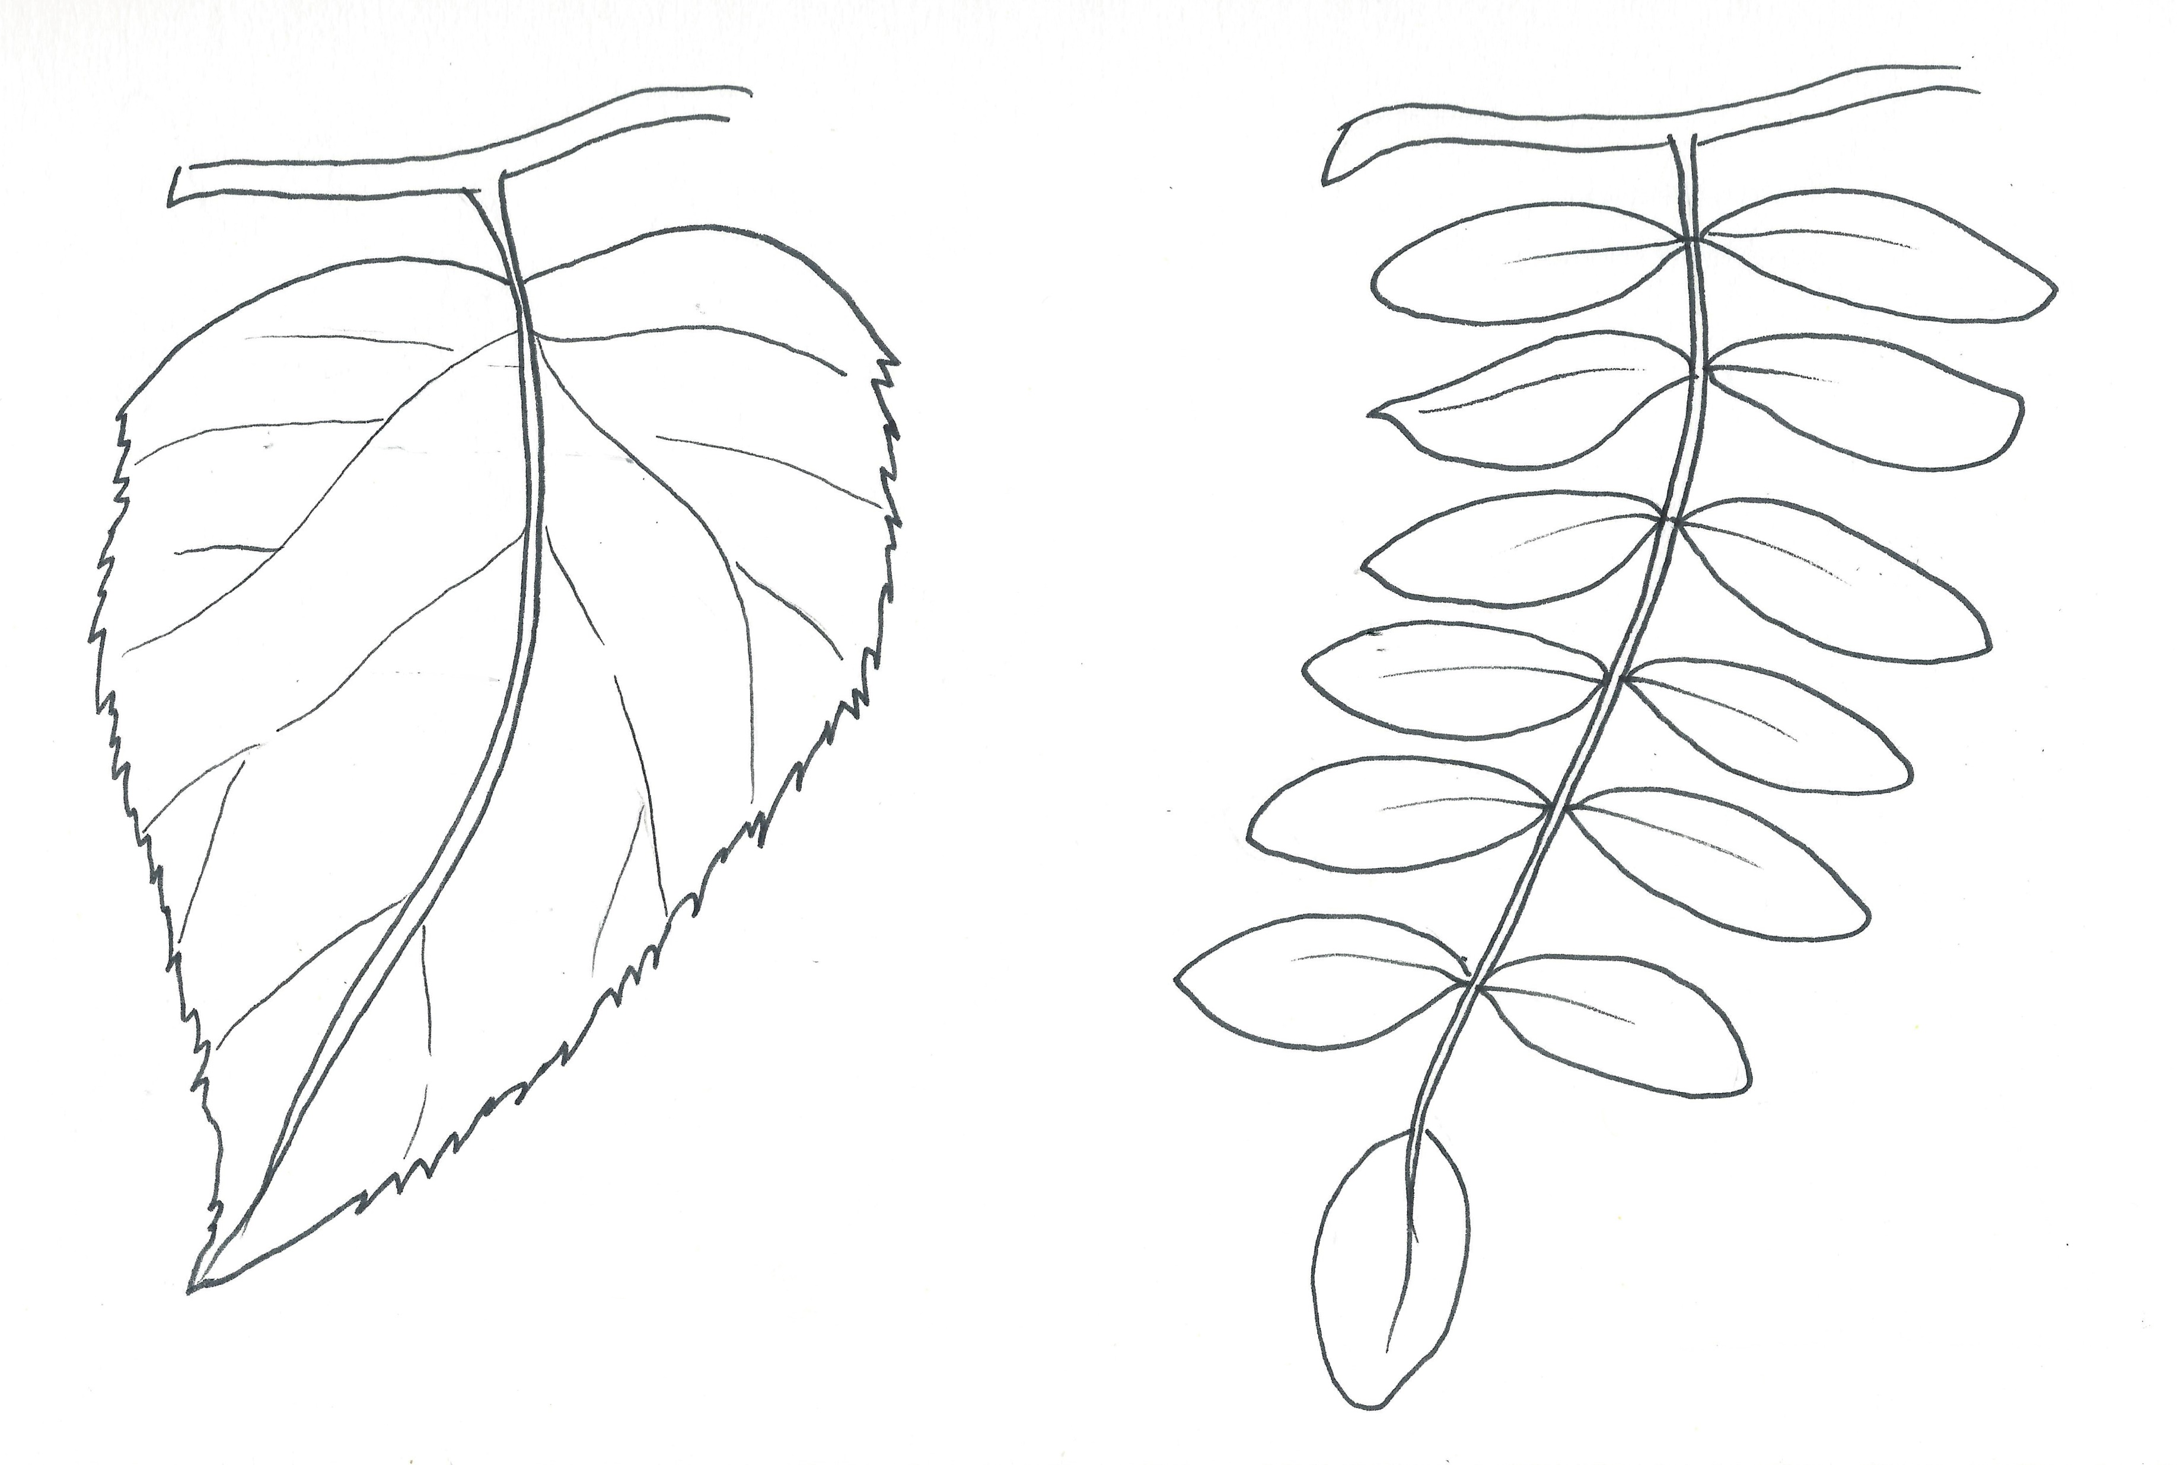
Structure and Growth of Leaves
Stem
Blade
Margin
Leaflets
Primary Vein or Midrib
Simple leaf:
Has one blade per leaf.
Compound leaf:
Has more than one blade per leaf.
Notes:
The way plants grow is important to their structure and survival. Part of nature journaling is accurately recording the plants and animals you observe in nature.
Simple leaf – having one blade per leaf
Compound leaf – having more than one blade per leaf. The multiple blades are called leaflets.

Slide 5
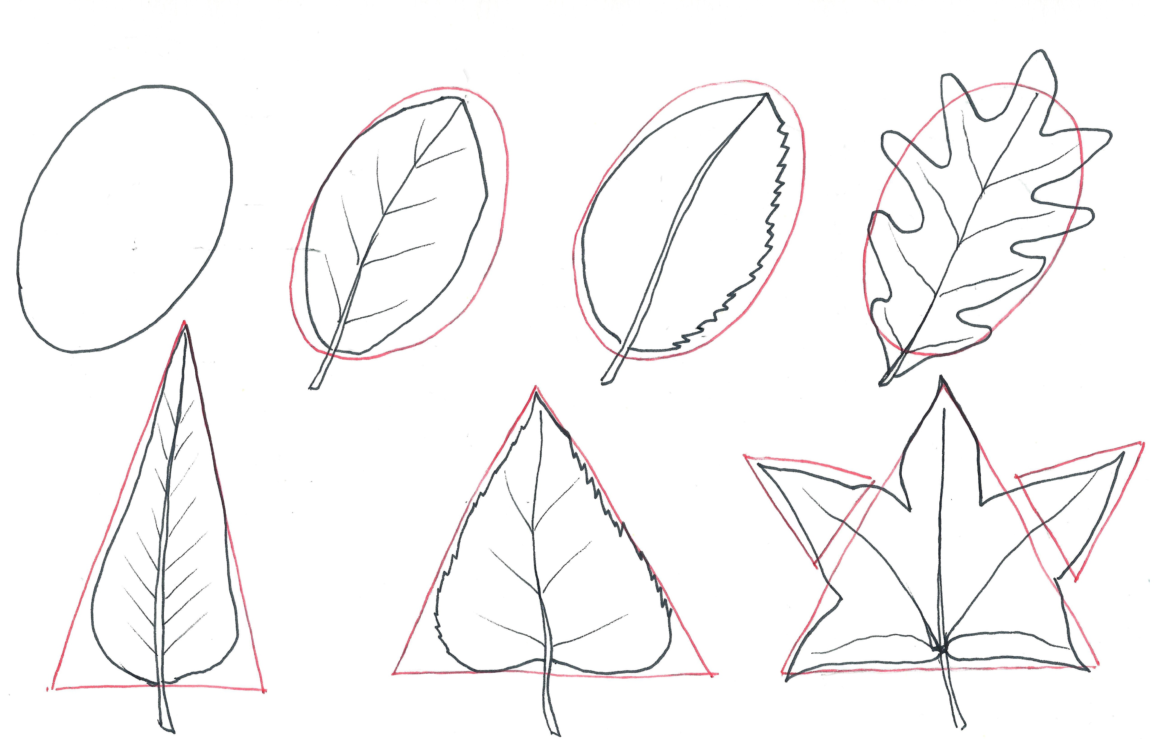



Types of Leaf Shape
Lanceolate
Deltoid
Oval
Star
Notes:
The way plants grow is important to their structure and survival. Part of nature journaling is accurately recording the plants and animals you observe in nature.
Lanceolate – willow
Deltiod – common smilax, sacred fig (Ficus religiosa)
Oval – mangroves, magnolias
Star – red maple
In between working on your final pieces, see if you can find these shapes in nature.

Slide 6

Types of Leaf Margins
Entire – Has a smooth edge.
Dentate – Has triangular, tooth-like teeth.
Lobed – Has rounded segments not divided all the way to the midrib.

Slide 7
Common Flower Parts
Pistil – the female part of the flower; made up of the stigma, style, and ovary.
Stamen – the male part of the flower; made up of the anther and filament.
Pollination occurs when the pollen grains on the anther of one flower are transferred to the stigma of the same flower, or one on a different plant of the same species.
Notes:
The female reproductive organ is called the pistil. The pistil is composed of three parts; the stigma, style, and ovary. The stigma is the receptive tip for pollen and is often sticky to ensure it catches at least a few pollen grains. The style is the stalk that leads pollen to the ovary of the plant.
Once the pollen has landed on the female part of the flower called the stigma, it will begin to germinate and travel down a pollen tube that grows down through the style. Think of this as a pollen highway. This highway takes the pollen into the ovary. The ovary is located at the base of the flower and houses unfertilized ovules which will then develop into seeds. What becomes the fruit? After fertilization, the ovary will become the fruit.

Slide 8
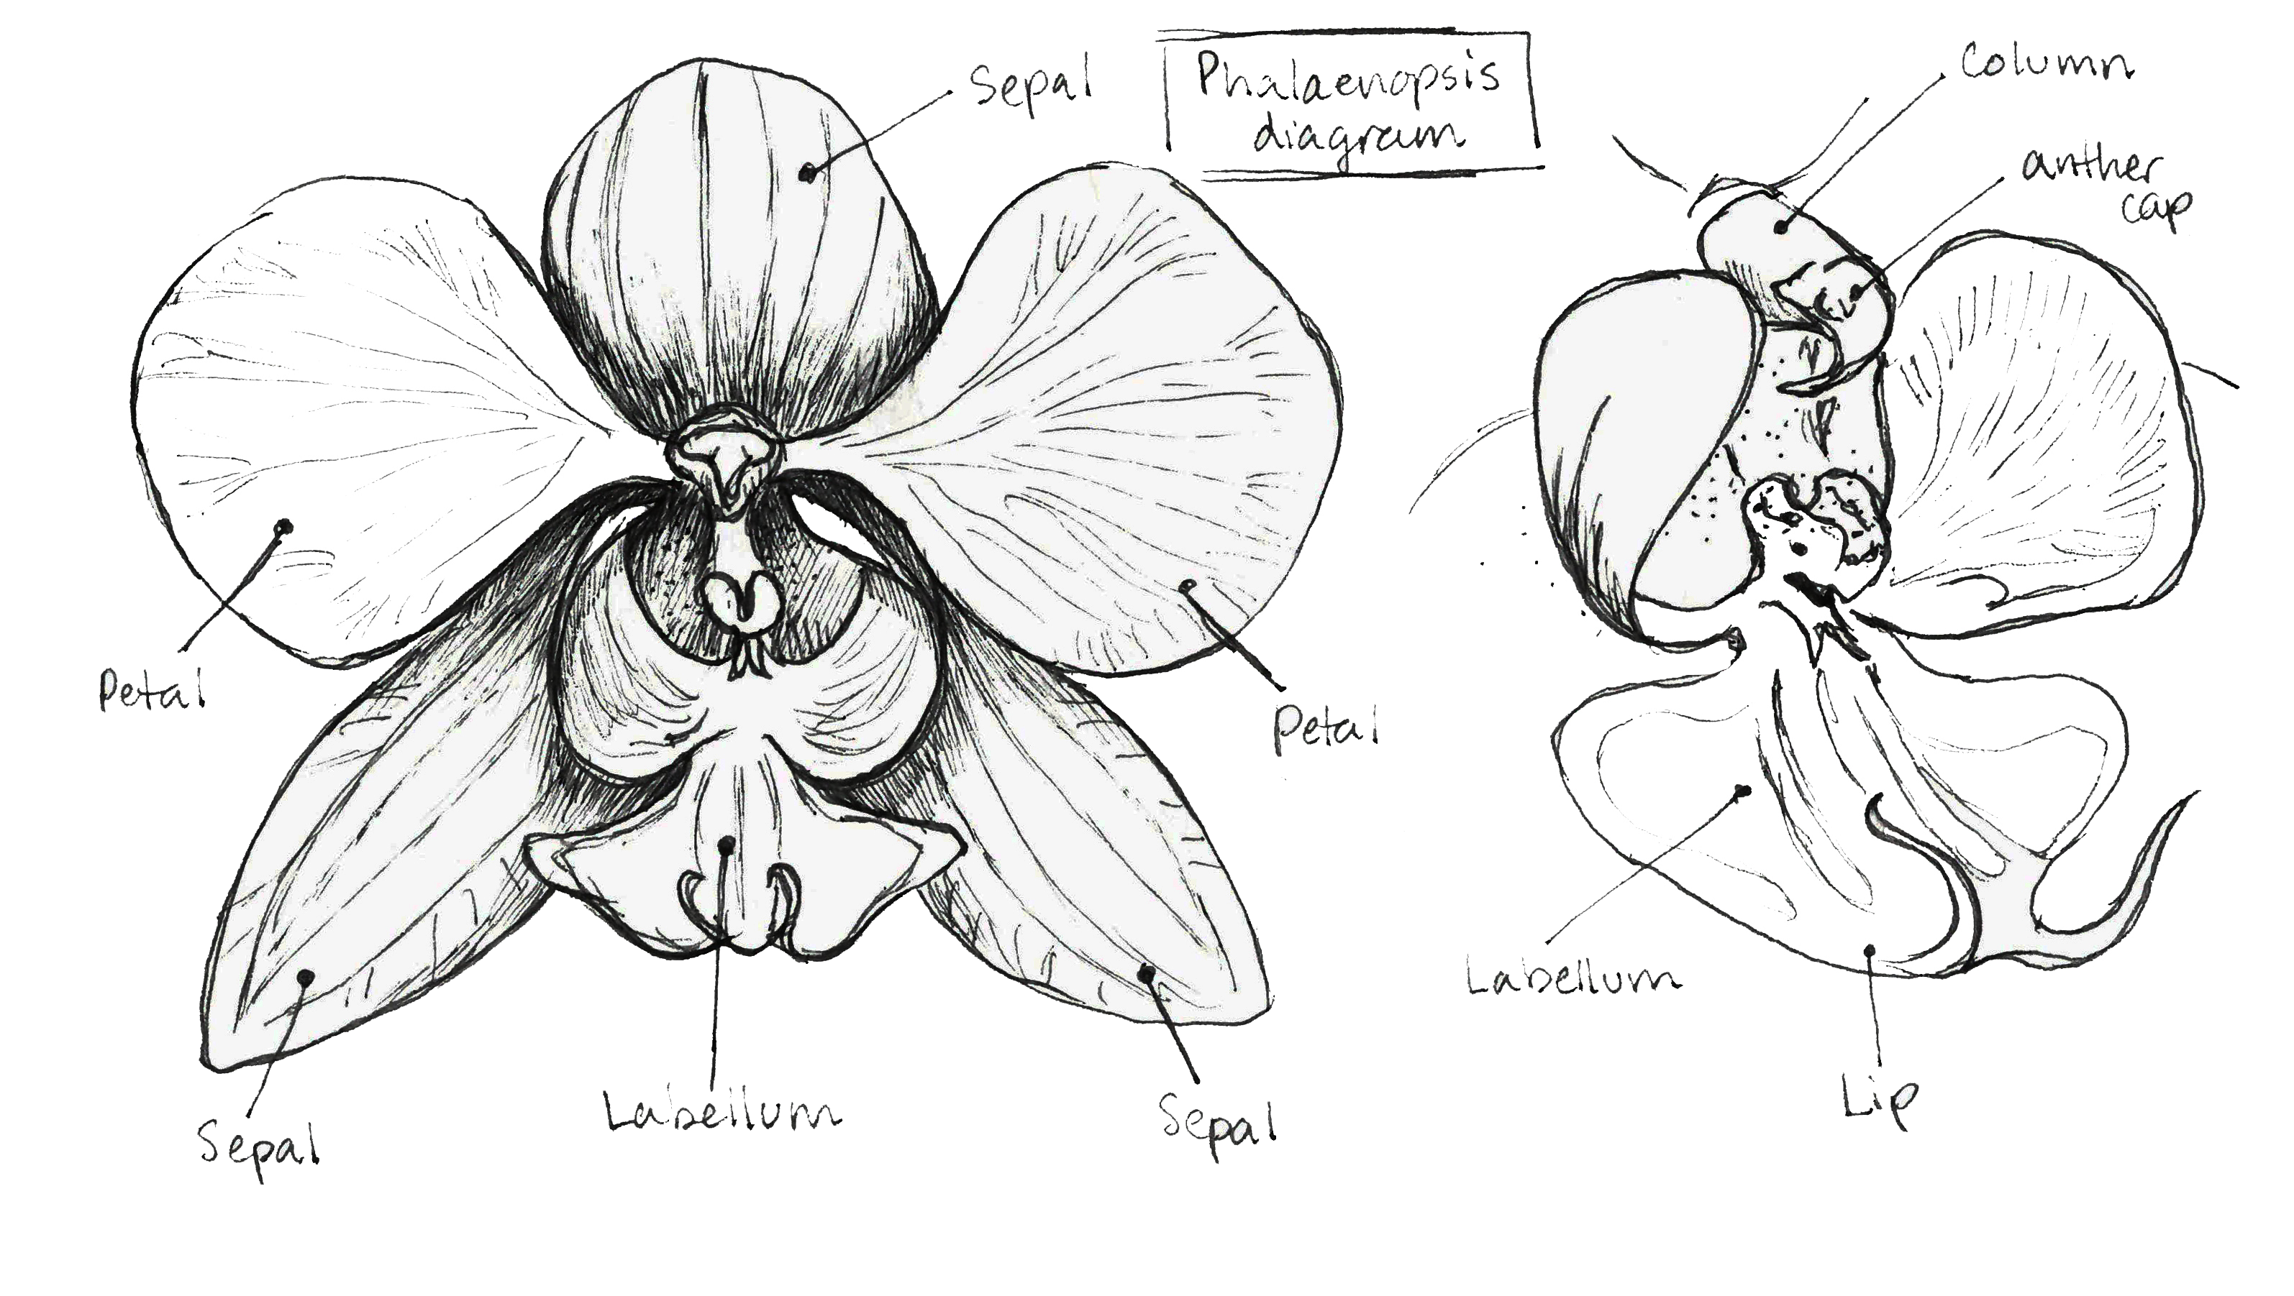
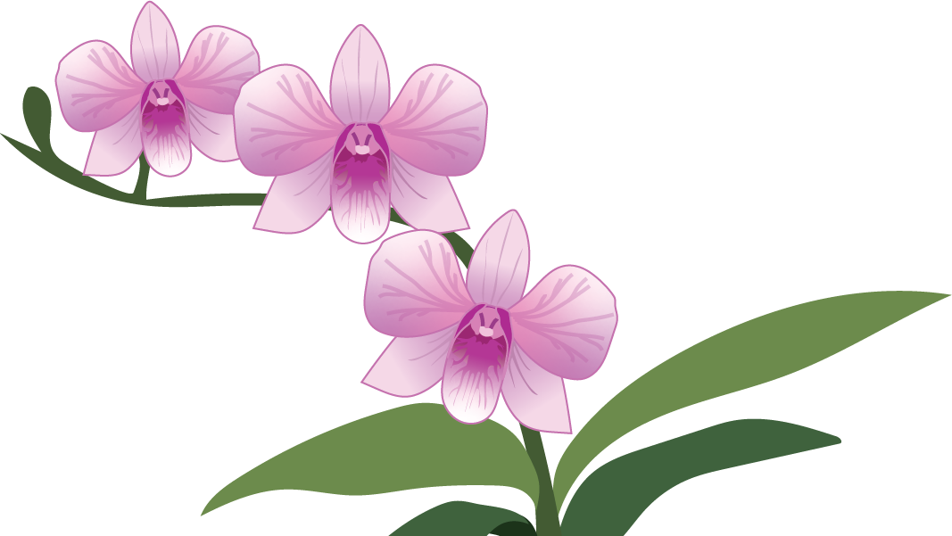
Sepals – though they may look like petals, they are the remains of the flower bud. With orchids, there are usually three sepals.
Petals – orchids always have three petals. Two are ‘normal’, the third becomes the labellum.
Labellum – the lower petal of an orchid, which provides a landing platforms for its pollinator.
Column – a finger-like structure that carries the orchid’s reproductive system
Notes:
Not all flowers are created equal.
One unique trait that has evolved in orchids is the fusion of the stamens (all male reproductive parts—anthers and filaments) with the pistil (all female reproductive parts—stigma, style, and ovary) in the flower. This reduction in stamen number has led to orchid groups with only three, two, or one stamen(s).
Most orchid flowers have the same basic reproductive structures:
A central structure known as the column is a unique adaptation of orchids that houses both the male (anther) and female (stigma) parts of the flower.
The column—at least the distal (away from the center) portion—is oriented horizontally. The anther is located at the distal end of the column. The stigma is located near the distal end and just on the underside of the column.
Directly below the column is the labellum, or lip, a modified petal that acts as a landing area for pollinators.

Slide 9
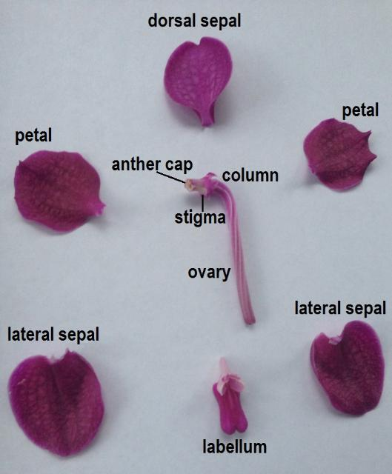
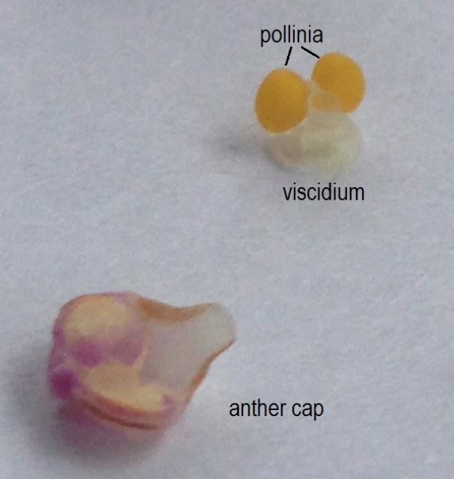
Notes:
When present, the floral nectaries (nectar producing tissue on the plant) are typically located at the base of the labellum or as a nectar spur behind the flower. As a pollinator moves on the labellum, it contacts the pollen. Unlike the loose pollen grains of most flowering plant families, orchid pollen grains are fused together into compact structures called pollinia. The pollinia (two to eight knob-like packets of pollen) are located under the male anther cap and contain a sticky structure called the viscidium, which helps the pollinia adhere to a pollinator as it feeds or seeks to mate with the column. When a pollinator visits another flower, the pollinia are likely transferred to the stigma.
Photos:
Figure 1. Structures of a Vanda orchid flower, including the petals, sepals, and column. Credit: Haleigh Ray, UF/IFAS
Figure 2. The removed anther cap from the pollinia with the viscidium visible. Credit: Haleigh Ray, UF/IFAS

Slide 10
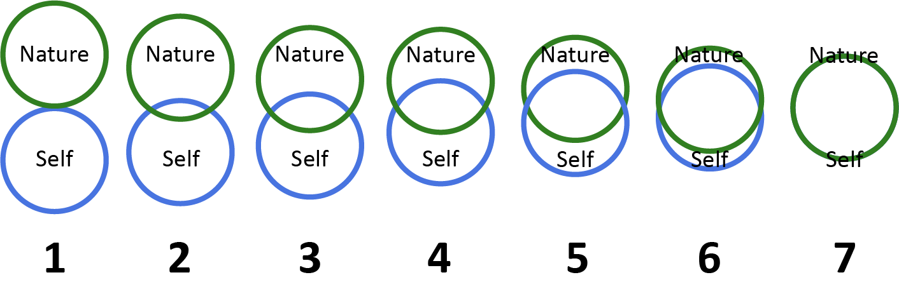
Homework
Put those final touches on your final piece!
Think about your relationship with the natural world. How interconnected do you feel with nature?
In your journal, describe how connected you feel to nature on a scale of 1 (completely disconnected) to 7 (completely connected).
Send your response to drichmond@naplesgarden.org
Notes:
And that’s it for our first class!
For Homework:
For Homework:
Please fill out the exit survey linked here as part of the homework for Class 7. Don't forget to do the connection to nature exercise too! Revisit the page in your nature journal where you completed this exercise for Class 1 and reflect on how your connection to nature has changed since then.
Think about your relationship with the natural world. How interconnected do you feel with nature on a scale of 1 to 7? Find a blank page in your journal and divide it in two by drawing a horizontal line across the page. Write your response to today’s homework in the top half. Keep the bottom half blank! We will revisit this question at the end of class.
You can type out your response or send a photo of your journal page to my email.
Optional: you can prep for the next class’s warm-up activity by drawing five boxes of different sizes on a blank page in your nature journal

Slide 11
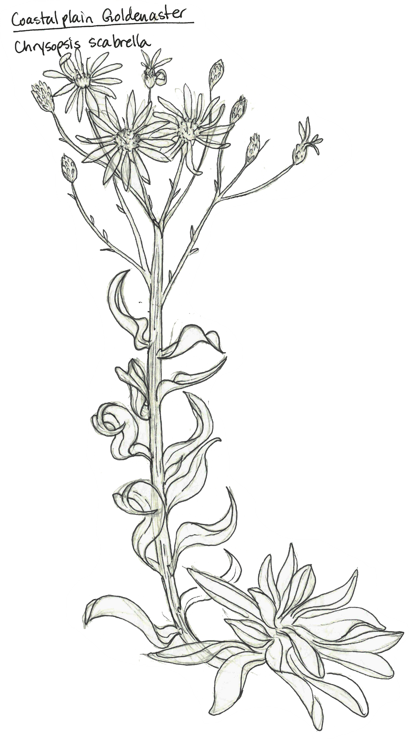
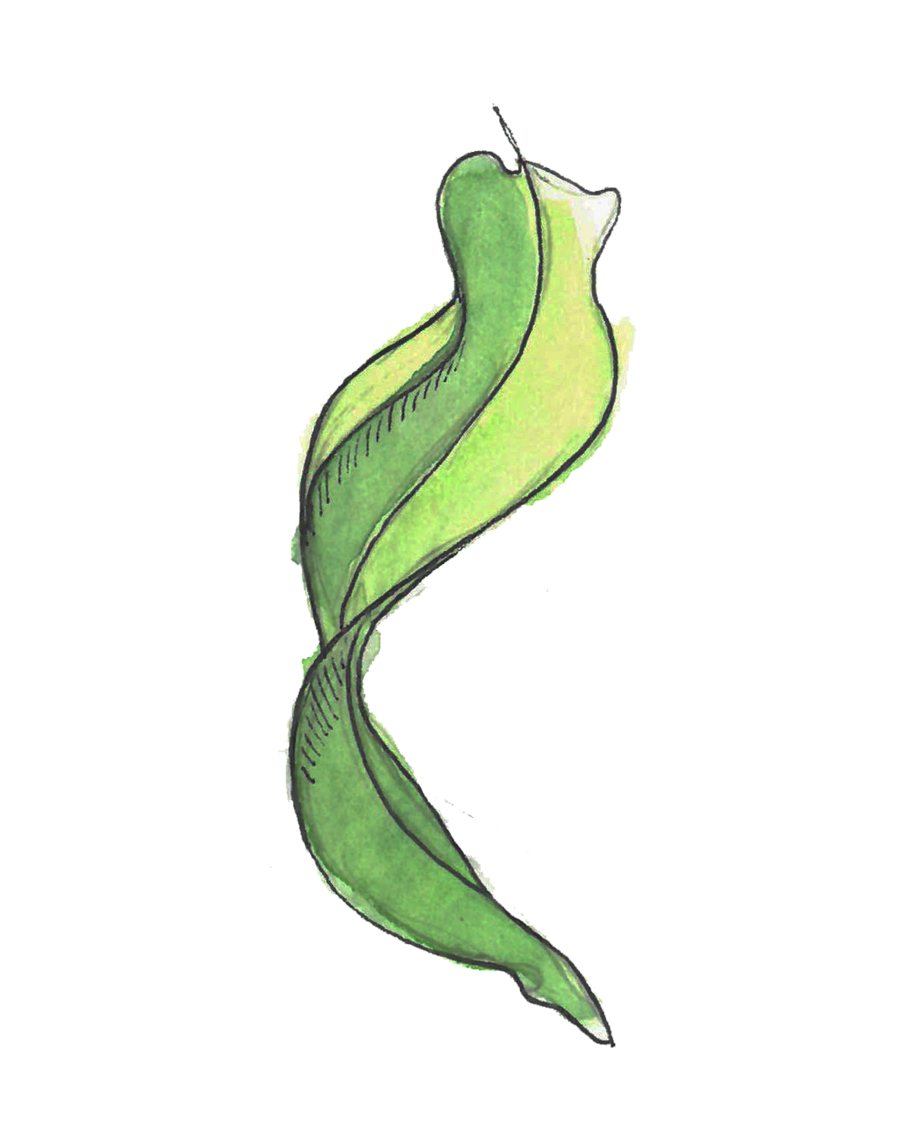
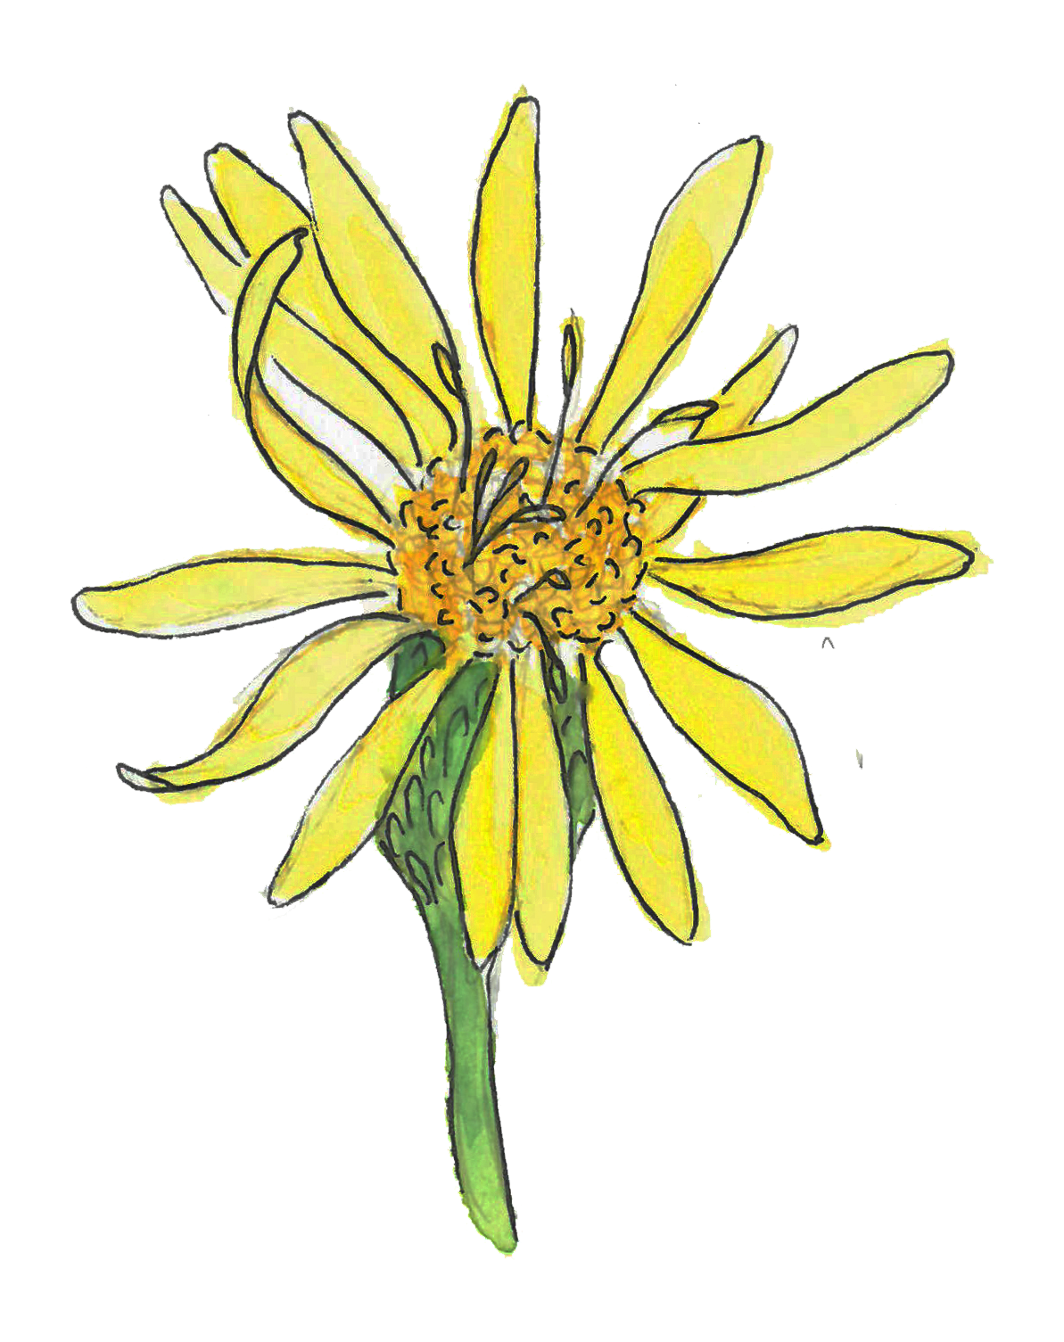
Demo:
Tips, tricks, and techniques
Notes:
Splatter painting with a toothbrush
Tracing paper transfers
Leaf rubbing

Slide 12
Class 7 Recap
Warm-up Activity
Structure and Growth of Leaves
Common Flower Parts
Homework & Final Touches on your Final Pieces
Demo: Tips, Tricks, and Techniques

