Slide 1
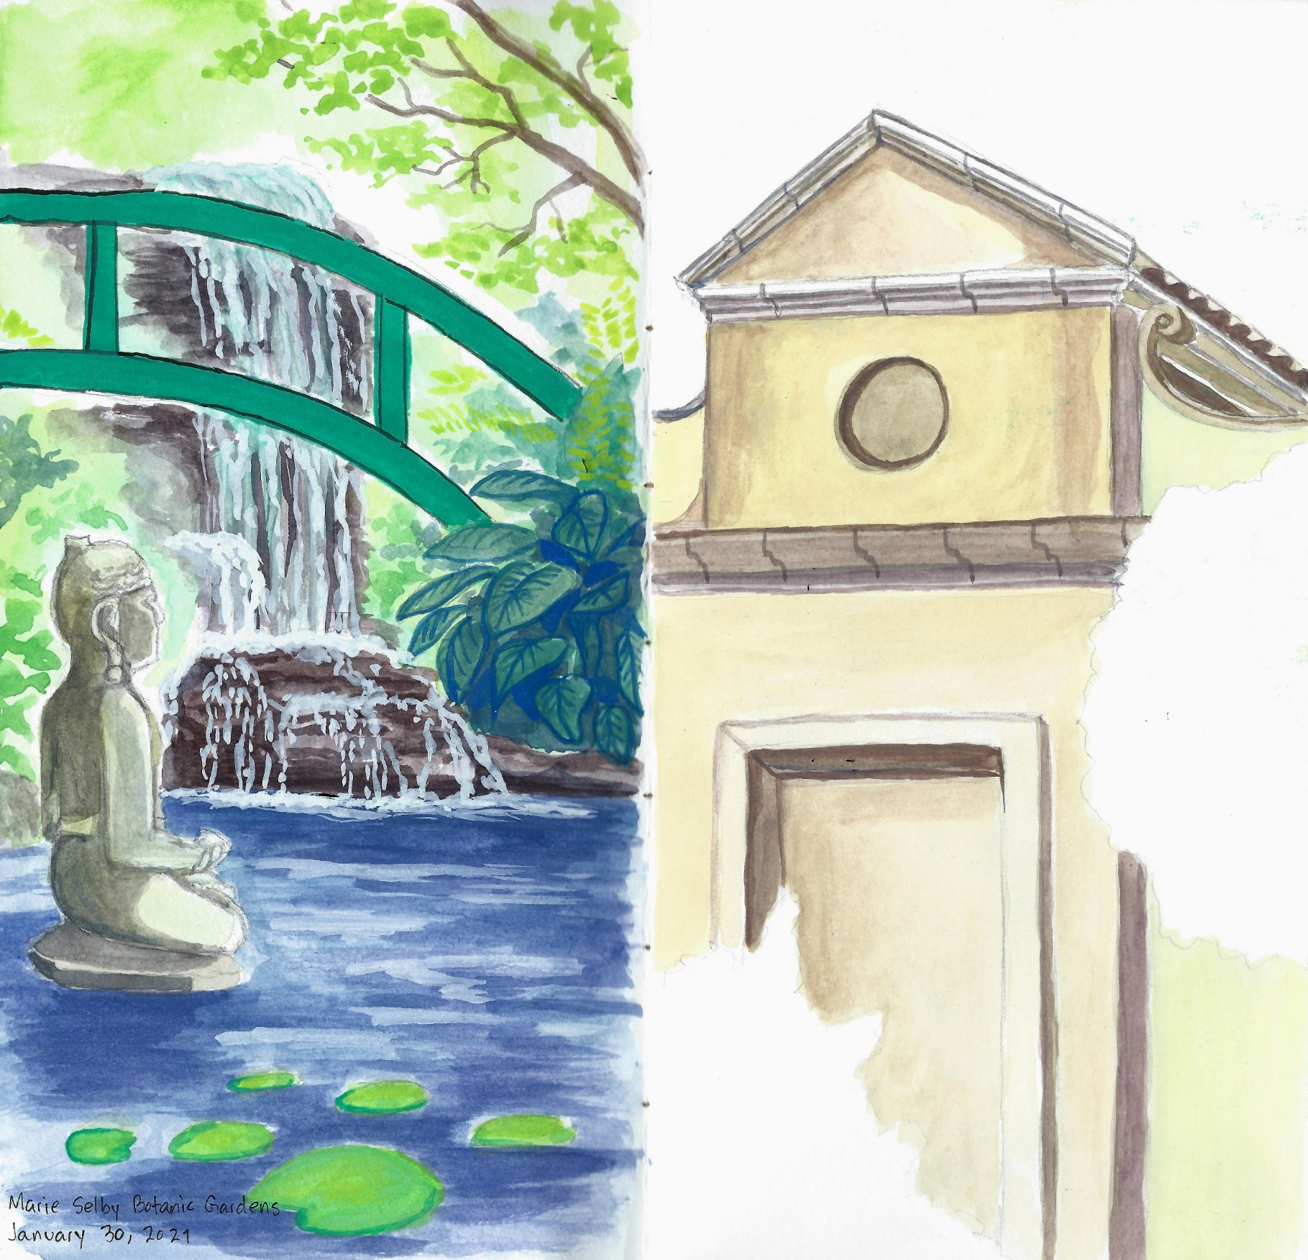
Introduction to NATURE JOURNALING Connecting to nature through art and observation
Class 8:
Your Journal and Your Journey
Notes:
Buckle up folks we’re about to get ARTSY

Slide 2
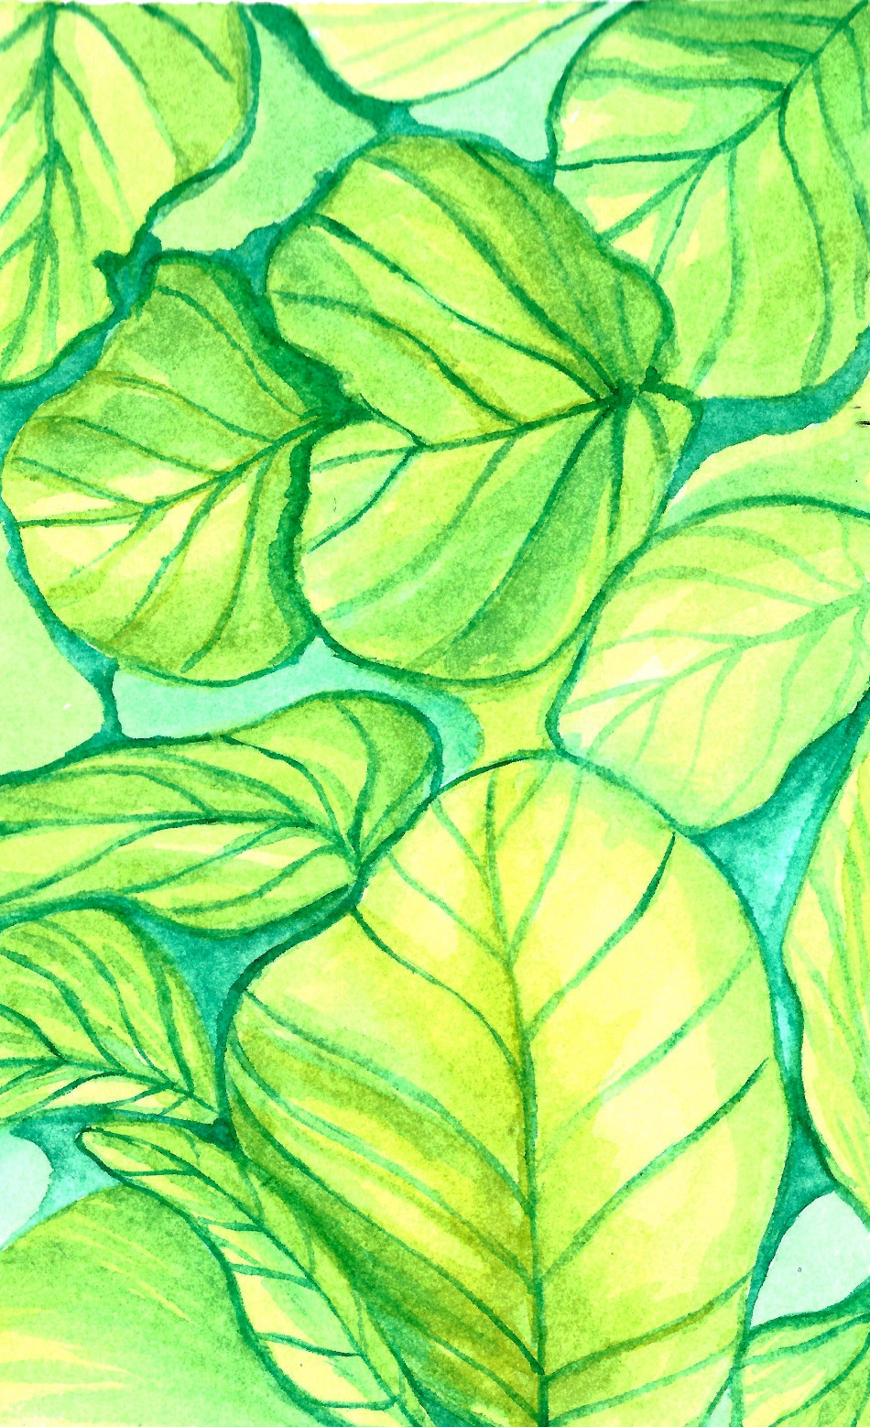
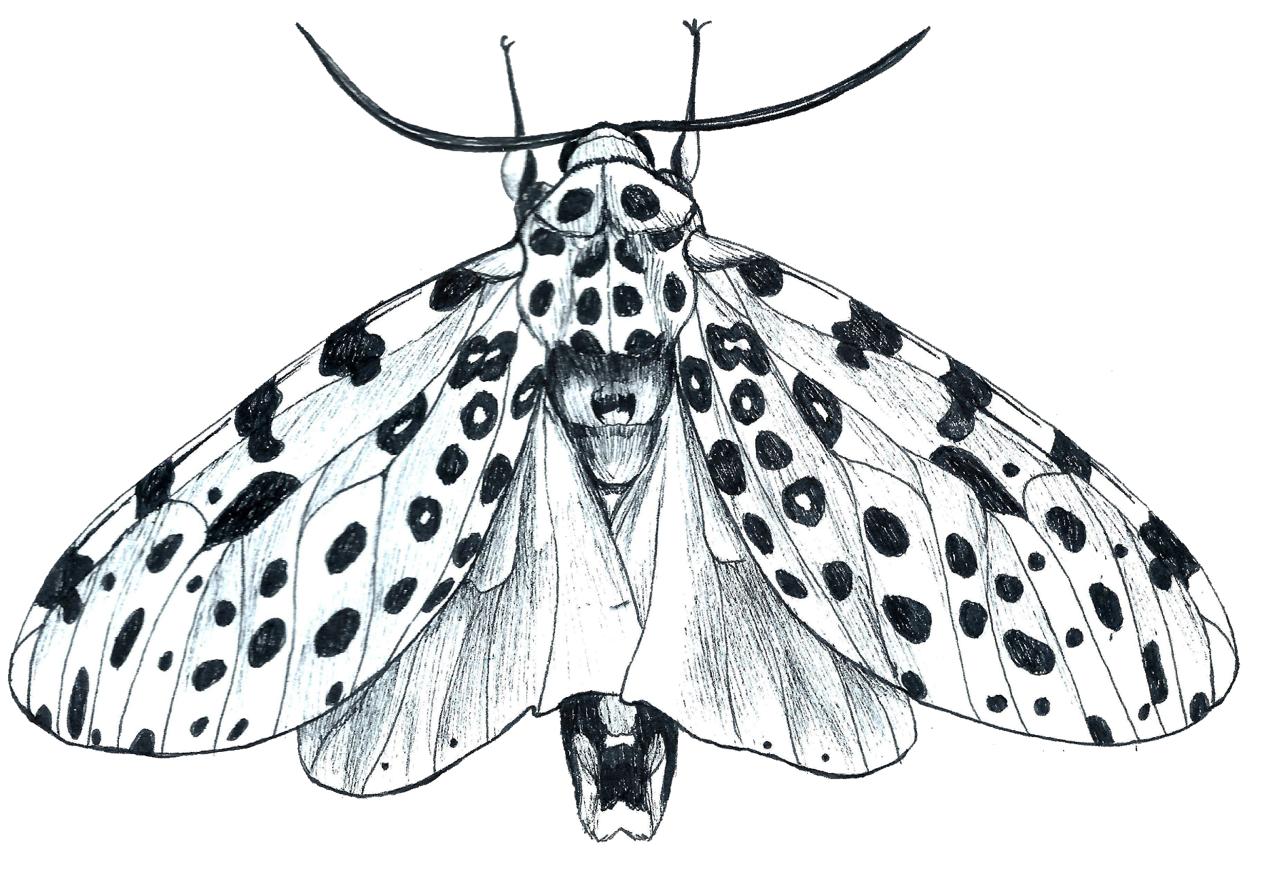
Class 8 Agenda
Warm-up: Prickle, Rose, Bud
Your Journal as a Time Capsule
Continuing Your Journal

Slide 3
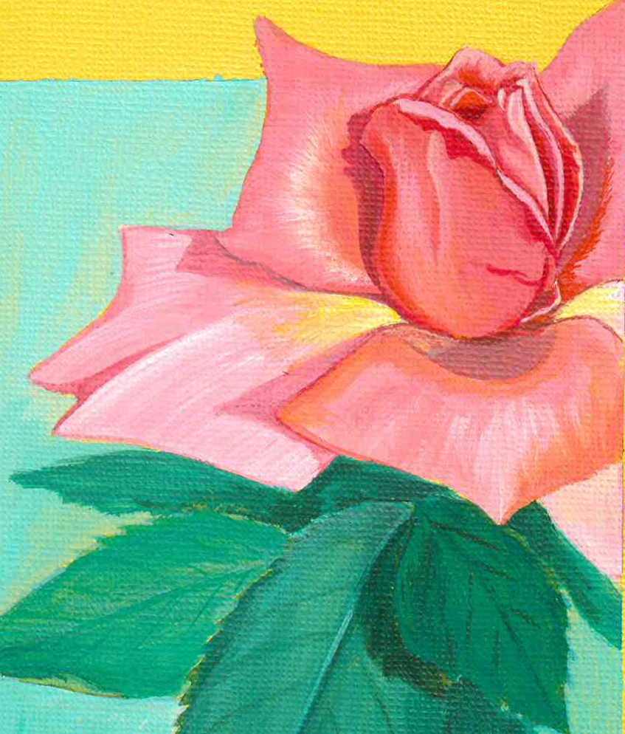
Warm-Up:
Prickle, Rose, Bud
Prickle – share a challenge you faced in class or with your final piece.
Rose – a positive experience or something new you’ve learned from the class.
Bud – what you are looking forward to accomplishing with your new skills.
Notes:
This ice breaker allows you to reflect on class and to share your experience with your classmates. With each part of the plant, we will discuss different things. Prickles you will share a challenge you faced in the class or with your final piece. Rose you share a positive experience or something you have taken from the class and a bud is what you are looking forward to with your new skills.

Slide 4
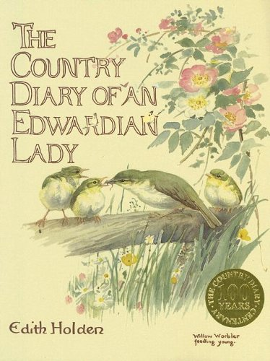
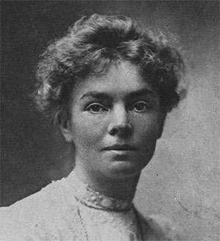
Edith Holden
(1871-1920)
Notes:
You never know what observation will be important to science in the future, or better yet – important to you.
Edith Holden lived 1871-1920
Her family lived in the small village of Olton in Warwickshire and it was there that she wrote and illustrated her book. After attending art school, she worked as an illustrator, with her drawings being published in several books.
Images:
The Country Diary of an Edwardian Lady by Edith Holden

Slide 5
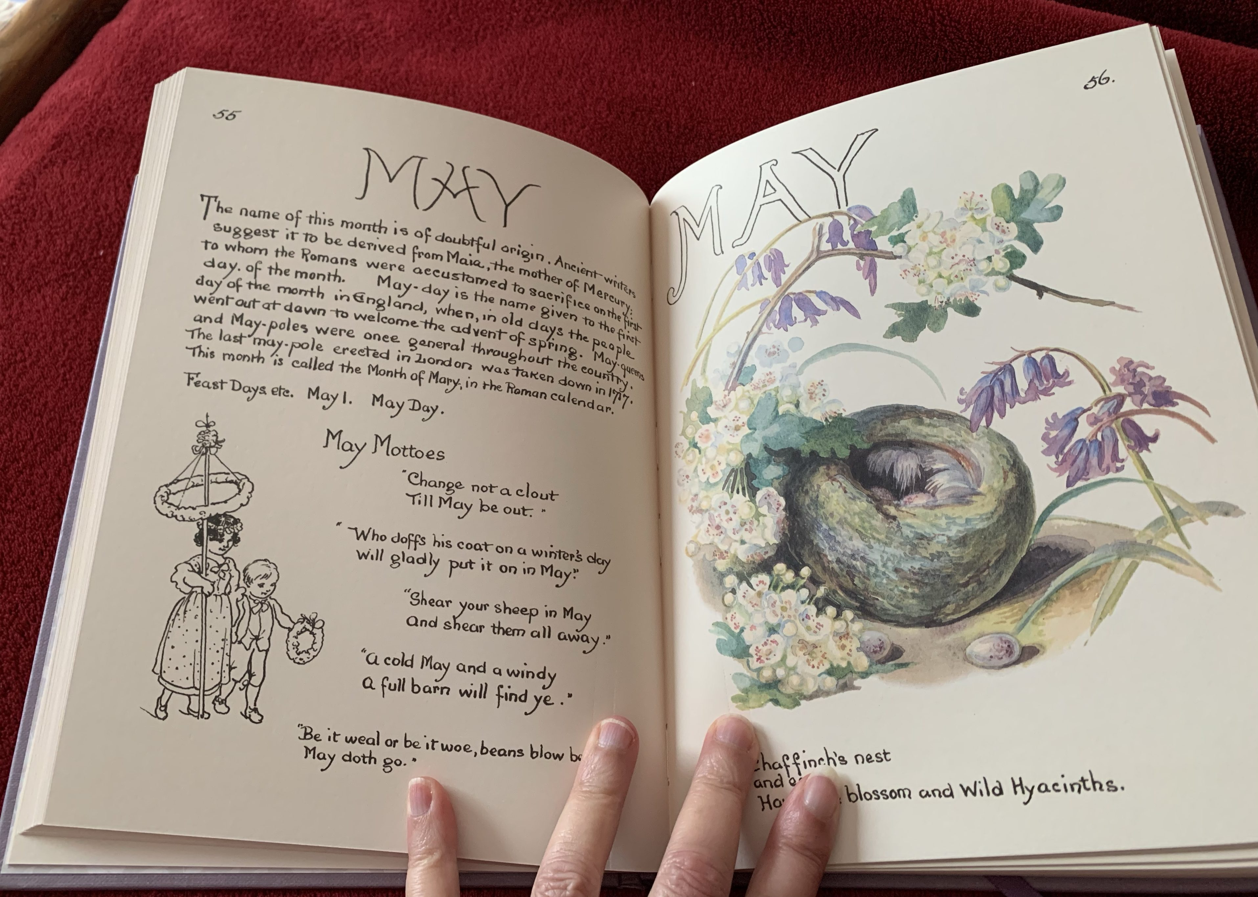
Notes:
Edith Holden’s original diary is filled with a naturalist’s masterful paintings and delightful observations chronicling the English countryside throughout 1906
Her words and illustrations transport the viewer to a romanticized version of the 1900s

Slide 6
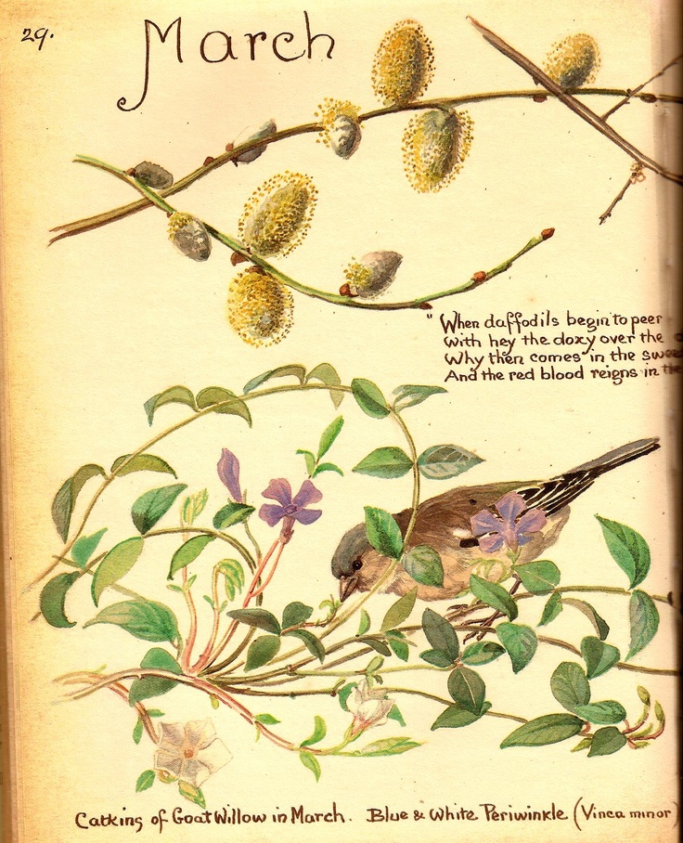
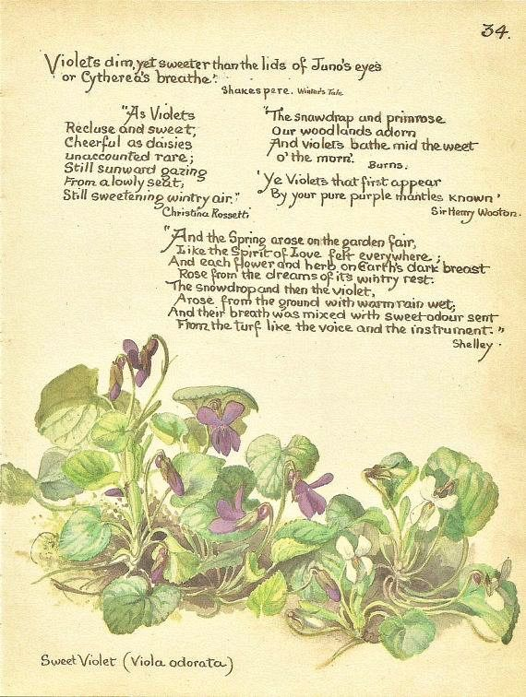
Notes:
Excerpt from a blog review written by a naturalist living in Sussex, England:
These diaries become ever more interesting as time goes on; they are 110 years old now and the differences between the countryside she describes and how it is currently are quite noticeable. The winters she describes are harsh, freezing affairs with much snow and frosts, the summers too are described as splendid English summers with lots of sunshine, thunderstorms and heat. She mentions seeing her last Chiffchaff (a small warbler/songbird native to Europe) of the year in early October, whereas today it is easy to see them in the middle of winter. What strikes the modern reader most though is not what different species were common or rare back then but the abundance of life she describes. Wildflowers are everywhere and in great numbers and diversity, the same goes for the birds and insects – things are so much more abundant in her notes than we experience today.

Slide 7
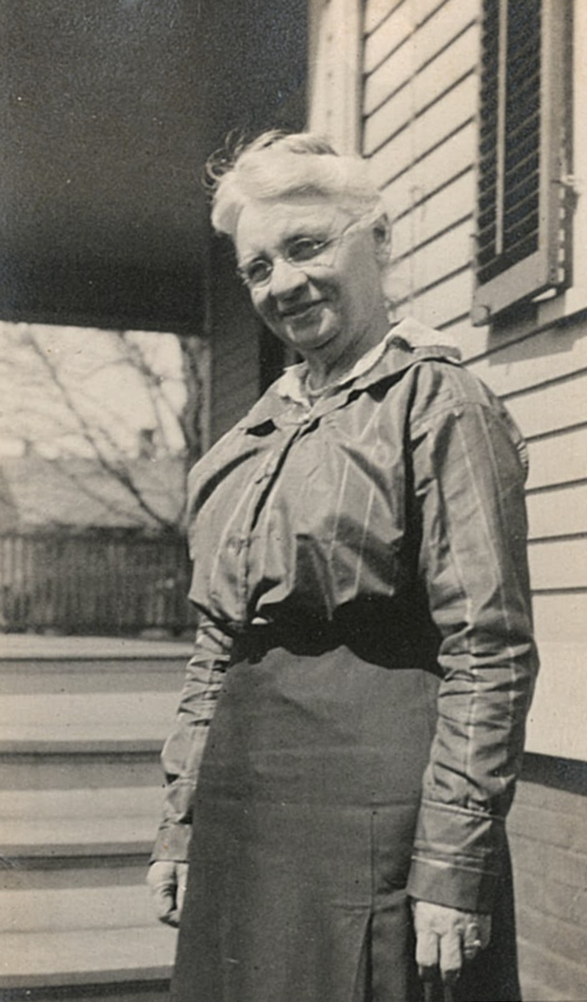
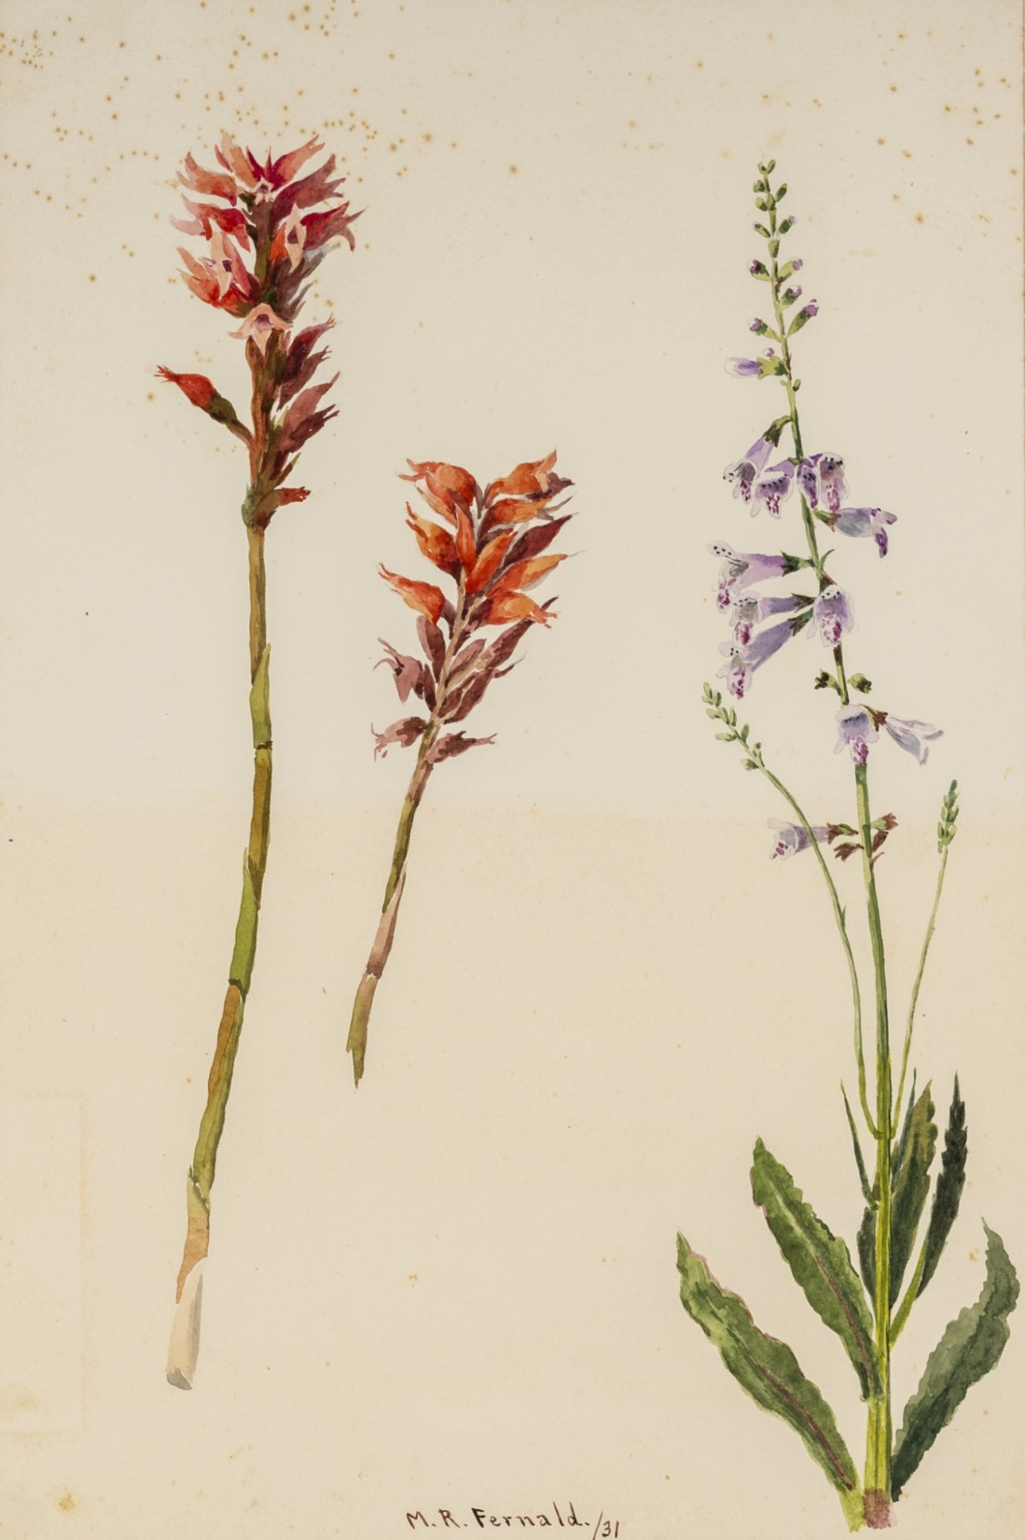
Minna Fernald
(1860-1954)
Florida Museum of
Natural History
Notes:
Botanist Mark Whitten was rummaging in an old drawer in the University of Florida Herbarium for tracing paper when he discovered something unexpected: hundreds of World War II-era watercolor paintings, each of a unique Florida plant.
Likely untouched in the 20 years since the herbarium’s move into Dickinson Hall, the collection was largely forgotten, but the same cool, dark conditions intended to preserve the herbarium’s more than 400,000 specimens also preserved the paintings.

Slide 8
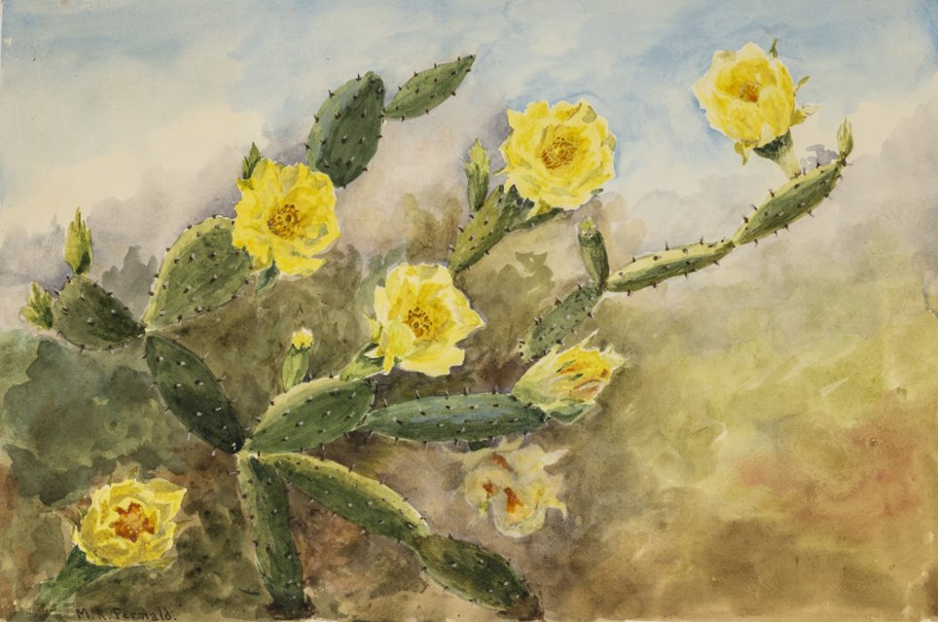
Notes:
Artist Minna Fernald donated over 320 paintings of Florida wildflowers to the university in 1942, providing a rich record of the state’s past ecological life.
“If you go out looking for these plants nowadays, you can find them but they’re only in little isolated preserves,” said Whitten, a biological scientist at the herbarium. “My impression is what Minna Fernald saw was a much more wild and interesting Florida than what it is now.”
Whitten has no doubt that Fernald spent a great deal of her time in the field.
“The way she captured the essence of the plants, it was clear to me that she wasn’t just sitting in her parlor with a vase full of things that people had brought her,” he said.
Born in Baltimore, Fernald led a varied life, completing her early schooling in Germany and later receiving a medal for her Red Cross work during WWI.

Slide 9
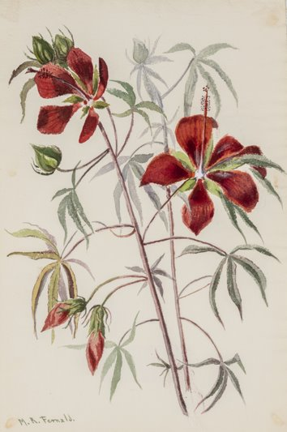
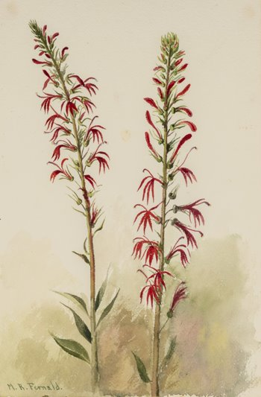
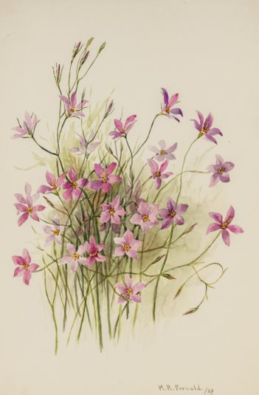
Notes:
Colors of herbarium specimens eventually fade, but paintings last a great deal longer
Images: Florida Museum of Natural History

Slide 10
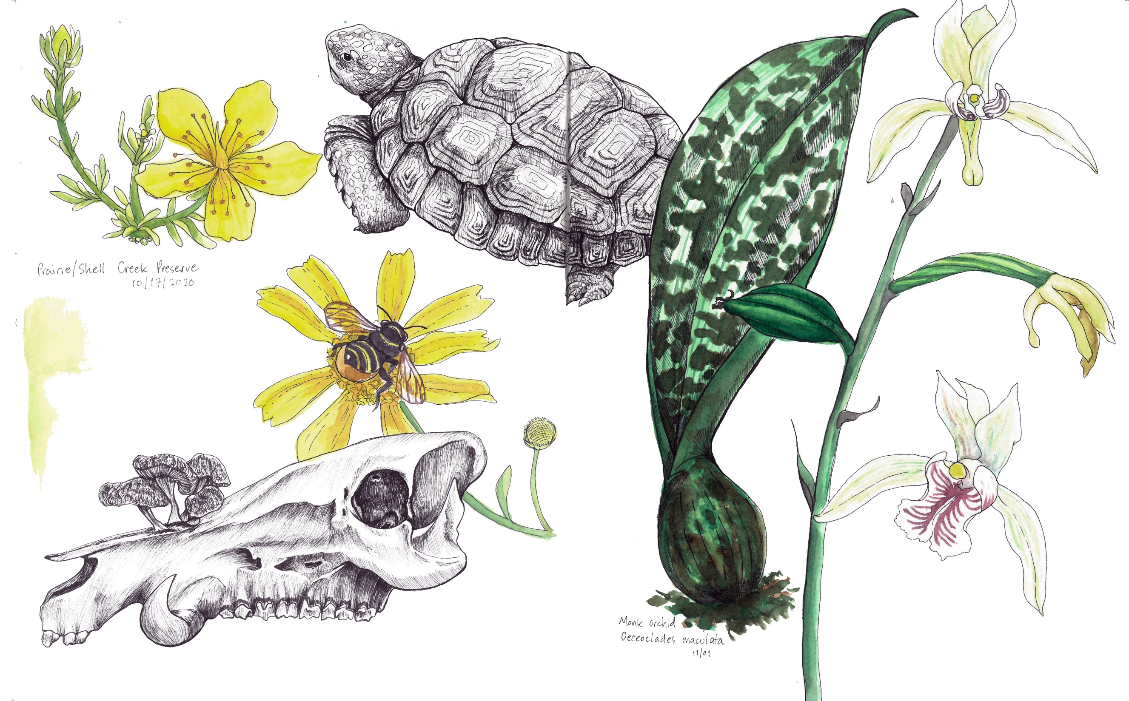
What has been your favorite nature journal experience?
Notes:
In 60 seconds or less tell us about your favorite nature journal experience.

Slide 11
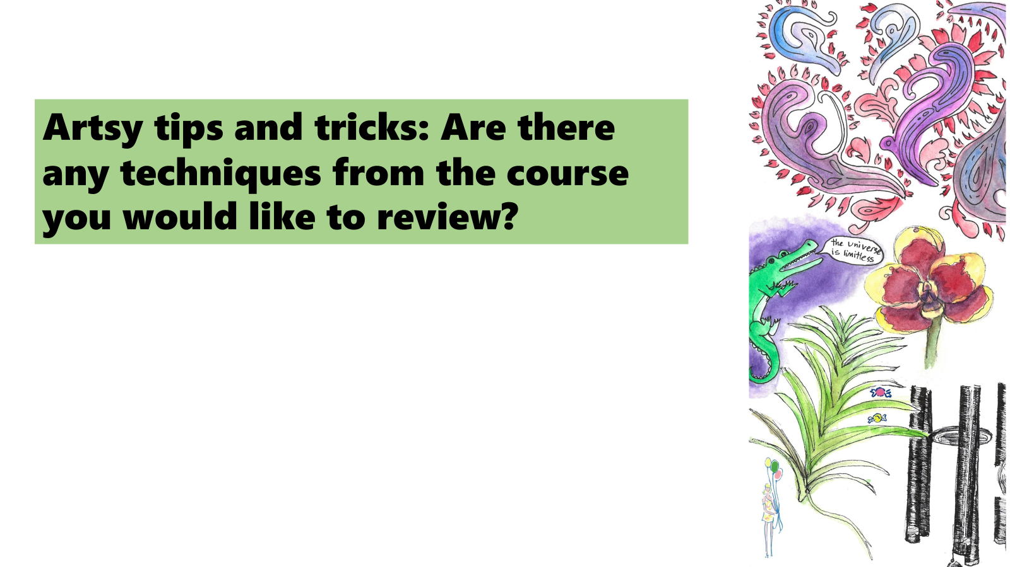

Slide 12
Congratulations!

